Slide 1
Presentation by
The user as data detective
Felix Ritchie
Bristol Business School
Budapest 21.10.16

Slide 2
Pressures on data collection
More complexity in data sources
  linked, multiple sources
  data sourced from administrative systems
  changing definitions
Greater demands for detail in aggregates
Greater demands for microdata
Limited resources at National Statistics Institutes (NSIs) and others
  greater use of statistical editing

Slide 3
Quality/resource trade-offs
Aggregate statistics
End
Means
Means or End?
Microdata
Resources
Difficult to satisfy all demands

Slide 4
How can the user help?
Different things matter to microdata users
  outliers
  multivariate characteristics and breakdowns
  measurement error in respect of multivariate bias
  genuine data, not imputation or estimation
  subsets
Users bring different skills
  no adherence to quality or aggregation guidelines
  expertise on relationships between variables
  extended timelines
  different coding skills

Slide 5
Example: compliance with minimum wages
Statutory minimum wage in the UK
3 survey datasets for checking compliance
  ONS: employer and employee surveys
  Department for Business: survey of apprentice pay
ONS validates its own data as usual
  1 extra rule: re-check response if wage appears to fall below the minimum
Low Pay Commission (LPC) analyses validated ONS data
  complex code to break down data into sub-population estimates

Slide 6
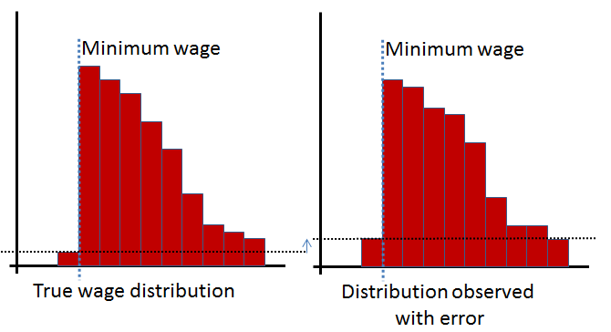
Why use minimum wage compliance to study quality?
three different datasets to triangulate
yes/no nature makes data problems stand out more
  measurement error per se matters

Slide 7
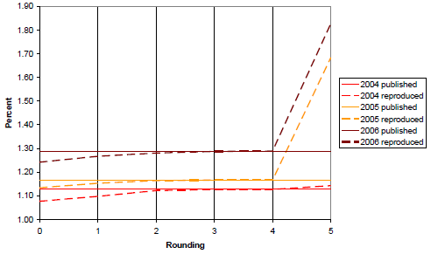
Things we’ve found: 1
Machine precision matters
Estimated rate of non-compliance
Number of decimal places used in calculation

Slide 8
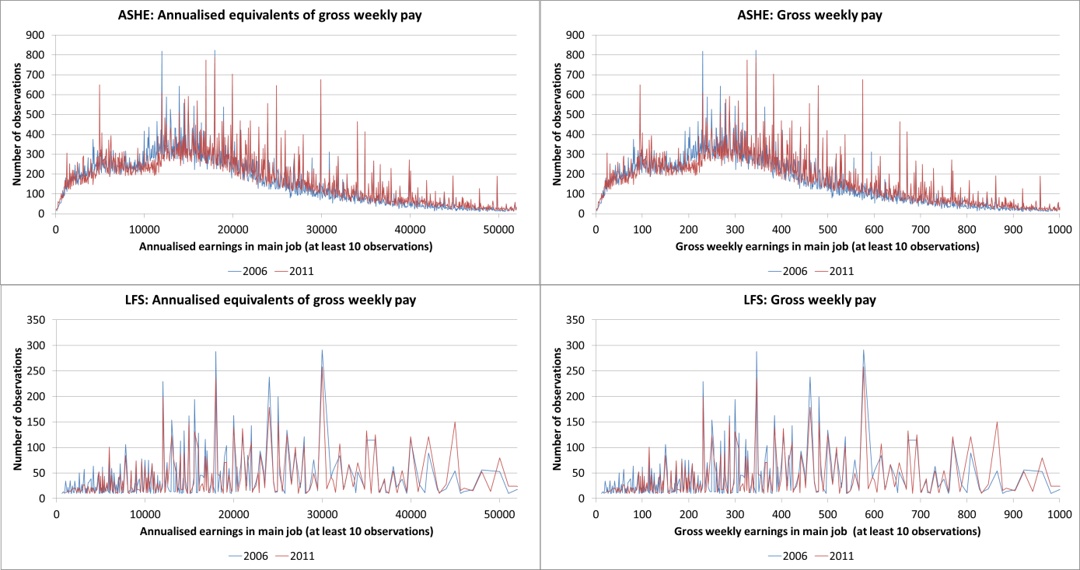
Things we’ve found: 2
Data sources can give very different answers

Slide 9
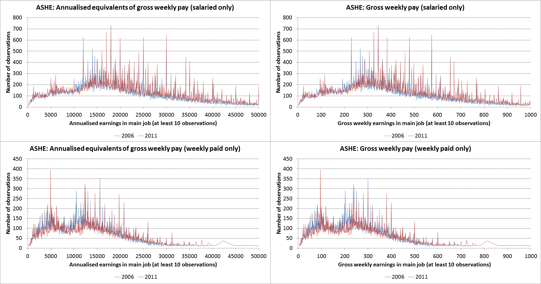
Things we’ve found: 3
Data quality is a function of other variables

Slide 10
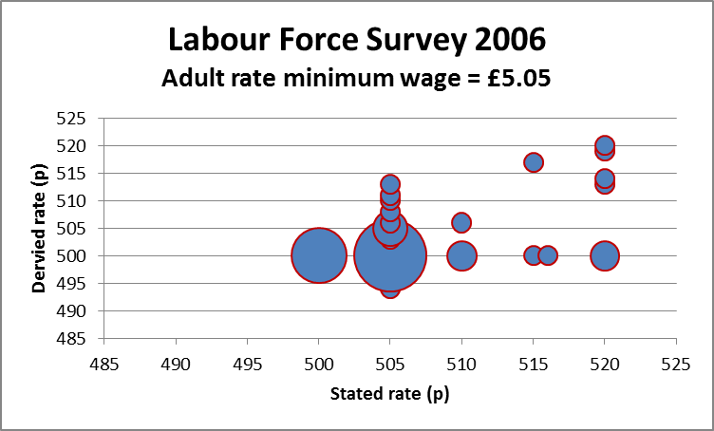
Things we’ve found: 4
Some errors can be obvious – when you draw the pictures

Slide 11
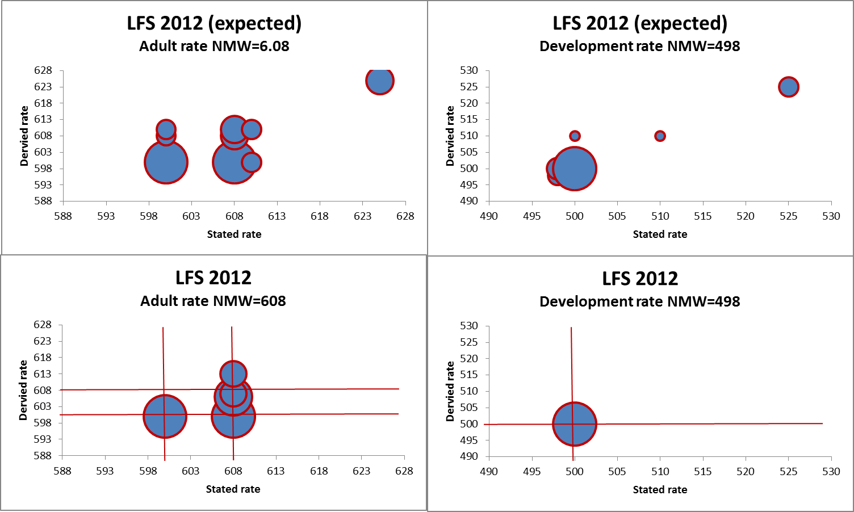
Things we’ve found: 5
Errors can be predictable

Slide 12
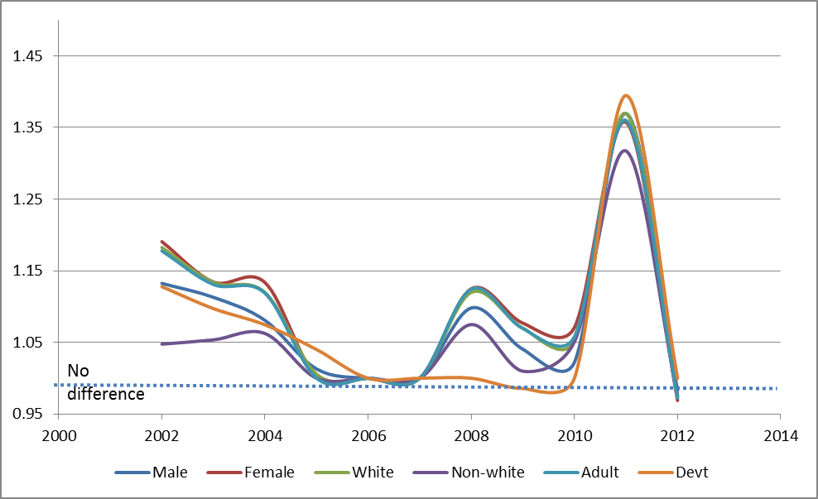
Things we’ve found: 6
Definitions need to reflect data
  LPC defines ‘minimum wage worker’ as earning less than NMW+5p
  We define it as earning up to the next 10p boundary
Effect on MWW counts using a “next 10p” rule

Slide 13
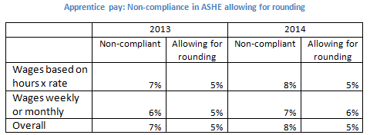
Things we’ve found: 7
We need to understand data collection
  ONS employer survey asks for data to 2 decimal places
    For monthly paid workers, employers multiply weekly hours by 4.348
    Apprentices paid monthly at the minimum wage rate almost always recorded as ‘below minimum wage’
Effect of rounding in monthly hours calculation

Slide 14
Lessons from other areas
In other work we’ve found
  observations missing
  values systematically missing
  ‘impossible’ values occurring
  conflicts between sources
  some data has no value
  documentation lacking
  institutional knowledge lost
but generally microdata analysis confirms data quality
No reason to believe ONS better or worse than any other NSI…

Slide 15
What have we learned?
Problems with
  data
  aggregation
  interpretation
Not amenable to NSI production systems
  resources
  dimensionality
  purpose
Microdata users are
  expert
  persistent
  responsive to positive engagement
  cheap!

