Slide 1
Enhancing statistical culture – The Role of the University and Education
Peter Kovacs, PhD - Klara Kazar, PhD –
David Arvai - Éva Kuruczleki
University of Szeged, Hungary

Slide 2
Introduction
„Data is the new oil”
Complex social and economic problems
„Let dataset to change your mindset”

Slide 3
Lecture outline
Statistical literacy
Target groups
What is the role of higher education?

Slide 4
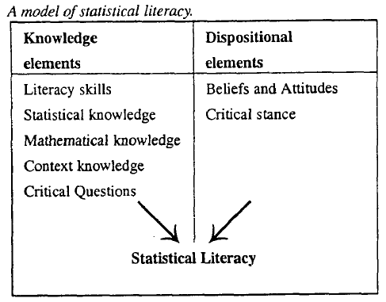
Statistical literacy
Gal (2002): ability to interpret, critically evaluate, and communicate about statistical information and messages
Notes:
knowledge of basic statistical key figures,
understanding concepts describing society
basic information about research methods
basic information about visualization
knowledge about data sources and the ability to evaluate the used data sources.

Slide 5
Statistical literacy (1)
Garfield and Ben-Zvi (2007)
Statistical literacy
Statistical reasoning
Statistical thinking
Notes:
Complex phenomenon
Garfield and Ben-Zvi (2007): understanding and using the basic language and tools of statistics: knowing what basic statistical terms mean, understanding the use of simple statistical symbols, and recognizing and being able to interpret different representations of data.

Slide 6
Level of users
level of statistics users
level of Citizens (statistical literacy)
The expert professional level.

Slide 7
Role of Higher Education
3 target groups
  students
  non-statistician teachers/researchers
  external actors

Slide 8
Academic staff
What is the foundation of the choice of a statistical method?
it would be necessary to broaden the methodological repertoire known by researchers

Slide 9
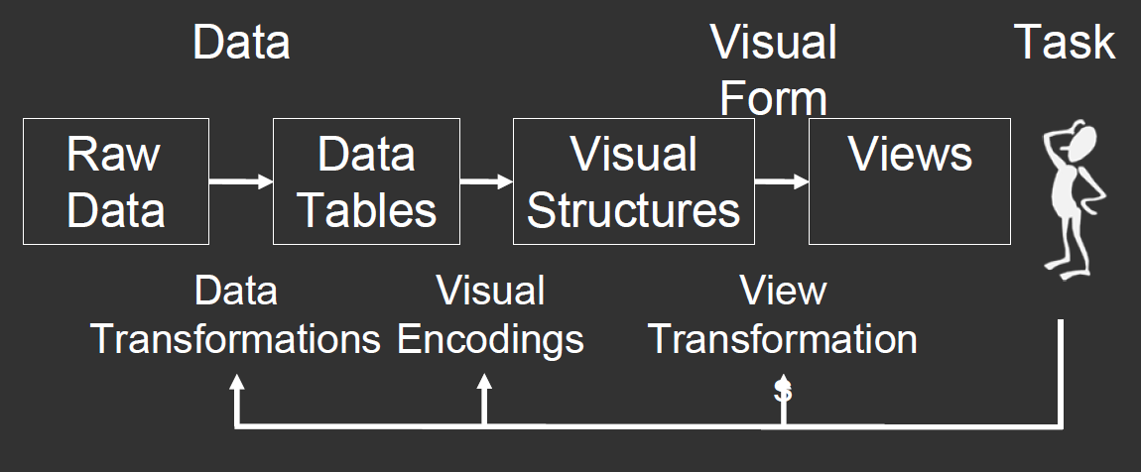
Students
Generation Y
The huge amounts of data, data sources, and visualization tools
Importance of visualization
  Source: Jeffry Heer
Notes:
Mobil, új platformok
Interaktivitás
Real time
Story teller
Integráció
3D
Kognitív ismeretek
Geoadatok

Slide 10
Ridgway’s (2015) recommendations to revise statistical curricula also include:
Working with multiple data sources,
Illustrating and using real problems with real data,
Using Internet resources,
Teaching about and with interactive graphics, and familiar technologies,
Introducing multivariate data at an early stage.

Slide 11
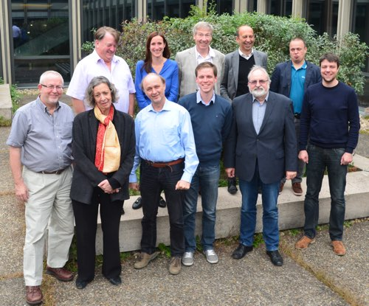
ProCivicStat
Promoting Civic Engagement via Exploration of Evidence: Challenges for Statistics Education project
Strategic Partnership of the Universities of Durham, Haifa,
Ludwigsburg, Paderborn,
Porto and Szeged
https://www.procivicstat.org
Notes:
These materials use authentic large scale data on topics such as migration, quality of life, sustainable development goals, and social inequality, often presented in innovative ways.

Slide 12
ProCivicStat
developing new methods for statistics instruction for high schools and universities
  contribute to young people’s ability to understand quantitative evidence about key social phenomena.
  Datasets, teaching materials, visualization
Challenges and Innovations in Statistics Education,
Multiplier Conference of PROCIVICSTAT,
Szeged (Hungary), September 7-9, 2017

Slide 13
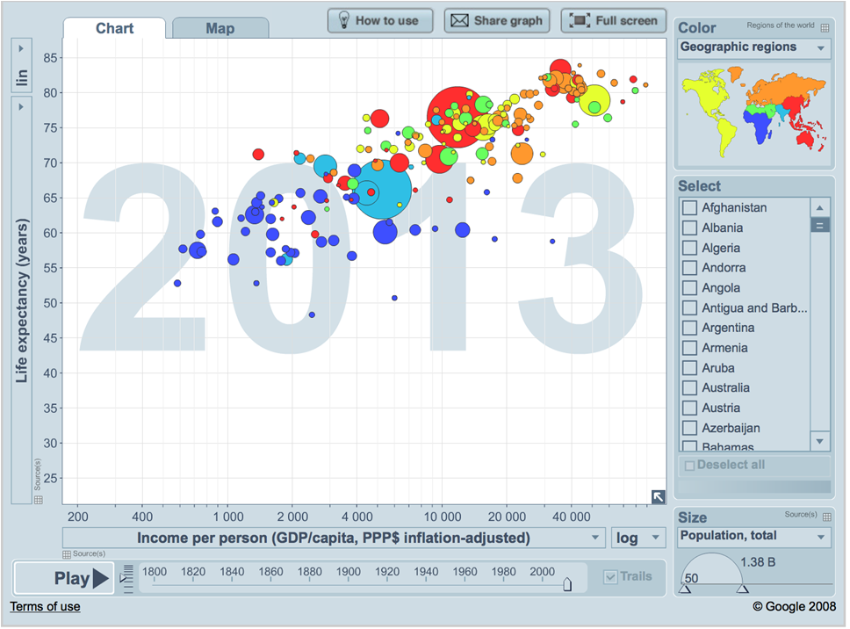
Gapminder World http://www.gapminder.org/world/

Slide 14
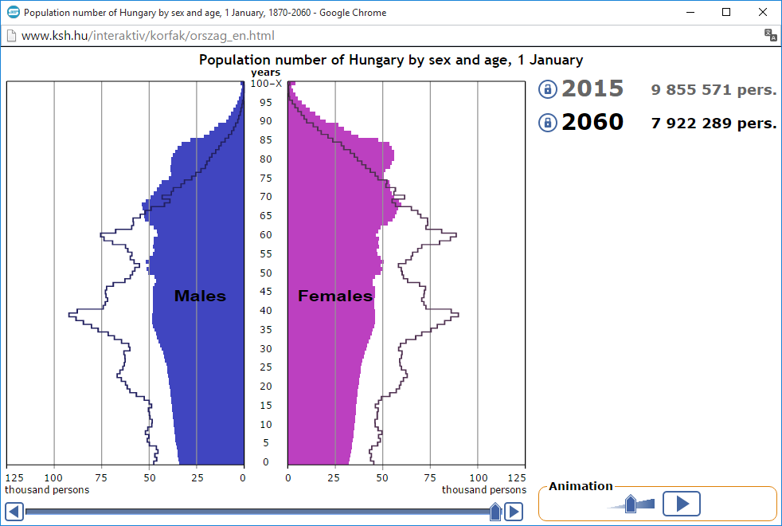
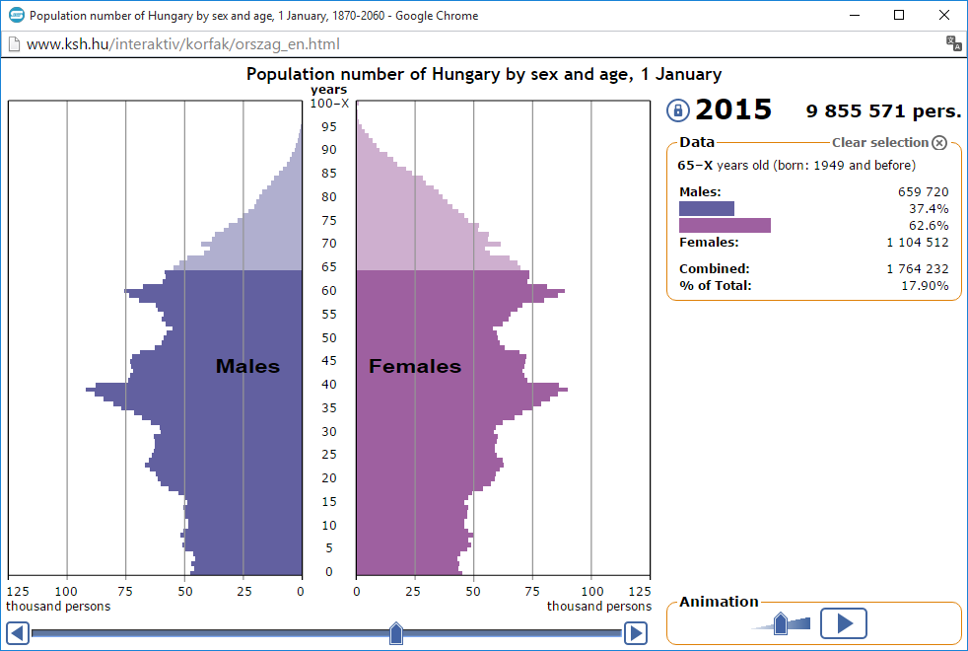
Population pyramid

Slide 15
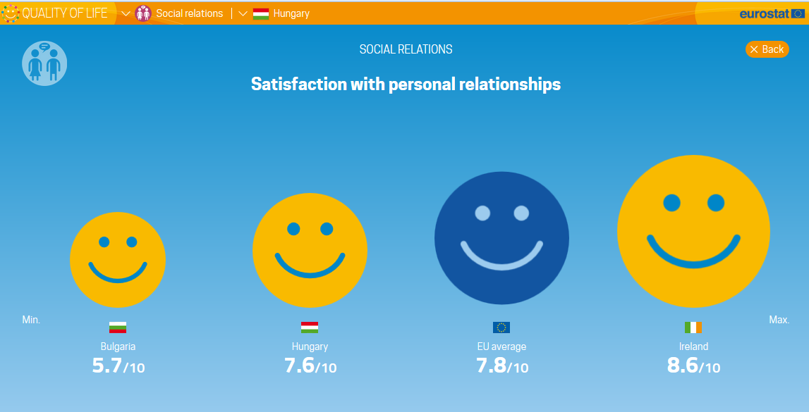
Official statistics

Slide 16
Role of Tertiary Education
Developing statistical literacy
Developing professional knowledge
Developing attitudes
Developing teaching methods and tools
Developing statistical way of thinking
Disseminate statistical methods
Developing statistical and visualizatoion methods
Third mission

Slide 17
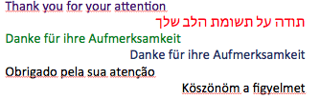






The preparation of this presentation has been partially funded with support from the European Commission.

