Slide 1







Conference of European
Statistics Stakeholders
Maria João
Valente Rosa
20–21 October 2016
Budapest
Member
Towards Statistical Literacy
What do we know?
What do we need?
Professor
Founder Director
Partner

Slide 2
1
About Statistical Literacy
an introduction

Slide 3
About Statistical Literacy – an introduction
The present deluge of data and information in the world makes statistics the basis of a new language.
Statistical Literacy is a key competence of nowadays modern societies.
Improving Statistical Literacy became a consensual step towards a better society.
Statistical Literacy is so important for personal and social inclusion and active citizenship as it was, in the past, knowing to write or read.

Slide 4
2
Improving

Slide 5
Improving
Pordata, a project of Francisco Manuel dos Santos Foundation, is a huge Portuguese database of social and economic indicators, for Portugal, Portuguese regions and EU countries.
There are many ways to improve Statistical Literacy.
Two examples, inspired on Pordata.
(www.pordata.pt)
To reinforce the understanding of data by the general public, Pordata developed a large Meta-information, with short, simple and clear explanations of all the main concepts involved in statistical indicators (e.g. GDP, risk of poverty).
2. To promote the ability to communicate statistical information, Pordata developed training sessions for journalists. The idea is to provide, in three hours, a kind of a guided tour through the basic principles of statistics, by exploring usual technical mistakes or misunderstandings.

Slide 6


Improving
But improving Statistical Literacy is not all!
If you can't measure it, you can't improve it.
(Peter Drucker)

Slide 7

Improving
To measure Statistical Literacy in a standard, comparable and regular way is the only process to diagnose:
the real impact of all our efforts towards the improvement of Statistical Literacy (i.e. measuring progress);
the effective contribution of Statistical Literacy for the social and economic wellbeing of our societies.

Slide 8
3
Measuring: The Index

Slide 9

Measuring: the Index
Social Data Lab created and developed in Portugal the Statistical Literacy Index, based on several indicators able to represent the main dimensions of the Statistical Literacy concept.
Concept
Statistical Literacy is an individual competence to form an opinion about the society or the world we live in, from the use and understanding of reliable statistical data.
The concept was divided in
Attitude & use
Understanding
Evaluation
Ability to form an opinion
Dimensions

Slide 10
Measuring: the Index
Attitude & use
recognition of the importance of reliable statistical/scientific information (awareness of the information sources)
interest in statistical data (frequency of paying attention to data)
2. Understanding
familiarity with the basic statistical concepts, symbols or representations (%, averages or basic charts)
3. Evaluation
capacity to know the limits of data information (country inference from a people street survey)
4. Ability to form an opinion
skills to identify the message of the data (transform the data information in a telling story)

Slide 11
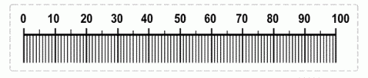
Standard questionnaire,
prepared to be applied through surveys (online or face-to-face) to samples of different populations
Measuring: the Index
Those 4 dimensions are converted in a short questionnaire
with 7 multiple choice questions
The answers of each sample unity are then weighted by dimensions to produce an individual index.
Dimensions
Weight
Attitude & use
Understanding
Evaluation
Ability to form an opinion
20
40
20
20
The Index varies from 0 (minimum) to 100 (maximum).

Slide 12


Measuring: the Index
During September 2016, Social Data Lab applied the questionnaire in a face-to-face survey to a 1.200 nationwide representative sample of Portuguese people with 18 years old or more.
Fieldwork by GfK Metris, market research company of GfK Group.
≥12y

Slide 13





Measuring: the Index
Final results:
By gender:
29%
33%
Total:
31%
Female
Male
By age:
24%
36%
≥65 yo
≤35 yo
know more about the Statistical Literacy Index
www.socialdatalab.pt
By education:
24%
38%
≤4 y
≥12 y

Slide 14

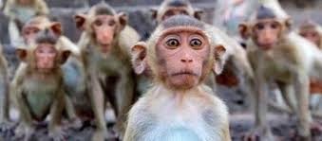

Measuring: the Index
But we must be prudent with the interpretations of the results.
With that in mind, we did the same survey to a 1.200 surprised «monkeys», which means we produced 1.200 random answers for each question, according to the available possible answers.
We must consider the monkey effect.

Slide 15
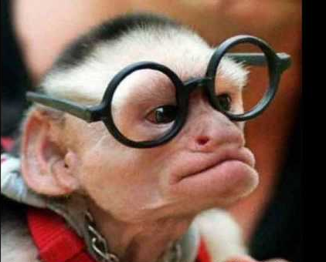
Measuring: the Index
And they did obtain a Statistical Literacy Index of
23%
31% is a worrisome result for people …
but if we consider the monkey effect the result is even worse!!!!

Slide 16
4
About Statistical Literacy
a conclusion

Slide 17
About Statistical Literacy – a conclusion
We now know much more about Statistical Literacy than in the past. But what we know today is not enough.
We believe that Statistical Literacy is vital for the social and economic wellbeing.
But if Statistical Literacy is so important for our modern societies, why it is not measured?
Better data. Better literacy. Better lives.
know more about the Statistical Literacy Index
www.socialdatalab.pt

Slide 18
Conference of European
Statistics Stakeholders
Maria João
Valente Rosa
20–21 October 2016
Budapest
Member
Thank you.
Professor
Founder Director
Partner

