Slide 1
Analyses and Data for Bank Resolution
Mauro Grande, SRB
Conference of European Statistics
20-21 October, Budapest

Slide 2

TABLE OF CONTENTS
SRB
  Why was it established?
  Key elements
Bank Resolution
  General
  Objectives and Tools
  Planning
  Actions
Resolution Analyses
  General
  Data Needs and Sources
    Business as Usual
    Recovery Stage
    Resolution Stage
Challenges
Takeaways

Slide 3


1. SRB: WHY WAS IT ESTABLISHED?
To end sovereign-bank doom-loop
SOVEREIGN-BANK DOOM-LOOP
G20
banks need government support
crisis deepens
government’s fiscal position weakens
refinancing costs rise; higher
debt yields
banks’ balance sheets weaken
2011 /2014
Financial stability
Board
BANKING UNION & BRRD
2013
Single Supervisory Mechanism - ECB
2014
Single Resolution Mechanism - SRB
European Deposit Insurance Scheme
PILLAR 3

Slide 4
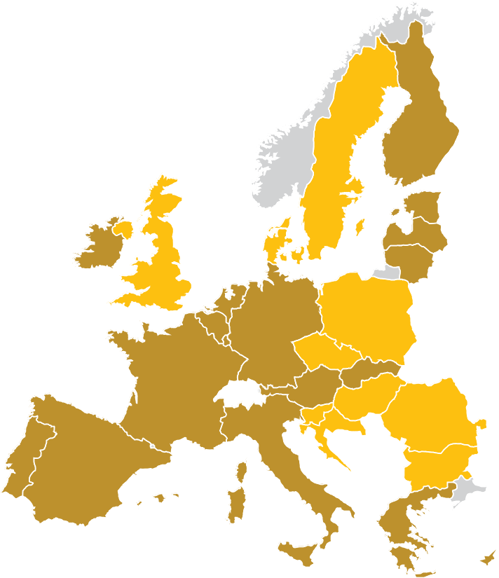
1. SRB: KEY ELEMENTS
The mission of the SRB
is to ensure an orderly resolution of failing banks with minimum impact on the real economy and the public finances of the participating Member States of the Banking Union.
The SRB together with the National Resolution Authorities (NRAs) forms the SRM.
The SRB is directly responsible for:
    Significant banks (SSM)
    Cross-border banking groups
NRAs are directly responsible for all other banks but SRB carries out an oversight function (it could ‘take over’ responsibility).
Key tasks:
    prepare resolution plans
    detect and remove obstacles to resolvability
    set MREL
    enact resolution schemes when a bank is failing
    build and manage the Single Resolution Fund
FI
Member States
in the Eurozone
Member States not in the Eurozone
SE
EE
IE
DK
LV
UK
LT
NL
PL
BE
DE
LU
CS
SK
FR
AT
HU
RO
PT
ES
IT
BG
EL

Slide 5
2. BANK RESOLUTION: GENERAL
What?
Restructuring of a bank by a resolution authority through the use of resolution tools
Why?
In order to safeguard the public interest
When?
Authorities determine that a bank is failing or likely to fail
There is no other supervisory or private sector intervention that can restore the institution to viability within a short timeframe
Normal insolvency proceedings (liquidation) would not satisfy the public interest to the same extent as resolution

Slide 6


2. BANK RESOLUTION: OBJECTIVES AND TOOLS
Five Resolution Objectives
1. Ensure the continuity of critical functions
2. Avoid significant adverse effects on financial stability
3. Protect public funds
4. Protect covered depositors and investors
5. Protect clients funds and assets
Four Resolution Tools
Sale of business - (partly) dispose the entity’s assets or liabilities
Bridge bank - transfer (parts of) the business to a temporary entity
Asset separation - transfer assets of which liquidation could cause market disruption to an asset management vehicle
Bail-in - write down or convert equity and debt, placing the burden on shareholders and creditors of the bank rather than on the public

Slide 7
2. BANK RESOLUTION: PLANNING
Determine possibility to liquidate
RESOLUTION PLANNING
IS AN ONGOING PROCESS
Determine MREL
If not, decide on resolution strategy
RESOLUTION PLANNING
Remove obstacles
Single or multiple point-of-entry
Resolution plans
are to be drafted and updated
at least annually
Identify
obstacles

Slide 8
2. BANK RESOLUTION: ACTIONS
BANK IDENTIFIED AS FAILING
OR BEING LIKELY TO FAIL
ECB/SRB
executive session
12h
12h
Green light
in max. 24h
Public interest
objection adopted.
BANK WOUND UP
Finding a solution
EU Council
OPTION 3
Objections of public interest OR use of SRF
Objection
refused
SRB executive session
Is private sector or supervisory solution possible? If not, is resolution in the public interest?
Decision by majority
Use of SRF
objection adopted
Resolution scheme modified
and approved
SRB
Resolution
in public interest.
RESOLUTION SCHEME
Adoption of
RESOLUTION SCHEME
Identifies resolution tools
Determines whether and how much of the single resolution fund can be used
Places the bank under resolution
OPTION 2
Objections to
discretionary elements
of the scheme
SRB
SCHEME ENTERS
INTO FORCE
European Commission
8h
Resolution not in public interest.
BANK WOUND UP
OPTION 1
Scheme endorsed

Slide 9
3. RESOLUTION ANALYSES: GENERAL
The SRB conducts many different types of analysis for resolution planning and preparation of resolution actions
Business as usual
Recovery stage
Resolution stage
Analysis for
resolution planning
Identify critical functions & core business lines
Assess loss absorbing capacity and set MREL
Define preferred resolution strategy and tools
Assessing
resolution conditions
Failing or likely to fail? (ECB and / or SRB)
Alternative measures possible? (SRB/ECB)
Public interest test / fulfilment of resolution objectives? (SRB)
Determining
resolution actions
Determine the resolution actions to be adopted
Valuation to determine the extent of the write down or conversion
Valuation to check the no-creditor- worse-off principle

Slide 10
3. RESOLUTION ANALYSES: DATA NEEDS AND SOURCES
Resolution Planning
Sources
Supervisory sources:
i.e. recovery plans, JST onsite reports, ECB/SSM supervisory reporting (FINREP / COREP)
Resolution sources:
i.e. SRB templates, EBA templates, information on banks’ liability structure
Commercial sources: public information on banks
Data/information needs
Bank’s general structure: business model, strategy, legal & governance structure
Bank’s financial position: income statement, balance sheet, interconnectedness
Bank’s operational structure: overview of service providers, relevant FMIs, information & IT systems
Analyses for
resolution planning
Identify critical functions, critical services, core business lines and material legal entities
Define preferred resolution strategy and tools
Assess financial & operational continuity in resolution
Assess loss absorbing capacity and set MREL
Identify impediments to resolvability

Slide 11
3. RESOLUTION ANALYSES: DATA NEEDS AND SOURCES
Resolution Conditions
Sources
Supervisory sources:
i.e. recovery plans, SREP scores, ECB/SSM supervisory reporting (FINREP/COREP)
Resolution sources:
resolution plans
Macro prudential sources
i.e. ESRB/ECB risk surveillance
Central bank sources: financial market data & statistics (ECB Statistical Data Warehouse)
Data/information needs
Bank’s financial health: income statement, capital and liquidity position
Recovery measures: deleveraging options, potential capital issuances
Economic environment: spreads, volatility, market depth, leverage, asset prices, GDP, growth
Assessing
resolution conditions
Failing or likely to fail? (ECB and / or SRB)
Alternative measures possible? (SRB/ECB)
Public interest test / fulfilment of resolution objectives? (SRB)

Slide 12
3. RESOLUTION ANALYSES: DATA NEEDS AND SOURCES
Resolution Stage
Sources
Supervisory sources:
i.e. recovery plans, ECB/SSM supervisory reporting (FINREP/COREP)
Resolution sources:
resolution plans
Macro prudential sources
i.e. ESRB/ECB risk surveillance
Central bank sources: financial market data & statistics (ECB Statistical Data Warehouse)
Data/information needs
Bank specific:
i.e. preferred resolution strategy & tools, liability structure, holders of bail-inable liabilities, liquidity sources, counterparties (FMIs)
Economic environment:
i.e. asset prices, spreads, volatility
Determining
resolution actions
Determine the resolution actions to be adopted
Valuation to determine the extent of the write down or conversion
Valuation to check the no creditor worse off principle

Slide 13
4. CHALLENGES
The quality of the data is crucial for the effectiveness of the resolution activities, but subject to challenges:
Combining different data sources (bank, supervisory/macroprudential authority, central bank, commercial databases)
Tailoring information to resolution needs (i.e. requesting data at legal entity level instead of consolidated levels, granular information on banks’ liability structure)
Data validation and quality checks for a large and heterogeneous
sample of banks

Slide 14
5. TAKEAWAYS
Bank resolution is a new policy domain pursuing specific public objectives in handling banks’ failures; it comes into play when bank supervision has exhausted its role.
Many analyses are needed for resolution planning, assessing resolution conditions and determining resolution actions
These analyses rely on a broad mix of quantitative and qualitative data
A comprehensive data system for bank resolution needs to be built limiting the burden on the bank industry
Coordination between bank resolution and supervisory reporting systems is necessary
The quality of the data is crucial for the effectiveness of resolution activities

