Slide 1

Indicators for territorial development
Data – the universal language of all European cities and regions
Cllr Sir Albert BORE
Birmingham City Council

Slide 2


Evidenced based Policy making
Responding to crises
Building political strategies
[SLIDE 2]
Notes:
2

Slide 3
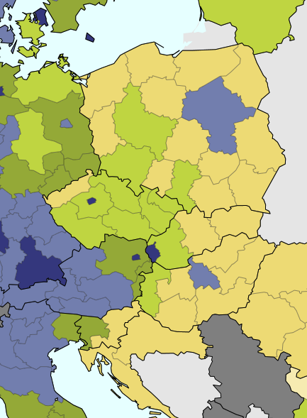
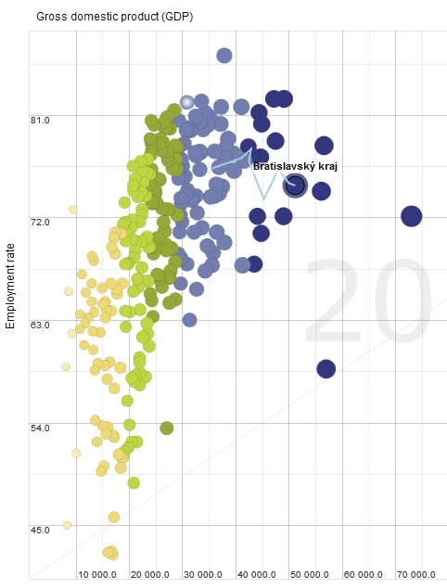
GDP distortion: Bratislava
[SLIDE 3]
Notes:
3
GDP is distorting because it is calculated where it is produced. This is especially obvious in agglomerations with strong commuting towards a centre (e.g. capital regions and hinterland).
The distortion leads to a situation where capital regions are richer on the paper than in reality (and hinterland regions the other way around). In fact, commuters use the infrastructure but spend a lot of their salary in their home region. The scatter plot shows GDP per capita on X and Employment on Y for EU NUTS-2 regions between 2006-2014 (light blue line is the change in time), that Bratislava region's GDP per capita was constantly growing but unemployment as well. Therefore, from Bratislava's point of view it would make very much sense to look beyond GDP – into social (or environmental) issues. As a more general comment, this short coming of GDP also calls for looking more into functional regions instead of NUTS – what has been also mentioned in the Marini opinion.

Slide 4
10 points of statistics for policy
Have a common vision
Inclusive decision about statistics and indicators
  Politicians + Researchers + Statisticians
Measure Progress
Give indicators a normative stance
Measure both: average and dispersion
[SLIDE 4]
Notes:
4

Slide 5
10 points of statistics for policy
Territorialise statistics
Look at the output side
Make forecasts
Link to international and global benchmarks
Take action
[SLIDE 5]
Notes:
5

Slide 6
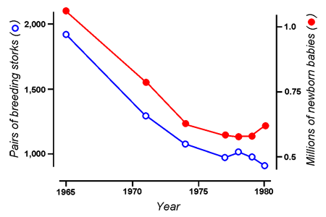

Lies, dumb lies and statistics ☺
[SLIDE 6]
Notes:
6

Slide 7

[SLIDE 7]

