Slide 1
Quality Declaration of the ESS
Inauguration
Walter J. Radermacher
Eurostat

Slide 2
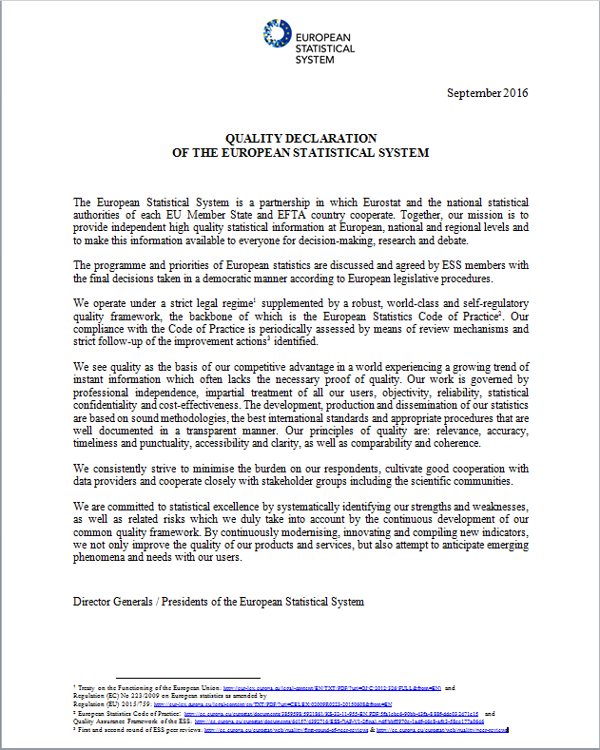
Proudly presenting
The 'crowning' of many
years' work:
The Quality Declaration
of the ESS
to demonstrate the competitive
advantage of European statistics,
what makes them different from
other data

Slide 3
Why in the form of a 'Declaration'
Because
It is a self-commitment, a continuous self-engagement of all members of the European Statistical System (ESS)
It builds on all the efforts that the ESS deployed in order to guarantee the development, production and dissemination of high-quality European statistics and services (amended Regulation 223, second round of peer reviews,…)

Slide 4
Its main message: awareness…
A very high level of quality awareness exists in the ESS
All members of the ESS partnership do the same in terms of quality &
The standards are set very high, as defined in the world-class quality framework: European Statistics Code of Practice =>

Slide 5
… and official guarantee:
'ESS made' (1/2)
Therefore, the product: European Statistics
equals high quality and can be trusted
is independent and 'unique' in today's oceans of information
is based on sound methodologies

Slide 6
… and official guarantee:
'ESS made' (2/2)
aims at minimising burden on respondents
is relevant and anticipates user needs
is based on close cooperation with stakeholders
is decided upon in a democratic manner
provides high value for money for the societies

Slide 7
CESS 2016
Some of the Declaration's key aspects through concrete projects:
The ESS.VIP.DIGICOM project and its work on the value of European statistics
The ESS.VIP. ADMIN project and its work on the quality of multi-source statistics
Important tool for reinforced collaboration between producers and academia: EMOS

Slide 8



DIGICOM project (2016-2019)
DIGItal COMmunication, User analytics and Innovative products
Contributes to 2 areas of the ESS Vision 2020
Aims to modernise communication and dissemination of European statistics
Involves Eurostat and 18 NSIs, ESAC members

Slide 9
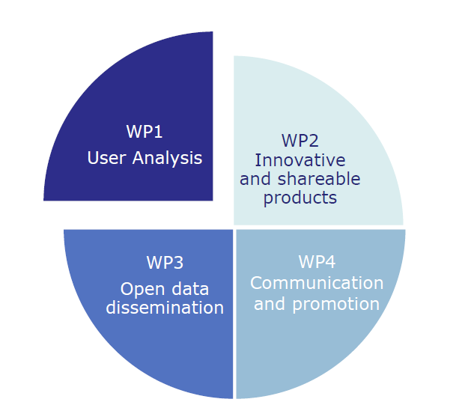
CESS 2016 will feed into DIGICOM
Session A7: Getting to know the users and uses of official statistics
Session A8: Engaging with users
Session A9: Collaboration and communication with the users of official statistics
Session A4: Visualisation of official statistics
Session A5: Exploring new ways to communicate statistics
Session A6: Communication of statistics in a digital age
Session D2: lecture on Linked Open Data
Session D3: The partnership between official statistics and scientific research – where will it take us next?
Session D4: Access to statistical data and research
Session A3: Value of official statistics – how to convince our stakeholders?
Session A11: Enhancing statistical culture
Session A12: Statistical Literacy and Accreditation of Statistical Professionalism

Slide 10
What will DIGICOM deliver?
User engagement
through social media Targeted products and services
Reaching new users through visualisation
Promote the value of European statistics
Statistical literacy
Hackathon
Empowering users to reuse and combine data
Improved access to microdata

Slide 11
Data driven policy making needs integration of sources
Statistics
Big Data
Administrative Data
Surveys
Geodata
ESS.VIP ADMIN
(2015-2019)
Topics:
Access to data sources
Methodology for integrating sources
Quality
Frames for social statistics
Support to Member States for pilot projects
Helpdesk, coaching and training for Member States
The sessions of CESS 2016 Track D(ii) will feed into the ADMIN project
Notes:
Unleashing the power of data through integration
Data-driven policy-making
Using data to justify interventions
Micro data linkage
Micro-simulation modelling
A data pool of European statistics based on a solid data warehouse approach
Moving away from stovepipes to an integrated collection and quality check process leveraging different sources

Slide 12

Network of EMOS labelled Master programmes providing higher education in the area of official statistics at the European level
Connects producers of statistics and academia
Label awarded by the ESS Committee for programmes meeting EMOS learning outcomes
Workshops
Webinars
Summer schools
Study visits
Internships
University network after two calls for applications 2015-16
  22 programmes in 15 countries
  Germany (6) and Italy (3) most present
  Montenegro outside EU
Presented at CESS 2016 Session A12

Slide 13
European Statistics -
Trusted statistics. Informed Europeans. Better decisions.
Thank you for your attention

