Slide 1

of Official Statistics
Conference of European Statisticians

Slide 2
UNECE Task Force on
Value of Official Statistics
  Established in May 2015 to:
    Define what is meant by value of official statistics
    Develop ways to measure the value of official statistics
    Develop better understanding and communication of this value
    Recommend actions for promoting and increasing the value
  Task Force members:
    United Kingdom (chair), Australia, Canada, Ireland, Mexico, New Zealand, Switzerland and Turkey
    Eurostat, OECD, Paris21, World Bank and UNECE

Slide 3
Why think about the value of statistics?
Why we need to think about the value of statistics?
  Tight budget constraints imposed on many statistical offices
  Technological advances and Big Data challenge our current ways of working
  Demand for statistics growing globally
  We work in an increasingly competitive information industry
  Stakeholders sometimes fail to see the value of official statistics
We need to:
  Define what is our business in the midst of Data Revolution
  Convey reasons why investment in official statistics should be made
  Pool good practices of statistical offices to support mutual learning
  Identify and develop better ways to measure and explain the value

Slide 4


How to keep fit?
Interim recommendations
Exploit the comparative advantage
of official statistics (the cornerstone – quality)
Put customers truly at the center
Design statistics for everyday life
Innovate to remain valuable
Go further with strategic partners
Build official statistics brand and gain visibility
Measure outcomes to achieve greater impact
Share and learn using a plug-and play platform

Slide 5
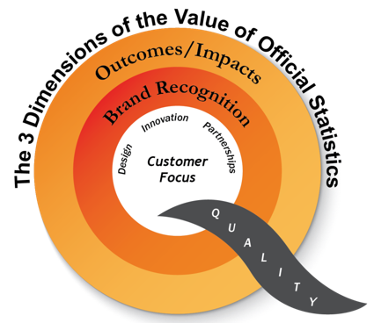
Dimensions of value

Slide 6
Current work of the Task Force
  Best practices wiki linked to the eight recommendations for learning and sharing
  Generic user survey to measure users’ views on the value of official statistics
  Convincing points on value of official statistics that could be used in stakeholder collaboration
  Measurement framework with objective and subjective indicators and methodologies for monetizing the value
  Recommendations on Value of Official Statistics and the measurement framework to be final by June 2017

Slide 7


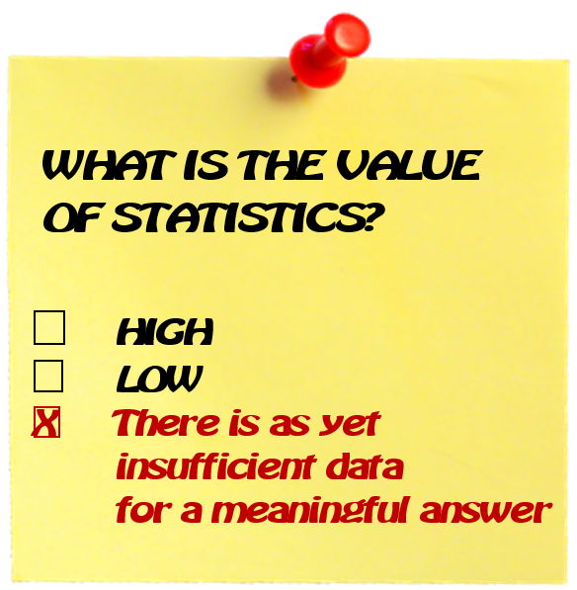

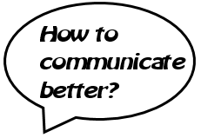
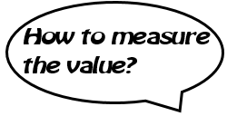
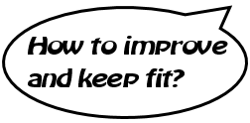
Statistics at a Checkpoint

