Slide 1

Map With Indicators
Anne Vibeke Jacobsen
Statistics Denmark

Slide 2
Agenda
Process
Requirements
The Map
Design and technology
Further work

Slide 3
The Process
Why?
How?
  Small projectgroup: Projectleader and two employees from the communication department
  Meeting in the steering group every quarter
  Started in summer 2014 and was ready in January 2016
Inspiration from different web-sites

Slide 4
Requirements
Use the Statbank for data
The data in the Statbank must be ‘in relation to’:
  E.g. number of citizens, who receive home care in relation to the total number of citizens (above 67 years)

Slide 5
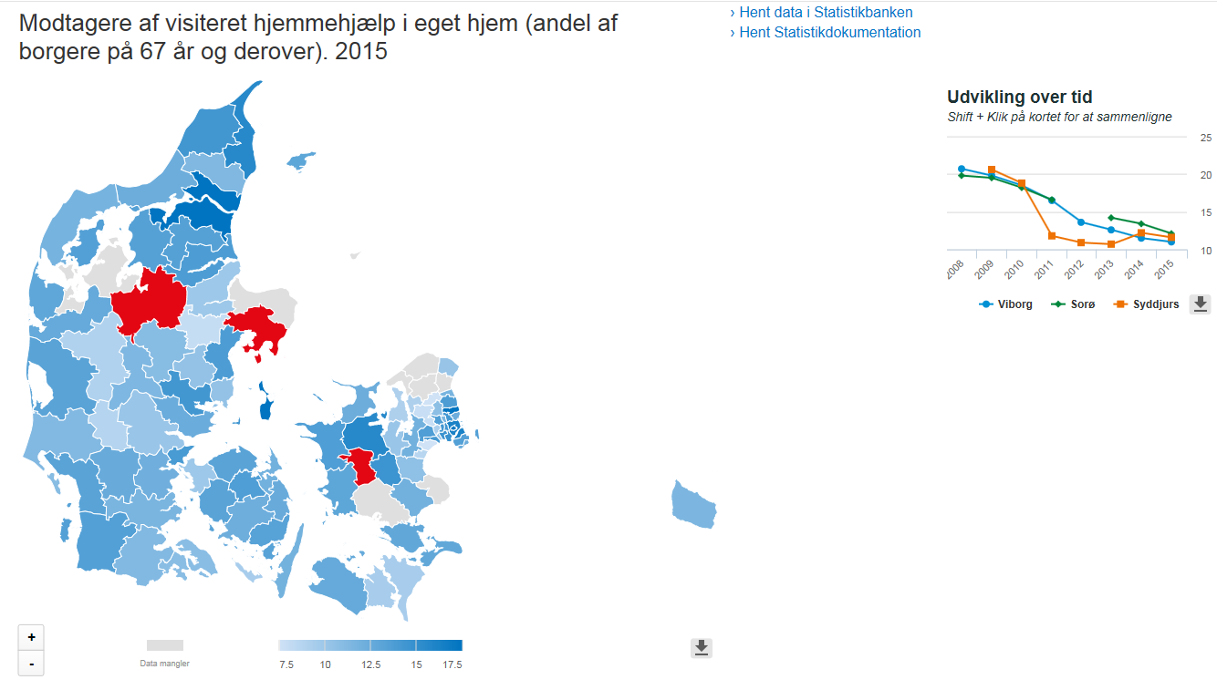
www.dst.dk/kommunekort

Slide 6
HighCharts & HighMaps
What framework to use
Looked at different frameworks
Selected HighChats & HighMaps

Slide 7
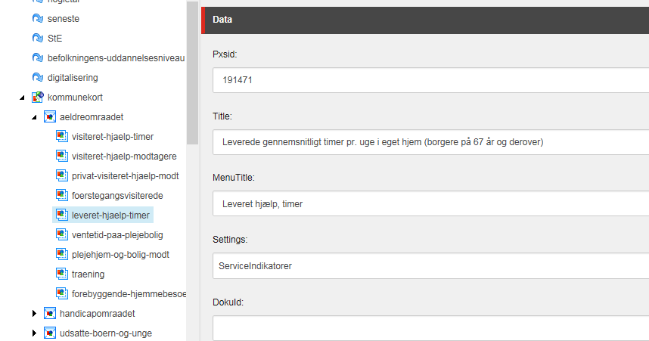
Municipality Indicators – how to….
Create ‘saved query’ in www.statbank.dk (get an ID)
Insert ID, texts and documentation ID in CMS (SiteCore)

Slide 8
Possible Further Work
Change the map over time – can only see this year
Overview of all indicators of a selected municipality
Compare municipalities on iPad
Country total

Slide 9
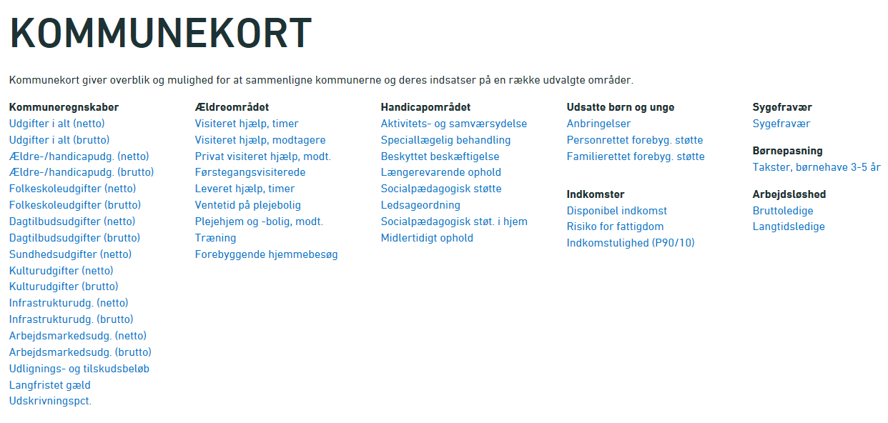

Slide 10

Thank you

