Slide 1



www.statview.eu
An innovative webGIS system for dissemination and visualization of official statistics and geospatial analysis
Emanuela Recchini, Alessandro Capezzuoli
Conference of European Statistics Stakeholders
Budapest, 20-21 October 2016

Slide 2
1
Official statistics: solicitations from ESS Vision 2020
2
Formats, standards and methods for data dissemination
3
Data visualization, webGIS and statistical data
4
A webGIS system for visualization, dissemination and geospatial analysis
5
Concluding remarks
An innovative webGIS system for dissemination and visualization of official statistics and geospatial analysis
Emanuela Recchini, Alessandro Capezzuoli – Conference of European Statistics Stakeholders, Budapest, 20-21 October 2016

Slide 3
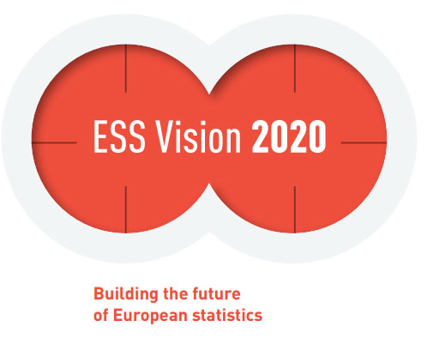

1. Official statistics: solicitations from ESS Vision 2020
Information and knowledge are fundamental building blocks for all modern societies
Quality is an overarching element in the statistical production process
Official statistics, characterized by the highest quality possible inasmuch as they are produced in compliance with the UN Fundamental Principles of Official Statistics and the European Statistics Code of Practice, play an essential role in supporting analysis and decision making.
The ESS Vision 2020 recognizes:
the importance to complement existing data derived from traditional sources, with newer emerging ones, including geospatial and big data
the relevance and the opportunity of sharing tools within the ESS
the usefulness of proper dissemination channels that meet the needs of as many people as possible.
Solicited by ESS, National Statistical Offices (NSOs) have started exploring new technology-driven areas when dealing with very large amount of data and are developing suitable tools for the integration of different types of information and its dissemination, i.e. platforms for data storage, analysis and visualization.
An innovative webGIS system for dissemination and visualization of official statistics and geospatial analysis
Emanuela Recchini, Alessandro Capezzuoli – Conference of European Statistics Stakeholders, Budapest, 20-21 October 2016
1

Slide 4



2. Formats, standards and methods for data dissemination
W3C open standard formats: XML vs JSON
eXtensible Markup Language
relies on the use of a Service Oriented Architecture - SOA
Javascript Object Notation
relies on the use of a Resource Oriented Architecture - ROA
REPRESENTATIONAL STATE TRANSFER (REST)
- is not a standard, is just an architecture style for designing networked applications
- is a lightweight alternative to mechanisms like RPC (Remote Procedure Calls) and Web Services (SOAP, WSDL, etc.)
- is a service concept that may be summarized by the CRUD principles
An innovative webGIS system for dissemination and visualization of official statistics and geospatial analysis
Emanuela Recchini, Alessandro Capezzuoli – Conference of European Statistics Stakeholders, Budapest, 20-21 October 2016
2

Slide 5
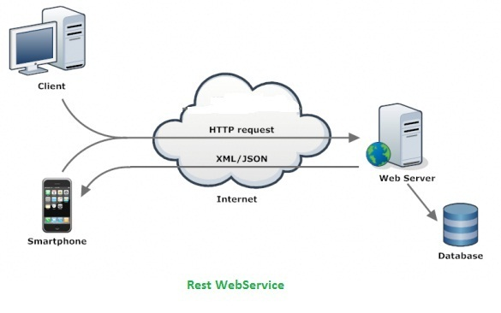
REST WEBSERVICES
2. Formats, standards and methods for data dissemination
Architectures for data visualization
RESTful – Systems conforming to the REST constraints
SOAP – Simple Objects Access Protocol
Can be used as
Application Programming Interface (API)
An innovative webGIS system for dissemination and visualization of official statistics and geospatial analysis
Emanuela Recchini, Alessandro Capezzuoli – Conference of European Statistics Stakeholders, Budapest, 20-21 October 2016
3

Slide 6
Data dissemination in Official statistics
3. Data visualization, webGIS and statistical data
The Istat experience
The Italian National Institute of Statistics (Istat) uses several channels for data dissemination:
    The single exit point for exchanging and supplying data to Eurostat and other institutional subjects through the SDMX format
    I.STAT, a web channel allowing data downloading in several formats (csv, excel, etc.)
    A set of API REST to disseminate data in the JSON-stat format
Istat, like other NSOs, uses the JSON-stat format for its data dissemination
An innovative webGIS system for dissemination and visualization of official statistics and geospatial analysis
Emanuela Recchini, Alessandro Capezzuoli – Conference of European Statistics Stakeholders, Budapest, 20-21 October 2016
4

Slide 7
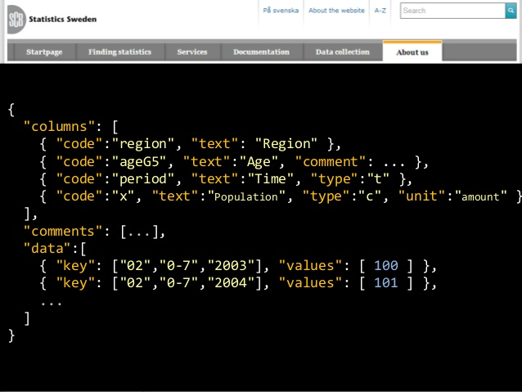
3. Data visualization, webGIS and statistical data
An example of JSON-STAT output
An innovative webGIS system for dissemination and visualization of official statistics and geospatial analysis
Emanuela Recchini, Alessandro Capezzuoli – Conference of European Statistics Stakeholders, Budapest, 20-21 October 2016
5

Slide 8
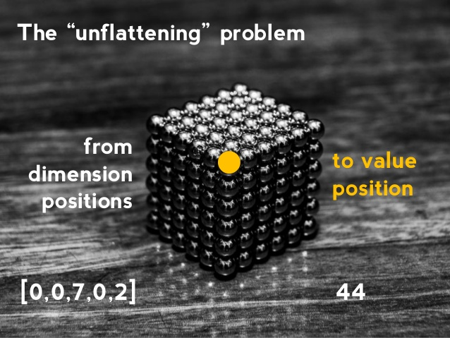
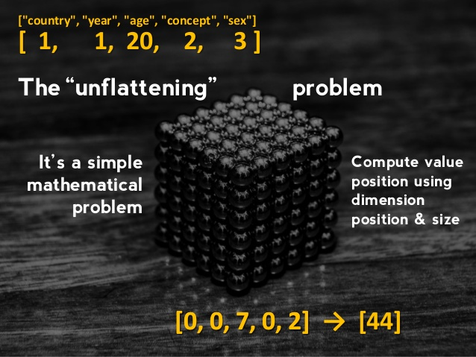
JSON-STAT, SDMX, ODATA
3. Data visualization, webGIS and statistical data
The JSON-stat format
The JSON-stat format is a simple lightweight JSON format for data dissemination. It is based on a cube model that arises from the evidence that the most common form of data dissemination is the tabular form.
In this cube model, datasets are organized in dimensions. Dimensions are organized in categories.
JSON-stat has been the starting point for the development of StatVIEW
An innovative webGIS system for dissemination and visualization of official statistics and geospatial analysis
Emanuela Recchini, Alessandro Capezzuoli – Conference of European Statistics Stakeholders, Budapest, 20-21 October 2016
6

Slide 9
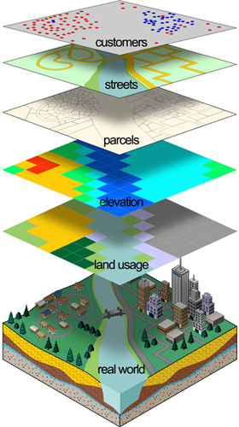
JSON-STAT, SDMX, ODATA
3. Data visualisation, webGIS and statistical data
WebGIS and statistical data platform
    Data dissemination and cartographic visualisation
    Dynamic territorial analysis
    Production of ad hoc applications for analysis and treatment of specific phenomena
    Data integration using REST (or SOAP) webservices and a standard for data representation (e.g. JSON-STAT), differently usable by a relational database designed on the basis of an Entity–Relationship model.
    Reaching a wider and more diversified audience, in as much as they satisfy numerous needs of analysis
An innovative webGIS system for dissemination and visualization of official statistics and geospatial analysis
Emanuela Recchini, Alessandro Capezzuoli – Conference of European Statistics Stakeholders, Budapest, 20-21 October 2016
7

Slide 10

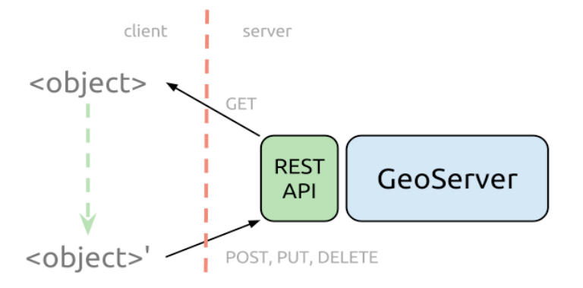


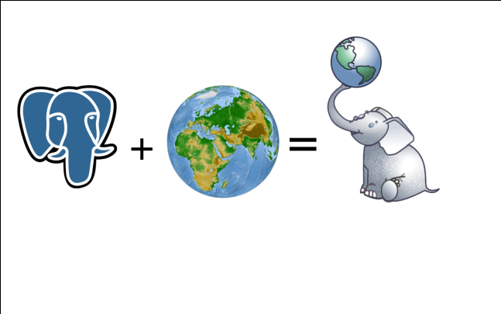
4. A webGIS system for visualization, dissemination and geospatial analysis
StatVIEW is a web GIS and statistical data platform comprising:
Map Server and a geospatial database (Geoserver, Postgres, PostGIS)
Different data sources (datawarehouse, webservices, database, etc.)
Interrogation engine and user interface
WMS
WFS
WCS
StatVIEW:
Supports different data sources (database, files, webservices)
Highly scalable system
Supports different models for open data sources (SDMX, DDI, JSON-STAT)
Supports different formats for open data sources (XML, JSON)
Source output in JSON-stat format
An innovative webGIS system for dissemination and visualization of official statistics and geospatial analysis
Emanuela Recchini, Alessandro Capezzuoli – Conference of European Statistics Stakeholders, Budapest, 20-21 October 2016
8

Slide 11
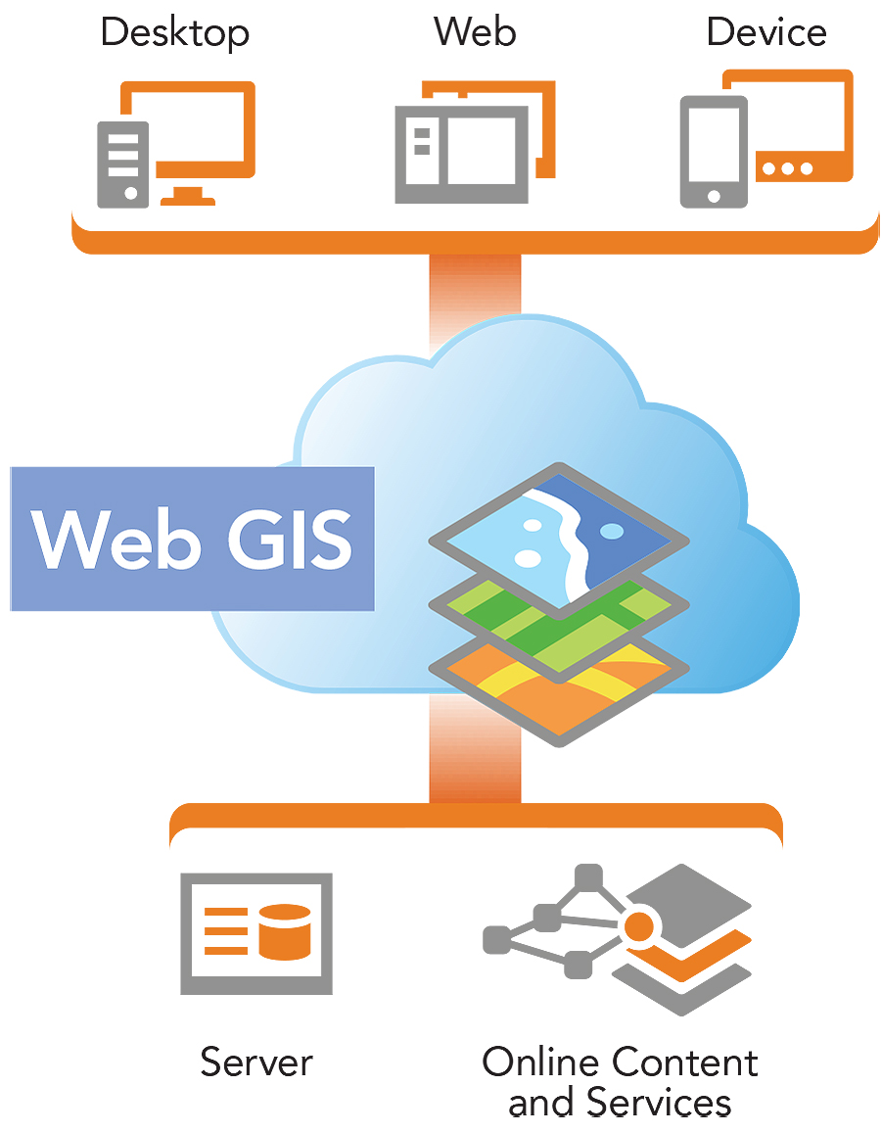
JSON-STAT, SDMX, ODATA
4. A webGIS system for visualization, dissemination and geospatial analysis
StatVIEW (www.statview.eu) allows users to carry out operations normally included in GIS Desktop and WebGIS systems:
Topology Overlay
Network analysis
Buffering
An innovative webGIS system for dissemination and visualization of official statistics and geospatial analysis
Emanuela Recchini, Alessandro Capezzuoli – Conference of European Statistics Stakeholders, Budapest, 20-21 October 2016
9

Slide 12
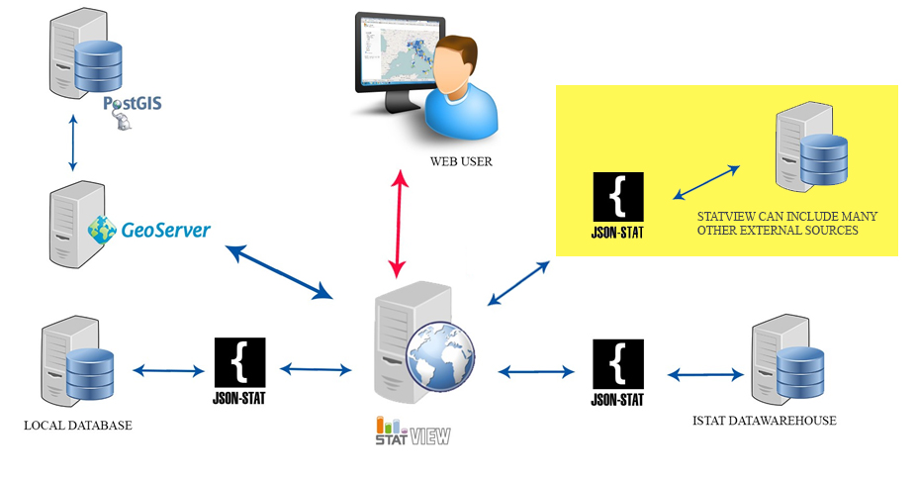
4. A webGIS system for visualization, dissemination and geospatial analysis
MICROSERVICE
Architecture
An innovative webGIS system for dissemination and visualization of official statistics and geospatial analysis
Emanuela Recchini, Alessandro Capezzuoli – Conference of European Statistics Stakeholders, Budapest, 20-21 October 2016
10

Slide 13
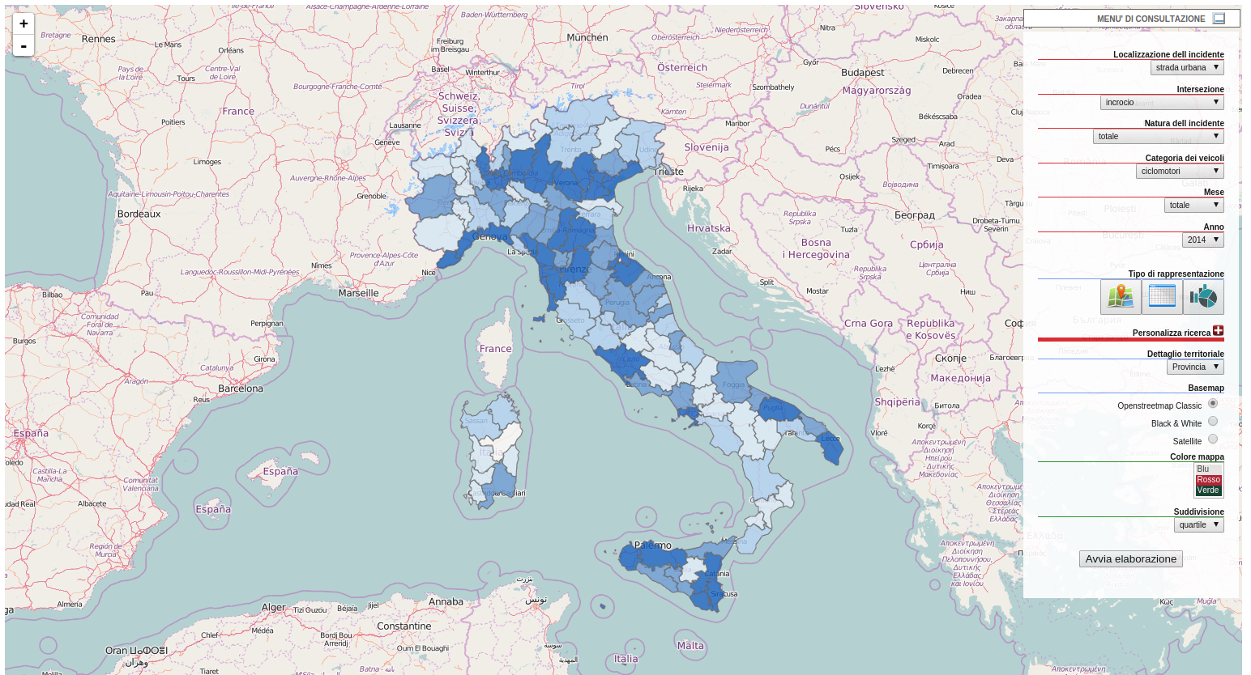

4. A webGIS system for visualization, dissemination and geospatial analysis
Dimensions associated to the dataset
Representation type (cartography, graphic, table)
Customize the research
arch
DENSITY MAP
A density map for vehicles involved in road accidents
An innovative webGIS system for dissemination and visualization of official statistics and geospatial analysis
Emanuela Recchini, Alessandro Capezzuoli – Conference of European Statistics Stakeholders, Budapest, 20-21 October 2016
11

Slide 14
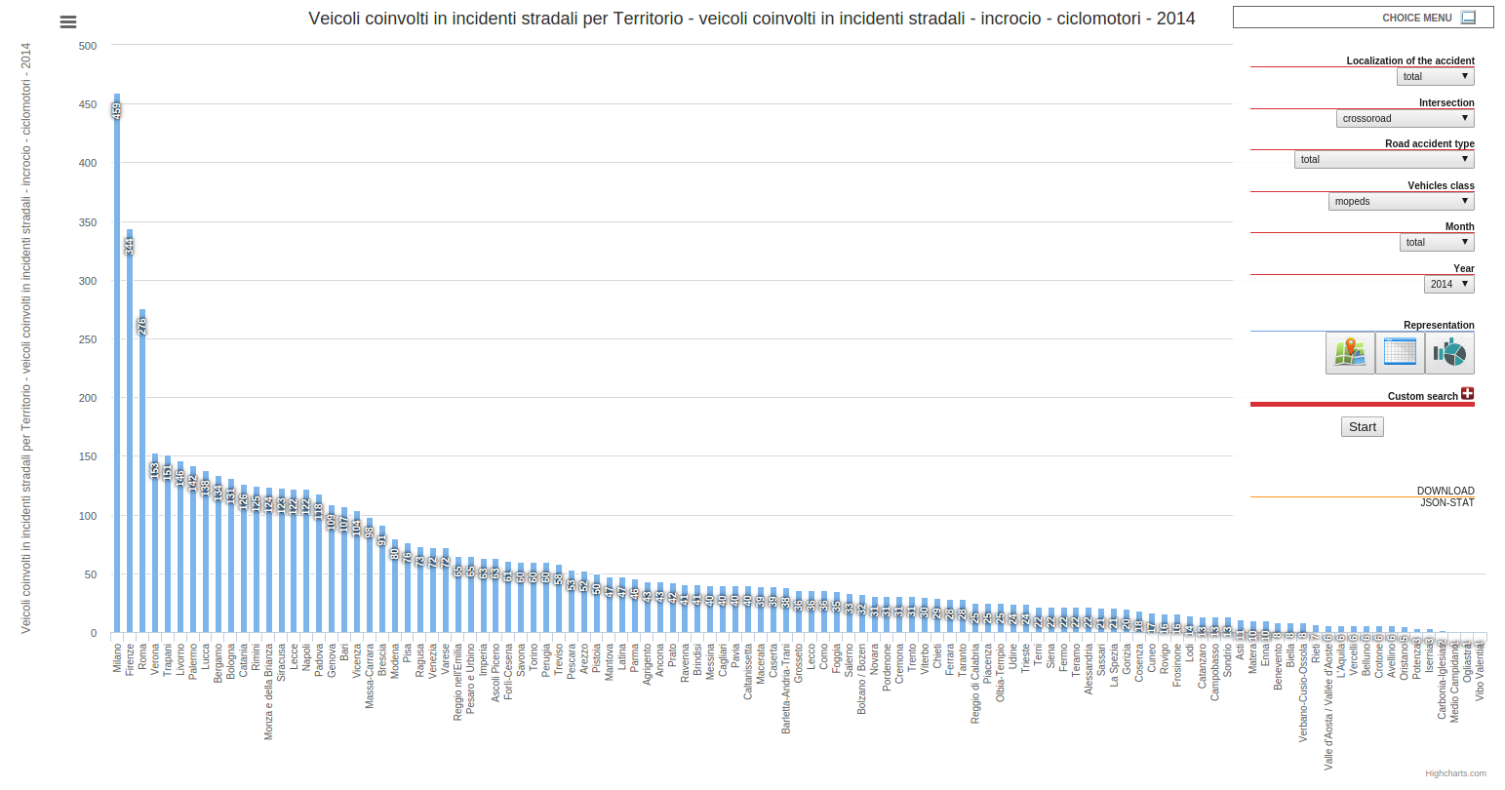
4. A webGIS system for visualization, dissemination and geospatial analysis
DYNAMIC GRAPH
A dynamic graph for vehicles involved in road accidents
An innovative webGIS system for dissemination and visualization of official statistics and geospatial analysis
Emanuela Recchini, Alessandro Capezzuoli – Conference of European Statistics Stakeholders, Budapest, 20-21 October 2016
12

Slide 15
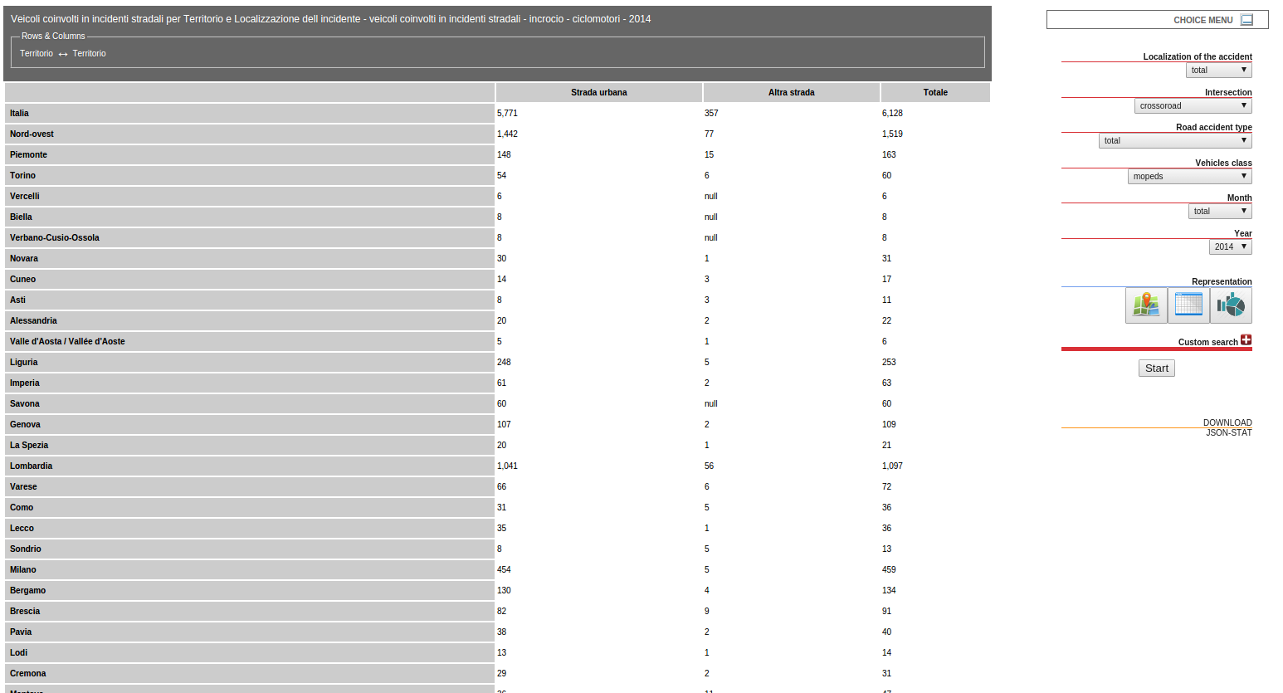
4. A webGIS system for visualization, dissemination and geospatial analysis
TABLE
A table for vehicles involved in road accidents realized with JSON-stat Table Browser
An innovative webGIS system for dissemination and visualization of official statistics and geospatial analysis
Emanuela Recchini, Alessandro Capezzuoli – Conference of European Statistics Stakeholders, Budapest, 20-21 October 2016
13

Slide 16
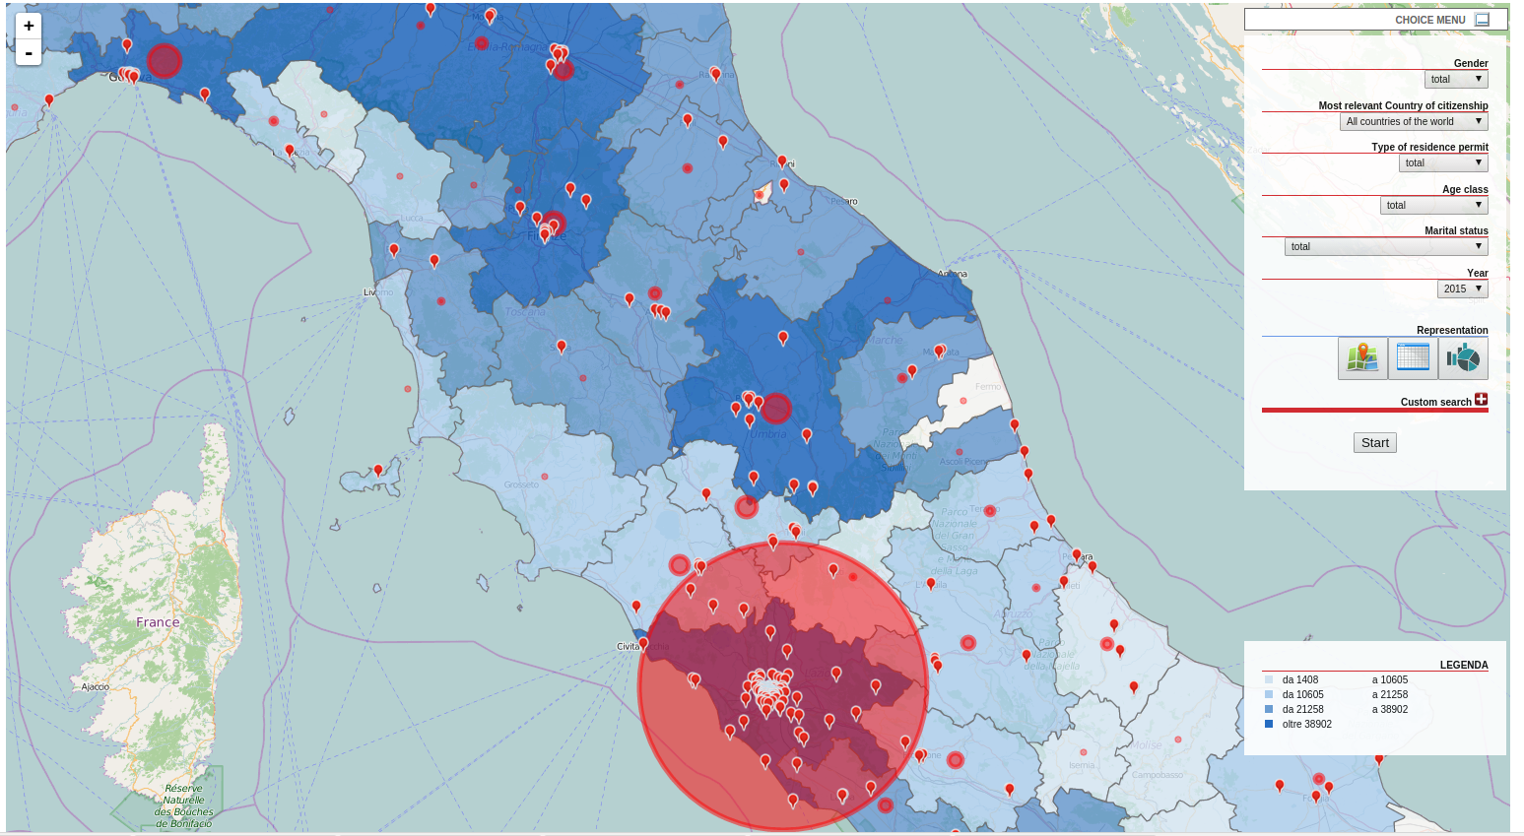
4. A webGIS system for visualization, dissemination and geospatial analysis
OVERLAY: Map - residence permits of non-EU citizens
By selecting the layers and, for example, a different base map, or a different color shade, or a different partition (quartile, quintile), it is possible to get a different visualization, leading to a different interpretation of the phenomenon.
The customization depends on the layers available in the chosen map.
One layer contains the georeferenced organizations providing assistance to migrants
Another layer creates, via a geospatial query, a bubble chart representing the number of the georeferenced organizations active in the territory
An innovative webGIS system for dissemination and visualization of official statistics and geospatial analysis
Emanuela Recchini, Alessandro Capezzuoli – Conference of European Statistics Stakeholders, Budapest, 20-21 October 2016
14

Slide 17
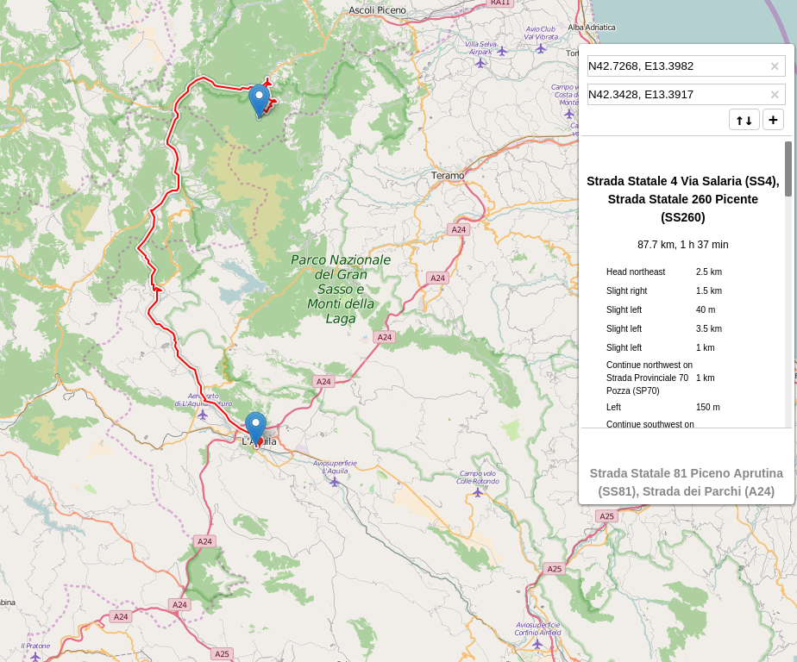
4. A webGIS system for visualization, dissemination and geospatial analysis
Routing
By using an OSRM (Open Source Routing Machine) routing algorithm, it is possible to obtain the shortest route to a geo-localised point in the map server used by StatVIEW (e.g. hospital, police station, etc.) from any point in the map, as well as the respective travel time.
An innovative webGIS system for dissemination and visualization of official statistics and geospatial analysis
Emanuela Recchini, Alessandro Capezzuoli – Conference of European Statistics Stakeholders, Budapest, 20-21 October 2016
15

Slide 18
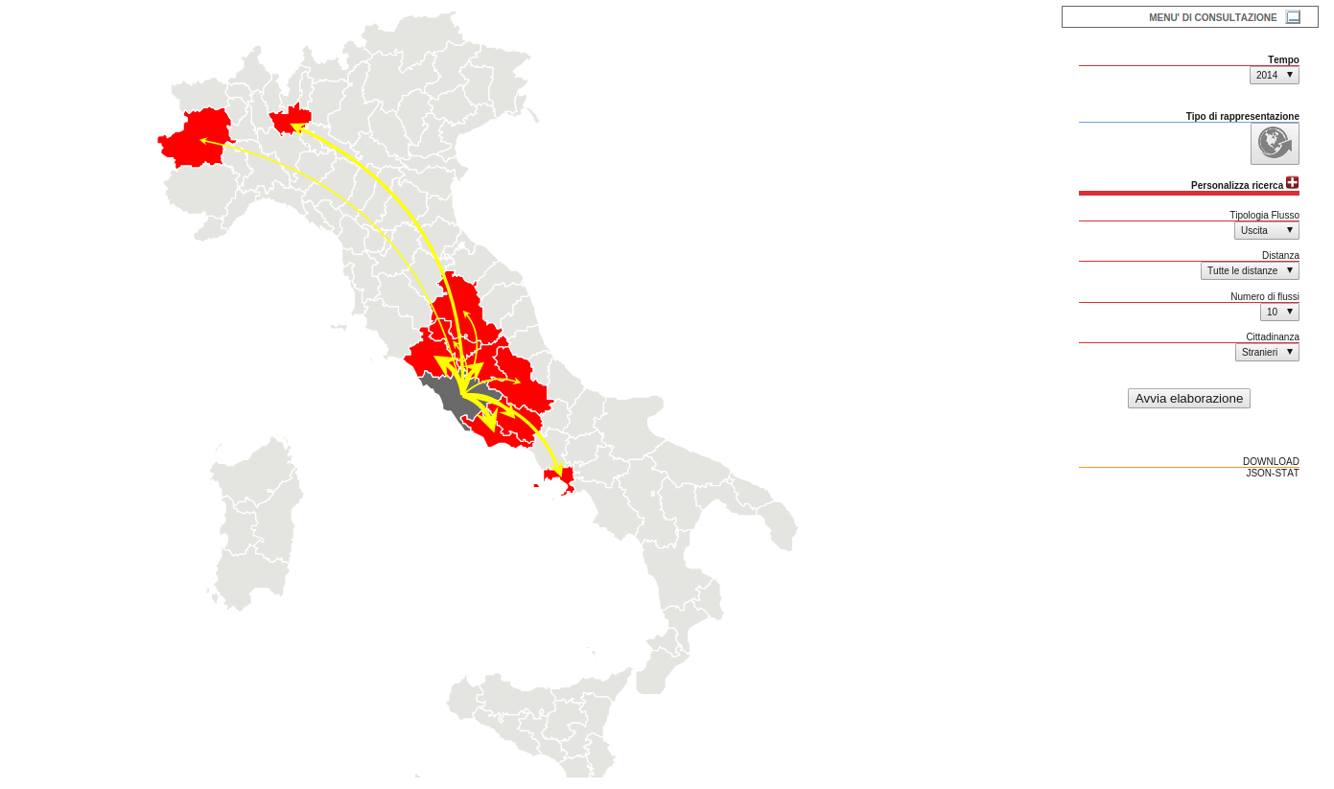
4. A webGIS system for visualization, dissemination and geospatial analysis
INTERNAL FLOW
Changes of residence for foreign citizens to and from Italian Provinces
It is possible to represent inflows and outflows to and from a given territorial border.
It is possible to set the maximum distance or the distance range for the desired flows.
For example, we may be interested in visualizing the flows within 100 km from a given Province, or within a distance ranging 100-300 km.
The dimension of the arrows gives an idea of volumes: the thicker the arrow, the greater the flow.
An innovative webGIS system for dissemination and visualization of official statistics and geospatial analysis
Emanuela Recchini, Alessandro Capezzuoli – Conference of European Statistics Stakeholders, Budapest, 20-21 October 2016
16

Slide 19
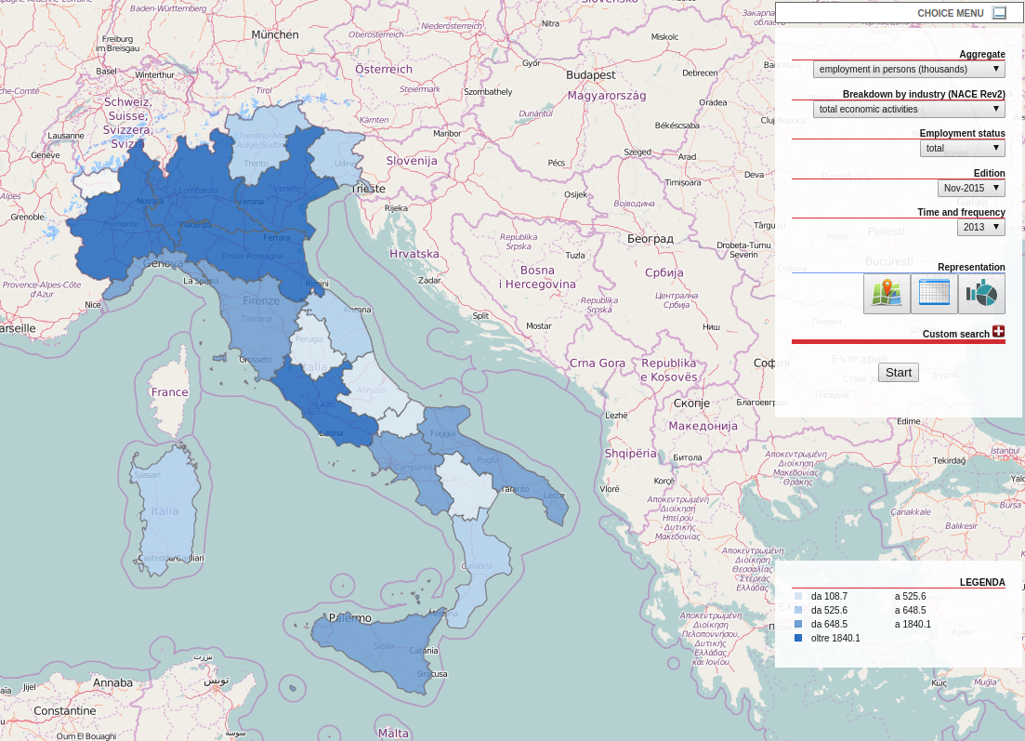
4. A webGIS system for visualization, dissemination and geospatial analysis
ITALIAN REGIONS
This example shows the evolution of employment data at the regional level
An innovative webGIS system for dissemination and visualization of official statistics and geospatial analysis
Emanuela Recchini, Alessandro Capezzuoli – Conference of European Statistics Stakeholders, Budapest, 20-21 October 2016
17

Slide 20
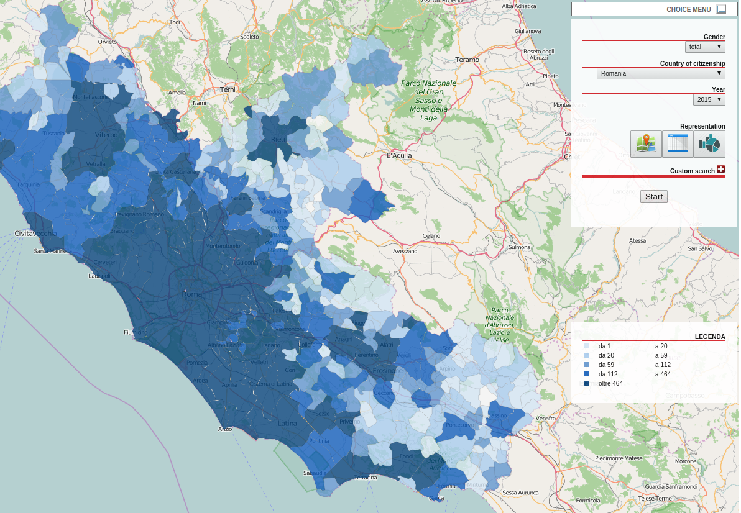
4. A webGIS system for visualization, dissemination and geospatial analysis
ITALIAN MUNICIPALITIES
This example shows the Romanian citizens who are resident in the Italian Lazio Region at the municipal level
An innovative webGIS system for dissemination and visualization of official statistics and geospatial analysis
Emanuela Recchini, Alessandro Capezzuoli – Conference of European Statistics Stakeholders, Budapest, 20-21 October 2016
18

Slide 21
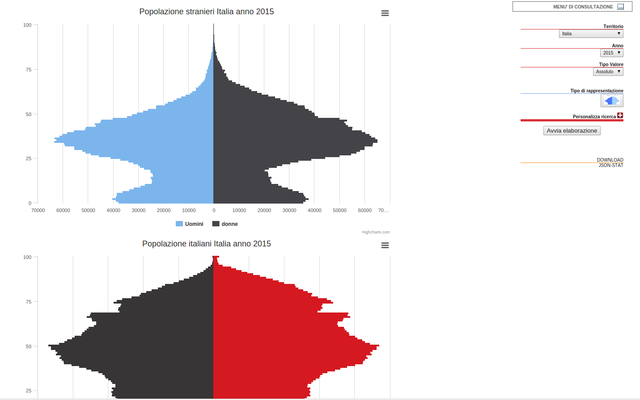
4. A webGIS system for visualization, dissemination and geospatial analysis
PYRAMID GRAPH
The standardization of the sources’ output allows the creation of ad hoc plugins for the generalized visualization of multi-source graphs or dashboards.
In the example a pyramid graph showing the age of foreign citizens resident in Italy, compared to that of resident Italian citizens
An innovative webGIS system for dissemination and visualization of official statistics and geospatial analysis
Emanuela Recchini, Alessandro Capezzuoli – Conference of European Statistics Stakeholders, Budapest, 20-21 October 2016
19

Slide 22
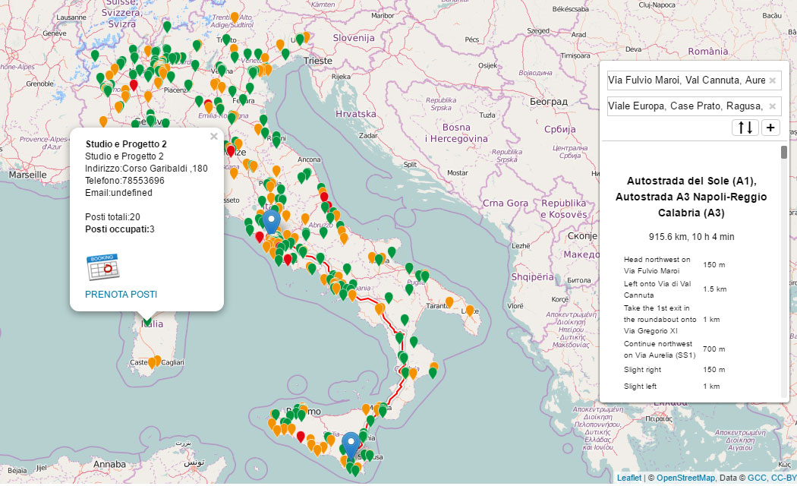
4. A webGIS system for visualization, dissemination and geospatial analysis
AD HOC WEB APPLICATION
The case of management of immigration centres provides an example of how StatVIEW, thanks to the support of geospatial database, allows users to develop ad hoc applications.
The map indicates the position of immigration centres.
The colours indicate the number of available accommodations (red = no accommodation available; orange = few accommodations available; green = many accommodations available).
By clicking on the marker of an immigration centre, an interested user (like, for example, a Prefecture) can book a certain number of accommodations, in order to equally distribute immigrants.
In a reserved area, it is possible to insert a new immigration centre (e.g. Via Diego Cadello, 9, Cagliari, Italy, Lat 39.238140, Lng 9.118743) that, thanks to the geospatial database, will be immediately visualized on the map.
An innovative webGIS system for dissemination and visualization of official statistics and geospatial analysis
Emanuela Recchini, Alessandro Capezzuoli – Conference of European Statistics Stakeholders, Budapest, 20-21 October 2016
20

Slide 23
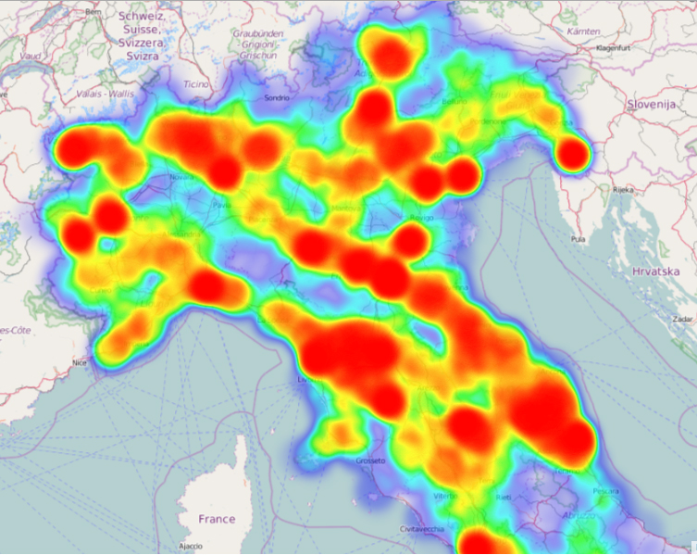
4. A webGIS system for visualization, dissemination and geospatial analysis
HEATMAP
Heatmap of private museums, monuments and archeological areas in Italy
An innovative webGIS system for dissemination and visualization of official statistics and geospatial analysis
Emanuela Recchini, Alessandro Capezzuoli – Conference of European Statistics Stakeholders, Budapest, 20-21 October 2016
21

Slide 24
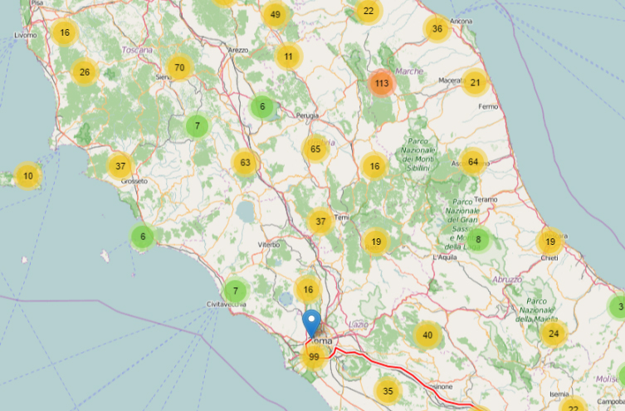
4. A webGIS system for visualization, dissemination and geospatial analysis
CLUSTERING
Marker clusters of private museums, monuments and archeological areas in Italy
An innovative webGIS system for dissemination and visualization of official statistics and geospatial analysis
Emanuela Recchini, Alessandro Capezzuoli – Conference of European Statistics Stakeholders, Budapest, 20-21 October 2016
22

Slide 25



5. Concluding remarks
With the support of StatVIEW, it is easier for research work to analyze a specific phenomenon, overlay different layers to describe several phenomena as a whole and quickly monitor the evolution of different phenomena at the same time.
This helps to highlight the possible connections between phenomena or the impacts that the phenomena under investigation have on each other, thus facilitating the analysis and the drafting of proper and early-warning advice for decision making.
According to the ESS Vision 2020, developing an ESS that engages users proactively and meets their demands in a cost-efficient and responsive manner is one aim of the EU agenda. A webGIS system such as StatVIEW is along these lines. In providing high quality information, StatVIEW is time saving and cost-effective. It represents a useful open source tool that can be conveniently shared among NSOs for analyzing, visualizing and sharing statistical and cartographic data in a machine-readable format.
An innovative webGIS system for dissemination and visualization of official statistics and geospatial analysis
Emanuela Recchini, Alessandro Capezzuoli – Conference of European Statistics Stakeholders, Budapest, 20-21 October 2016
23

Slide 26


THANK YOU FOR YOUR ATTENTION
FOR ANY
QUESTIONS
CONTACT US:
alessandro.capezzuoli@istat.it
emanuela.recchini@istat.it

