Slide 1




Visualising and sharing statistical narratives
Conference of European Statistics Stakeholders
Budapest, 20–21 October 2016
Matthias Rumpf (OECD)
Florabela Carausu (DevStat)

Slide 2
Outline
Conference of European Statistics Stakeholders
Budapest, 20–21 October 2016
Statistical narratives and data providers
Setting up visuals and statistical narratives – challenges for data providers
Use cases
Additional options
Conclusions

Slide 3
Statistical narratives and data providers
Conference of European Statistics Stakeholders
Budapest, 20–21 October 2016
We all want data stories, but we don’t always know how to get there

Slide 4
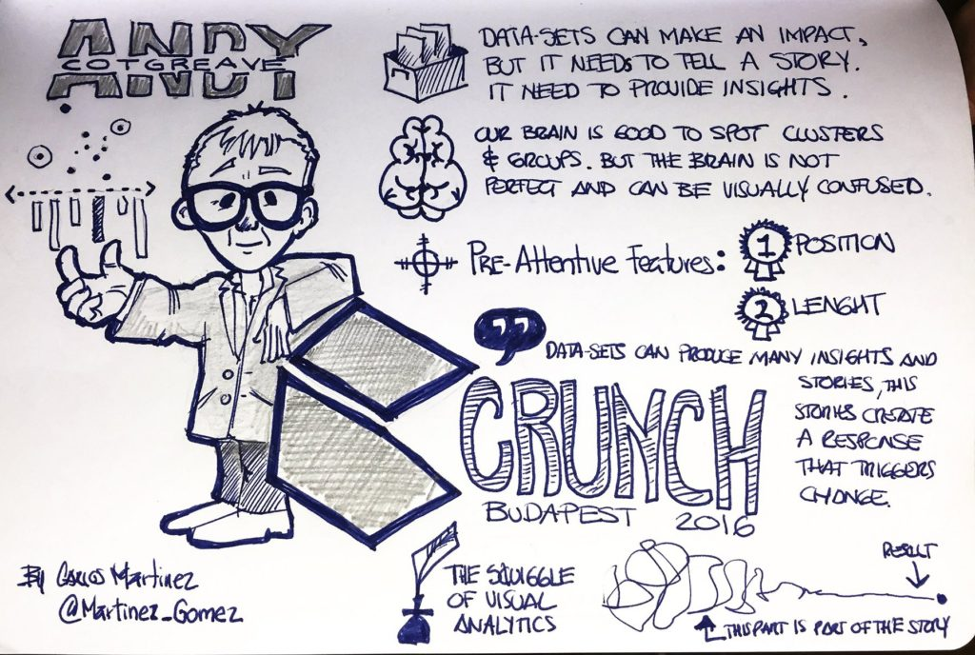
A plea for statistical narratives
Conference of European Statistics Stakeholders
Budapest, 20–21 October 2016
But narratives / stories may trigger personal and emotional feelings, especially if expressed through visuals.
…and visuals can be sometimes missleading.

Slide 5
Statistical narratives: principles and practices
Conference of European Statistics Stakeholders
Budapest, 20–21 October 2016
A proposal for principles for statistical narratives if developed by official data providers:
  compliance with quality criteria (e.g. relevance and accuracy);
  provision of neutral information;
  ensure access to the data and metadata behind;
  (preferably) offer useful/helpful explanations.

Slide 6
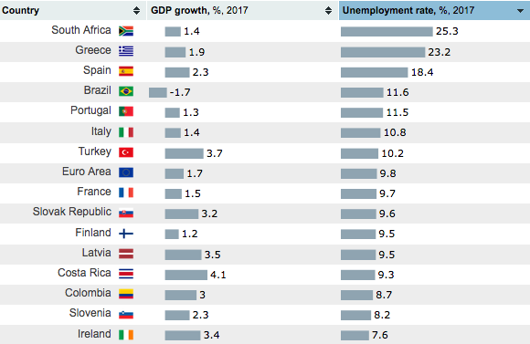
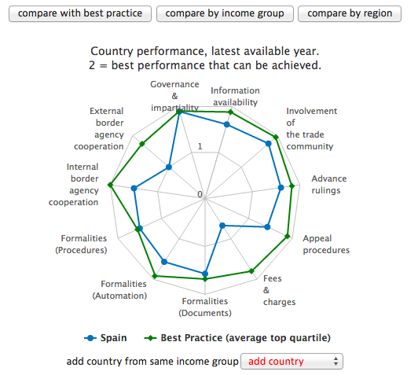
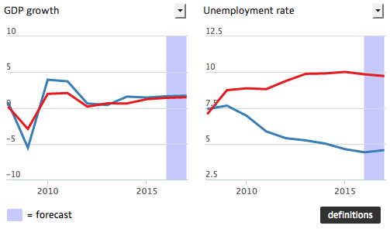
Modules for visual narratives
Conference of European Statistics Stakeholders
Budapest, 20–21 October 2016

Slide 7
Setting up visuals and statistical narratives – challenges for data providers
Conference of European Statistics Stakeholders
Budapest, 20–21 October 2016

Slide 8
The visuals, a template based approach
Conference of European Statistics Stakeholders
Budapest, 20–21 October 2016
Custom visuals for individual data sets are more intuitive and provide a more insightful presentation of data (population pyramids, tree maps for inflation data)
Generic templates (rankings, maps, line charts…) can facilitate the presentation of large sets of indicators
Can ensure reaching both non-expert and expert users, but also educating users

Slide 9
Accessible language for labels and metadata
Conference of European Statistics Stakeholders
Budapest, 20–21 October 2016
Key for the success of you narratives
Avoid statistical jargon - Short, concise, non-technical explanation of data.
Remove clutter (footnotes, flags) where ever possible
Build an information hierarchy with summary information upfront and more detailed technical information on a second or third layer of your tool

Slide 10
Manage set-up and updates
Conference of European Statistics Stakeholders
Budapest, 20–21 October 2016
Limited, topic based projects are easier to implement than whole -organisation programmes
Use agile development strategies, wherever possible. Set-up minimal viable beta versions and adjust from user feedback
Integrate viz with your SDMX data infrastructure
Design your project with enough time and resources for experiments and late adjustments
Communicating visually is a long term commitment

Slide 11
Use cases
Conference of European Statistics Stakeholders
Budapest, 20–21 October 2016

Slide 12
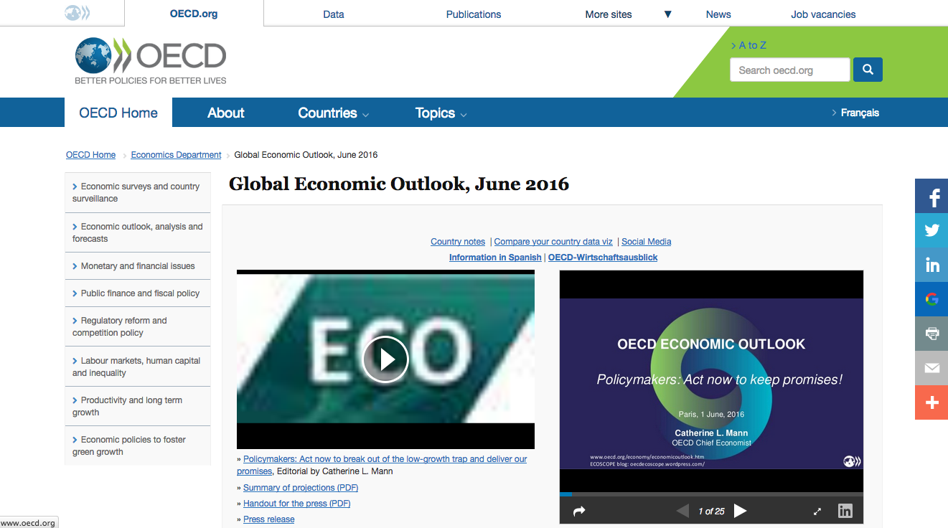
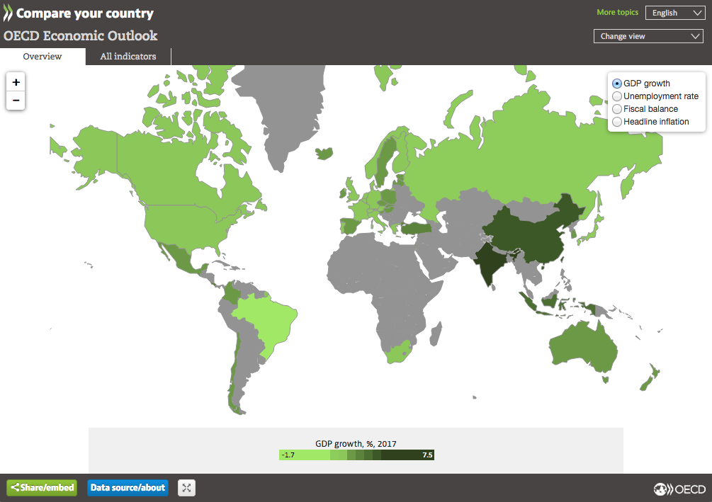
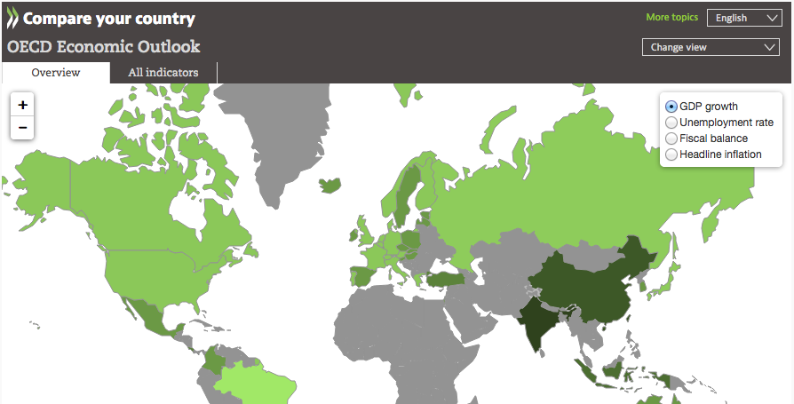
Stand alone or within corporate website
Conference of European Statistics Stakeholders
Budapest, 20–21 October 2016

Slide 13
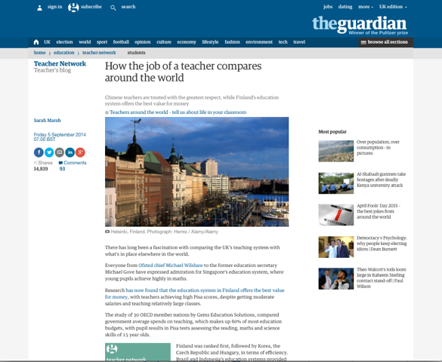
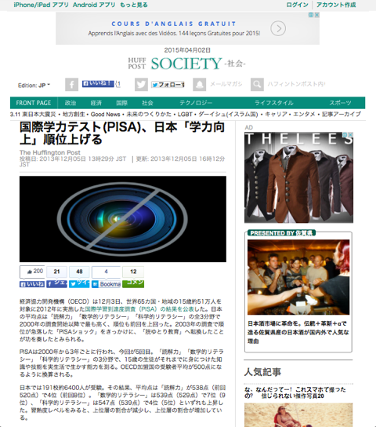
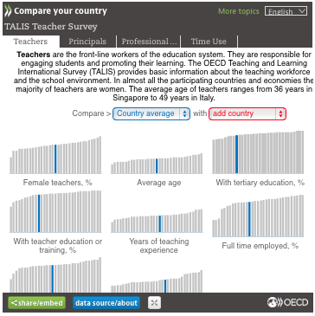

External embeds
Conference of European Statistics Stakeholders
Budapest, 20–21 October 2016

Slide 14
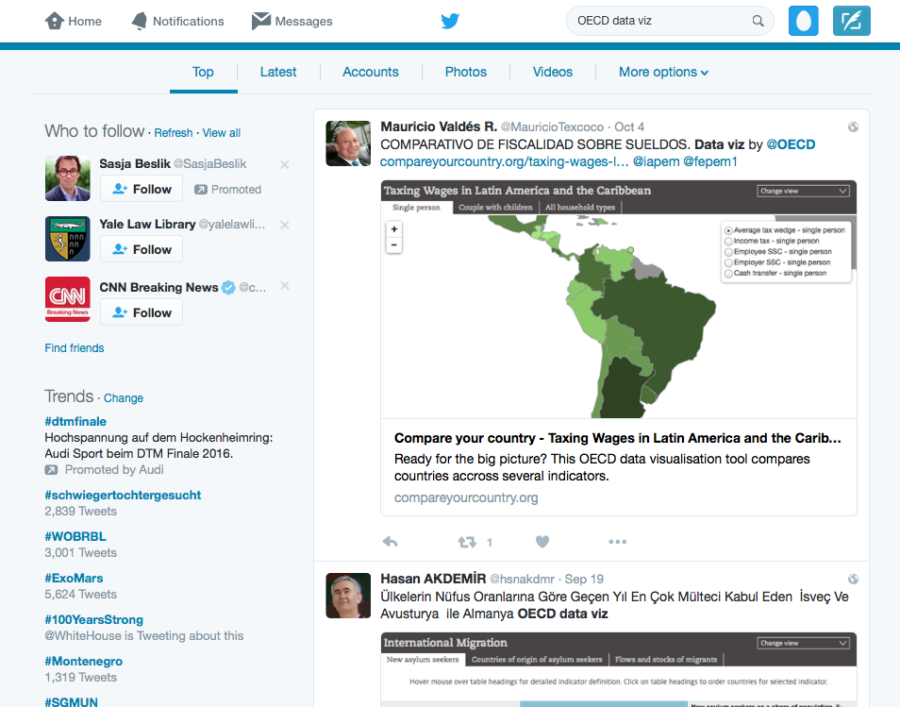
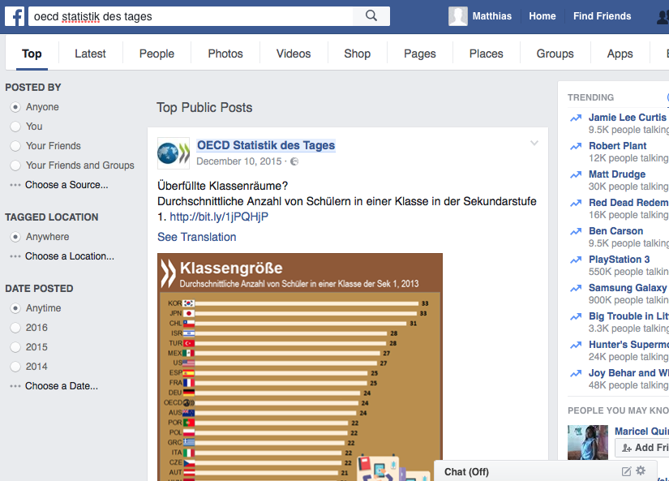
Social media
Conference of European Statistics Stakeholders
Budapest, 20–21 October 2016

Slide 15
Additional options
Conference of European Statistics Stakeholders
Budapest, 20–21 October 2016

Slide 16
Additional options
Conference of European Statistics Stakeholders
Budapest, 20–21 October 2016
Shared software solutions for data viz can reduce investment costs for data viz communication
Shared tools provide a platform for peer learning on data viz comms strategies
Jointly developed viz software could be the staring point for a data hub with multiple sources

Slide 17
Conclusions
Conference of European Statistics Stakeholders
Budapest, 20–21 October 2016

Slide 18
Conclusions
Conference of European Statistics Stakeholders
Budapest, 20–21 October 2016
Visualisations are able to support more story based data communication, while preserving the data provider’s neutrality
Viz tools developed by official data providers are able to ensure the value (utility) of the data being displayed
Viz tools should be built in a modular way with reusable features that work across different data sets
Integration with SDMX based data warehouses reduces maintenance costs
Visualisations have to be integrated into a broader communication strategy

Slide 19
Thank you!
Conference of European Statistics Stakeholders
Budapest, 20–21 October 2016
matthias.rumpf@oecd.org
fcarausu@devstat.com

