Slide 1
Exploring new ways of communicating statistics:
The first Eurostat digital publication
Philippe Bautier and Pascal Wolff
Eurostat

Slide 2

In a world of fast-food information, European statistics should be:
- easily accessible
- easy to understand
- interactive
- reusable

Slide 3
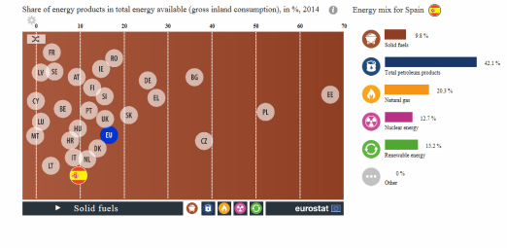
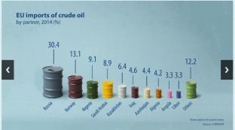

The first Eurostat digital publication
Presents statistics which better correspond to new behaviours of users:
- short texts
- interactive infographics
- diversity of tools

Slide 4

The first Eurostat digital publication
Provides statistical background to citizens who want to better understand the priority of the European commission: the Energy Union.

Slide 5

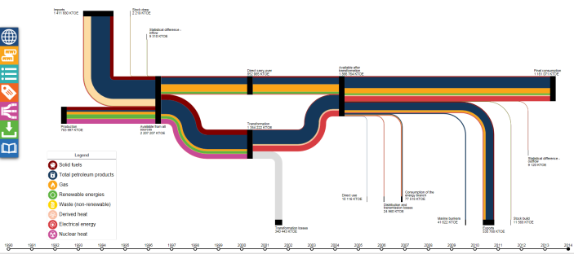
The first Eurostat digital publication
Replies to the needs of less experienced users and experts.

Slide 6
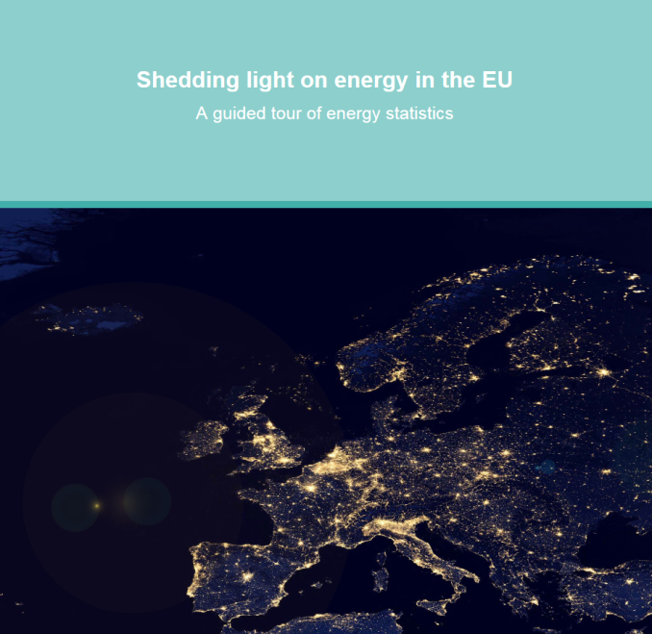
The first Eurostat digital publication
Shedding light on energy in the EU
– A guided tour of energy statistics
Let's go live!

Slide 7
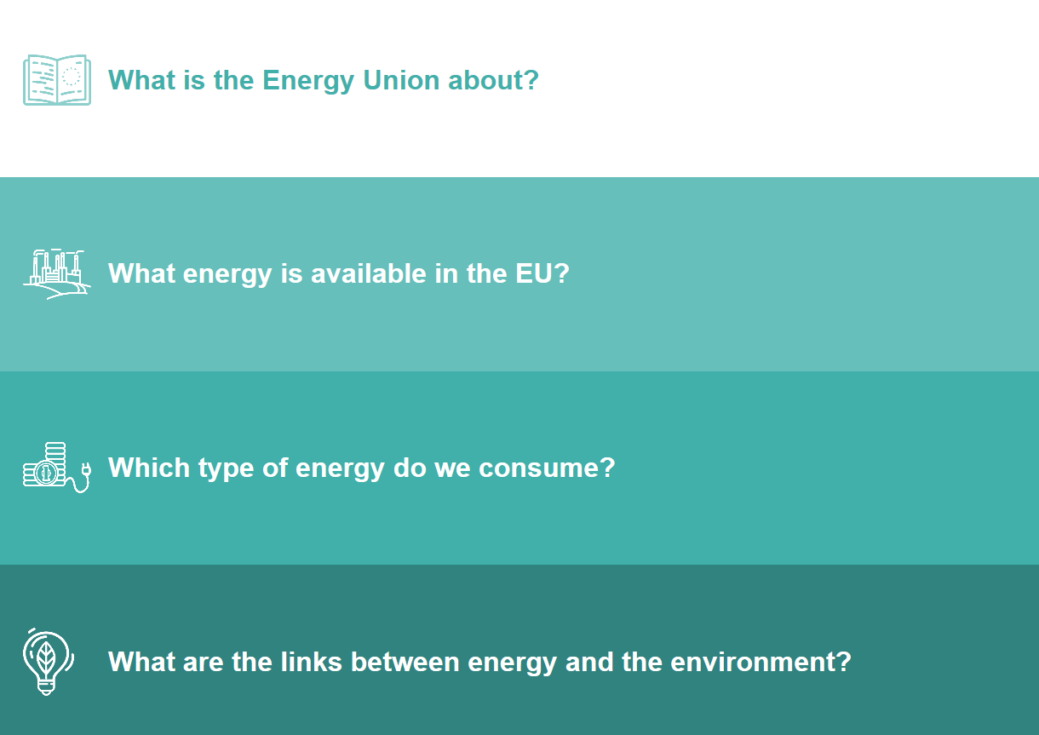
Four chapters answering questions on energy

Slide 8
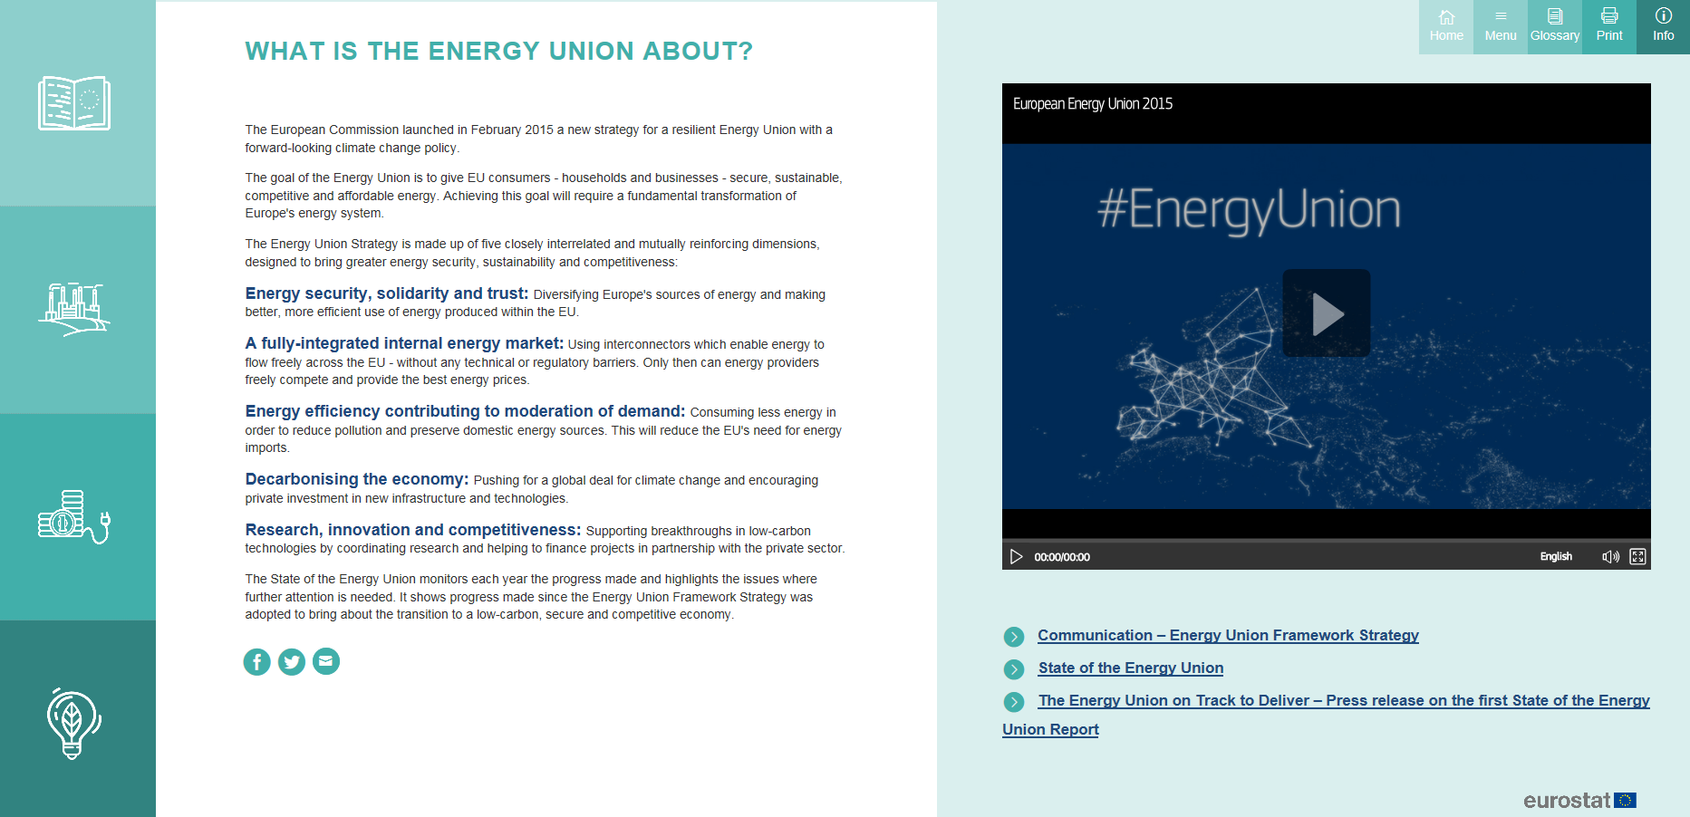
Policy background

Slide 9
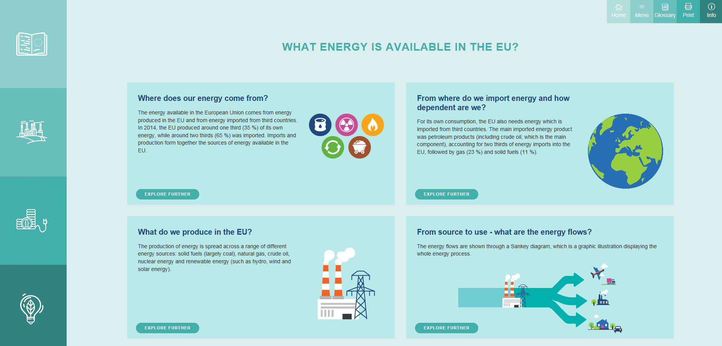
What energy is available in the EU?

Slide 10
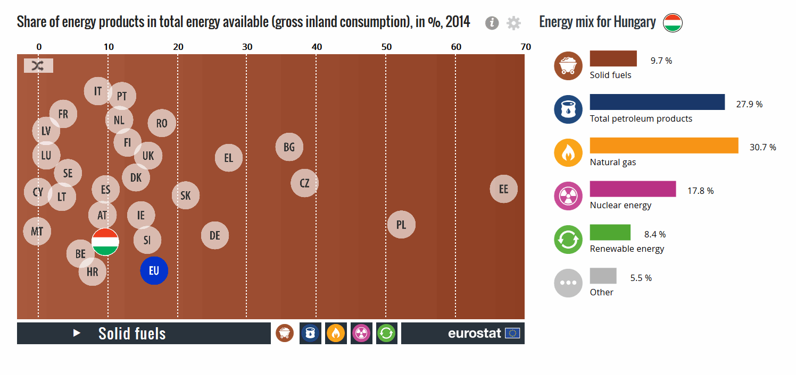
Interactive infographics

Slide 11

Photos

Slide 12
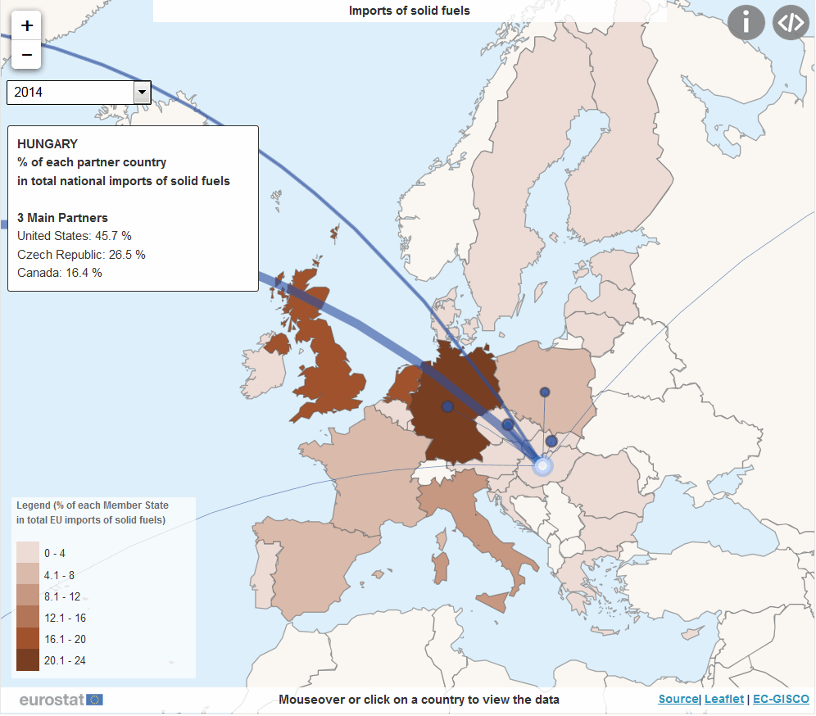
Flow maps

Slide 13

Energy flows (Sankey diagram)

Slide 14
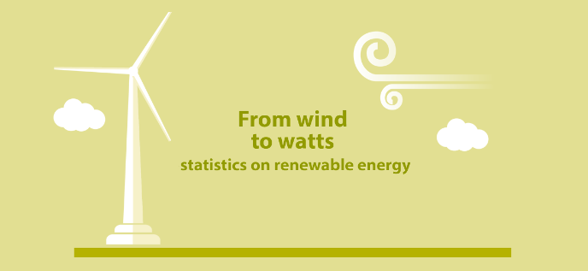
Animations

Slide 15
Impact in various media
Over 3 weeks (20 Sep – 12 Oct):
  457 Tweets
  39 mentions in other social media
  116 mentions in newspapers and blogs
  7110 visits on Eurostat website

Slide 16


The near future...
More digital publications to come:
- Women and men in the EU
- The Digital Single Market
- ... ?

Slide 17

Thank you for your attention!
Any questions?

