Slide 1
CESS 2016
Added-value dissemination services for data consumers
Peter Varga
Bloomberg
October 20th, 2016

Slide 2
CESS 2016
Agenda
  Bloomberg as a business
  Data processing/presentation
  Challenges - Future opportunities

Slide 3

CESS 2016
Bloomberg Professional

Slide 4
CESS 2016
Main Departments
  Data
  News
  Trading Systems
  Analytics
  Sales

Slide 5
CESS 2016
Data Processing
Timeliness/Accuracy
Source
Processing
Terminal
-email -automate acquisition
-website -mapping codes/metadata
-web services (SDMX) -quality control
-post to terminal
Goal – instantaneous publication of complete datasets without error

Slide 6
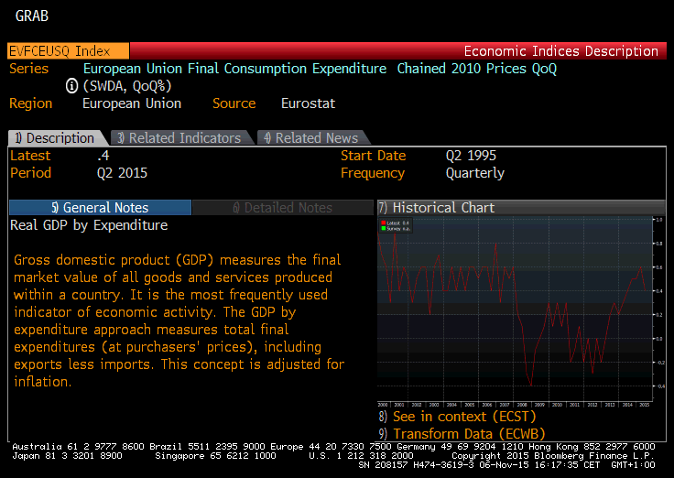
CESS 2016
Eurostat GDP – Final Consumption Expenditure of European Union description page
{EVFCEUSQ Index <GO>}
namq_10_gdp CLV_PCH_PRE,SWDA,P3,EU28

Slide 7
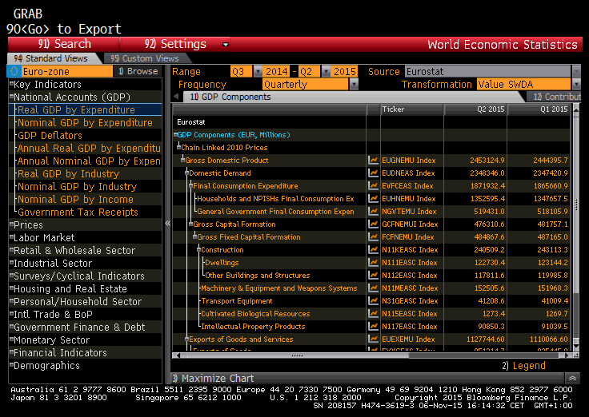
CESS 2016
Economic Statistics page
{ECST <GO>}

Slide 8
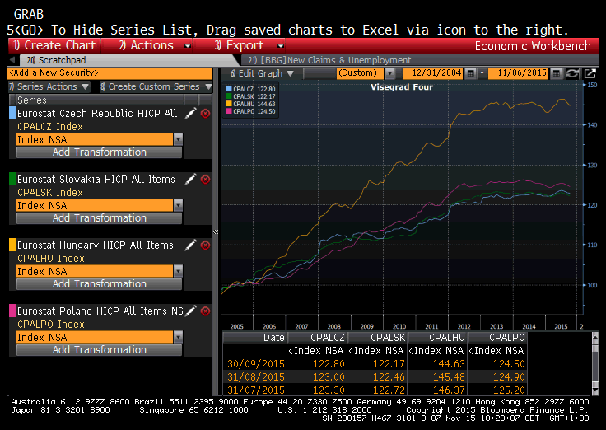
CESS 2016
Economic Workbench
{ECWB <GO>}

Slide 9
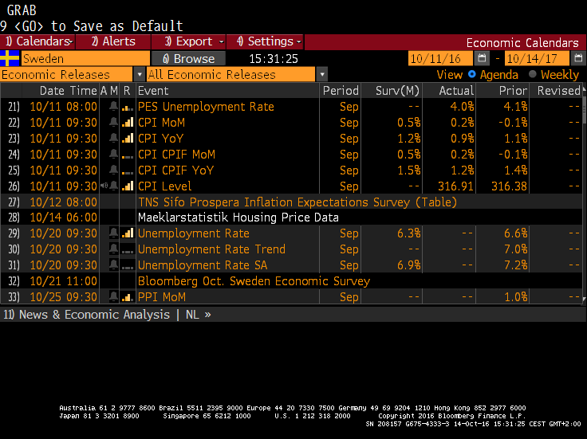
CESS 2016
Economic Statistics Calendar
{ECO SW <GO>}

Slide 10
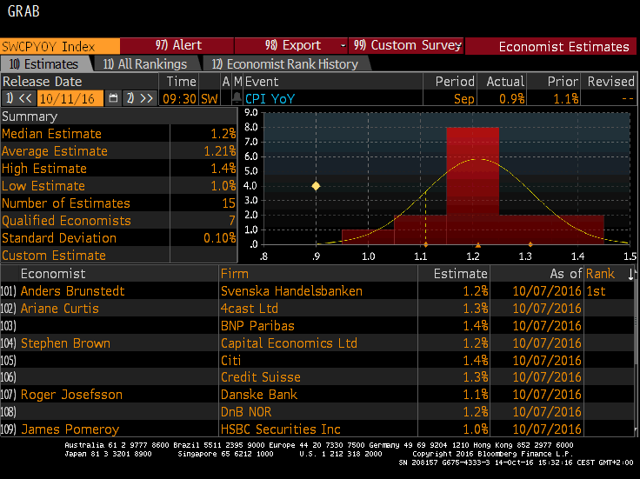
CESS 2016
Economist Estimates
{ECOS <GO>}

Slide 11
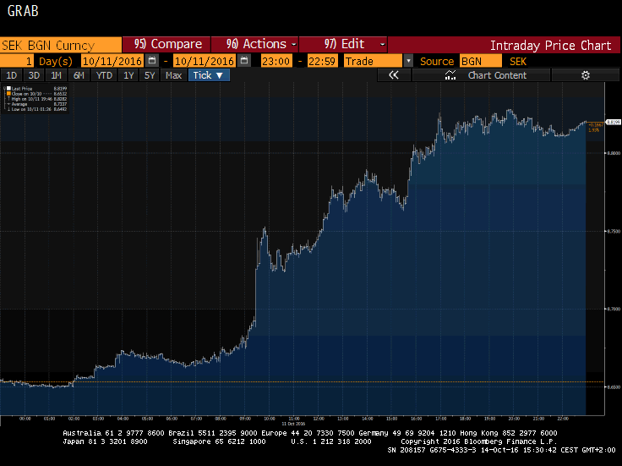
CESS 2016
Market impact on the Swedish Krona after inflation report
{SEK Curncy GIP <GO>}

Slide 12
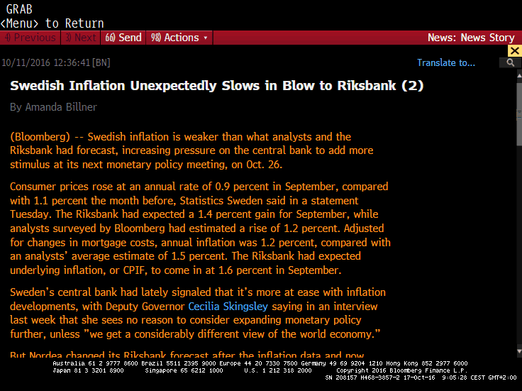
CESS 2016
News article on Swedish inflation
{TNI ECO SWEDEN <GO>}

Slide 13
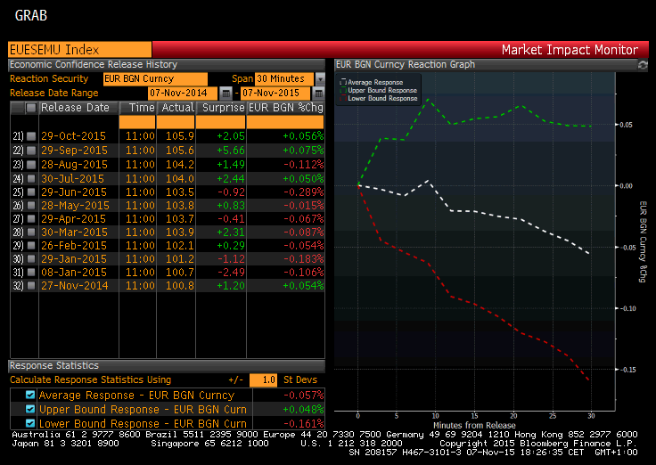
CESS 2016
Market Impact Monitor
{ECMI <GO>}

Slide 14
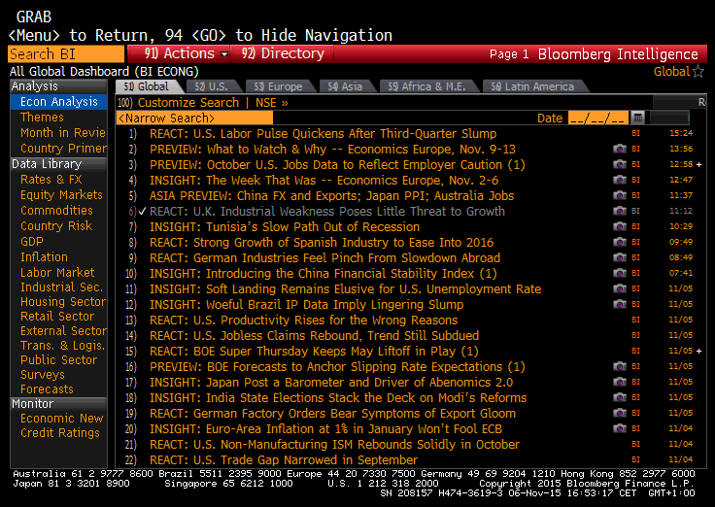
CESS 2016
Bloomberg Intelligence Global Economics Dashboard
{BI ECON <GO>}

Slide 15
CESS 2016
  Challenges - Future Opportunities
  Technical
  Communication
  Embargo system

Slide 16
CESS 2016
  Challenges - Future Opportunities
  Technical
        -be able to ping any frequency
        -no limit on download size
        -”UpdatedAfter” feature
        -real-time RSS dataflow notifications
        -adopt SDMX also towards the public – web services
        -cross reference data tables to database
  -interchangeable codes

Slide 17
CESS 2016
  Challenges - Future Opportunities
  Communication
        -English
        -neutrality, same time reporting, equal access
        -reliability, sticking time to reporting calendar
        -consistency of files, report if changes
        -standardized reporting, comparable data (IMF, time-lag)
        -commentary, “on record”, expert contact
        -workshops
        -notification system, timeliness
        -“blog” for data users

Slide 18
CESS 2016
  Challenges - Future Opportunities
  Embargo system
  -preparation enables accurate reporting at the time of the release
  -timeliness - market sensitive data
  -time to contact the source in case of discrepancy
  Without embargo:
  -data cannot be put in context - no background
  -drastically increases the chance of error - time pressure
  -fierce competition - overloaded servers at release times

Slide 19
CESS 2016
  Thank you!

