Slide 1
Conference of European Statistics Stakeholders
20-21 October 2016
Communicating through indicators
mariana.popova@ec.europa.eu
Eurostat

Slide 2
Eurostat methodological series on indicators
Part 2: Communicating through indicators
Part 3: Relevance of indicators for policy making
Part 1: Indicator typologies and terminologies
To be released in the Eurostat collection 'Manuals and guidelines' in November 2016
Aimed both at practitioners and ordinary citizens
Eurostat

Slide 3


Purpose and target audience of the paper
It is a discussion paper
It is not a manual with step-by-step instructions
Eurostat

Slide 4
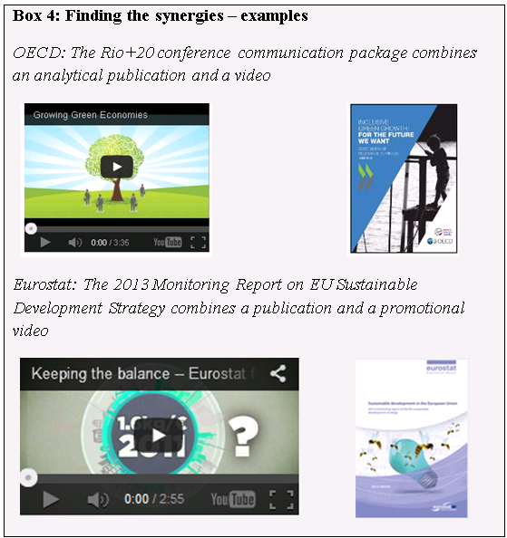
Approach followed
Inductive approach:
Concrete experiences of communicating through indicators…
…of Eurostat and other relevant national and international statistical institutions…
…analysed and summarised as case-studies
Eurostat

Slide 5
Structure
Categorisation through the two basic concepts of communication – linear information transmission and communication as an interactive exercise
How indicators 'use' the key elements of the two concepts of communication:
clarity of the message and the transparency of the communication channels (informational approach )
interactivity and context sensitivity (interactive communication approach)
Eurostat

Slide 6
Main content points
What is the role of the context?
When is communication through indicators more than just dissemination and why interactivity matters?
When to opt for interactive communication and when for linear information approach?
When do we need a public consultation on indicator sets?
Who are the users?
Which techniques to apply to be clear?
Indicators sets or composites? Are there ways between?
Eurostat

Slide 7


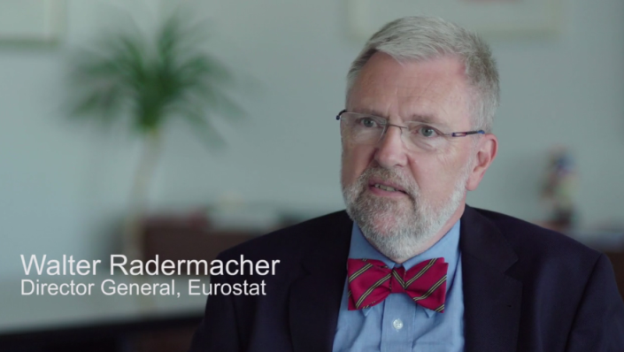
Example of Eurostat 2016 ‘Citizen package’
Publication
‘Figures for the future:
Sustainable
development
in our everyday lives.
A guide for citizens’
Videos
Eurostat

Slide 8

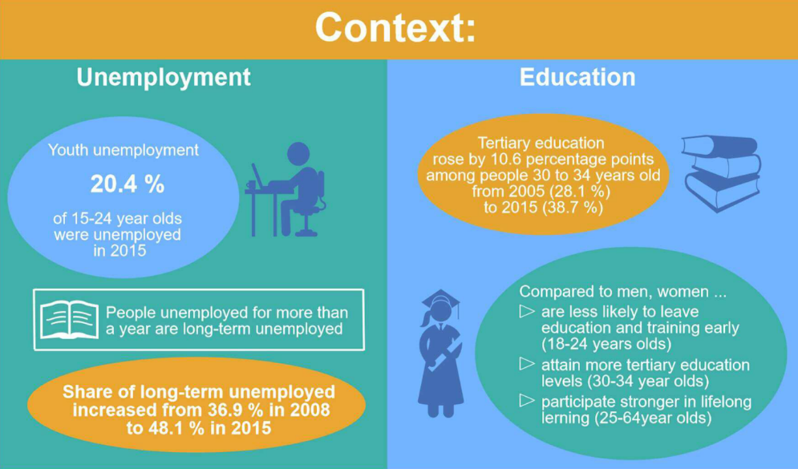
What is the approach?
Fictional character – young Anne and her closest environment of relatives and friends – centre of the story – relevance of indicators to everyday citizens lives
Cluster approach – the importance of the context for getting the message through
Eurostat

Slide 9

What about indicators and digital interactivity?
Anne is writing a blog about SDGs
Eurostat

Slide 10
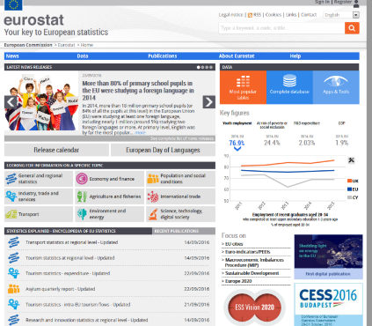
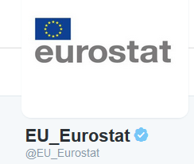
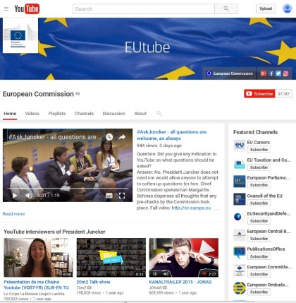
Eurostat following Anne in the digital world – dissemination planning
Citizens Package goes live on the 22nd November 2016 not only through a news release but also at:
Eurostat Twitter account – follow up stories in next 14 days
ESS Facebook account shared by NSIs on their accounts
EC Facebook (various accounts)
Videos on EUTube
Eurostat

Slide 11
Key messages and thank you for your attention!
Effective indicator-based communication is not only clear and precise but also relevant.
To this end it is highly recommended to make a full use of digital interactivity including online public consultations, digital dashboards, Twitter and Facebook accounts.
Eurostat

