Slide 1


Slide 2




ODISMET
Initiative promoted by the ONCE Foundation in 2014
Co-financed by the European Social Fund and supported by Spanish Government through Ministry of Employment and Social Security
Updated statistics on the situation of people with disabilities in Spain as regards to the labour market
Compliance with existing legal framework at national and international level (i.e. UN Convention on the Rights of Persons with Disabilities art. 31, etc.)
2

Slide 3
INFORMATION OFFERED
Online Observatory (www.odismet.es) gathering, analysing and visibilizing all existing statistical information (international, national, regional)
Databank with analysed indicators (55 basic and 17 interactive in 7 thematic areas)
Other products (database on labour inclusion policies and measures, virtual library, newsletters, periodical studies and annual reports)
Leaflet and infography: access to wide audience (specialized and general public)
3

Slide 4
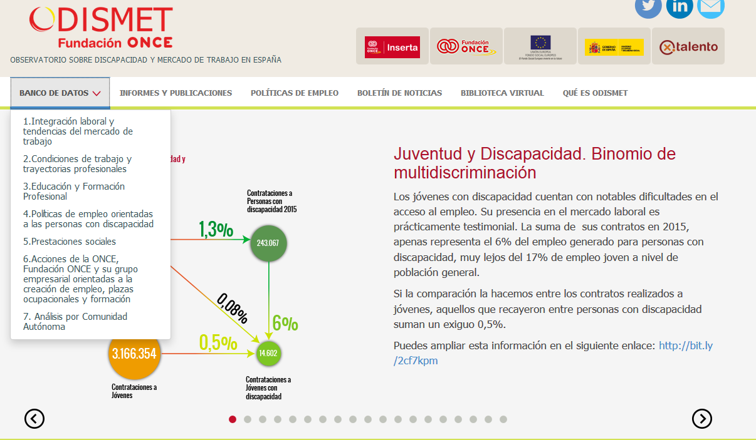
WEBSITE
4

Slide 5
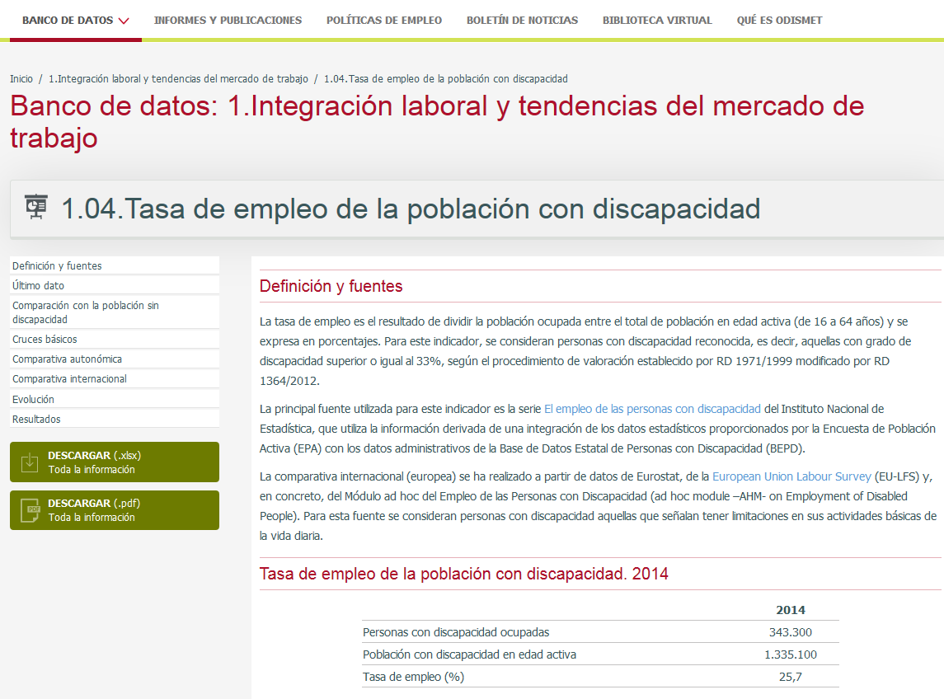
5

Slide 6
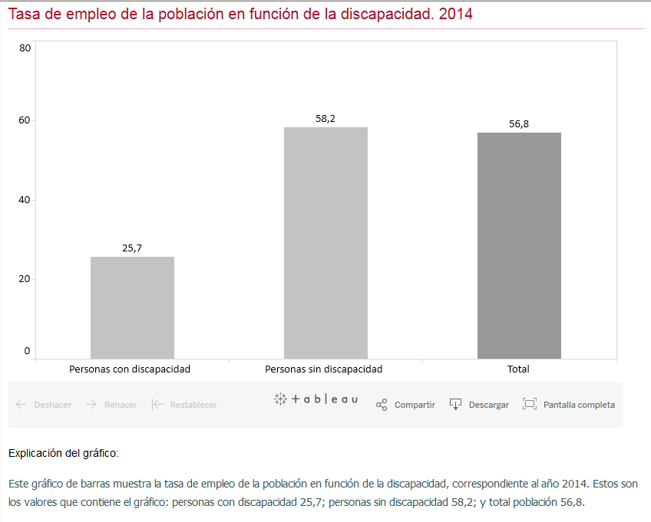
6

Slide 7
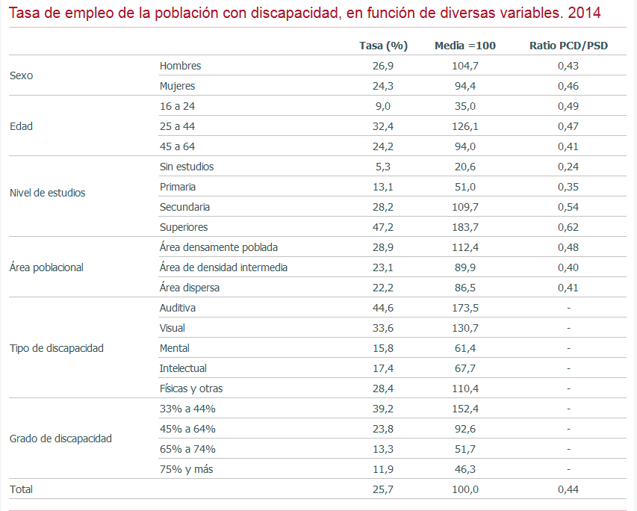
7

Slide 8
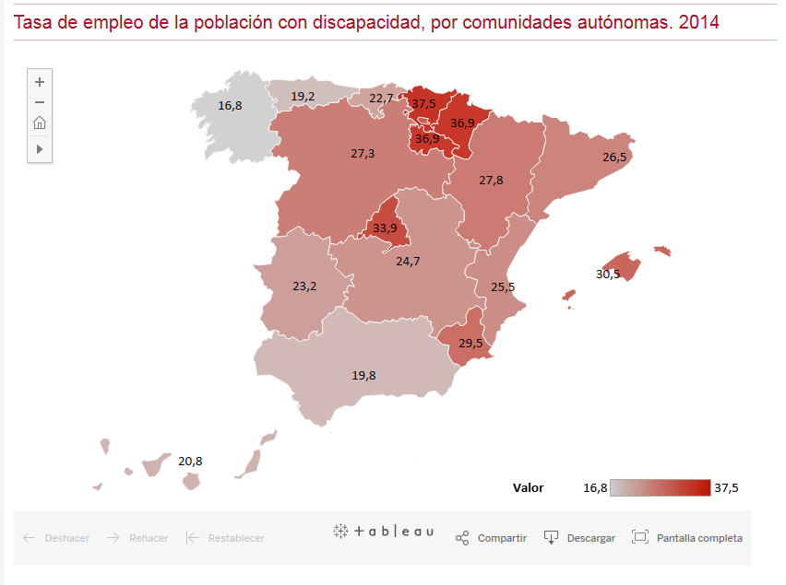
8

Slide 9
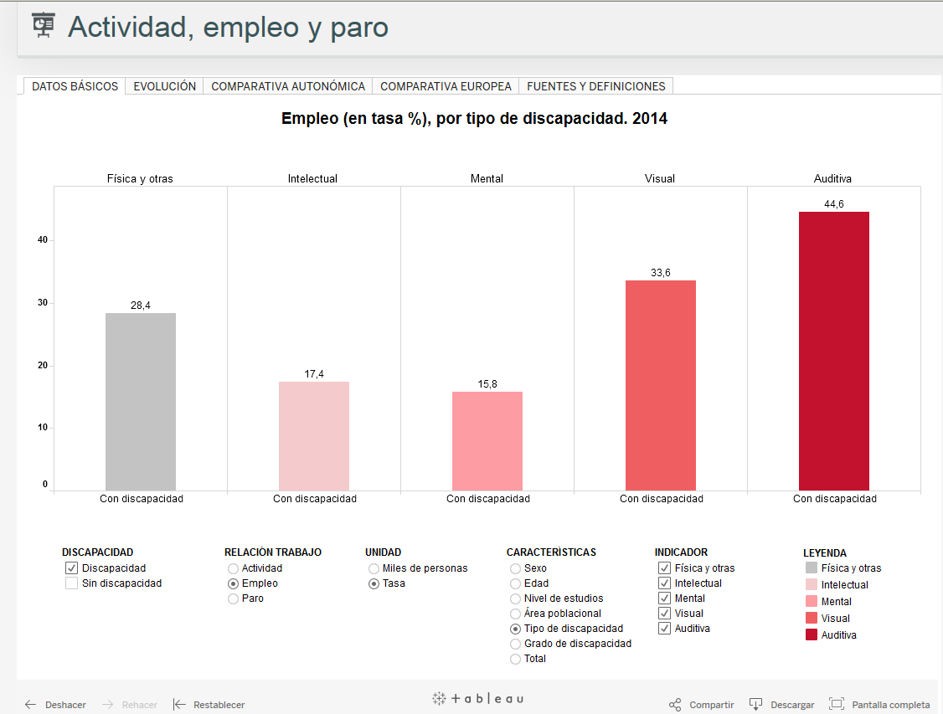
9

Slide 10
NEED ADDRESSED
People with disabilities face more difficulties and barriers to enter the labour market.
Measures and policies arisen in last few years fostered by international regulation and social movements.
No data or evidence available on results and impact of labour inclusion initiatives
Critical need for:
    Analysis in transversal way of employment trends and evolution of indicators
    Reliable statistical data
    Systematic analysis framework
10

Slide 11
PREVIOUS SITUATION
Many information sources available but only on specific aspects (partial); impossible to make a thorough analysis
Insufficient/non-existent updates (main statistical operation performed aprox. every 10 years)
Two types of sources: statistical data and administrative records. Two different ways of dealing with disability
Access to records not always easy
Disability lacking a stable conceptual identification
Statistics based on subjective self-perception of disability
11

Slide 12
KEY ASPECTS
Unprecedented initiative in Europe
Public-private partnership
Accessibility for all
12

Slide 13

PUBLIC-PRIVATE COLLABORATION
Main partner: INE (Spanish Statistical Office), public body with a legal power to require any administrative information
Long history of collaboration before ODISMET:
Information quality – Official information on degree and ty pe of disability (resulting from an objective professional assessment)
Sustainability granted due to INE’s agreements and fluent collaboration with Public Administrations (Institute for Older Persons and Social Services – IMSERSO)
Agreement for Pilot Statistical Project (origin of 47.3% of current indicators)
1986
1999
2008
2010
2011
13

Slide 14
MAIN DATA SOURCES
SEPE - Spanish Public Employment Service
INE
Spanish Statistical Office
Spanish Ministry of Education, Culture
and Sports
Annual Report on the Labour Market and People with Disabilities
Statistics on recruitment of People with Disabilities
Employment of People with Disabilities
Salaries of People with Disabilities
Survey on Social Inclusion and Health
Survey on living conditions
Labour Statistics Bulletin of the Ministry of Employment and Social Security
Annual Statistics of the Ministry of Employment and Social Security
Statistics on Non-University Studies
Eurostat
European Agency for Development in Special Needs Education
European Union Labour Survey
European Labour Market Policy Statistics
Statistics on Income and Living Conditions
Special Needs Education Country Data
14

Slide 15
ACCESSIBILITY
Design for All: AA Conformance to Web Content Accessibility Guidelines 1.0.
Every user (specialized or not):
  Public administrations in charge of employment policies and inclusion of people with disabilities
  3rd Sector entities working in social and labour initiatives
  Disability Movement
  Professionals in the disability sector
  Researchers, teachers and students
  The Media
  Companies interested in hiring people with disabilities
  People with disabilities themselves and their relatives
15

Slide 16
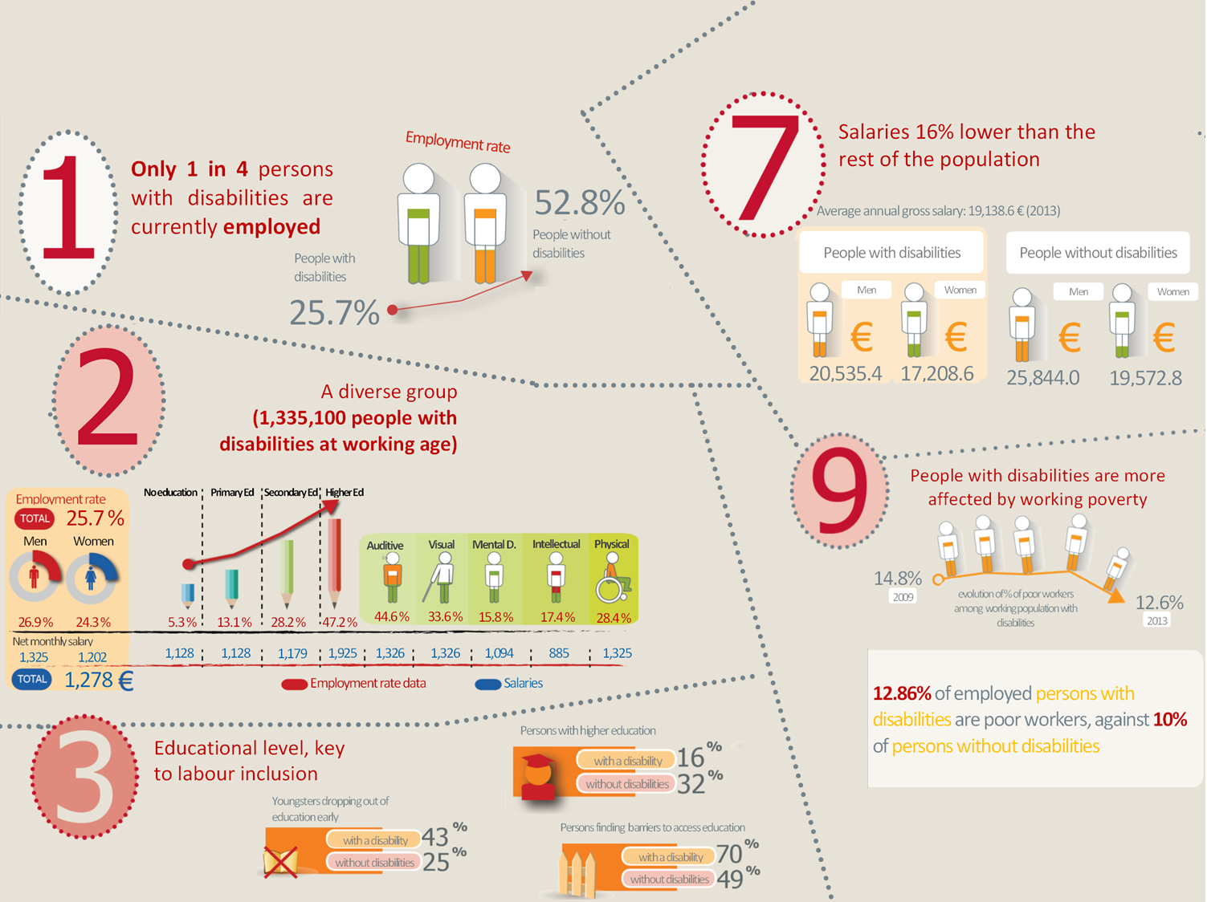
RESULTS
16

Slide 17
CONCLUSIONS - LESSONS LEARNT
Importance of involving the Public Body for Statistics
Huge initial effort needed to clean data from records
Essential collaboration with Administrations providing records and statistics
Systematic scheduling of reports
Automation of data update processes through TABLEAU SOFTWARE (Visual Business Intelligence) for data visualization and analysis.
Difficult comparability with other European Countries
17

Slide 18

Thank you!
Sabina Lobato
ONCE Foundation
slobato@fundaciononce.es
www.odismet.es
@Odismet

