Slide 1
Conference of European Statistics Stakeholders, Budapest, 20–21 October 2016
Towards more flexibility in responding to users’ needs
Obstacles, bottlenecks and options
Josef Richter October 2016 1

Slide 2
Conference of European Statistics Stakeholders, Budapest, 20–21 October 2016
Contents
Introduction
Obstacles and bottlenecks
Options
Conclusions
Josef Richter October 2016 2

Slide 3
Conference of European Statistics Stakeholders, Budapest, 20–21 October 2016
Introduction
Objectives of the European statistical programme 2013-17:
“The programme shall shall include the development of appropriate instruments resulting in enhanced quality, a greater flexibility of the ESS and the increased ability to satisfy users’ needs in a timely manner” (Article 4).
ESS Vision 2020:
“We have to become more efficient and make improvements in some key aspects such as timeliness, agility and flexibility”.
Josef Richter October 2016 3

Slide 4
Conference of European Statistics Stakeholders, Budapest, 20–21 October 2016
Introduction
FRIBS
“The flexibility of European business statistics should be improved to enable it to react to the changing economic environment and to provide a quick and timely response to emerging user needs” (Public consultation paper p. 2).
Means to increase flexibility according to the ESS Vision 2020:
Strengthening strategic alliances with both public and private partners in order to be more flexible.
Emphasis on new IT tools and methodological developments and on an improved dissemination and communication strategy.
Josef Richter October 2016 4

Slide 5
Conference of European Statistics Stakeholders, Budapest, 20–21 October 2016
Introduction
Are the lack of appropriate instruments and the need for developing an excellent dissemination and communication strategy really the key limiting factors in this context?
European statistics are based on legal acts and compulsory methodologies.
In the legal framework the ‘stove-pipe principle’ is omnipresent. Consistency and coherence between closely related statistical domains is often not guaranteed.
Major obstacles in reacting quickly to new needs are thus embodied in the legal framework on which statistics in Europe rest.
Josef Richter October 2016 5

Slide 6
Conference of European Statistics Stakeholders, Budapest, 20–21 October 2016
Obstacles and bottlenecks
A well-known bottleneck is the fact that it takes years to revise a Regulation.
The other key factors are general characteristics of the system such as
  the “output-orientation” of most legal acts and
  the lack of consistency across statistical domains.
The legal acts usually define minimum requirements.
In most cases Member States are free to collect additional data, offer more detailed results, etc.
A number of methodological manuals recommend ‘best practices’ and aim at a certain standardisation of processes.
Josef Richter October 2016 6

Slide 7
Conference of European Statistics Stakeholders, Budapest, 20–21 October 2016
Obstacles and bottlenecks
Output-orientation
The basic concepts of European statistics are usually laid down in Regulations.
Such concepts are:
  Statistical unit,
  Target population – scope,
  Classifications and their application (breakdowns, special aggregates).
Josef Richter October 2016 7

Slide 8
Conference of European Statistics Stakeholders, Budapest, 20–21 October 2016
Obstacles and bottlenecks
Output-orientation
The Regulations also include very specific and detailed provisions regarding the information which has to be transmitted:
  Variables and their definitions;
  Reference periods, periodicity;
  Availability of data, form of transmission;
  Quality requirements.
The legal acts define in a rather precise and detailed way, which kind of information has to be provided when and in which format.
Josef Richter October 2016 8

Slide 9
Conference of European Statistics Stakeholders, Budapest, 20–21 October 2016
Obstacles and bottlenecks
Output-orientation
Member States are usually free to decide which sources are to be used, which processes are to be applied. A typical formulation in a Regulation (abridged):
Member States may acquire the necessary data using a combination of the different sources specified below, applying the principle of administrative simplification:
      (a) Compulsory surveys;
      (b) Other sources which are at least equivalent as regards accuracy and quality;
      (c) Statistical estimation procedures, where some of the characteristics have not been observed for all of the units.
Josef Richter October 2016 9

Slide 10
Conference of European Statistics Stakeholders, Budapest, 20–21 October 2016
Obstacles and bottlenecks
Output-orientation
Because of the output-orientation many statistical projects are fit for the purpose of a single (often narrowly defined) analytical goal only.
If the data to be transmitted are based on sample surveys these surveys are “made to measure” surveys to meet the requirements laid down in a specific legal act, i.e. tailored according to a specific target population, a specific breakdown by economic activities and size classes.
It is difficult (often impossible) to re-use this information for other purposes.
Josef Richter October 2016 10

Slide 11
Conference of European Statistics Stakeholders, Budapest, 20–21 October 2016
Obstacles and bottlenecks
Lack of consistency across domains
The lack of consistency even across closely related statistical domains does not allow the combination of material from different statistical sources to answer emerging questions in a meaningful way quickly.
In the case of business statistics the lack of consistency is inter alia given with reference to
  Statistical units
  Target populations
  Breakdown by activities
  Breakdown by size classes
Josef Richter October 2016 11

Slide 12
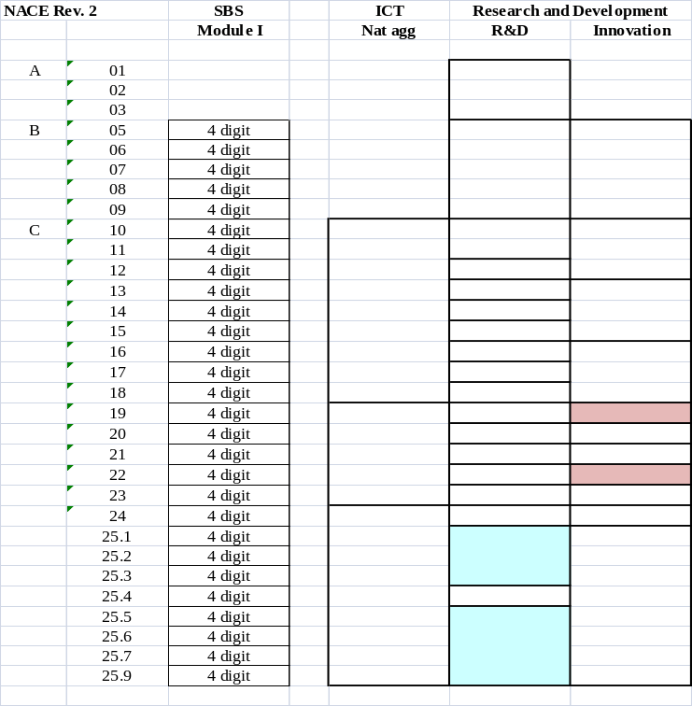
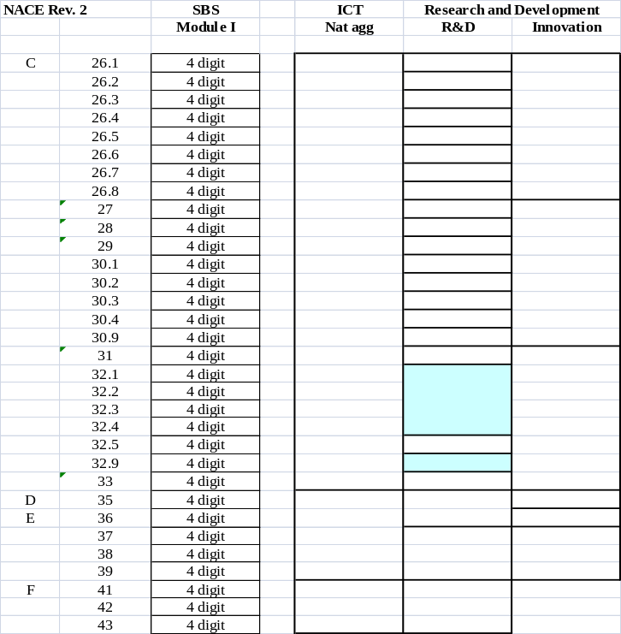
Conference of European Statistics Stakeholders, Budapest, 20–21 October 2016
Obstacles and bottlenecks
Lack of consistency across domains - Example: Present breakdown of annual enterprise statistics by NACE Rev. 2
Josef Richter October 2016 12

Slide 13
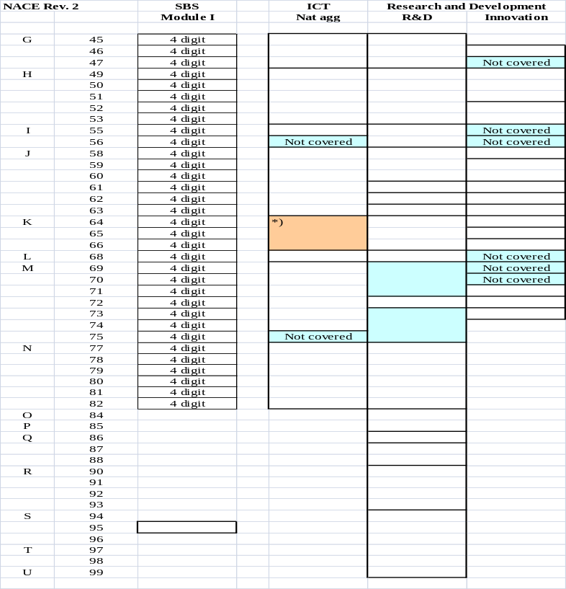
Conference of European Statistics Stakeholders, Budapest, 20–21 October 2016
Obstacles and bottlenecks
Lack of consistency across domains - Example: Present breakdown of annual enterprise statistics by NACE Rev. 2
Josef Richter October 2016 13

Slide 14
Conference of European Statistics Stakeholders, Budapest, 20–21 October 2016
Options
Farewell to the “stove-pipe principle” - the vision of integrated systems such as FRIBS.
Common concepts are a necessary but not a sufficient criterion.
Coherence and compatibility will only be given in the case of a certain harmonisation of processes.
Of particular importance:
  Identification of units
  Process of classifying units
  Maintenance of the statistical business registers
  Related statistical projects need to be based on the same version
  of the statistical business register
Josef Richter October 2016 14

Slide 15
Conference of European Statistics Stakeholders, Budapest, 20–21 October 2016
Options
Promotion of datawarehouse architectures to increase flexibility and to promote the re-use of existing information.
Closely related: strengthening the role of registers
Josef Richter October 2016 15

Slide 16
Conference of European Statistics Stakeholders, Budapest, 20–21 October 2016
Conclusions
Some progress towards more flexibility can be achieved by better IT tools.
Even more by methodological progress which is not only focused on a single process or a single statistical domain.
The key to more flexibility in responding to new users’ needs is a major revision in the legal basis and in the underlying principles.
The trade-off between the goal ‘more flexibility’ in responding to users’ needs and other objectives and principles needs to be taken seriously.
Josef Richter October 2016 16

Slide 17
Conference of European Statistics Stakeholders, Budapest, 20–21 October 2016
Conclusions
The coherent solution offering more flexibility is not necessarily the ‘best solution’ for a statistical project seen in an isolated way.
What is required is a clear hierarchy of objectives.
A system aiming at more flexibility in responding to new users’ needs cannot be based on a system which allows a lot of flexibility in producing European statistics.
Progress towards more flexibility is essential for the ESS.
When no major progress can be achieved other “data producers” will step in.
Josef Richter October 2016 17

Slide 18
Conference of European Statistics Stakeholders, Budapest, 20–21 October 2016
Thank you for your attention
josef.richter@aon.at
Josef Richter October 2016 18

