Slide 1
Monitoring health and well-being with survey research – reporting results for regional level decision making
Oona Pentala, Jukka Murto, Timo Koskela, Satu Helakorpi
Conference of European Statistics Stakeholders
Budapest, 20–21 October 2016

Slide 2
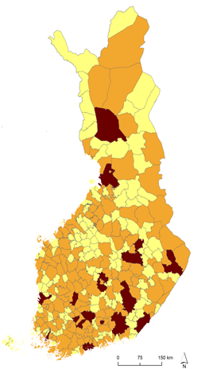

Survey description and purpose
Regional Health and Wellbeing study (ATH) is a questionnaire based survey for the adult population (20 years and upwards)
Created to answer both national and regional monitoring needs, includes information that can’t be obtained from registers
Power of regional data: Finland has 300+ municipalities that have broad responsibilities and authorities
5 498 450 residents
313 municipalities
18 counties
Number of respondents per municipality
Notes:
We have a survey called Regional Health and Wellbeing study, ATH from its finnish initials. It is a questionnaire based study for adult population
It started in 2010 in order to answer both national and regional monitoring needs since there is a lot of information that authorities need but that we cant find from registers such as living habits of residents and unmet need of social or healthcare services. So we are trying to fill in the hole in the information stream fro decision-makers
The questionnaire content is very similar to European Health interview survey with national approach
We aim to serve all different area types of Finland with our data: Finland is a big country when it comes to the number of municipalities – with 5,5 million resident we have over 300 municipalities that have broad responsibilities and authorities. For example, municipalities have to monitor their residents health and wellbeing somehow and this they have to do by law.
You can see the map of municipalities there – as you can see there is a great variation in size and location, municipalities are very different.

Slide 3
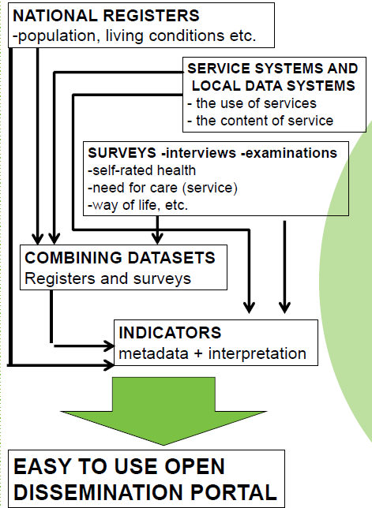
Data gathering and validating process
2013-2015 sample size 170 000 results by sociodemographic groups for municipalities with population of 30 000 and over
XML formats, questionnaires both internet and paper, optical scan, logical validity checks
Register linkage: gender, age, education, living area, marital status, household size etc.
Nonresponse adjustment with Inverse probability weighting
Notes:
Starting from 2013 we have asked over 170000 Finns to answer our survey. This means that we can reliably provide results by sociodemographic groups such as age, gender and education level for all the municipalities that have 30 000 residents or over. With smaller ones we aim to provide at least one result per topic that covers the municipalities populations as whole.
Our data gathering process is quite highly tuned: we use XML formats to create both paper and internet questionnaire, and use those XML formats for saving and checking the data. We are lucky to be Able to use national registers and unique personal identification codes so we also link some registers to our survey data.
We of course have faced the problem of nonresponse, our overall response rate is 54 % at the moment. We adjust that nonresponse bias with inverse probability weighting where we use register information for both the nonrespondents and respondents and we have found this quite efficient.
Our whole process is shortly described on the right and next I’ll focus a bit more on our reporting process

Slide 4
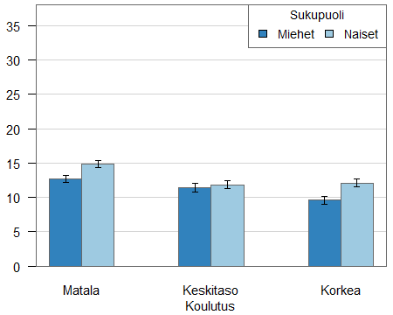
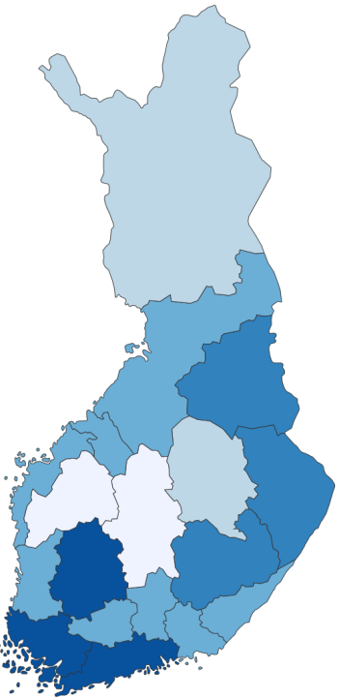
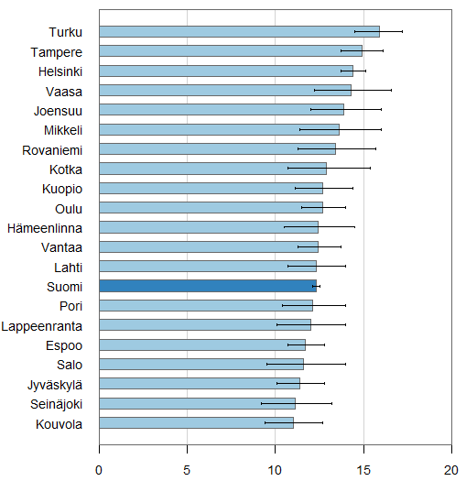
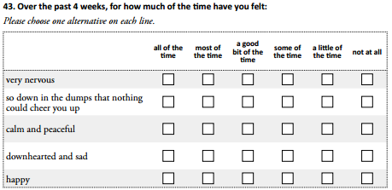
Reporting process
Proportion of population suffering from severe mental strain (%)
By education level and gender
From data to indicators, tables, plots, metadata
METADATA for indicator
Data content
Interpretation
Restrictions
Literature
Who to contact
Survey data
Register data
Classifications
Calculations
Metadata written by topic experts
Proportion of population suffering from severe mental strain (%)
Cities with over 50 000 residents
Mental Health Inventory MHI-5
Notes:
So we start from the bottom left, we have Mental health inventory question in the questionnaire and saved data from respondents. This is a globally used instrument that has good documentation so we can calculate every respondents score and create an indicators which tells if the respondents score is higher than the limit calculated for severe mental strain.
Turn it into an indicator
Combined with register data we can adjust the nonresponse bias and calculate weighted estimates and create plots and maps from those estimates as you can see on the right side of the slide
We also ask experts from our institute to write metadata for the indicator answering questions like: what does severe mental strain mean? What can cause it? What can it cause? How local authorities can help making the situation better? In some indicators we even have an estimate, how much costs certain indicator result can cause to the area. This can help decision-makers to grasp

Slide 5
Results in online services
  Our Health (terveytemme.fi) (available only in Finnish)
    Based on survey-data
    Presents population health and well-being indicators by interactive maps, graphs and tables
    Indicator results with confidence limits allow reliable comparisons between regions and population groups
    Contains also metadata descriptions
    Easy way to find effective plots and copy them to e.g. presentations
  SOTKAnet Statistical and Indicator Bank (sotkanet.fi)
    About 2 300 indicators and their metadata, also register data
    In 3 languages: Finnish, Swedish, English
    Mostly only tables or line graphs
    Data available also via open interface
  Welfare Compass (hyvinvointikompassi.fi)
    Contains a collection of 100 key indicators, which give an overview of the situation in the region and enables comparison between regions
    Collects data from SOTKAnet-database
Notes:
Due to historical reasons at the moment we have 3 different online services that our results are reported into:
Mainly we use service called our health which gives us an opprtunity to create plots and interactive maps easily. This is the most used service among decision-makers and I will show you later on why
Sotkanet database is broad indicator bank where the data is available as tables and via open interface so it is open data. From this database the results go automatically to different applications such as the municipality’s health and welfare report that they have to do every 4 years.
Welfare compass is a service which has a collection of 100 most important indicators per region. It is an easier way to get a good overview of the area’s situation without getting into too much detail.

Slide 6
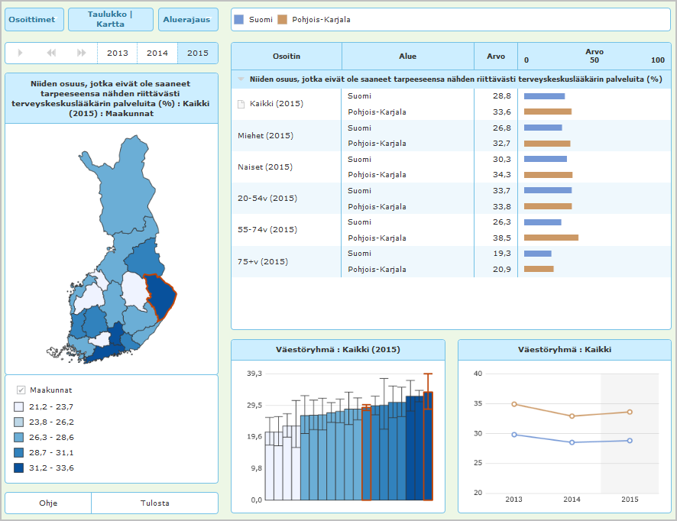
For monitoring regional and socioeconomic health inequalities
’Our Health’ (Terveytemme.fi)
Allows health inequality monitoring by region, age groups, gender and socioeconomic groups (education level)
Presents population health and well-being indicators by interactive maps, graphs and tables
Currently available only in Finnish
www.terveytemme.fi
Notes:
- These are examples from the Our health service which we have developed together with decision-makers

Slide 7
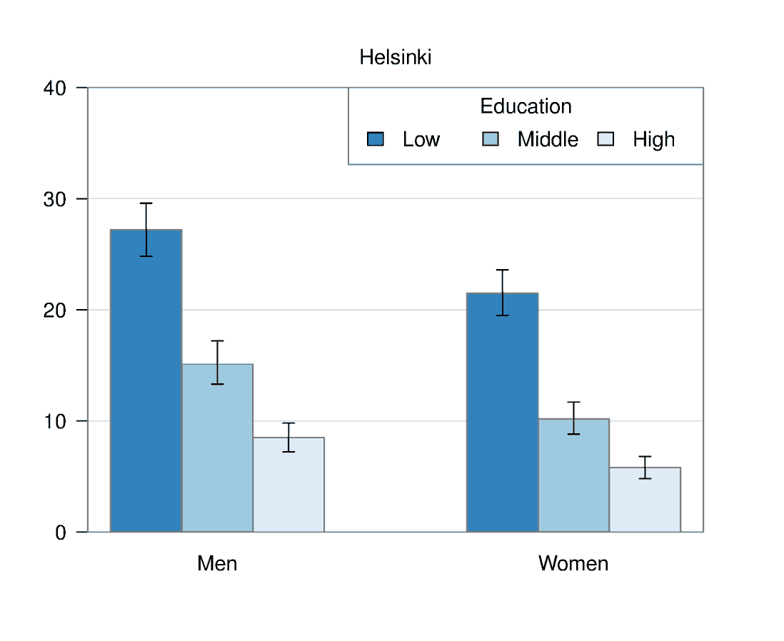
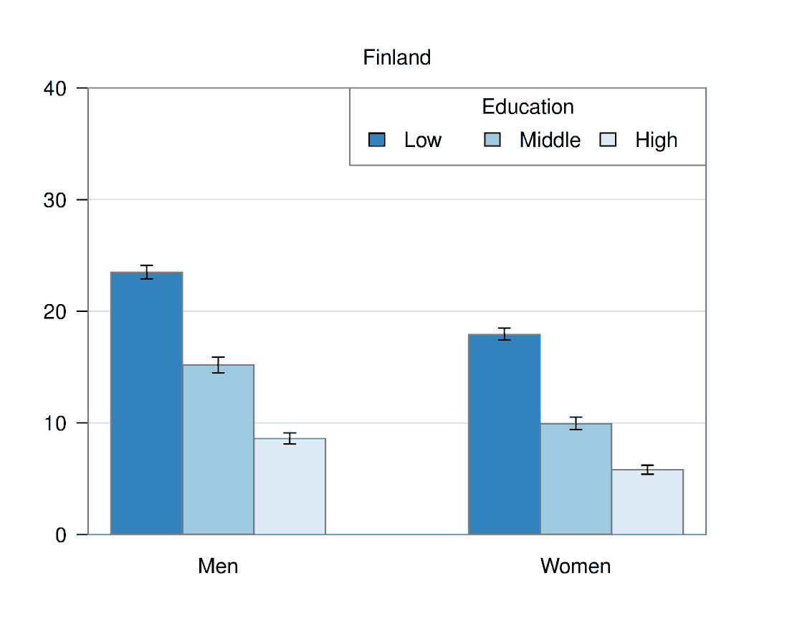
Examples: Daily smokers (%)
In Helsinki, the number of daily smokers is higher in men and in lower educational groups
than in Finland on average. 37% of men with lower education are daily smokers in
Helsinki when in Finland on average only 24% of men with lower education are daily
smokers.
Metadata: The annual cost of treating smoking-related illnesses is equal at least to the work
input of an entire central hospital. Finland has 16 central hospitals.

Slide 8
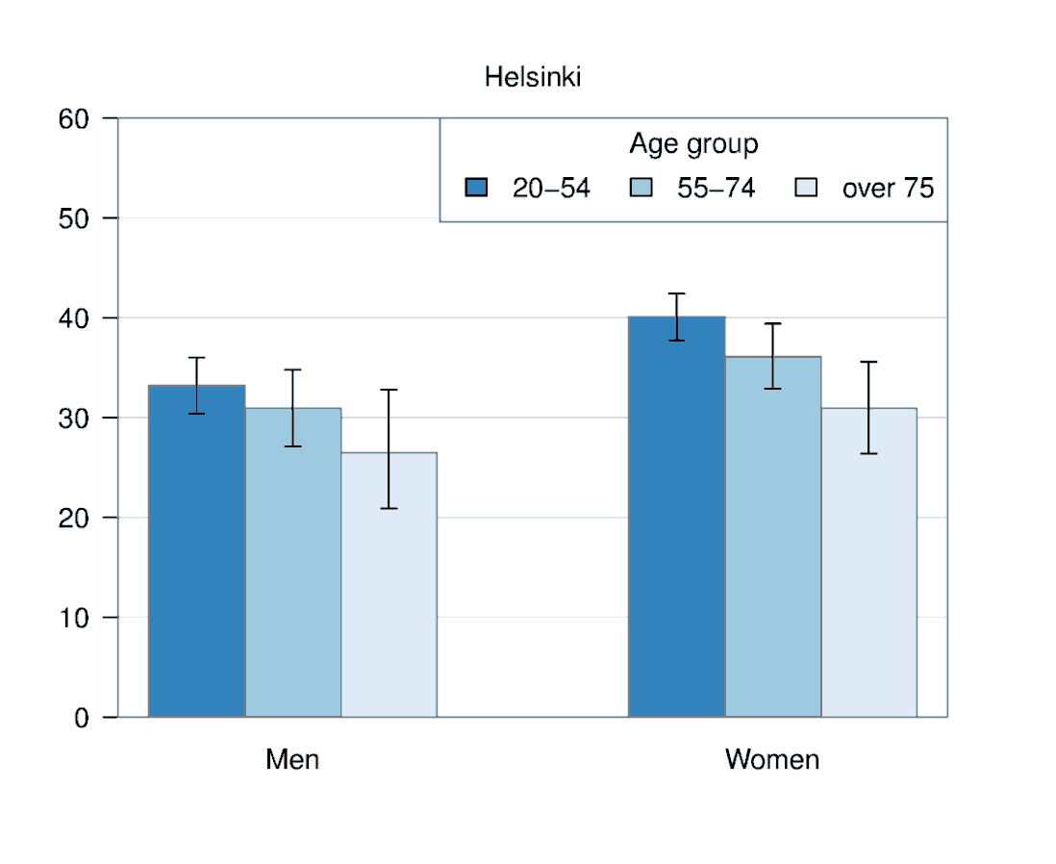
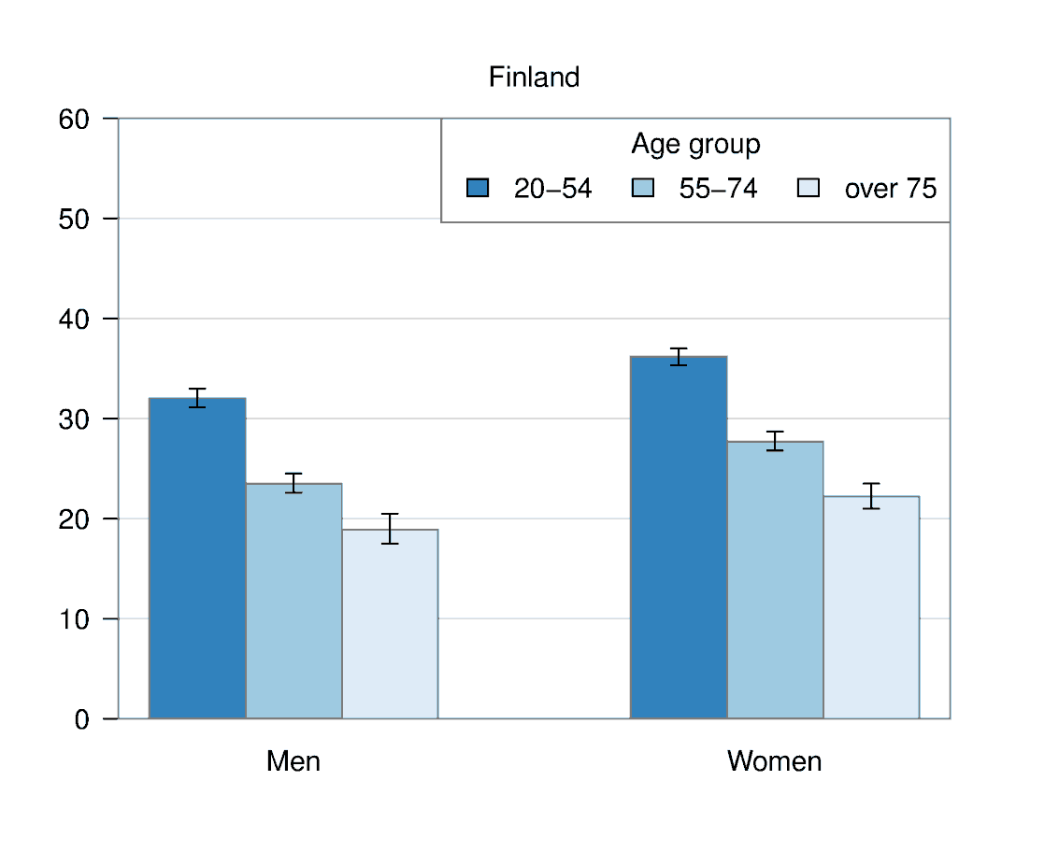
Examples: Unmet need of doctors services in public healthcare (%)
In general there is more unmet need of doctors services in Helsinki than in
Finland, especially in the older age groups. Overall there is more unmet need in the
age group of 20 to 54.
Metadata: Unmet need means that the respondent has not received the service when needed
or the service has not been adequate enough.

Slide 9
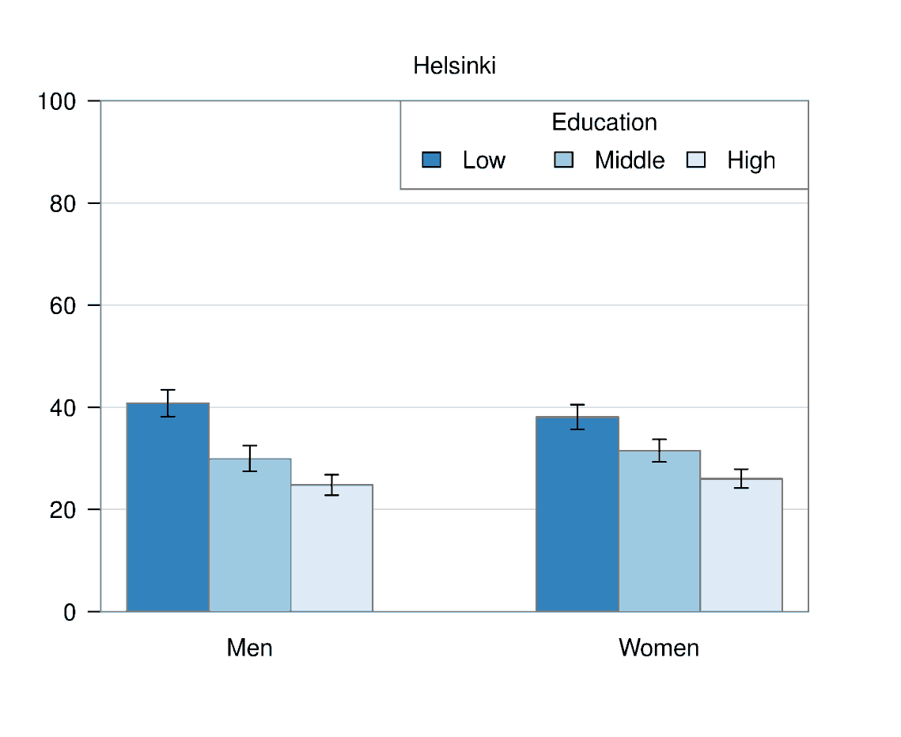
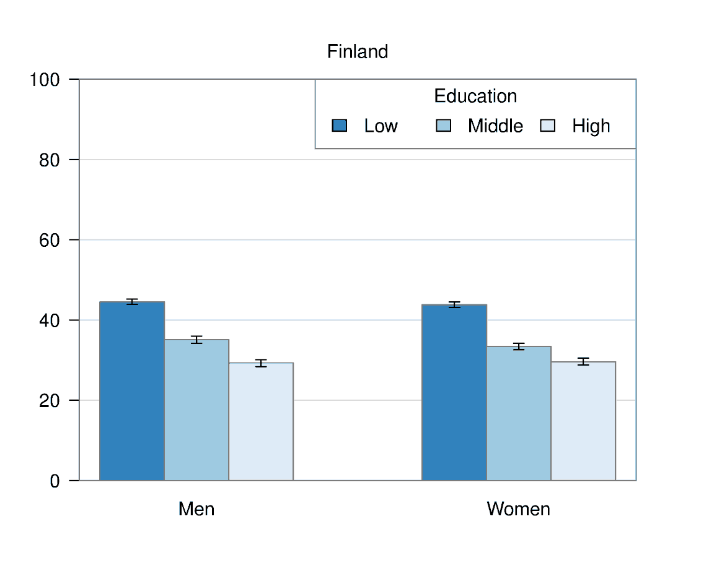
Examples: Self-rated health moderate or worse (%)
It seems to be that lower education associates with poor self-rated health in both
Helsinki and Finland.
Metadata: Poor perceived state of health in the population reflects the high incidence of illnesses,
symptoms and restrictions on functional capacity that increase the use of health care and social
welfare services and decrease the length of working life and life expectancy.
Notes:
- In Helsinki low-educated men stand out from the other groups although overall men in Helsinki seem to have better self-rated health than Finnish men in general.
- All the numbers that go into creating these plots are available also as Excel or csv files so if the user has resources, they can take the numbers and create their own graphs

Slide 10
How do we get the authorities to use our results?
We provide
  Easy to access online service
  Easy to understand plots and maps
  Interpretation of the results with metadata
  Comparable results among areas and sociodemographic groups
  Applications; what areas have done with our results
  Sustained data for monitoring
We do
  Marketing; locally and nationally, also try to get media attention
  Training; our experts teach how to use our online services
  Collaboration; we constantly use wide networks: local authorities, counties, hospital districts, third sector
  Developing; we ask and listen our ‘clients’ how to develop our services
Notes:
Comparable: get decision-makers to ask why is our area so different? Where we should allocate our resources?

Slide 11
Key messages
Finland is a versatile and big country in terms of number of municipalities;
  National guidance is not powerful enough to affect local decision making, local data is more effective
It is not enough to just collect and report;
  Decision makers need marketing and educating in order to start using our results
National and/or local media plays an important role;
  Headlines based on our results will also get the attention of policy-makers
It is useful to share good practices of information-based decision making among municipalities
  Showing what another municipality has been able to do with our results will almost always result in better comprehension
Notes:
Media: residents are aware of the results, they will start questioning the decision-makers. Decision makers have to be on top of the discussion they need more information

Slide 12
Thank you!
More information:
www.thl.fi/ath
www.terveytemme.fi/ath
https://www.sotkanet.fi/sotkanet/en/index
Oona Pentala / oona.pentala@thl.fi

