Slide 1



Engaging with users
The ONS website – user research and developing personas
John Lewis - User Researcher
: john.lewis@ons.gov.uk
: @JohnLewisONS
: /johnlewisONS

Slide 2
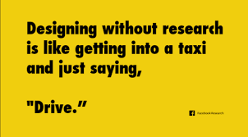
What is User research
If you understand your users’ circumstances, influences and expectations, it will help you design a service that’s easy to use and valued by the people who need it.
Unlike market research, you need to work out how your users think and behave rather than find out what they like or think they want.
Government Digital Service (GDS)
Notes:
It’s about understanding user’s needs

Slide 3
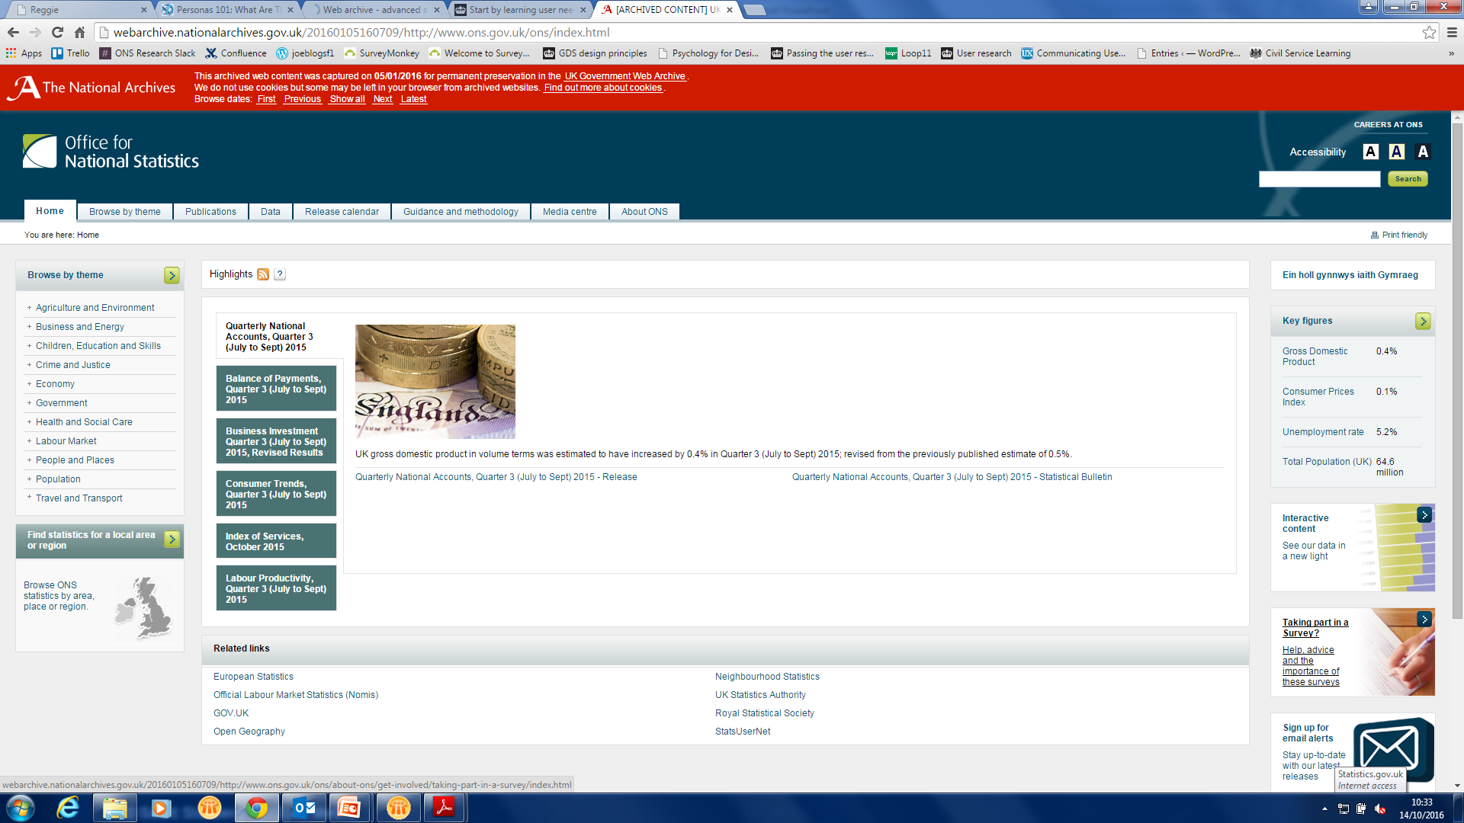
The ONS website

Slide 4
What we did
1. Online user survey
2. Contextual interviews
3. Observations – Lab based user research
4. Multiple Correspondence Analysis (MCA)*
5. Development of personas for the ONS website
*We contracted a company to do this

Slide 5
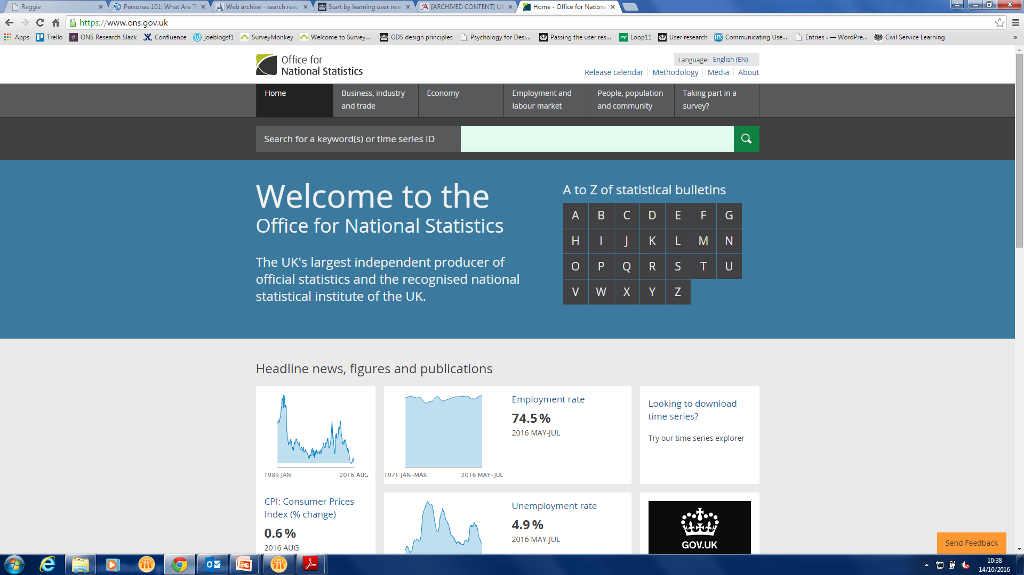
The ONS website
Notes:
Script this slide – less clutter, easier to find content, feedback button in bottom right corner – to assist with further developments and highlight unknown problems users might be having

Slide 6

Personas
Fictional characters based on real life observations
They help focus and prioritise decisions and design choices by providing a link to the real world
What information users need
Why they need it
What they do with it
Notes:
Run through the other information you can use to develop personas

Slide 7
Benefits of personas
Identify gaps and opportunities
Ability to test, validate and prioritise ideas throughout development
Provide a focus and common understanding of the customer
Empathise with the user – their behaviour, goals and expectations
A reference tool that can be used for implementation and future strategy
Reduces time and cost needed to obtain user requirements
Notes:
Script this slide
Identify opportunities and product gaps to drive strategy
Provide a quick and cheap way to test, validate and prioritise ideas throughout development
Give focus to projects by building a common understanding of customers across teams
Help development teams empathize with users, including their behaviours, goals, and expectations
Serve as a reference tool that can be used from strategy through to implementation
Replacing the need to canvass an entire user community, significantly reducing time and cost needed to obtain user requirements
Concentrating on designing for a manageable target who represents a larger group
Personas are model users that the team creates to help understand the goals, motivations, and behaviors of the people who will use the interface. The persona represents behavior patterns, helping the designer understand the flow of the user’s day and how the interface will fit into it.
It’s not about what a person likes and dislikes!
Personas are able to provide details to important questions that a "user" cannot define.
Which information is necessary at which point of the day?
Is the user concentrating on only one thing at a time?
Does the user have frequent interruptions during their experience?
Why is he/she using the product?
What motivates him/her to use this specific product over a competitor's?
By using a persona to answer these questions, product design teams can actually be in the user's shoes, and can better meet a real user's needs and wants. Personas are not what people tell you about themselves; they are observations and descriptions of why (motivation) a person does what he/she does.

Slide 8

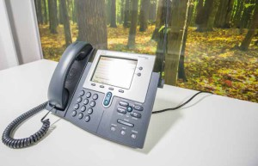
How we did it
Online survey, sent out across social media, email and advertised on the website
399 responses
Follow up telephone interviews with survey respondents
Notes:
How often they accessed the site
What type of data they looked for
Are they social media users
Their job
Age
Technology use
What file types they use – pdf, excel etc.
How they search for information
Display preferences – written reports, infographics etc.
How urgently they need the data
Also offered free text boxes for any comments/feedback they wanted to leave.
Follow up telephone interviews were held with a selection of those who responded to the survey

Slide 9
Findings: Persona key goals
The Expert Analyst | The Information Forager | The Inquiring Citizen
Find a particular Excel spreadsheet to download, without being distracted by similar-sounding information | Looking for data that can be used to make practical, strategic decisions for her business | Finding out the unbiased ‘truth’ about information presented by the media and political parties
Cut and paste data from spreadsheets into own statistical models and analyses | To see high level summaries, narratives and key charts that provide context for deeper understanding | Finding out about economic indicators such as RPI in order to be able to make informed decisions about pensions and investments
Viewing all versions of a particular dataset | Occasionally downloads datasets for simple analysis if necessary | See charts and infographics to get visually engaging overview of key data and trends
Sometimes uses a reference code to search for datasets | Wants to keep up to date with latest economic and population data | Wants to find simply worded, high level summaries and narratives of newsworthy issues
Create a bespoke dataset, tailored to exactly to support the statistical models he is creating
Notes:
Script this slide!

Slide 10
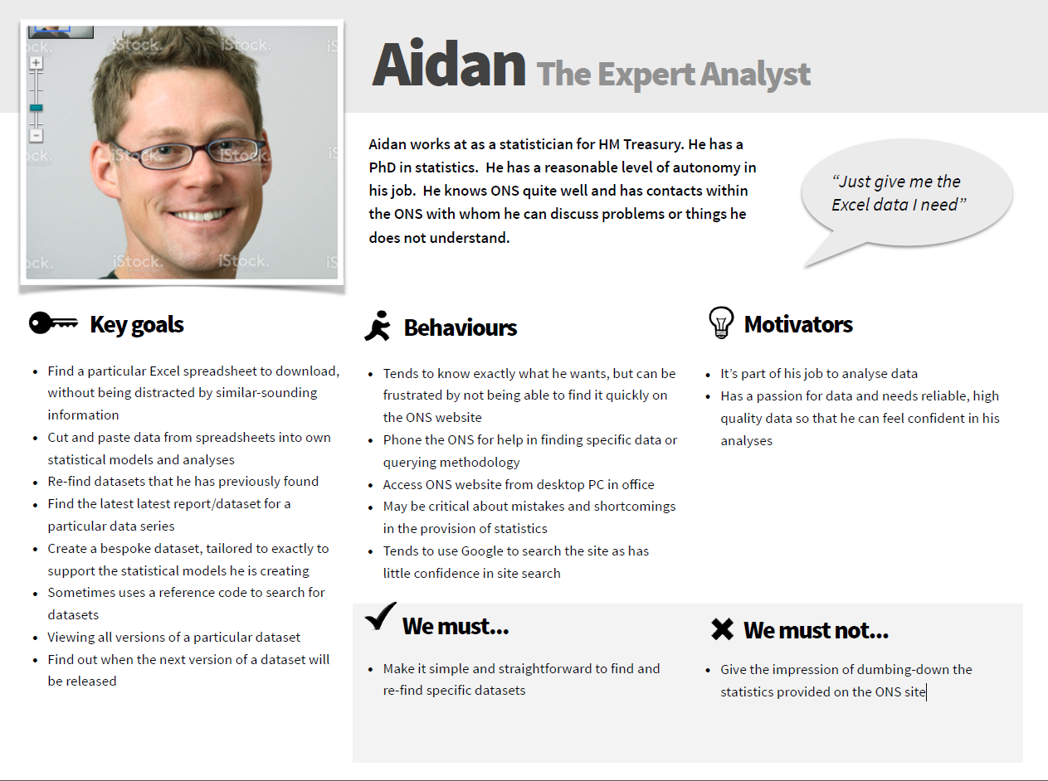
ONS Persona - Expert Analyst
Notes:
Script this slide – what are the key points of the Expert Analyst persona???

Slide 11
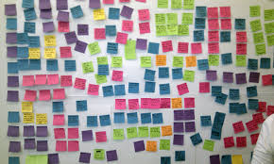
How we use our personas
Further research and testing:
Provided a better understanding of our users
Needs of our various users are considered when building new services/products
Work to be prioritised based on the type of user the product is aimed at
Ability to develop products that users want/need and test them with appropriate user types
One product doesn’t necessarily fit all, but this knowledge has enabled us to tailor specific products and our associated websites to the needs of the most likely user types
Notes:
Ensures the needs of our various users are considered when building new services/products
Allows work to be prioritised based on the type of user the product is aimed at
Given us a better understanding of our users, giving the ability to develop products that users want/need and test them with appropriate user types
One-product doesn’t necessarily fit all, but this knowledge has enabled us to tailor specific products and our associated websites to the needs of the most likely user types

Slide 12
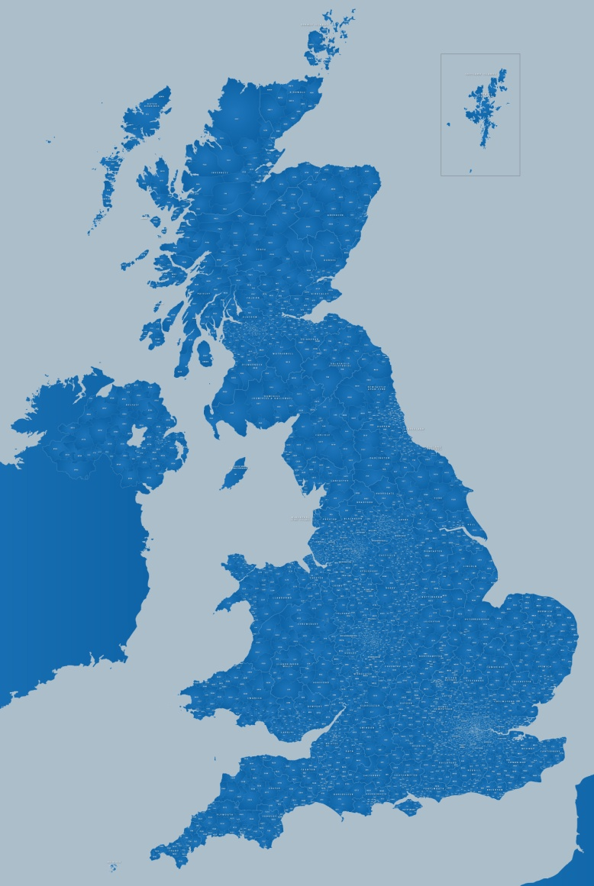
Testing around the country
Newcastle
Leeds
Liverpool
Birmingham
Newport
Cardiff
London
Notes:
Info about the fact we went around the country – not just near the office and London – to ensure we captured the a full account of what users needed, not just what London users needed.

Slide 13
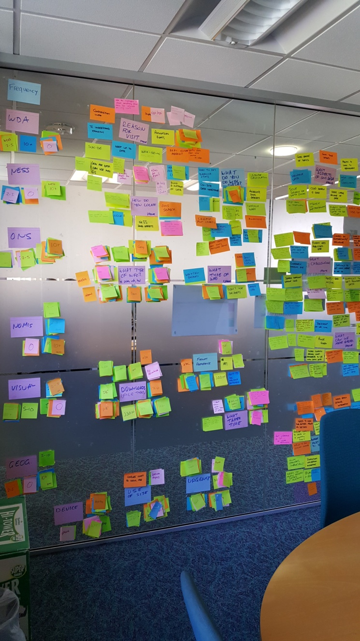
Continuing our work on our personas
When you’ve created personas the work doesn’t stop there
Things can change
Need to review and re-assess your users/personas
Notes:
Script this page – more detail about we’ve done with personas
Assumption, research and development of new personas – why?

Slide 14
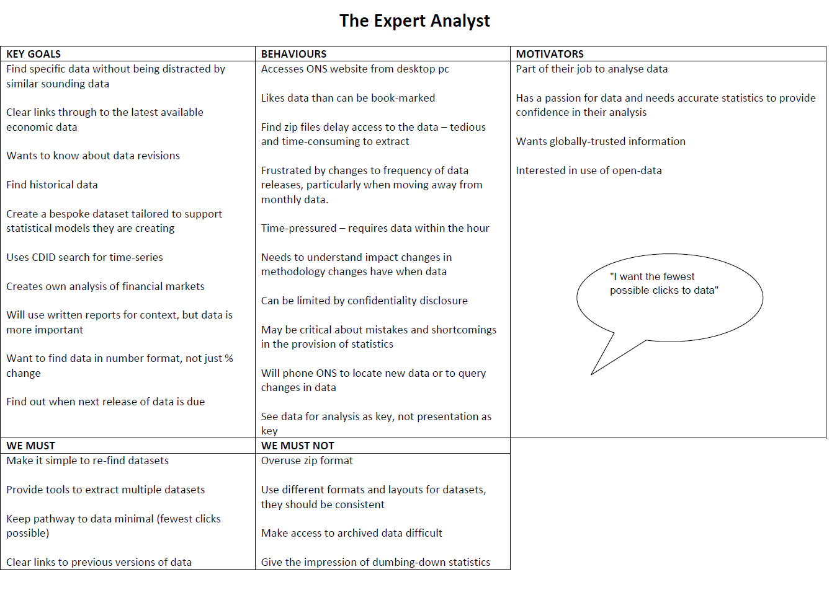
What’s next
The ‘Technical Expert’
Notes:
Script this slide – what are the main differences with the new persona

Slide 15

Lessons learned
Don’t underestimate how much time developing personas can take
Time spent on user research will reduce the time spent on the wrong things further down the line
If the user is having a problem, it’s our problem
Steve Jobs

Slide 16

The End…

