Slide 1
Strategies of the CSO of Poland for increasing competence in various users groups
Ewa Czumaj
Central Statistical Office of Poland

Slide 2
Democracy can flourish only if citizens know what is going on, and are able to participate fully.
White Paper on a European Communication Policy; Brussels, 1.2.2006 COM(2006)35 final
Information and knowledge are fundamental building blocks for all modern societies.
ESS VISION 2020

Slide 3
Agenda
Main CSO strategic documents concerning cooperation with users
Communication Strategy of Official Statistics
Concept of Statistical Education System
Selected CSO actions toward improving competence of users
STRATEG - Monitoring development system
Knowlegde sharing about international initiatives
ESS Vision 2020 including DIGICOM project
Bookmark for Sustainable Development

Slide 4
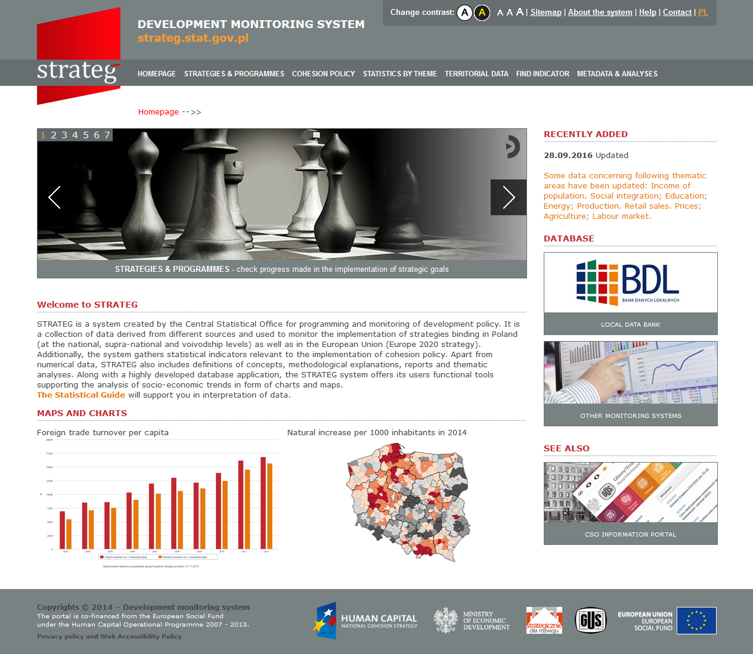
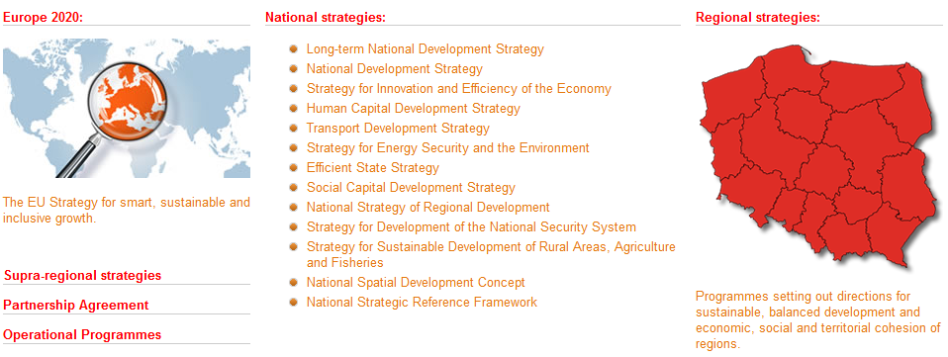
STRATEG –
DEVELOPMENT
MONITORING SYSTEM
database
visualisation tool
rich set of metadata
http://strateg.stat.gov.pl

Slide 5
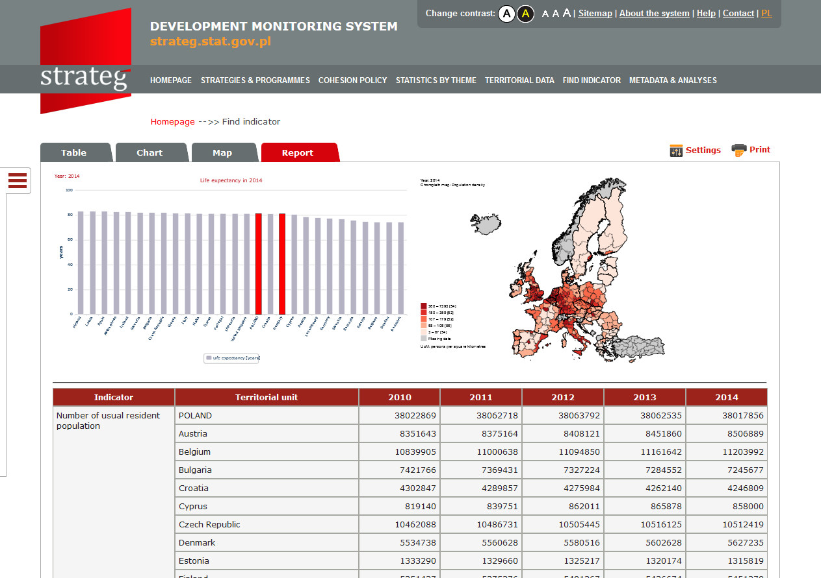
STRATEG –
diversified
forms of data presentation
http://

Slide 6
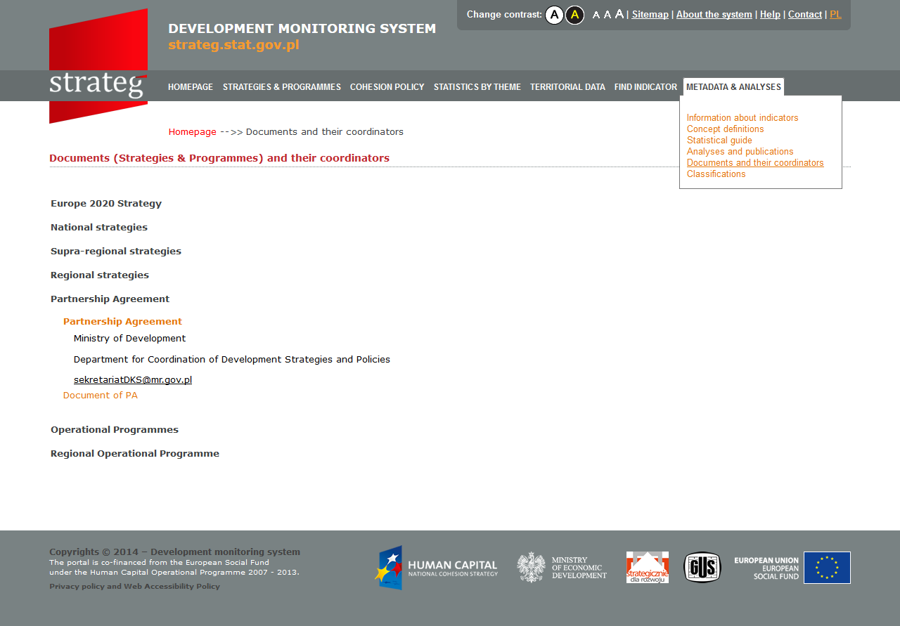
Comprehensive source of information
content supporting users’ work with indicators
strategic documents

Slide 7
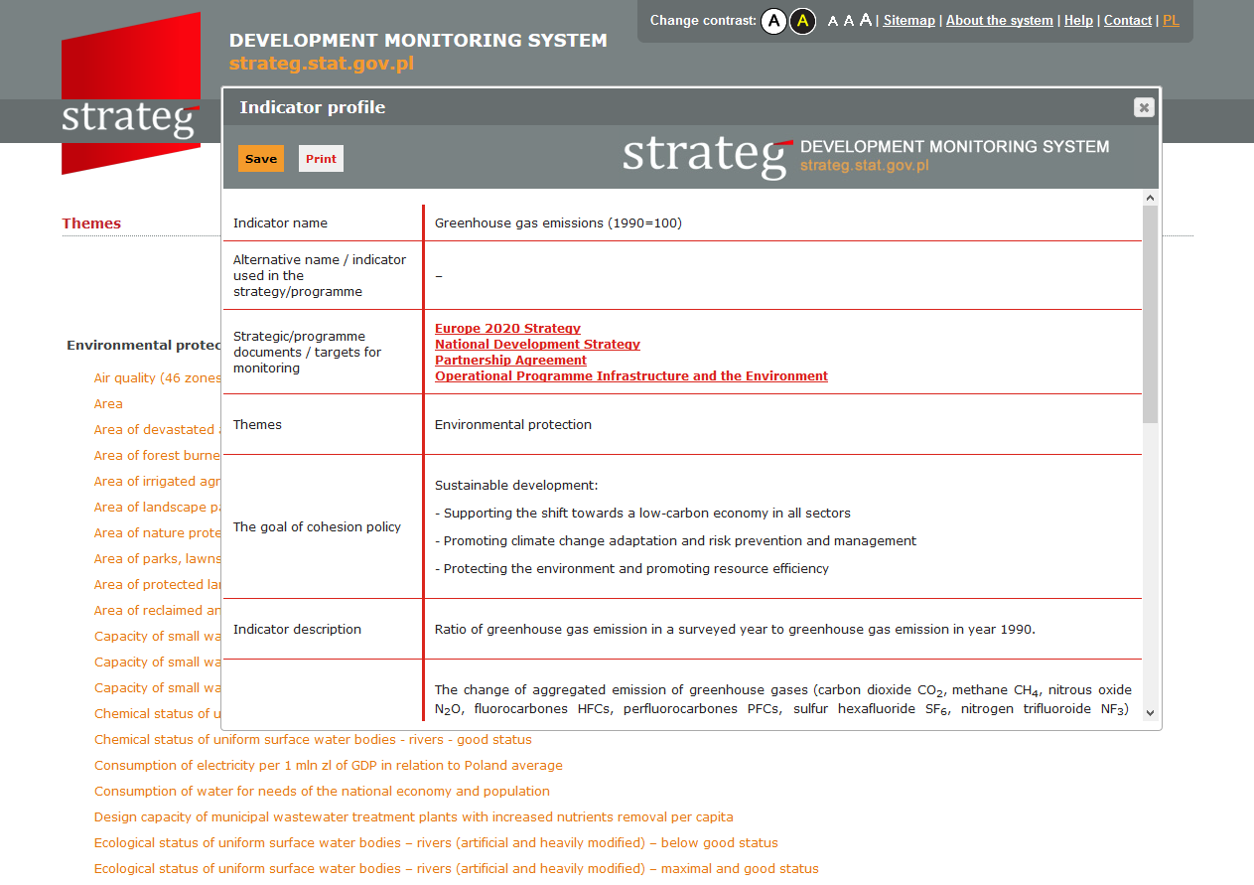
Indicator profiles
indicator name
strategic documments
theme category
goal of cohesion policy
indicator description and methodology explanation
data source and availability
available variables territorial levels

Slide 8
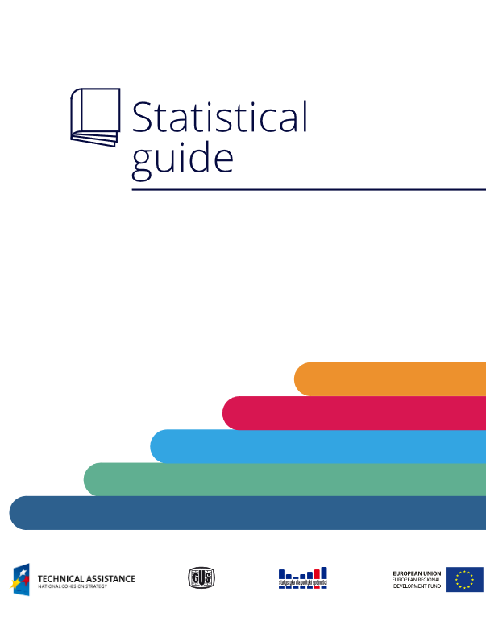
STRATEG – Statistical Guide
clear layout
inserting symbols and links which facilitate
using of the guide
straightforward language
interpretative pointers
explanations enhancing comprehension
reference to the datasources and reading matters

Slide 9
STRATEG – communication and user education aspects
Conducting regular dialog with users
consultations on the system designing stage
workshops before launching the system
contacts with users after system implementation
Creating coaching structure on central and regional levels
12 workshops on central level (330 participants from 37 institutions)
63 training sessions on regional level (800 participants)

Slide 10
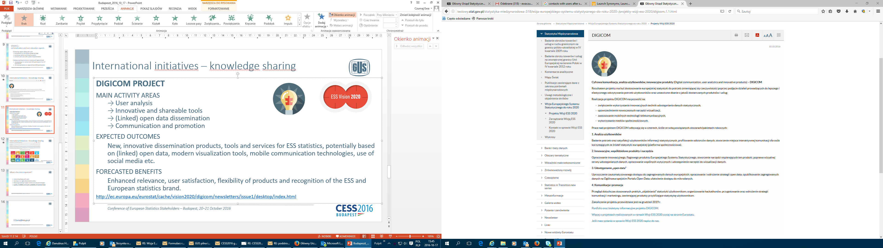
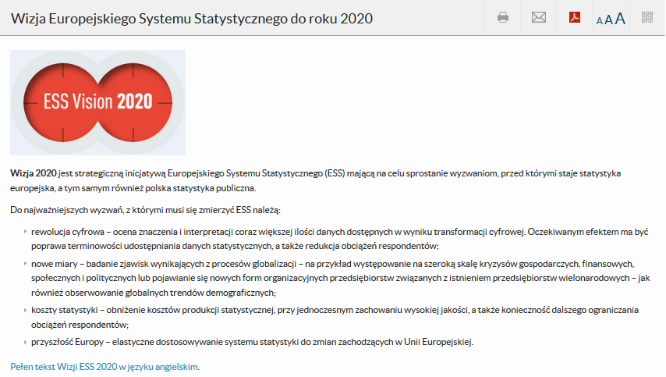
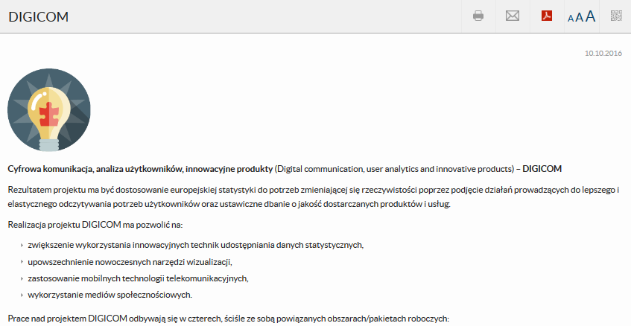
International initiatives – knowledge sharing

Slide 11
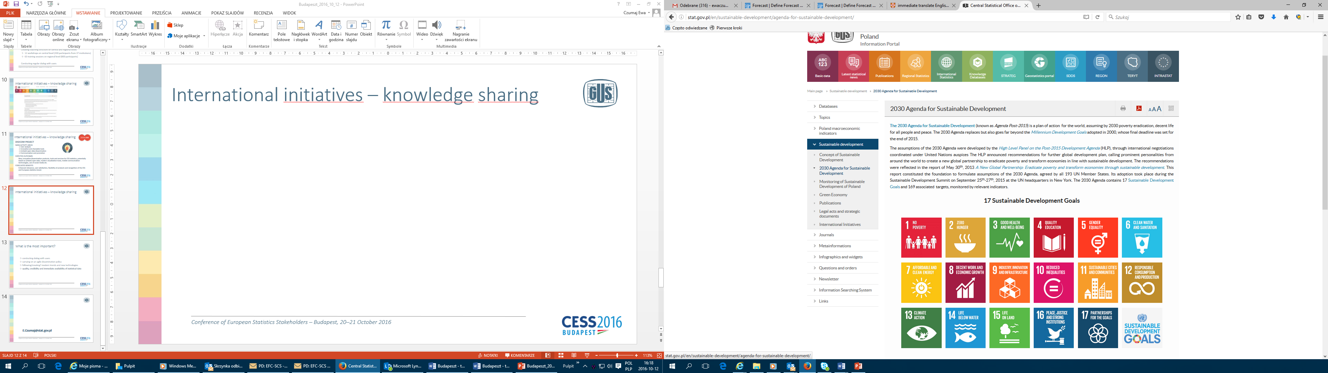
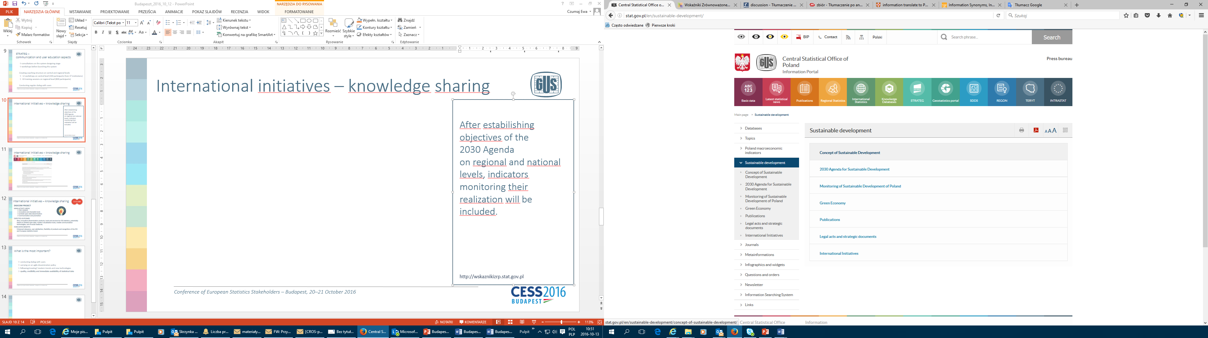
International initiatives – knowledge sharing
http://wskaznikizrp.stat.gov.pl

Slide 12
What is the most important?
conducting dialog with users
carrying on an agile dissemination policy
following/creating? modern trends and new technologies
quality, credibility and quick availability of statistical data

Slide 13
E.Czumaj@stat.gov.pl

