Slide 1
Experiences of collaboration with customers
– cases of educational sector and media
Reija Helenius and Hannele Orjala
Conference of European Statistics Stakeholders
Budapest, 20–21 October 2016

Slide 2

How to get our message, our data and statistics more and more used?
Statistical literacy as objective
Case 1: The joint blog of statistics
  A platform for open dialogue
Case 2: Statistical chat service
  Statistical advice in real time
Case 3: Tilastrofi –
Statistical Yearbook for children
Conclusions

Slide 3

What is Statistical Literacy?
Knowledge of basic statistical
key figures
Understanding of concepts describing society (e.g. inflation, unemployment, GDP)
Basic knowledge about research methods, visualisation and interpretation
Knowledge about data sources and the ability to evaluate them
Knowledge to produce and present new information
58%
70%

Slide 4
Cases
”If you can’t explain it simply, you don’t understand it well enough”.
-Albert Einstein-

Slide 5
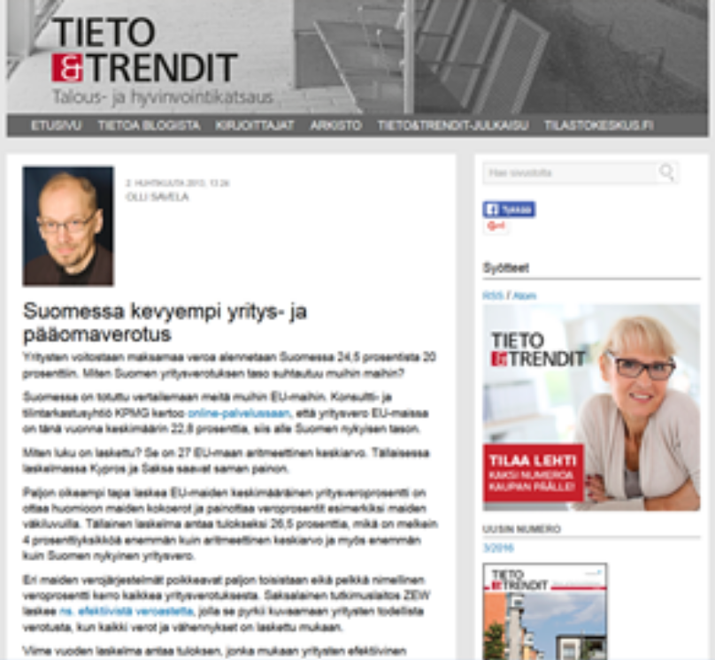
Case 1: Joint blog launched in 2013
Post on corporate and capital taxation
3 731 visits
30 bloggers, 100 postings (about 25 posts per year
and 2 posts per month)
Olli Savela, expert on national accounts:
“A tool for addressing issues raised by the public or bringing new facts and viewpoints to the discussion”
Provoked dialogue – this one raised
13 comments

Slide 6
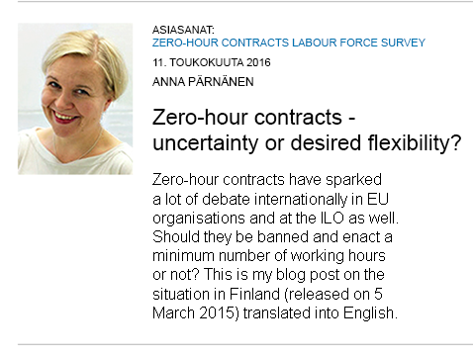
Anna Pärnänen, Senior Researcher, Labour Force Survey:
“This post in one go answered the very predictable questions
of the media”
“Blog posts strengthen the expert profile”
“Blogging has taught me to focus on one point”
“Blogging simply belongs to today”

Slide 7
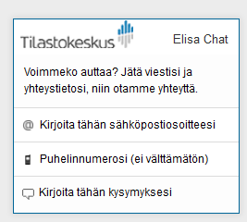
Case 2: Chat service on stat.fi website
Can we help you? Please leave your message and contact information, so we will contact you.
Enter your email address here
Your telephone number
(not necessary)
Write down your question here
+100%
+20%

Slide 8
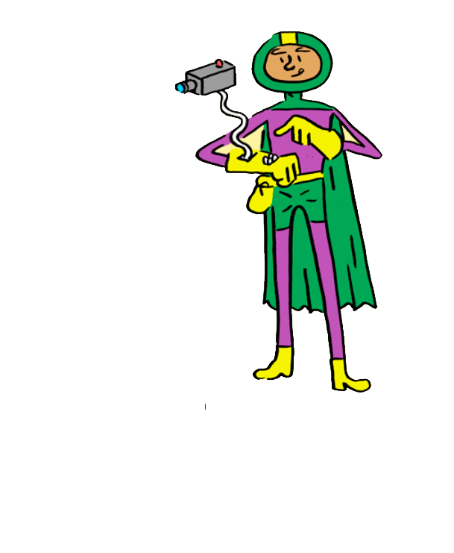
Case 3: Tilastrofi - Statistical Yearbook for children
A national operations model with schoolchildren aged 7 to 15 of how statistical know-how should be developed as part of the educational system since 2012
Students:
  Study their everyday life, special features of their
  school or their living area, and
  Produce data on important things found there
  using statistical methods and visualisations.
Finnish cooperation project of Helsinki Mathland,
City of Helsinki Urban Facts, Forum Virium,
Statistics Finland, Aalto University and the
Summamutikka centre
      Tilastrofi in English on Vimeo

Slide 9
Statistics are useful only when they have been understood and used. The use of data must be supported in a number of different ways.

Slide 10
Hannele Orjala hannele.orjala@stat.fi
Reija Helenius reija.helenius@stat.fi

