Slide 1
How far have we come on eu banking statistics ?
Are we there yet?
Gaetano Chionsini / LUIS GARCIA / Mario Quagliariello *
21 October 2016
*European Banking Authority. The views expressed in this text are those of the authors and do not necessarily reflect the position of the EBA.

Slide 2
Objective of this paper
Track recent progresses made in the development of banking statistics in the EU, focusing analysis on data consistency, processes and availability
Provide a way forward in this field, supported by the authors’ experience

Slide 3

The crisis…
Lehman Brothers collapsed and impact in the EU was relatively contained, some argued
Few months after, data gaps regarding the EU banking sector became noticeable (who owes what? where are exposures located in? what are amounts?)
Lack of information on the market was considered a major weakness that led to contagion effects
Then, in 2009, the De Larosière report showed the way forward for the EU rule-making process, in order to better withstand shocks arising from financial crisis and, most importantly, to break the bank-sovereign link that so much contributed to the euro area crisis

Slide 4
…and a new beginning
In 2011, the European Banking Authority (EBA), as part of the European System of Financial Supervision (ESFS), was created
With it coming:
A renewed attempt to achieve consistency of reporting and enhance comparability of data in the EU (COREP, FINREP, etc)
Same risk indicators, with coherent formulas across the EU
Shorter deadlines for transmitting data
Harmonized reporting formats (LEI, DPM, XBRL)
Heightened level of quality assurance, introducing an unprecedented number of validation rules, quality checks and supervisory alerts
User-friendly disclosures of granular data, on a bank by bank basis when possible

Slide 5

Comparable data and risk indicators
COREP and FINREP, EBA’s predecessor, the Committee of European Banking Supervisors, pushed through efforts to achieve common reporting definitions for the EU
However, these attempts were only a partial success since not all countries adopted the non-binding guidelines. Actually, only 2 fully adopted those before 2014
A single set of supervisory reporting standards was then prepared and published by the EBA in 2014, first applicable reference date being Q1 2014
Legally binding, fully applicable on all EU member states
Maximum harmonization, as opposed to previous philosophy of minimum harmonization, with costly national frameworks
While addressed to all banks, proportionate requirements take into account burden imposed on smaller institutions
Analyses based on same risk indicators

Slide 6
Improved timeliness
Where delays in submitting supervisory data were the norm, data now arrives widely on time
Since 2014 but noticeably in 2015 and 2016, timeliness of data submitted to the competent authorities, and to EBA thereafter, has improved dramatically
Nowadays, close to 100% coverage by the established remittance dates has been achieved
Ensuring that financial and prudential information, as well as other banking supervisory statistics, feed into supervisors’ and researchers’ veins in a timely manner is a must for conducting effective supervision and better understanding financial phenomena

Slide 7
Harmonized reporting formats
A comprehensive Data Point Model (DPM), where each data point uniquely describes a specific reporting requirement via a combination of metrics, dimensions, categories and sectors
A common submission format to transmit to the EBA has been adopted, bridging innovative IT solutions with advanced business language representation techniques
(the XBRL format, although almost a stranger to the EU before 2013, had been used for several years in the United States)
Combination of the two above aspects allows for a somewhat flexible reporting framework; yet it needs to be revised/enlarged from time to time, whether because reporting requirements change, or due to the desire to implement technical or data modelling improvements

Slide 8
Heightened level of quality assurance
Avoid double reporting, by setting sequential data flows for primary and secondary reporting
Shorter production cycles, occurring at the same time across the EU
Quality assurance involves statisticians, data analysts and supervisors
Considerable list of validation rules (currently 3000+), performed against submitted data will track major consistency errors in the information, thus triggering corrections from the reporting institutions
On top of formal validation rules, quality checks (now around 800) are executed as to add another layer of assurance; plausibility of figures is carefully assessed and trigger data improvements where needed
Feedback and follow-up actions are being boosted everyday, allowing data compilers to gain precious time and best practices dissemination

Slide 9
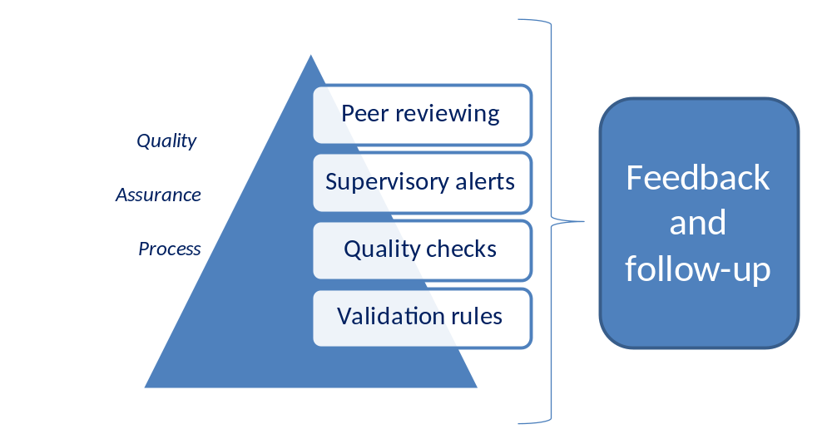
Heightened level of quality assurance (2)

Slide 10
User-friendly disclosures
For data disclosure to be effective, all kinds of users should be capable of reading and draw accurate conclusions from it, without major effort
Therefore, aggregate and bank-by-bank data, has been released from 2011 onwards, in a centralised way for the largest banks in the EU
Different tools for different types of users were made available, aiming for the most advanced market investors, computer/banking data-savvy, researchers, but also to users with average computer skills or knowledge of banking statistics
CSV files with raw data, map tools and interactive excel files have been offered
Another way of giving credibility to disclosures has been the direct sign-off from board-level bankers, making those disclosures direct responsibility of banks’ top management
Stress Tests / Recapitalisation exercises
data
Transparency exercises
data
Risk Dashboards and Assessment Reports
Global Systemically Important Institutions data
RWA consistency and Supervisory Benchmarking data

Slide 11
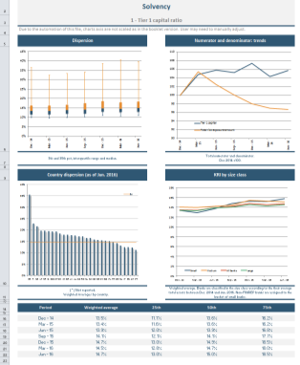
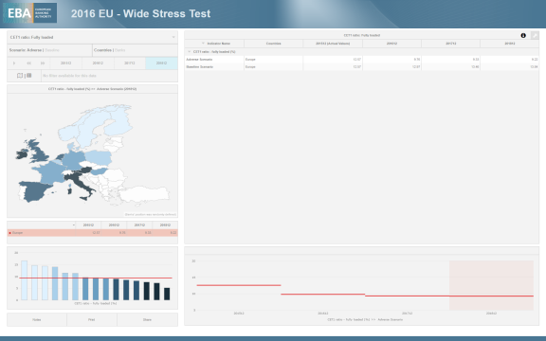
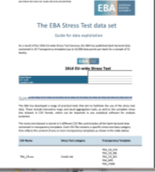
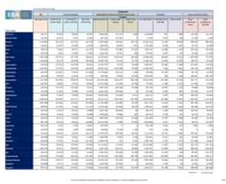
User-friendly disclosures (2)

Slide 12
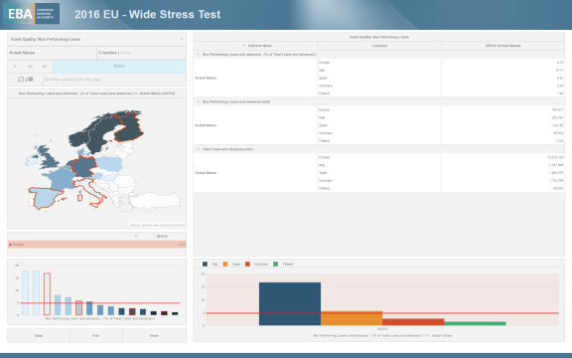
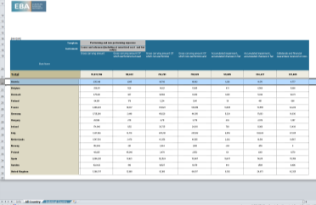
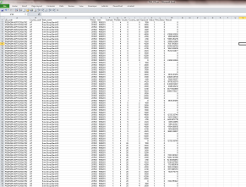
User-friendly disclosures: an example
Non performing loans in the EU, Finland, Germany, Spain and Italy

Slide 13
Conclusions & Way Forward
Supervisory statistics will remain a sensitive topic for banks and authorities
Reporting burden and some flexibility to supervisors will need to be taken into account, however a single reporting framework should continue to be seen as a major breakthrough in the crisis aftermath, and it should not be put at stake
To promote a truly EU-wide Single Market and resilient cross-border banks, (reporting) rules must be known and common to every jurisdiction, bolstered by real information exchange between supervisors from different Member States
Thus:
Maximum harmonization should be permanently encouraged
The ongoing cultural change with regards supervisory data should be embraced, fully establishing it as the main source of information for supervisory actions
Concerns about the health of the EU banking system must be fought with increased transparency and bank-by-bank disclosures; a clear mandate to do so is still lacking

Slide 14
Thank You

