Slide 1
Real Estate Statistics
Price Dynamics and Beyond
Andrew Kanutin
European Central Bank
DG-Statistics
Conference of European Statistics Shareholders
Budapest, 20-21 October 2016

Slide 2
Agenda
1
History – ECB involvement
2
International initiatives and groups
3
Residential property price statistics
4
Additional indicators on residential real estate
5
Commercial property price statistics
6
E(S)CB ongoing work
7
Real Estate Report
8
ESRB
9
Variables required
10
WGGES role and plans

Slide 3
History – ECB involvement
EMI / ECB working on data underlying property markets for many years (>20)
Historically main focus on residential (both conjunctural and structural). In last few years also commercial
Historically macroeconomic analysis emphasis. Since downturn fin. stability has emerged as primary “customer”
Outcome: 3 main data-sets, all “experimental”
Real Estate prices – Residential and Commercial (NB recent Eurostat publication of official data)
Structural Indicators on housing markets
All considered extremely useful by the user community
But…more required

Slide 4
International initiatives and groups
IMF initiated “Financial Soundness Indicators” (FSIs)
Inter-secretariat Working Group on Price Statistics
  Handbooks on residential (2013); “Commercial property price indicators: sources, methods, issues”, currently reviewed by IMF, to be published by Eurostat in 2017
Interagency Group on Economic and Financial Statistics
  IAG Housing Statistics Expert Group (met September 2015): headline indicators, metadata, long time series, seasonal adjustment
G-20 Data Gaps Initiative (DGI) and (DGI-2)
    Recommendations II.17 and II.18 on residential and commercial property prices
European Systemic Risk Board (ESRB)
  Reports on gaps in residential and commercial property statistics (Dec 2015)
  Forthcoming recommendation on closing data gaps (End 2016)
Single Supervisory Mechanism (SSM)
  E.g. compiles annual “Mortgage fact sheets” for the systemically important banks

Slide 5
Residential property price statistics (1)
“Residential property price indicators” by ESCB:
data + metadata for euro area and most EU Member States
In the early 2000s
since 2000: coordinated ESCB work
→ “Working Group General Economic Statistics” (WGGES)
in early years: data from secondary sources; compiled mostly outside official statistics
data primarily taken from Bank for International Settlements (BIS): pioneer work started already in 1989!
several EU central banks started contributing to compilation
further impetus to statistical work: 2003 ESCB report “Structural factors in the EU housing markets” (http://www.ecb.europa.eu/pub/pdf/other/euhousingmarketsen.pdf)

Slide 6
Residential property price statistics (2)
Until recently, residential property price statistics were …
mostly of limited representativity in geographical terms and/or by dwelling type
followed different statistical concepts (type of price information, aggregation, quality adjustment etc.): limited comparability
not always met frequency (quarterly) and timeliness (three months) requirements
→ “experimental data”, e.g. compiled by ESCB in ECB Monthly/ Economic Bulletin

Slide 7
Residential property price statistics (3)
House price indices by EU statistical offices:
many improvements
Broadly harmonised statistical concepts + approaches:
  Transaction prices
  Aggregation (regions, dwelling types)
Quarterly frequency
Timeliness: three months
Press releases + release calendar
but: time series are rather short (start in 2005 or later)
For some countries: other indicators (from NCBs or private providers) are currently still preferable (e.g. BE, DE, GR, CY, AT) but this under review

Slide 8
Additional indicators on residential real estate
In 2003, ESCB agreed on a set of additional (“structural”) housing indicators:
National data from national central banks; ECB calculates euro area and EU aggregates
Indicators:
  Number of private households
  Number of dwellings
  Vacancy/occupancy rates of residential housing
  Housing starts and completions
  Number and value of housing transactions
  Type of tenure (owner-occupied and rented)
Comprehensive set of metadata

Slide 9
Commercial property price statistics (1)
ESCB looking at topic ≈ 6 years
In the G20 publication “Financial crises and Information gaps”
ESCB /ESRB uses:
Financial stability
Exposure to risk by finance providers
Macro-economic analysis (inflation, property sector, construction sector)

Slide 10
Commercial property price statistics (2)
ECB experimental data – first published in Feb 2014
Based on commercial sources as well as a limited amount of official data
Enhancements planned
Re-examination of weighting approaches (simple GDP weights used at present)
Enhancement of interpolation methods
Spatial autocorrelation
Etc.

Slide 11
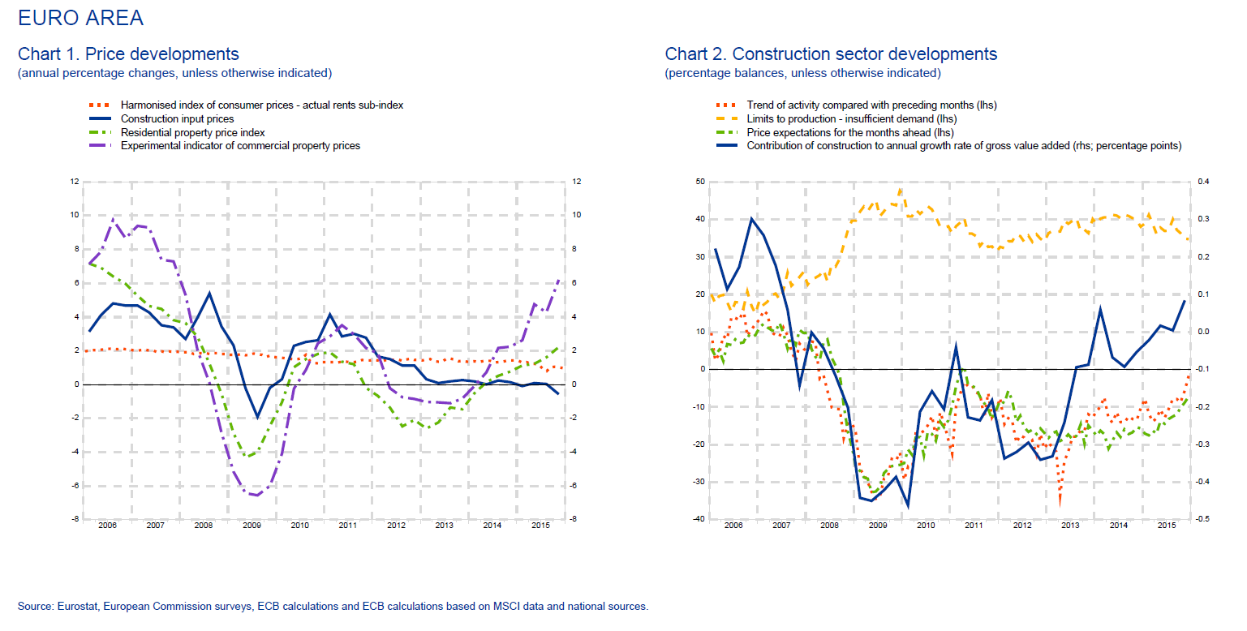
Data

Slide 12
E(S)CB Ongoing Work
Three main strands to current and ongoing work
Making data more accessible to end-users
Addressing increasing user demand (especially for financial stability)
Allied indicators (vacancy rates, construction starts, etc.)

Slide 13
Real Estate Report
  New mandate
  Targeted audience: wide range of users
    Cost/benefit analysis undertaken
    Content defined
    Presentational aspects
    Based on already existing statistics for EU Member States
    Blocks covering prices (Residential and commercial), housing wealth, housing construction / investment

Slide 14
European Systemic Risk Board
  Mission and objectives
“The ESRB shall be responsible for macro-prudential oversight of the financial system within the Union…
…in order to contribute to the prevention or mitigation of systemic risks to financial stability in the EU that arise from developments within the financial system and taking into account macro-economic developments…
…so as to avoid periods of widespread financial distress, and contribute to a smooth functioning of the internal market and thereby ensure a sustainable contribution of the financial sector to economic growth”

Slide 15
ESRB
  Expert Group on Real Estate
Report(s) covered:
  Structural features of real estate markets
  Availability and comparability of data
  Best practices for use of instruments (e.g. lending standards)
  Residential and commercial real estate
  Reported: end 2015
Data issues follow up requested by the ESRB General Council
- Result: (Almost final) ESRB Recommendation

Slide 16
Residential & Commercial market indicators
Variables required
Residential | Type of data | Commercial | Type of data
Value | Ratio: Loan to value | Price index | Index
Income | Ratio: Loan to income | Rental index | Index
Rent received | Ratio: Loan to rent (for buy to let) | Rental yield index | Index
 |  | Vacancy rates | Rate
 |  | Construction starts | Number of square metres
 |  | Value | Loan to value
Highly stylised table of requirements!
Significant breakdowns requested e.g. by property type and domestic “prime”/ non-”prime”

Slide 17
Normal approach taken to “fill gaps”:
WGGES role and plans
WGGES: Sub-group of the ECB Statistics Committee.
Part of mandate to fill data gaps
  Stocktaking
  Assessment
  3) Target definition
  4) Test collection / aggregation
  Agreement on experimental data

Slide 18
Conclusions
  ECB has built up some expertise in the real estate statistics field as a result of needing to fill data gaps
  Price data, albeit experimental, available for both residential and commercial
  Much development work underway worldwide but also significant and urgent demand
  ESCB tries to fill the gaps using existing data and/or innovative means where possible
  Challenges ahead for non-price indicators but work starting

Slide 19
Thank you for your attention!

