Slide 1
ELTINGA Centre for
Real Estate Research
Insight from Hungarian Stamp Duty Data
Áron Horváth
CESS 2016.
Budapest

Slide 2
Motivation and background
During the negotiations with the IMF in 2009, Hungarian experts had to present price changes about the residential market.
To prove that Hungarian residential market is more stable than the Baltic ones.
More indices were born soon.
This week the NBH launched its own.

Slide 3
Outline
Source of data.
List of variables.
Problems.

Slide 4
1. Source of Data

Slide 5
Stamp duty data
Based on purchase-and-sell transaction data of residential real estate.
Source of the data is the National Tax and Customs Administration of Hungary.
Data recording in stamp duty offices based on purchase contracts.
Notes:
According to the rules of the Act on Duties the buyer have to pay property acquisition duty on the transfer of property
The territorially competent stamp duty office calculates the amount of the duty based on the purchase contract.
Data recorders process these contracts into their information system

Slide 6
The unified informatical system, called VISKO („shanty”) was established in 2008.
  Before that stamp duty offices recorded data in differing methods.
When documented purchase price is suspiciously low, an appraiser might inspect the house, and alter the price.
  In these cases (6-7%), more property attributes are available .

Slide 7
2. List of Variables

Slide 8
List of variables
Year of purchase
Price
  Purchase price documented through transaction
  Home appraisal value
Area data
  Useful floor area
  Lot area (houses)
Location based on ZIP codes
  In some cases street name is also available

Slide 9
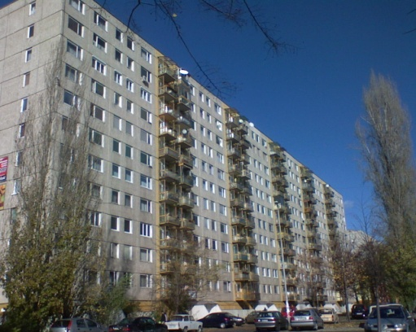
Building type
  Detached or terraced house
  Condominium
  Flat in a large block of flats
The proportion of ownership
In case of local inspection
  Number of rooms
  Existence of balcony
  Year of construction
  Grade of status

Slide 10
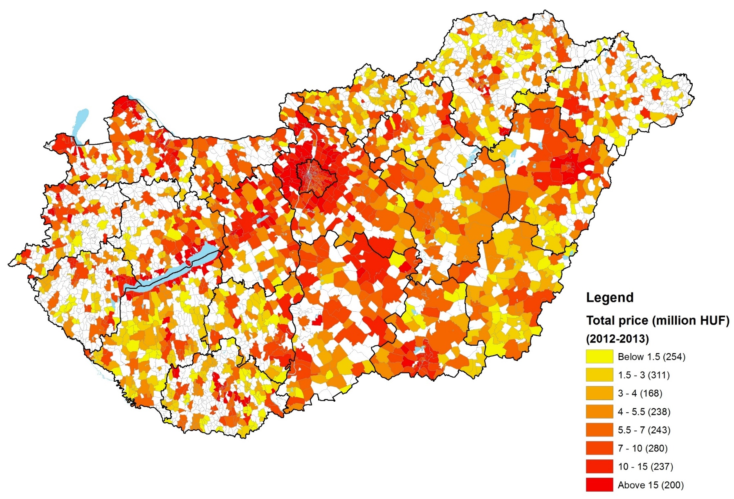
Data coverage during two years (2012-2013)
Notes:
In the first place it represents average total price in ZIP code level expressed in million forints.
It looks like there is a fairly high variation in total price, Budapest and the other major cities are more expensive than the countryside plus the central and western regions could be described with higher prices than the eastern counties.
But you can see a lot of white territory – which means in 2012 and 2013 there wasn’t any transaction in these settlements/ZIP codes in our sample.

Slide 11
3. Problems

Slide 12
Problems
Regulation of access
  CSO gets more data compared to others
Strict data protection rules
  Extreme problem in those areas where transactions are rare
Decreasing transaction number and data coverage during the crises

Slide 13
Decreasing transaction number and data coverage
Notes:
The left axis represents the number of transactions with key information, and the right stands for the number of unique settlements per year in our sample.
Key information means that we dropped transactions where fractional ownership was transferred and we also removed observations which came with irrelevant or missing price/location/purchase year.
It is striking at first sight that there is a break between 2007 and 2008. This coincides with both the break in our database and the financial crisis.
Transaction number and number of unique settlements have dropped to a fraction of previous years. Crisis itself and stricter data protection rules also lowered the number of observations since 2008.
Unfortunately the extent of the two effects cannot be exactly measured, but we argue that the market slowdown had a greater impact on the declining number of transaction.

Slide 14
Irrelevant price values
Irrelevant or incomplete area data
  In some cases lot area is recorded instead of useful area
  Typical issue of house transactions where differing useful floor and lot area are needed
Data precision varies regionally and by settlement type
Notes:
Old database: there is no recorded area data for one fifth of the transactions
New database: Property area is fully available, but useful floor area, which we think is accurate, is recorded for half of the transactions
In some cases lot area is recorded instead of useful floor area. It is really important to have relevant floor data because it is indispensable to calculate square meter prices. Moreover the precision of the data varies regionally and by settlement type (village, town, big cities)

Slide 15
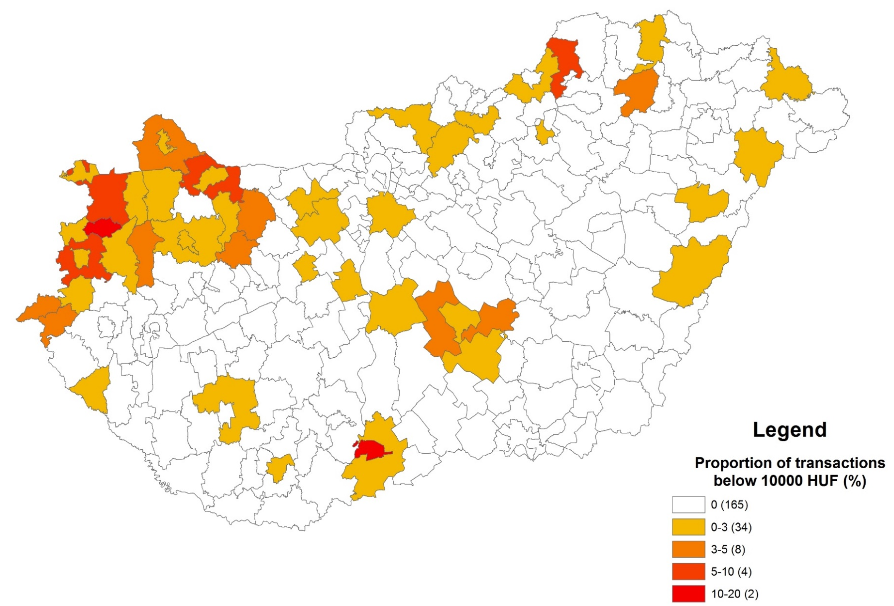
Irrelevant purchase prices
Notes:
The second problem is irrelevant purchase prices. We consider a price irrelevant if it is equal to or less than 10000 forints.
We are confident that no one can buy a house or flat in such a low price, so these cases are the result of some data entry failures and we dropped them.
Unfortunately as you can see this failure happens more frequently in some counties in the western part of the country, not randomly

Slide 16
Our approach to „messy” data
Transactions with reliable data are kept -> Several rounds of data cleaning is required.
We dropp those transactions were key information is missing.
  Price, location, purchase year, area
We do not deal with fractional ownership.
Rigorous way (robustness check): Two differing area data is required in case of houses.
Notes:
We defined observations with less than 10 or more than 1000/3000 square meters area as outliers.
Houses: Uncertain area problem
Only one area data is recorded, or property area=useful floor area
Two differing variable would be required to clearly decide which one is related to the useful floor size.
Defining differing area: contains both property and useful floor area and the property area is at least 5 % higher than the useful one.

Slide 17
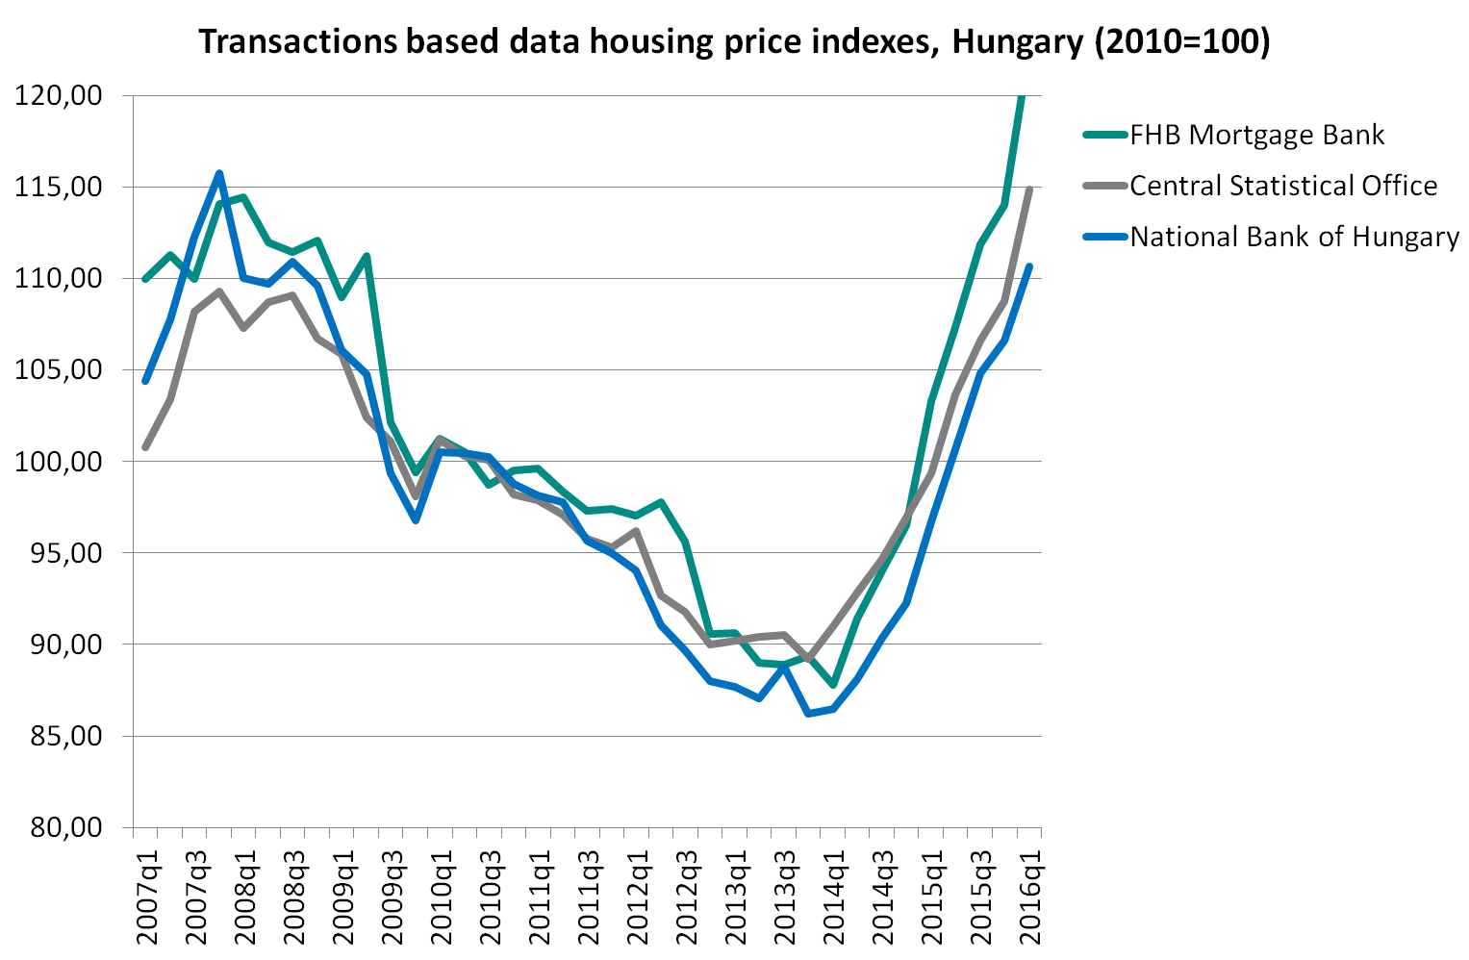
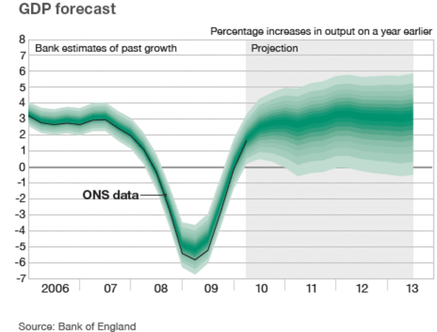
Differing modelling specifications

Slide 18
Thank you for your attention!

