Slide 1
How should we measure residential property prices to inform policy makers?
Christine Schlitzer

Slide 2
Structure of the presentation
Motivation and introduction
The Bundesbank’s dashboard
Affordability indicators
Conclusion
Long time series
“Residential and commercial property prices” (Recommendations 17 and 18 of the G20 Data Gaps Initiative II, DGI-2)

Slide 3
1. Motivation and introduction
The various motivations for the analysis of house prices call for alternative measures to be applied.
  Macroeconomic: identification of price signals, evaluation of monetary policy channels, volume measurement in National Accounts.
  Macroprudential: assessment of asset price bubbles, build-up of risks in banks‘ credit exposures, financial soundness of private households.
  However, these indicators can give different results, which could undermine their credibility for many users.
  Still, there should be no unique indicator.

Slide 4
1. Motivation and introduction
The residential property market plays an important role for the real economy, the financial system and the financial stability.
The year 2010 saw a trend reversal in the German housing market, which was reflected in a sharp rise in prices.
This situation needs to be addressed in light of the ongoing low-interest-rate environment.
In order to determine whether threats to the economy or financial stability emanate from the housing market, the Bundesbank based its analyses on a broad set of indicators.

Slide 5
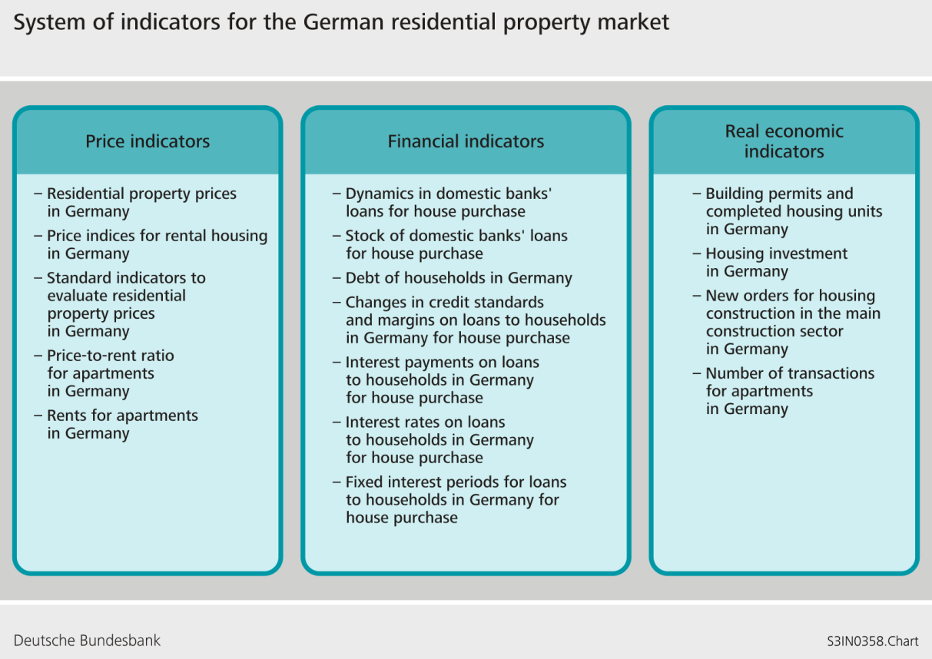
2. The Bundesbank’s dashboard

Slide 6
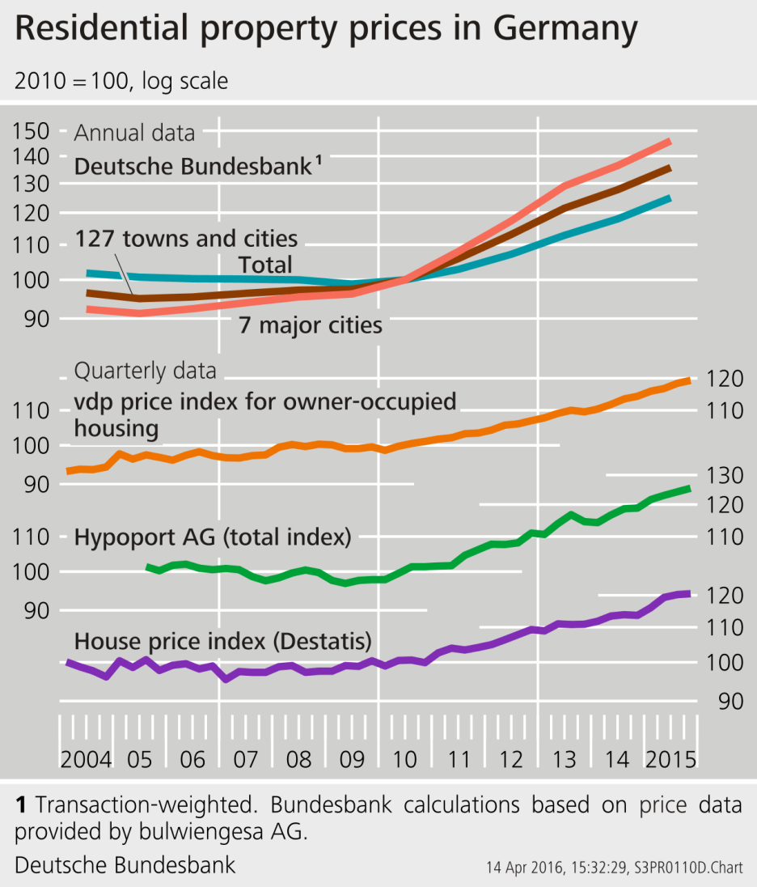
2. The Bundesbank’s dashboard
Continuing strong demand outweighed expansion of the housing stock.
Last year saw a further sharp increase in residential property prices with housing price inflation being regionally more broadly based than in earlier years.
The observed price movements do not, on their own, make it possible to derive any potential overvaluation or undervaluation. A benchmark would be required, but it cannot be specified unambiguously from a conceptual point of view, nor can it be observed directly.
All things considered, the increase in the price of residential property in towns and cities during 2015 is likely to be greater than is suggested by the dynamics of the demographic and economic fundamentals.

Slide 7
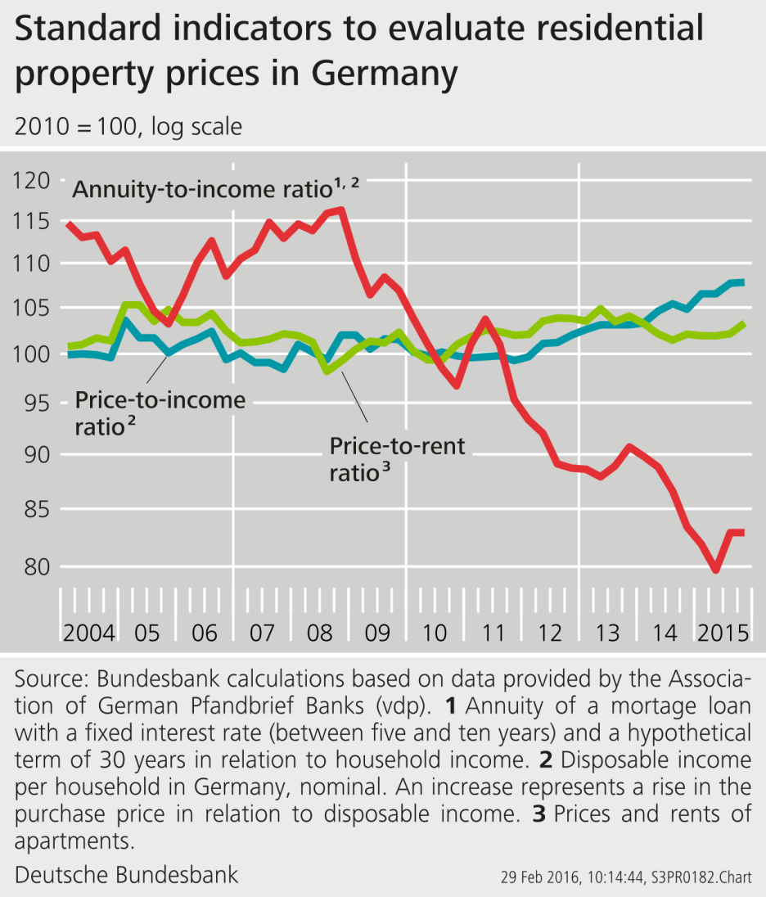
2. The Bundesbank’s dashboard
Housing is still being valued exceptionally highly in urban regions.
If prices as well as rents rise substantially, the price-to-rent ratio may remain largely unchanged. Conversely, the price-to-income ratio would shoot upwards.
While the macroeconomic price-to-income ratio has shown a marked increase over the past three years, there is likely to have been a further improvement in the affordability of residential property owing to the low financing costs of acquiring it.
The question, however, remains what drives the ratio – is it the numerator (e.g. price) or the denominator (e.g. income)?

Slide 8
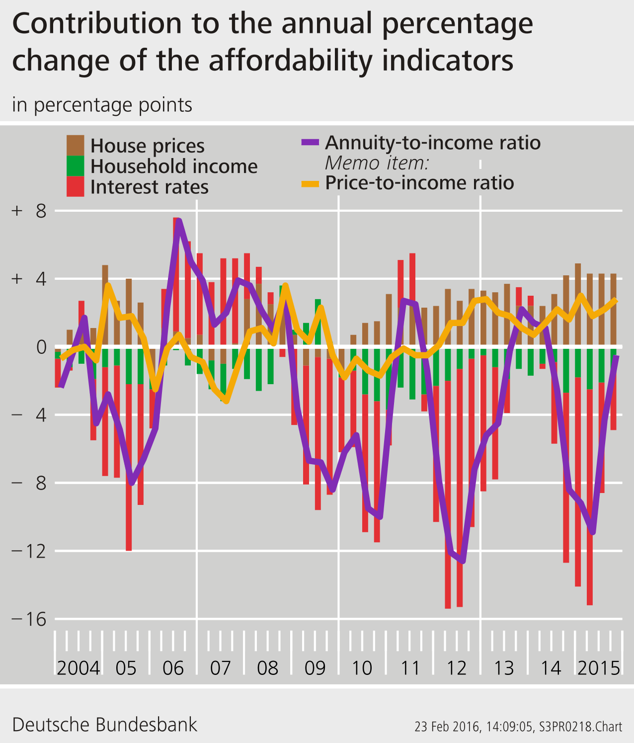
2. The Bundesbank’s dashboard
Additional stimulus by the further improvement in financing conditions.
According to vdp, house prices have risen since the beginning of 2010 to the end of 2015 by 21%.
Nominal disposable income per household increased in the same time period by 12%.
The average rate for mortgage loans declined during the past five years by more than 2 percentage points to below 2%.
The annuity burden has (ceteris paribus) decreased by 26% in the period under consideration due to the low-interest-rate environment.
Hence – albeit prices have risen – the affordability of financing a house has increased by 20% (although it decreased by 8% without the interest rate effect).

Slide 9
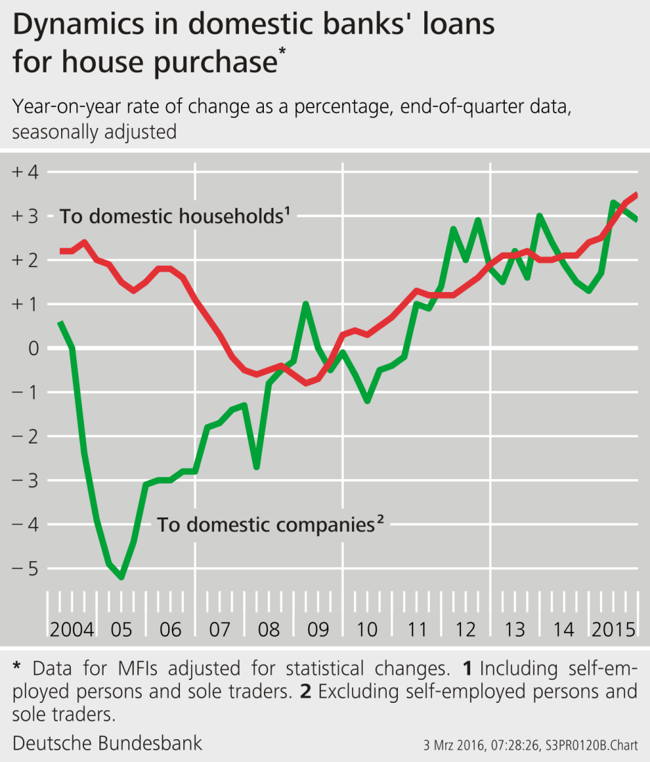
2. The Bundesbank’s dashboard
Continued low-interest-rate environment entails risks.
If prices continue to rise, creditors could be tempted to expand lending excessively and loosen credit standards. This can result in systemic risks.
Although new lending accelerated significantly during 2015, growth in mortgage lending to households can still be described as moderate in a longer-term comparison.
Moreover, household debt levels in Germany continue to decline, at least in aggregate terms.
What is more, the Eurosystem’s regular Bank Lending Survey shows that German banks have not loosened their lending standards for mortgage loans since 2014.

Slide 10
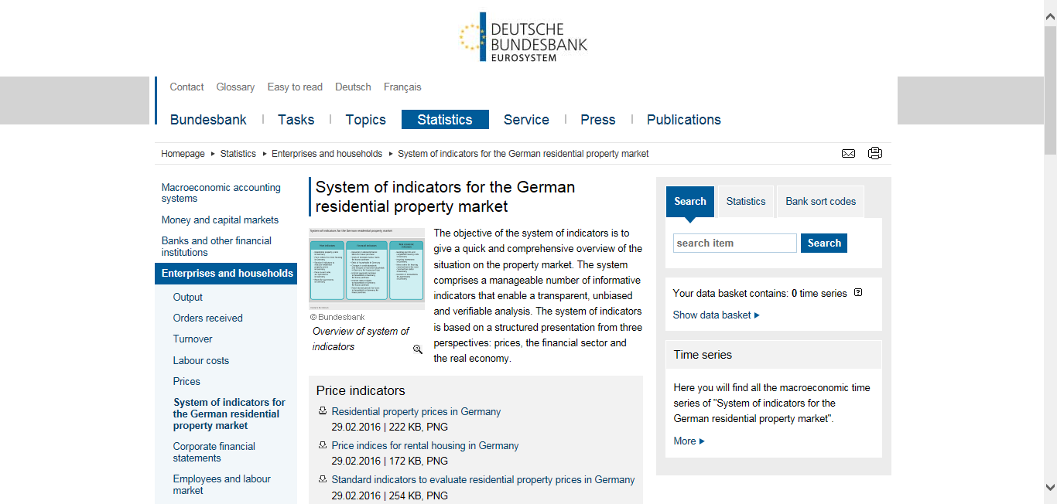
2. The Bundesbank’s dashboard http://www.bundesbank.de/Navigation/EN/Statistics/Enterprises_and_ households/System_of_indicators/system_of_indicators.html

Slide 11
3. Affordability indicators
Institutional characteristics of mortgage loans (SVR 2013/14, p.459)
Country | Housing loans to GDP (%) | Average loan to value (%) | Share of floating rates (%) | Average life of the loan (years) | Possibility to withdraw equity
Belgium | 47 | 83 | 10 | 20 | No
Germany | 45 | 70 | 15 | 25 | No
France | 42 | 75 | 15 | 15 | No
Ireland | 84 | 70 | 67 | 20 | Limited
Italy | 23 | 50 | 47 | 15 | No
Netherlands | 106 | 90 | 18 | 30 | Yes
Austria | 28 | 60 | 61 | 25 | No
Sweden | 78 | 80 | 52 | 25 | Yes
Spain | 62 | 70 | 91 | 20 | Limited
U. K. | 84 | 85 | . | 25 | Yes
U. S. | 76 | 80 | 47 | 30 | Yes

Slide 12
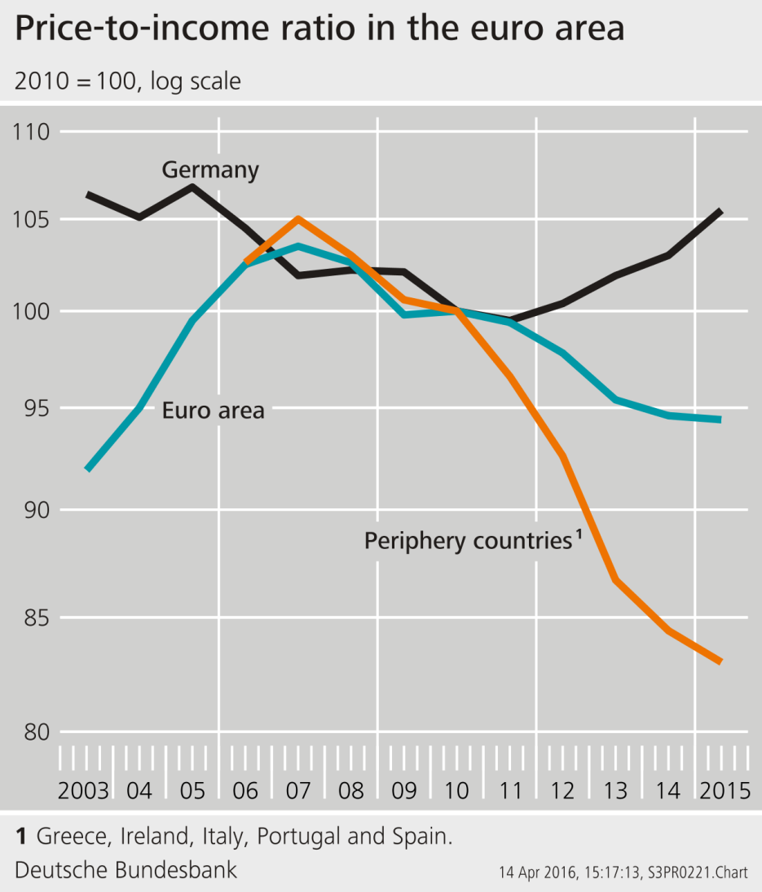
3. Affordability indicators
Price-to-income ratio in the euro area
Percentage change from 2010 to 2015
Country | Prices | Income | P-to-I
Germany | +18 | +11 | + 6
Euro area | – 1 | + 5 | – 5
Periphery* | –18 | – 2 | –17
An increase represents a rise in the purchase price in relation to disposable income.
Share of disposable income (gross)
Country | Percentage of euro area
Germany | 28
Periphery* | 35
* Greece, Ireland, Italy, Portugal and Spain.

Slide 13
4. Conclusion
A complex phenomenon such as the residential property market cannot adequately be reproduced by a unique indicator.
The analysis should provide an transparent, unbiased and easily comprehensible assessment of the situation in the residential property market.
The Bundesbank dashboard is based on a broad and clear set of highly significant indicators.
    Since 2010, only the price indicators for Germany demonstrated strong upward movements.
    Financial indicators did not reach critical levels.
Lending standards differ considerably across countries.

Slide 14
Contact
Christine Schlitzer
Deutsche Bundesbank
Central Office
General Economic Statistics
Wilhelm-Epstein-Strasse 14
60431 Frankfurt am Main, Germany
Tel: +49 69 9566 3520
Mobile: +49 172 7950739
Fax: +49 69 9566 2941
E-mail: christine.schlitzer@bundesbank.de
www.bundesbank.de

