Slide 1
Factor Based Index of Systemic Stress (FISS)
Tibor Szendrei, Katalin Varga
MTA
2016.10.21.

Slide 2
Motivation
The Factor based Index of Systemic Stress (FISS) is a financial stress composite index dedicated for signalling episodes of financial turbulence.
Timely identification of financial stress is crucial for policy makers: Late policy action can be more costly than no intervention
Identify key drivers of risk
Studying the links between the risk drivers
Why do we need it?
What is the difference from CISS?
Uses factor modelling methodology
Utilises a larger number of input factors with limited data transformation
Identifies pure financial stress: doesn’t factor in effect on GDP directly
The aggregation of the sub-indicies (factors) purely mathematical: limits the possibility of ad-hoc decisions
The smoothing methodology ensures that in the final series the level of noise is as low as possible

Slide 3
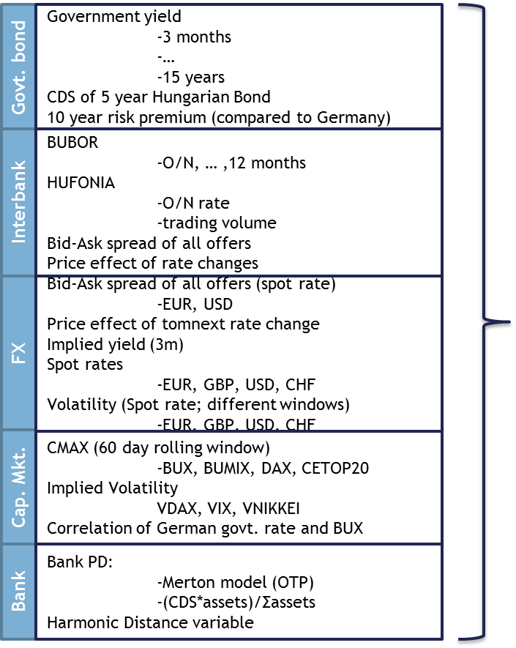
The final set of variables was chosen based on the static PCA explanatory power as well as the liquidity of the market
Final variable set
Government yield
-3 months
-10 years
CDS of 5 year Hungarian Bond
Govt. bond
BUBOR
-3 month
HUFONIA
-O/N rate
-trading volume
Interbank
Bid-Ask spread of all offers (spot rate)
-EUR, USD
Spot rates
-EUR, GBP, USD, CHF
FX
CMAX (60 day rolling window)
-BUX, BUMIX, DAX, CETOP20
Implied Volatility
VDAX
Cap. Mkt.
Bank PD:
-Merton model (OTP)
-(CDS*assets)/Σassets
Harmonic Distance variable
Bank

Slide 4
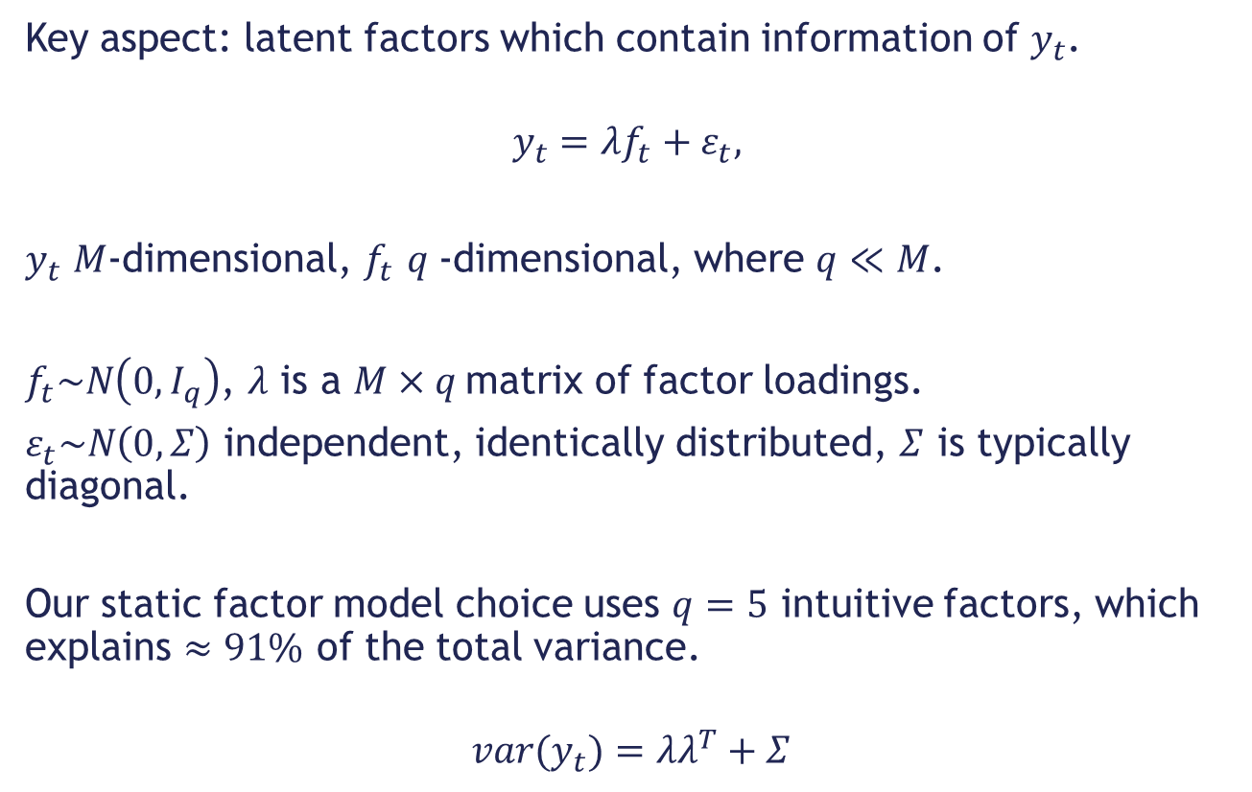
Preliminary Model: PCA Type Static Factor Model
Key aspect: latent factors which contain information of $y_{t}$.
$$y_{t}=λf_{t}+ε_{t},$$
$y_{t}$ $M$-dimensional, $f_{t}$ $q$-dimensional, where $q≪M$.
$f_{t}\sim N\left(0,I_{q}\right)$, $λ$ is a $M×q$matrix of factor loadings.
$ε_{t}\sim N\left(0,Σ\right)$ independent, identically distributed, $Σ$ is typically diagonal.
Our static factor model choice uses $q=5$ intuitive factors, which explains $≈91\%$ of the total variance.
$${var(y}_{t})=λλ^{T}+Σ$$

Slide 5
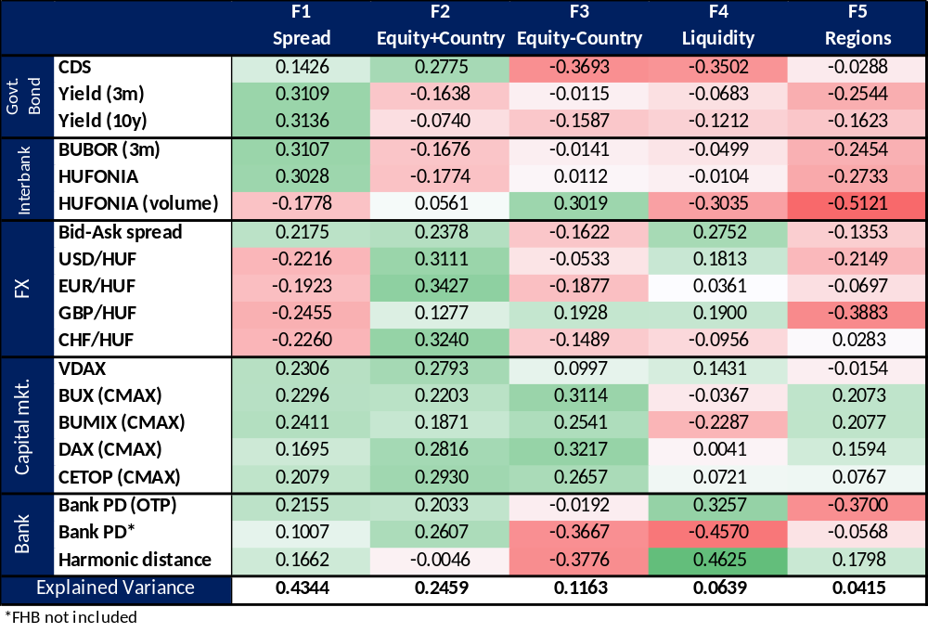
Intuitive and Interpretable Factors

Slide 6
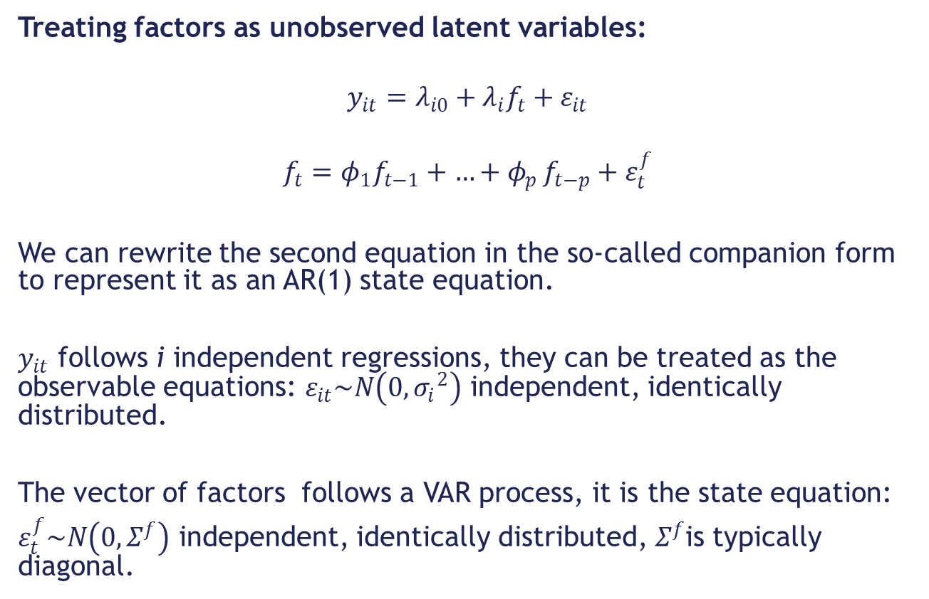
Final Model: Dynamic Bayesian Factor Model
Treating factors as unobserved latent variables:
$$y_{it}=λ_{i0}+λ_{i}f_{t}+ε_{it}$$
$$f_{t}=φ_{1}f_{t−1}+{{…+φ}_{p}f}_{t−p}+ε_{t}^{f}$$
We can rewrite the second equation in the so-called companion form to represent it as an AR(1) state equation.
$y_{it}$ follows i independent regressions, they can be treated as the observable equations: $ε_{it}\sim N\left(0,{σ_{i}}^{2}\right)$ independent, identically distributed.
The vector of factors follows a VAR process, it is the state equation:
$ε_{t}^{f}\sim N\left(0,Σ^{f}\right)$ independent, identically distributed,${ Σ}^{f}$is typically diagonal.

Slide 7
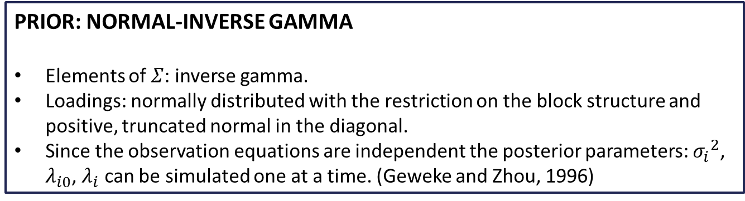
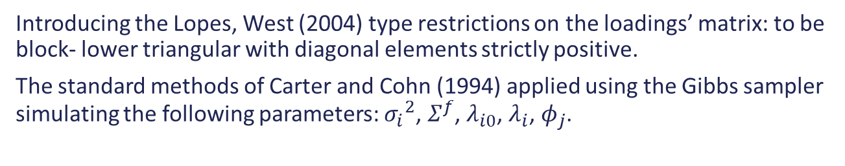
Specification of the Bayesian Priors- Posteriors
Introducing the Lopes, West (2004) type restrictions on the loadings’ matrix: to be block- lower triangular with diagonal elements strictly positive.
The standard methods of Carter and Cohn (1994) applied using the Gibbs sampler simulating the following parameters: ${σ_{i}}^{2}$, $Σ^{f}$, $λ_{i0}$, $λ_{i}$, $φ_{j}$.
PRIOR: NORMAL-INVERSE GAMMA
Elements of $Σ$: inverse gamma.
Loadings: normally distributed with the restriction on the block structure and positive, truncated normal in the diagonal.
Since the observation equations are independent the posterior parameters: ${σ_{i}}^{2}$, $λ_{i0}$, $λ_{i}$ can be simulated one at a time. (Geweke and Zhou, 1996)
Observation equation
PRIOR: NORMAL-WHISHART
The state equation is in a VAR form, Gibbs sampling can be carried out without using a Metropolis-Hastings algorithm following Kadiyala-Karlsson (1997).
State equation

Slide 8
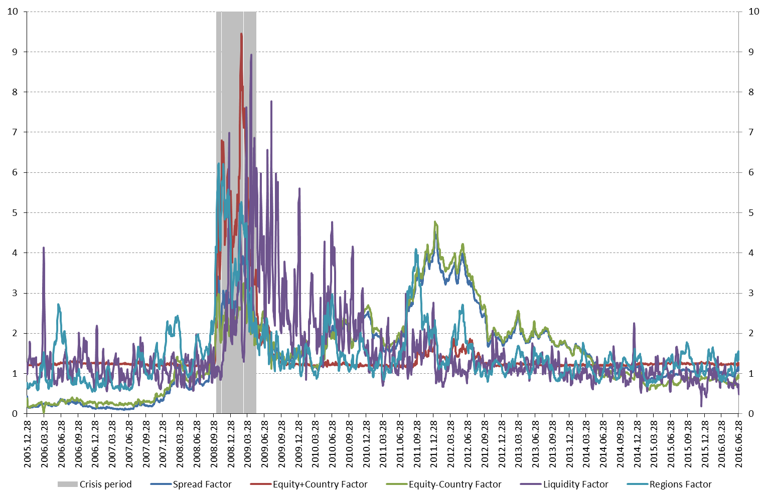
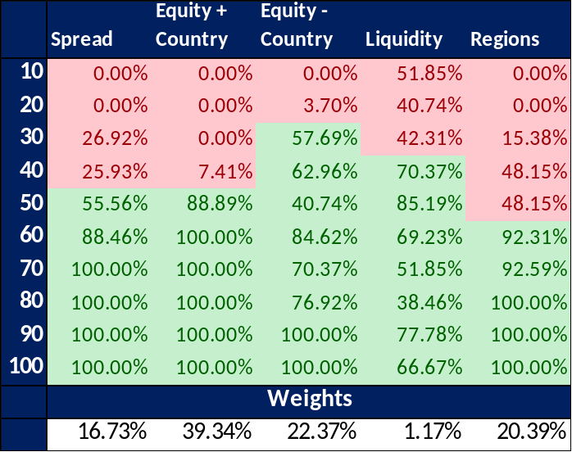
The method of combining multiple factors into one index is not a trivial choice: we decided to use the Information Value methodology
To aggregate the factors into one comprehensive index we used the Information Value methodology:
Defined crisis period between 2008.10.13 (Intervention in FX swap market) and 2009.05.15
Defined evaluation period between 2008.08.01 and 2009.07.31
Break down each factor into deciles and see which factor has the best signalling potential at different decile bands.

Slide 9
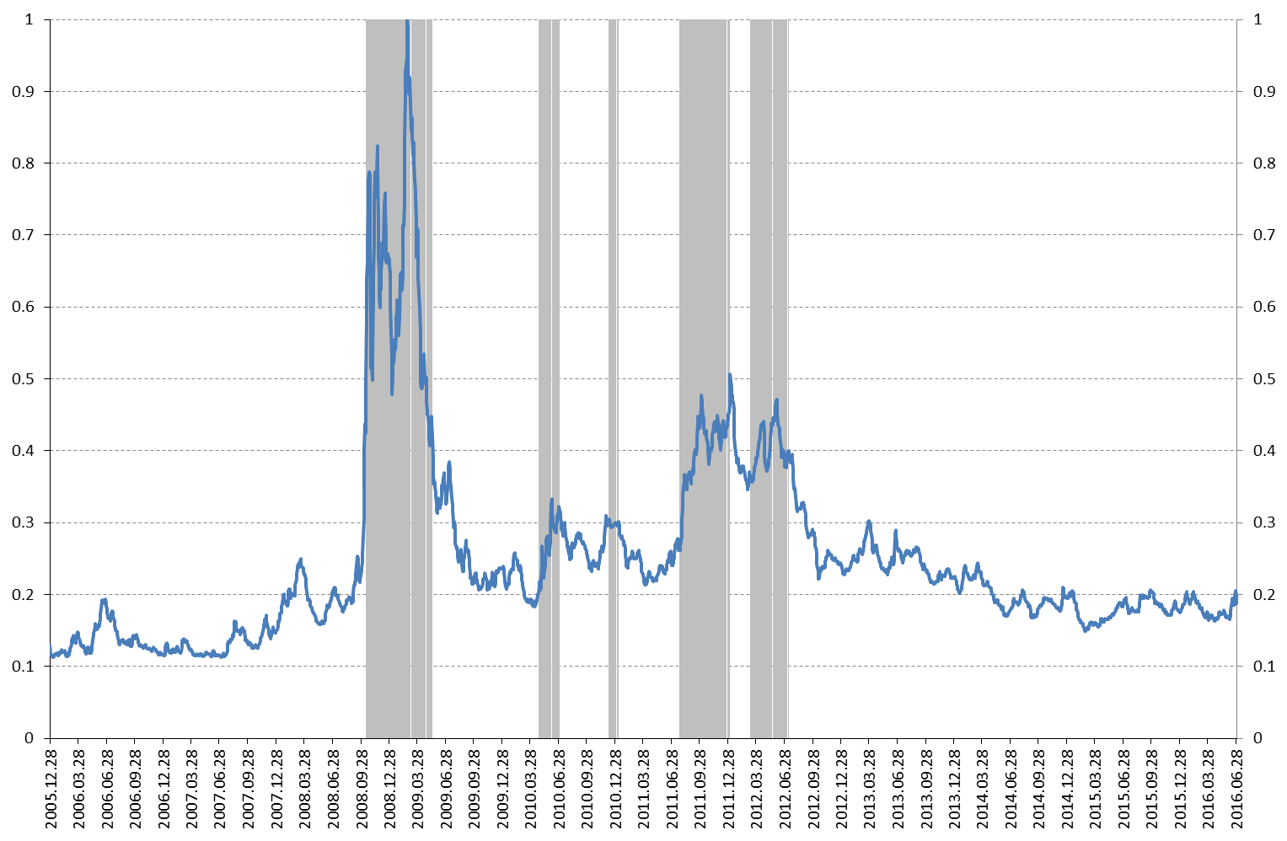
Verification of the calibrated index: How does it perform on the complete time horizon
2008.10.13 - 2009.05.15
Global Financial Crisis
2010.04.27 - 2010.06.30
Start of euro soverign debt crisis (downgrade of Greece and Portugal)
2010.12.09 - 2011.01.07
Turbulence on Hungarian FX market
2011.07.25 - 2012.01.02
CHF/HUF FX rate increases
Downgrade of Greece
Downgrade of the US
Hungary invites IMF
2012.03.09 - 2012.07.09
Austerity demonstrations across Europe

Slide 10
Take-away and further improvements
Factor modelling suitable for creating stress indices
Fast-moving comprehensive index
Allows us to see what’s driving the process
Smoother indicator for stress events compared to current practice
Plan to use the index in a broader TB-VAR
Index suitable for use as a threshold variable for non-linear macro models
Take away
Index volatility is high when level is high
Introduce stochastic volatility in observation and state equation
Follow the procedure of Del Negro, Otrok (2008)
Further improvements
Plan to have a documented, final index published as a WP on MNB website in January

Slide 11
Literature
Bai, J., & Ng, S. (2002). Determining the number of factors in approximate factor models. Econometrica, 70(1), 191-221.
Banerjee, A., Marcellino, M., & Masten, I. (2014). Forecasting with factor-augmented error correction models. International Journal of Forecasting, 30(3), 589-612.
Barigozzi, M., Lippi, M., & Luciani, M. (2016). Non-stationary dynamic factor models for large datasets.
Bernanke, B. S., Boivin, J., & Eliasz, P. (2004). Measuring the effects of monetary policy: a factor-augmented vector autoregressive (FAVAR) approach (No. w10220). National Bureau of Economic Research.
Breitung, J., & Eickmeier, S. (2006). Dynamic factor models. Allgemeines Statistisches Archiv, 90(1), 27-42.
Breitung, J., & Eickmeier, S. (2011). Testing for structural breaks in dynamic factor models. Journal of Econometrics, 163(1), 71-84.
Carter, C. K., & Kohn, R. (1994). On Gibbs sampling for state space models. Biometrika, 81(3), 541-553.
Darracq Paries, M., Maurin, L., & Moccero, D. (2014). Financial conditions index and credit supply shocks for the euro area.
Del Negro, M., & Otrok, C. (2008). Dynamic factor models with time-varying parameters: measuring changes in international business cycles. FRB of New York Staff Report, (326).
Eichler, M., Motta, G., & Von Sachs, R. (2011). Fitting dynamic factor models to non-stationary time series. Journal of Econometrics, 163(1), 51-70.
Engle, R., & Watson, M. (1981). A one-factor multivariate time series model of metropolitan wage rates. Journal of the American Statistical Association, 76(376), 774-781.
Geweke, J., & Zhou, G. (1996). Measuring the pricing error of the arbitrage pricing theory. Review of Financial Studies, 9(2), 557-587.
Hollo, D., Kremer, M., & Lo Duca, M. (2012). CISS-a composite indicator of systemic stress in the financial system.
Holló, D. (2012). A system-wide financial stress indicator for the Hungarian financial system. MNB Occasional papers, 105.
Koop, G., & Korobilis, D. (2014). A new index of financial conditions. European Economic Review, 71, 101-116.
Koop, G., & Korobilis, D. (2010). Bayesian multivariate time series methods for empirical macroeconomics. Now Publishers Inc.
Lopes, H. F., & West, M. (2004). Bayesian model assessment in factor analysis. Statistica Sinica, 41-67.
Stock, J. H., & Watson, M. W. (2006). Why Has U.S. Inflation Become Harder to Forecast?
Stock, J. H., & Watson, M. W. (2011). Dynamic factor models. Oxford handbook of economic forecasting, 1, 35-59.

