Slide 1
Developing cross-border statistics by collaboration NSI’s
j.vandervalk@cbs.nl

Slide 2
Project of Statistics Netherlands
Feasibility study to assess the possibility and need to set up cross-border statistics
To be financed externally by national stakeholders

Slide 3
Why do we need X-border statistics?
Border regions are often economically vulnerable regions
Cooperation across borders has potential
Data is needed to identify opportunities and challenges

Slide 4
X-border statistics not available?
Need for comparable data on the border regions: low regional detail and harmonised
Sources: admin data + (big data) but not surveys
EU data: harmonised (surveys) but not enough regional detail
National data: regional data (admin) but not harmonised

Slide 5
X-border information is challenging
Cross-border statistics are difficult to produce
  Require low regional detail
  Require international comparable methods and sources
  Include measurement of flows of persons & goods

Slide 6
Role of Statistical institutes
(Regional) statistical institutes are able to produce statistics on border regions
  have detailed regional data
  have knowledge on methods and sources
And are willing …
  If there is a genuine need for data
  To collaborate internationally
  When the extra work is financed

Slide 7
Envisaged data providing services
Network of statisticians responsible for cross-border statistics
Dataset of basic indicators
Regular reports on developments
Internet tool for aggregating and presenting data for EUregions
Database of detailed information that can be used for further research (separately financed)

Slide 8
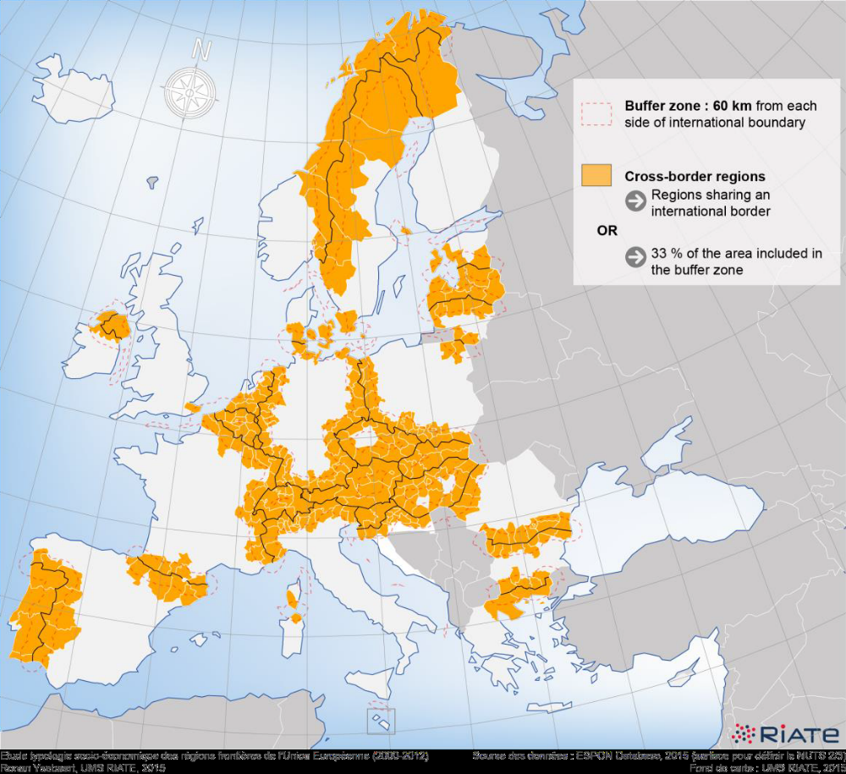
EU-perspective: many CBC-regions

Slide 9
X-border information need EC
CBC unit of DG_REGIO is in need of data
  To monitor INTERREG projects
  To have information comparable across regions
  Identifying obstacles for cross-border cooperation
DG REGIO is prepared to finance pilot projects of limited scope
  Call for proposals just launched

Slide 10
Conclusions
X-border stats: Need for collaboration between NSI’s
  To use survey data creatively
  To use admin data
  To explore big data
Exchange methods on EU level essential
Statistics Netherlands is willing to organise workshop to explore how to do this

