Slide 1

The challenge of permeable borders: estimating cross-border employment between Italy and Switzerland. An analysis of sources and estimates
Maria Elena Comune, Sabina Ronconi, Lorena Viviano
Italian National Statistical Institute (Istat) -
Territorial Office for Piemonte and Valle d’Aosta, Lombardia and Liguria
Conference of European Statistics Stakeholders
Budapest, 20 October 2016

Slide 2
Background research on cross-border employment
Istat territorial office for Lombardia in collaboration with Swiss statistical authorities: compare data of neighbouring territories across border (2004-2006)
Renewed interest to comply with new national accounts standards, Istat Working Group (2014) focused on all Italian land borders:
1. Sources in Italy and neighbouring countries;
2. Estimate in-flows/out-flows of cross-border workers
(2010-2011)
Objective: exhaustiveness of labour input
Comune Ronconi Viviano - CESS 2016 - Budapest 20 october

Slide 3
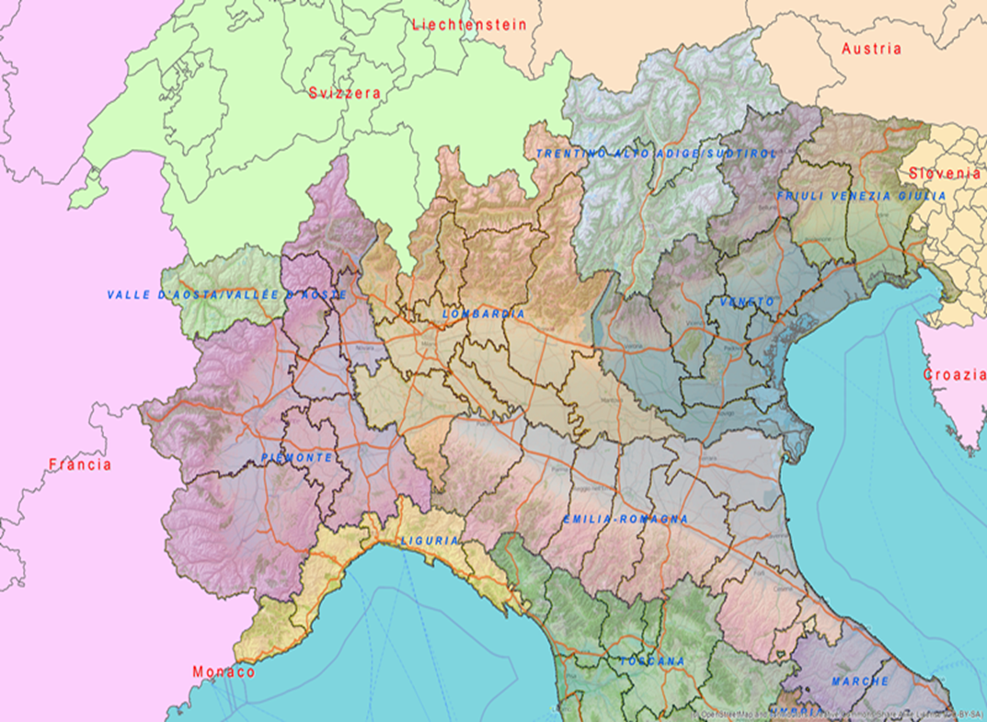
WHERE?
Flows of cross-border workers Italy (Lombardia and Piemonte, NUTS-2) - Switzerland
Comune Ronconi Viviano - CESS 2016 - Budapest 20 october

Slide 4
WHO?
“cross-border workers”
=
daily / weekly commuters
YES tele-workers
NO seasonal workers
Regular and irregular work
Comune Ronconi Viviano - CESS 2016 - Budapest 20 october

Slide 5
Data sources (Italy)
No ad hoc source
Official data on cross-border workers:
Population Census (PC) - every 10 yrs
Labour Force Survey (LFS) - sampling errors
Other sources:
Tax files, Survey on tourism (Bank of Italy), BoP, Local institutions

Slide 6
Data sources (Switzerland)
Ust - Federal Office of Statistics: primary source for flows to/from Switzerland
Ustat - Statistical Department of Canton Ticino of the Swiss Federal Office:
Ticino receives most Italian cross-border workers; from Ust data, Ustat provides detailed information (e.g. province of origin, NUTS3)
Survey units =
foreign workers with special «G permit» for cross-border work with gainful employment in CH (back to residence abroad at least once a week)
Comune Ronconi Viviano - CESS 2016 - Budapest 20 october

Slide 7
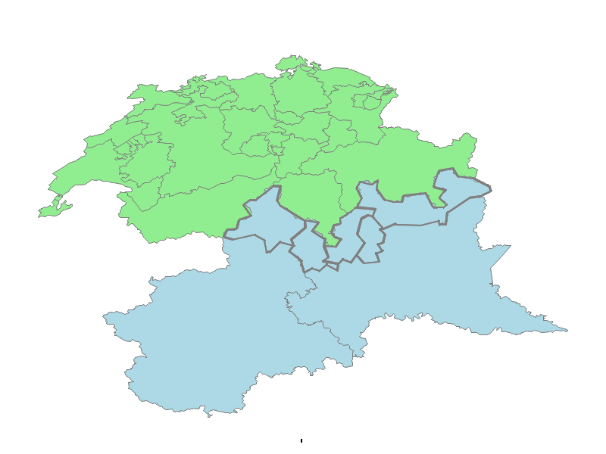
Cross-border flow from I to CH
Main cantons of destination (CH)
Ticino
Grisons
Valais
Main provinces of origin (I)
Varese
Como
Sondrio
Lecco
Verbano-Cusio-Ossola
SWITZERLAND
LOMBARDIA
PIEMONTE

Slide 8
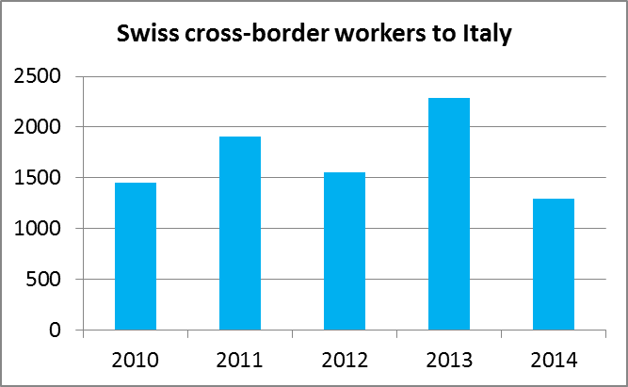
Results – How many, where in Switzerland
(Source: Ust)
Italy Switzerland (2015)
Total: 69 000
Ticino: 62 564
Grisons: 5 072
Valais: 1 312
Switzerland Italy (2014)
∼ 1 300
Comune Ronconi Viviano - CESS 2016 - Budapest 20 october

Slide 9
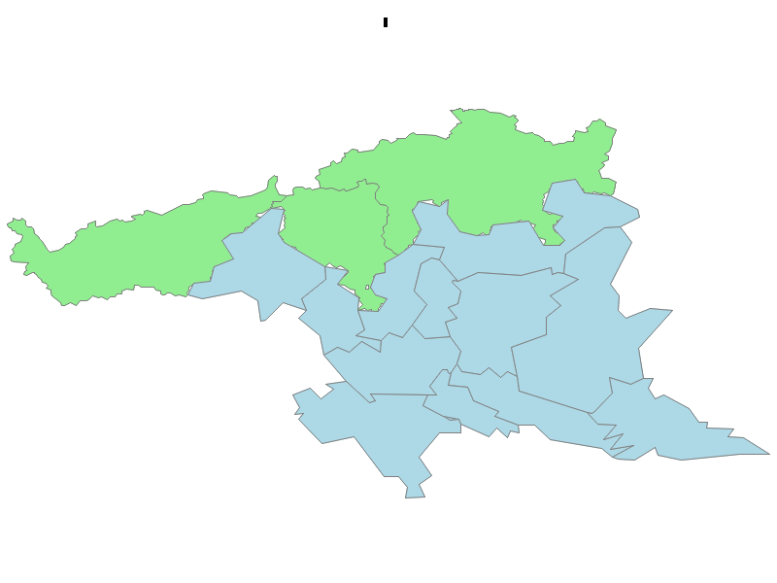
Focus on Canton Ticino: from where in Italy
(Source: Ustat)
(SWITZERLAND)
Italian cross-border workers by province (NUTS3) of origin (%-2014)
GRISONS
TICINO
VALAIS
VERBANO-C.O.
COMO
VARESE
MILAN
(ITALY)
Comune Ronconi Viviano - CESS 2016 - Budapest 20 october

Slide 10

The Italian cross-border worker in Switzerland
Identikit
Male (62%)
Aged 35-44 (33%)
Resident in Varese (40%)
Married (50%)
Low education (lower secondary diploma: 41%)
Employee (98%)
Skilled blue-collar worker (27%)
Manufacturing sector (28%)
Comune Ronconi Viviano - CESS 2016 - Budapest 20 october

Slide 11
WHAT DO THEY DO?
Italian cross-border workers to CH
(Source: PC 2011)
STATUS IN EMPLOYMENT:
97,8% Employees
86,5% with stable contracts
86,5% Full-time
80,0% 40-50 hour working week
TYPE OF OCCUPATION
27,1% Skilled worker
21,6% Unskilled worker/service worker
13,8% Service and sales activities
10,5% Technicians and associate professionals
SECTOR OF ECONOMIC ACTIVITY
28,4% Manufacturing, repair and installation of machinery and equipment
20,1% Construction of buildings, civil engineering and specialized construction activities
9,0% Wholesale and retail trade; repair of motor vehicles and motorcycles
8,7% Accommodation and food service activities
6,1% Professional, scientific and technical activities
6,2% Health and residential/non-residential care activities

Slide 12
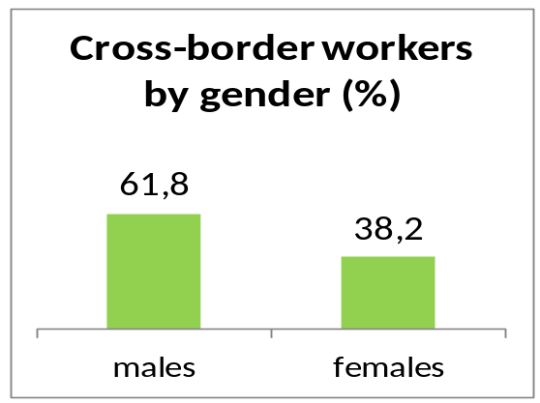
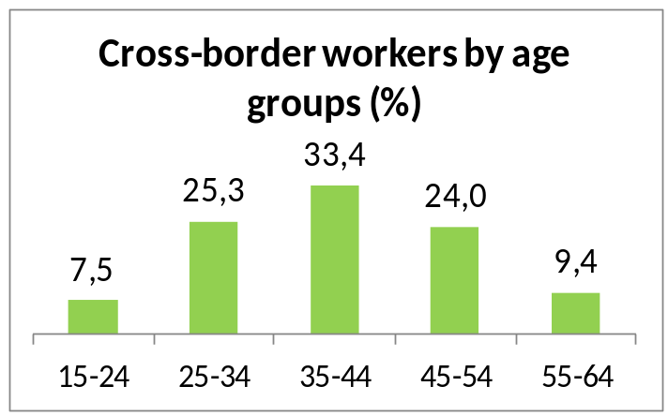
WHO ARE THEY? (1)
Italian cross-border workers to CH
(Source: PC 2011)
Comune Ronconi Viviano - CESS 2016 - Budapest 20 october

Slide 13
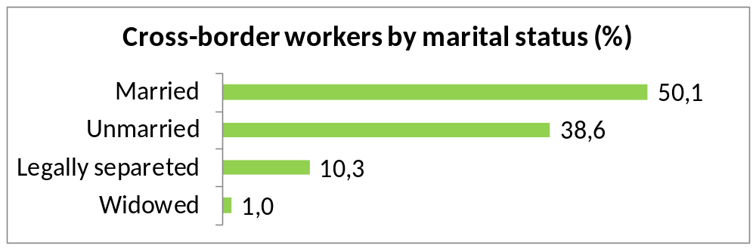
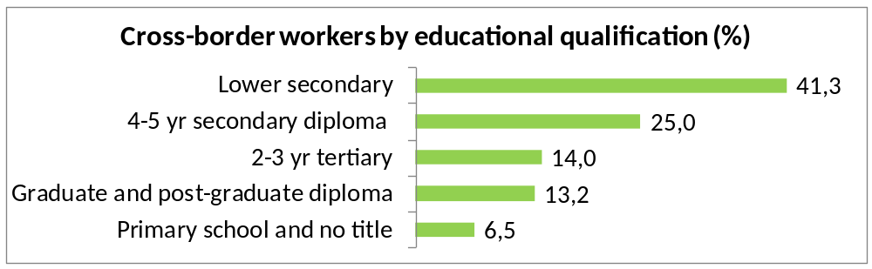
WHO ARE THEY? (2)
Italian cross-border workers to CH
(Source: PC 2011)
Comune Ronconi Viviano - CESS 2016 - Budapest 20 october

Slide 14
Conclusions
Cross-border employment in Italy: relevant at local level, constantly increasing trend. Mainly alpine area, flows significant to Switzerland. Good quality data available thanks to Swiss peculiar system of work permits. Other Italian border areas: lack of data, unofficial information or expert opinions
Statistical/administrative records: key role for data availability, but isolating information on cross-border workers may not be straightforward
Future work: design ad hoc methodologies or exploit other local/administrative sources
  (e.g. ArchIMEDE – Istat repository of economic and demographic microdata to integrate different administrative data - includes municipal registers, fiscal data, social security data, etc.)
Comune Ronconi Viviano - CESS 2016 - Budapest 20 october

Slide 15
Thank you for your attention!
Comune Ronconi Viviano - CESS 2016 - Budapest 20 october

