Slide 1
Use of European statistics to analyse and monitor the European Single Market in terms of competitiveness and openness
Aleksander Rutkowski
and Stefano Vannini
Directorate-General for Internal Market, Industry, Entrepreneurship and SMEs,
European Commission
Conference of European Statistics Stakeholders,
Budapest, October 2016

Slide 2
Outline
Context:
  our policy areas
  data inventory
What:
  focus on our conceptual framework for the European Semester indicators
  key Eurostat datasets used in that framework
How: our customised in-house tools/apps
Wish list for the future

Slide 3
Our big Directorate General, abridged
A - Competitiveness and European Semester
European Semester and Member States Competitiveness,
International Affairs
C - Industrial Transformation and Advanced Value Chains
Clean Technologies,
Resource Efficiency and Raw Materials,
Advanced Engineering,
Automotive and Mobility Industries
E - Modernisation of the Single Market
Consumer services, Public Interest Services, Digitalisation of the Single Market,
Business-to-business Services, Professional Qualifications and Skills
G - Single Market for Public Administrations
Public (e-) Procurement
H - COSME Programme
Enterprise Europe Network and Internationalisation of SMEs
I - Space Policy, Copernicus and Defence
Defence, Aeronautic and Maritime Industries
B - Single Market Policy, Regulation and Implementation
Mutual Recognition and Surveillance,
Prevention of Technical Barriers,
Standards, Enforcement
F - Innovation and Advanced Manufacturing
Innovation and Investment, Clusters, Social Economy and Entrepreneurship, KETs, Digital Manufacturing and Interoperability, Tourism, Emerging and Creative Industries, Intellectual Property and Fight Against Counterfeiting
D - Consumer, Environmental and Health Technologies
REACH, Chemicals,
Biotechnology and Food Supply Chain,
Health Technology and Cosmetics
J - EU Satellite Navigation Programmes
Galileo and EGNOS
➔ many heterogeneous files,
project-specific datasets and analysis methods

Slide 4
Our main data sources
General-purpose and macroeconomic
Eurostat (incl. Comext)
OECD.Stat (incl. PMR)
UN (incl. Comtrade)
WIOD
AMECO (DG ECFIN)
World Bank (incl. Doing Business)
IHS World Industry Service

Slide 5
Our main data sources, continued
Domain-specific and microeconomic
Orbis (Bureau van Dijk)
PATSTAT/INPADOC (European Patent Office)
MAPP/TED (public procurement, in house)
Trademarks (WIPO, OHIM/EUIPO, national)
fDi Markets (FT.com)
strictly sectorial external (e.g. automobiles)
strictly sectorial in-house (e.g. fertilisers, postal)

Slide 6
Our conceptual framework for the European Semester based on the Eurostat data
3 general groups of country-sector-time level indicators:
IMPORTANCE
INTEGRATION
PERFORMANCE
Notes:
Explained next 3 slides

Slide 7
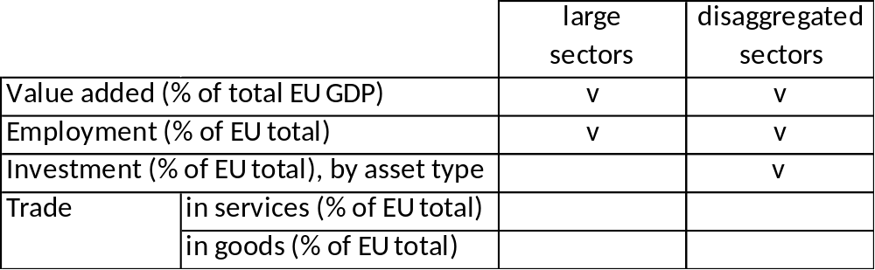
Our conceptual framework for Eurostat data: “importance”
Large vs disaggregated – no duplication:
a trade-off – more timely vs more fine-grained data.

Slide 8
Our conceptual framework for Eurostat data: “importance”
Value added share in total EU GDP (%), large sectors
Value added share in total EU GDP (%), disaggregated sectors
Employment share in the EU total (%), large sectors
Employment share in the EU total (%), disaggregated sectors
Investment share in the EU total (%), disaggregated sectors and asset types
Trade in services, share in the EU total (%)
Trade in goods, share in the EU total (%)
Large vs disaggregated – no duplication:
a trade-off – more timely vs more fine-grained data.

Slide 9
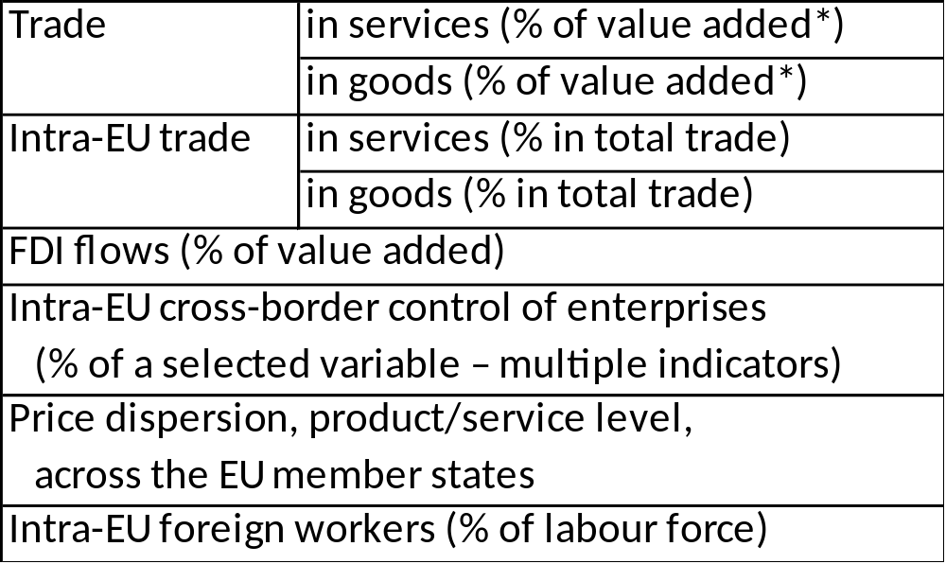
Our conceptual framework for Eurostat data: “integration”
* Required building in-house “correspondence tables” between different classifications – we couldn’t find the appropriate ones on Eurostat’s RAMON.

Slide 10
Our conceptual framework for Eurostat data: “integration”
Trade in services (% of value added)*
Trade in goods (% of value added)*
Intra-EU trade in services, share in total trade (%)
Intra-EU trade in goods, share in total trade (%)
FDI flows (% of value added)
Intra-EU cross-border control of enterprises (% of a selected variable – multiple indicators)
Price dispersion, product/service level, across the EU member states
Share of intra-EU foreigners in labour force (%)
* Required building in-house “correspondence tables” between different classifications – we couldn’t find the appropriate ones on Eurostat’s RAMON.

Slide 11
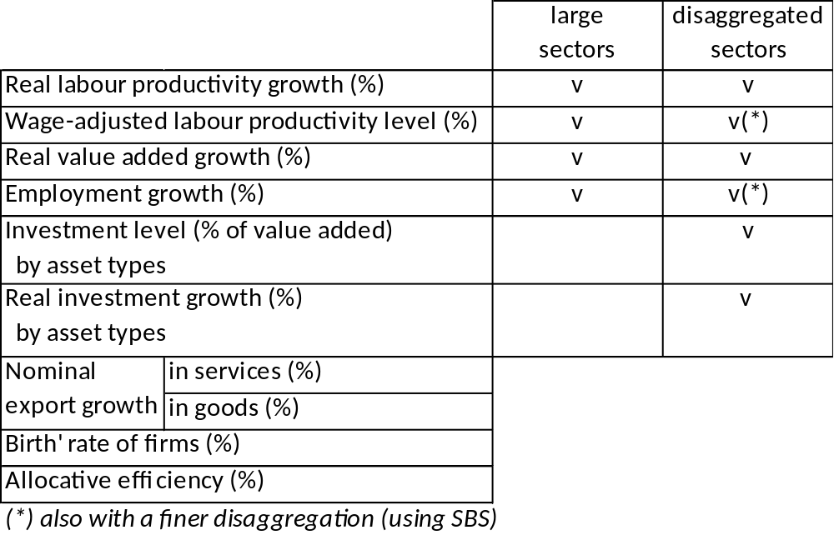
Our conceptual framework for Eurostat data: “performance”

Slide 12
Our conceptual framework for Eurostat data: “performance”
Real labour productivity growth (%), large sectors
Real labour productivity growth (%), disaggregated sectors
Wage-adjusted labour productivity level (%), large sectors
Wage-adjusted labour productivity level (%), disaggregated sectors
Wage-adjusted labour produc. level (%), the most disag. sectors (based on SBS)
Real value added growth (%), large sectors
Real value added growth (%), disaggregated sectors
Employment growth (%), large sectors
Employment growth (%), disaggregated sectors
Employment growth (%), the most disaggregated sectors (based on SBS)
Investment level (% of value added), disaggregated sectors and asset types
Real investment growth (%), disaggregated sectors and asset types
Nominal export growth in services (%)
Nominal export growth in goods (%)
'Birth' rate of firms (%)
Allocative efficiency (%)

Slide 13
Our conceptual framework for Eurostat data: 25 actual datasets (so far)
National Accounts
nama_10_a10
nama_10_a10_e
nama_10_a64
nama_10_a64_e
nama_10_an6
nama_10_gdp
nama_10_nfa_fl
Labour Force Survey
lfsa_agan
Prices
prc_ppp_ind
Structural Business Stat.
sbs_na_1a_se_r2
sbs_na_con_r2
sbs_na_dt_r2
sbs_na_ind_r2
sbs_sc_1b_se_r2
sbs_sc_con_r2
sbs_sc_dt_r2
sbs_sc_ind_r2
sbs_sc_sca_r2
Foreign Affiliates Stat.
fats_g1a_08
Balance of Payments Stat.
bop_fdi_flow_r2
bop_fdi6_flow
bop_its_det
bop_its6_det
Trade in goods
ext_lt_intratrd
Business demography
bd_9bd_sz_cl_r2

Slide 14
Our tools and applications: analyst side (Chief Economist Team)
Command-line toolset – the packages/libraries of Stata commands and R functions for automated:
  multi-criteria search through dataset inventory
  (“table of contents”)
  download, decompress, import, and reshape of the datasets
  joins/merges with descriptive labels for codes (“dictionaries”)
Hence, we rely fully on and integrate deeply with Eurostat’s Bulk Download Facility
All developed in-house by economists rather than IT developers. Modern tools allow domain knowledge (data/statistics) to takes precedence over IT knowledge.

Slide 15
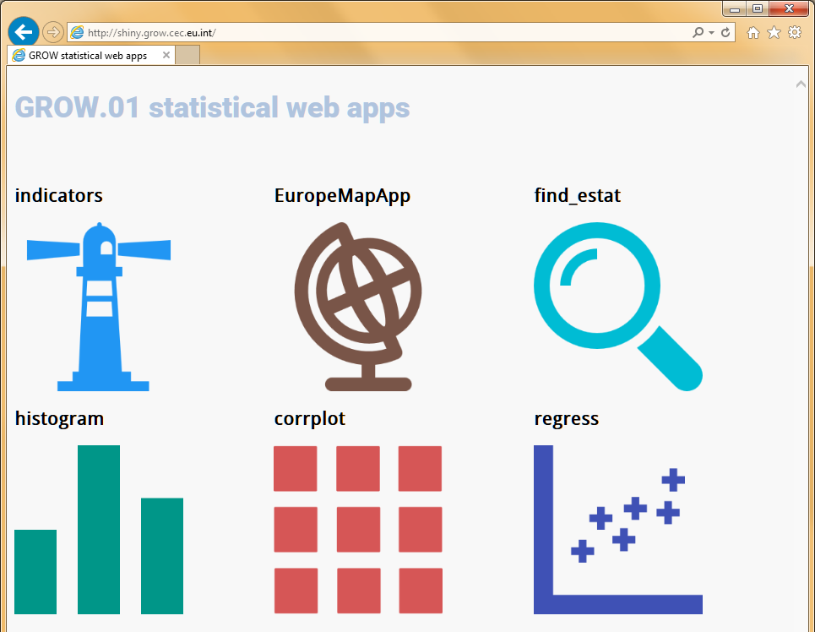
Our tools and applications: user side (policy units)
Intranet web server
GUI apps based on open-source R/Shiny
Mapping indicators on geo maps. We rely on Eurostat’s NUTS-3 shapefiles.
Our in-house data search engine.
We dare to say: more convenient than the current Eurostat's search engine (clearer tabular output, focus on datasets)
IMPORTANCE, INTEGRATION, PERFORMANCE, updated daily,
dynamic selection, dynamic charts, explanatory notes
The icons are made by Freepik, Plainicon, and SimpleIcon, from www.flaticon.com and licensed by CC BY 3.0.

Slide 16
Wish list for the future
We look forward to:
As always ☺ data being more up-to-date and less missing data
  working together on harmonised “now-casting” and imputation?
Better consistency of the datasets and the RAMON correspondence tables codes, more correspondence tables
  easier conversions between classifications, no more semi-manual data cleaning, easier work with multiple datasets
Some version control for datasets
  easy identification of revisions without the need to constantly make own copies of different vintages of the Eurostat datasets

