Slide 1
Labour productivity indicators for the EU28 Member States: Quality Adjusted Labour Input
Isabelle Rémond-Tiedrez
European Commission, Eurostat
José M. Rueda-Cantuche
European Commission, Joint Research Center

Slide 2
QALI in European Union
Outline
  Project background
  Methodology of QALI
  Data sources for QALI
  Constraints of data sources
  Results and applications

Slide 3
Project background
Competitiveness project
  Regular production of coherent set of competitiveness dashboard (35 indicators)
  European Statistical System statistics (30/35) + OECD, WorldBank
  One part: productivity measures
    Quality Adjusted Labour Index
    Capital indicators (estimation of a set of capital indicators - (net) fixed capital stock; gross fixed capital formation by 7 asset categories (AN_F6) and 10 industries (NACE Rev. 2, A*10); in current prices and in volume )

Slide 4
Methodology of QALI
  Törnqvist index: weights are labour income shares
  National Accounts aggregates benchmarked hours worked and compensation of employees
  Workers groups
    Age: 3 categories
    Skill: 3 categories
    Industry breakdown: 10 or 21
  Same methodology for all EU Member States (macro level not micro data linking)

Slide 5
Data sources for QALI
LFS
Annual Hours
% by Skill/Age
SES/SILC
Earnings
% by Skill/Age
SES/SILC
hours
% by Skill/Age
NA
Hours
NA
Compensation of Employees
SES/SILC
Earnings/hour
% by Skill/Age
Surveys Annual Earnings
% by Skill/Age
NA
Hours
by Skill/Age
NA
Compensation of Employees
by Skill/Age
QALI
by Skill/Age

Slide 6
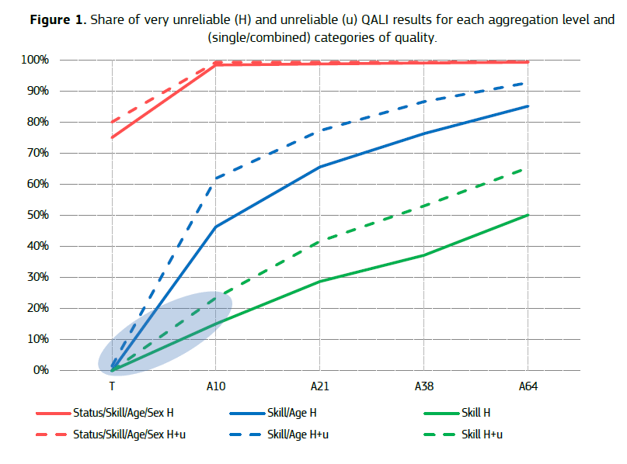
Constraints of data sources
Confidentiality and reliability dissemination constraints
Coverage : EU-SIL for Agriculture activities
Interpolation of data sources: SES 2002, 2006, 2010
Change of NACE classification

Slide 7
Results
EU 2014 composition of labour force per age

Slide 8
Result (2)
EU employment by skill level

Slide 9
Results (3)
EU index

Slide 10
Applications
EU 2014 Employment embodied in exports

