Slide 1
Towards to interpretable FDI data in external statistics
Filtering distortions arising from globalisation from data of multinational enterprises
Practice of the Central Bank of Hungary
Ms. Beáta Montvai
Statistical analyst
Magyar Nemzeti Bank
montvaib@mnb.hu
Conference of European
Statistics Stakeholders
Budapest, 20–21 October 2016

Slide 2
Globalization vs. National statistics
FDI is a key element in the evolving international economic integration
Multinational enterprises have become significant players of cross border investments
Statistical data collection, compilation and dissemination is based on national level
Financial structures of multinational enterprises represent multidimensional complexity and needs new answers from the current internatinal statistical methodology and the national compilers of international statistics (BOP, NA)

Slide 3

Practice of the MNB
FDI statistics shall properly reflect international investment flows
In order to publish interpretable FDI data, the MNB has identified distortive effects of globalization on BoP/FDI data and publish supplemenary brekdowns to inform users.
Distortive effects:
  1. Special Purpose Entities (SPE)
      Separate BOP compilation
  2. Capital in transit
      Micro level approach
  3. Asset portfolio restructuring
      Micro level approach
Suplementary breakdowns :
  Separating M&A transactions
  Inward FDI position published by the country of the ultimate investor

Slide 4
Special purpose entities compiled an published separately as of 2006
An enterprise is usually considered as an SPE if it meets the following criteria:
registered as a legal entity
100 % of voting power controlled by a non-resident parent
has no or few employees
little or no production in the host economy
little or no physical presence
most assets and liabilities of the enterprise represent investments in or from other countries
core business is group financing or holding - channelling funds from non-residents to other non-residents
Notes:
SPEs are residents, they basically perform their activities abroad, their connection with the domestic economy is minimal. They are primarily involved in intra-group intermediation of financial resources, that might be resulted in substantial external financial flows and positions.

Slide 5
New distortive effect in 2010’s - 1. Capital in transit
If a resident, non-SPE company belonging to a multinational company group is also active in passing through capital within the enterprise group, in addition to its normal activities (production, service)
The foreign owner decides if the special activity is performed through the resident affiliate or third countries
To recognize a capital in transit it helps that the volume of inflow and outflow is typically same or similar within a specific (short) period
Beside enterprise approach (statistical units are enterprises), separate transactions of the statistical units must be considered
This activity increases the total value of both capital inflows and outflows in the statistics. Similarly to the activities of SPEs, this flow of capital has no effect on the economy of the given country.

Slide 6
New distortive effetcs - 2. Asset portfolio restructuring
  If a multinational corporation, restructures the assets of a subsidiary into another subsidiary in another country (intra company movement)
On national level: Extremely high capital withdrawal and equity or debt investment must be recorded in the BoP without any real capital withdrawal and investment taking place into the country.

Slide 7
Suplemental breakdowns -1. segregating mergers and acquisitions
With M&A, a company does not receive additional funds and no disinvestment takes place either, only the ownership structure of the already existing investments changes
M&A transactions do not distort FDI statistics, only provide supplementary information on the changes in the funds available for the companies affected by direct investments

Slide 8
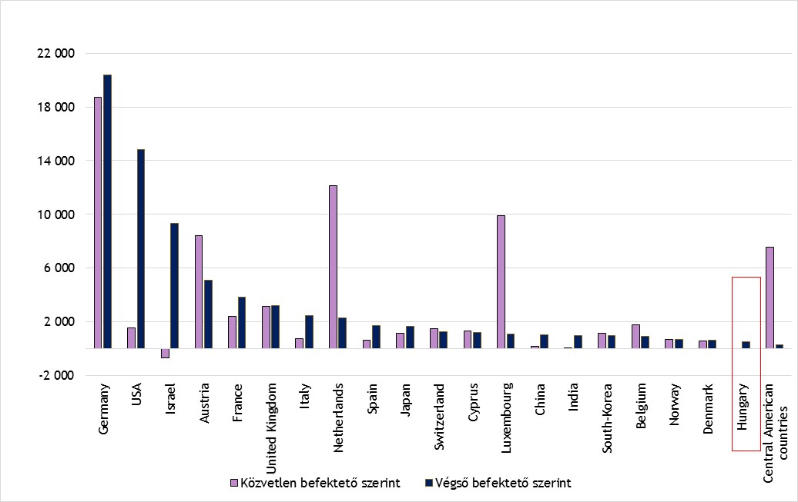
Suplemental breakdowns 2. Inward FDI position by country of the ultimate investor
Standard FDI statistics are presented according to the location of the immediate investor (by the immediate source of the funding) (pink coulor)
However, new aproach requires the identification of the ultimate investor who ultimately controls investment and bears the risks and reaps the rewards of the investment in a country (dark blue colour)

Slide 9
Closing remarks
International financial flows of Multinational enterprise groups affect national statistics with different importance - Globalisation may have significant distortive effects on the national statistical data collection, processing, publication- thus interpretation - of national FDI-statistical publications.
The new editions of international guidelines, especially the OECD Benchmark Definition on FDI 4th edition (BMD4) gives new technics in financial measures of foreign direct investment.
In order to improve the quality of these statistics and reducing the distortive elements of FDI statistics we have developed a special national practice in Hungary.
Besides separating Special Purpose Enterprises as required in BMD4/BPM6, we found informative/necessary for our users to publish detailed data on capital in transit, asset portfolio restructuring transactions and adjusted direct investment flows.

Slide 10
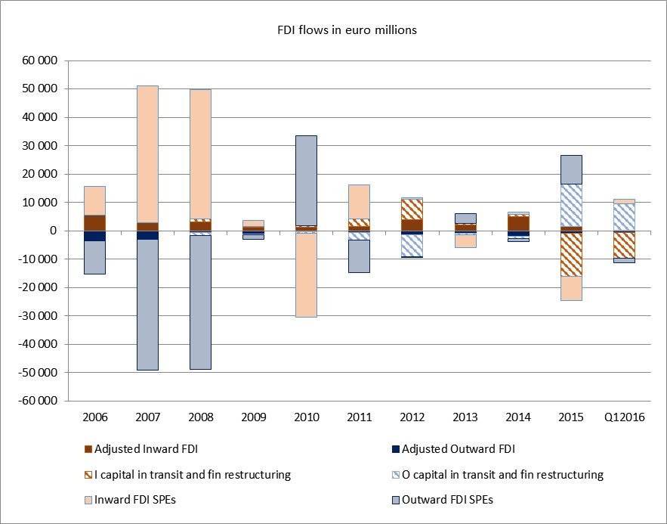
The different magnitude of the adjusted FDI flows and distortive effects in Hungary

Slide 11
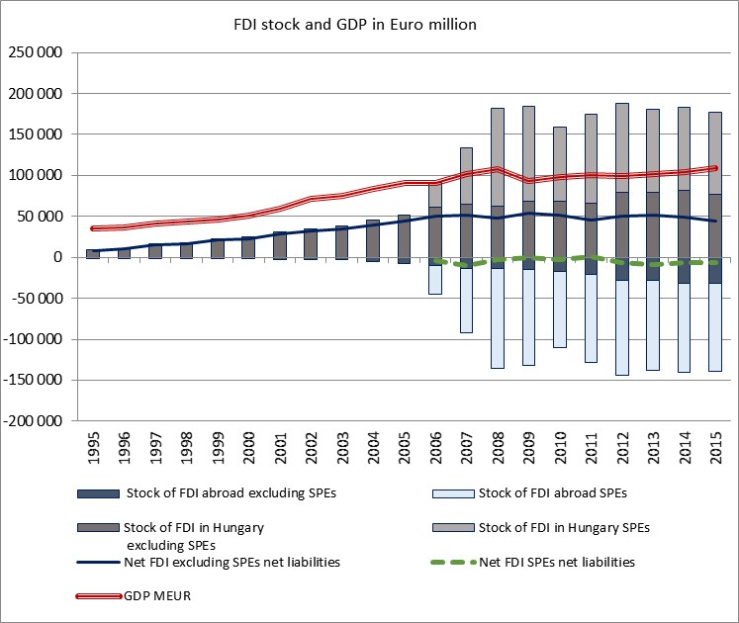
The different magnitude of FDI stocks excluding SPEs and including them

Slide 12
Thank you for your attention!

