Slide 1
Providing comparable information to assess global financial stability risks
Bruno TISSOT
Head of Statistics and Research Support, BIS
Head of Secretariat, Irving Fisher Committee on Central Bank Statistics (IFC)
CESS 2016 Conference of European Statistics Stakeholders - Budapest, 20–21 October 2016
The views expressed are those of the author and do not necessarily reflect those of the BIS or the IFC.

Slide 2
Main points
A lot has been done since the Crisis to enhance data comparability
Yet (much) more is needed
  ►At the macro and at the more micro level
We also need a change in our conceptual framework
  Financial stability issues are global
  Looking at traditional residency-based statistics can be misleading
  Nationality-based consolidated datasets can help to better analyse the relative situation of a country

Slide 3
1. Data issues highlighted by the Great Financial Crisis…
The 2007/09 Crisis highlighted key data aspects, such as:
  Excessive leverage…
  New players in financial markets…
  Cross-border linkages…
  Supervisory challenges…
Collecting comparable international data is key to address financial stability issues

Slide 4
… leading to large post-crisis statistical efforts…
G20-endorsed Data Gaps Initiative (DGI)
  Phase I issued by FSB and IMF in 2009 with 20 recommendations
  The integration of economies and markets (…) highlights the critical importance of relevant statistics that are timely and internally consistent as well as comparable across countries
BIS and central bank community involved directly or indirectly in around 2/3 of the recommendations
Inter-Agency Group on Economic and Financial Statistics: coordinating & monitoring the implementation of the DGI

Slide 5
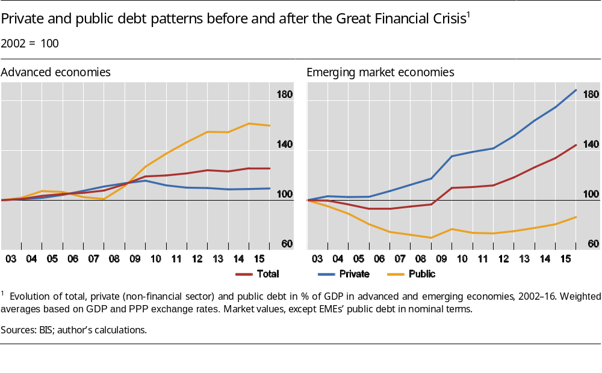
… with significant progress in terms of data on (i) debt…
We now have better data to compare debt across countries
& sectors !

Slide 6
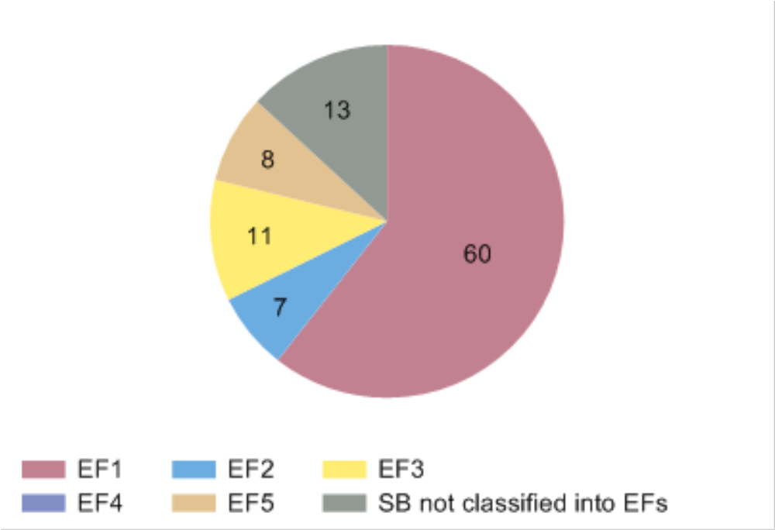
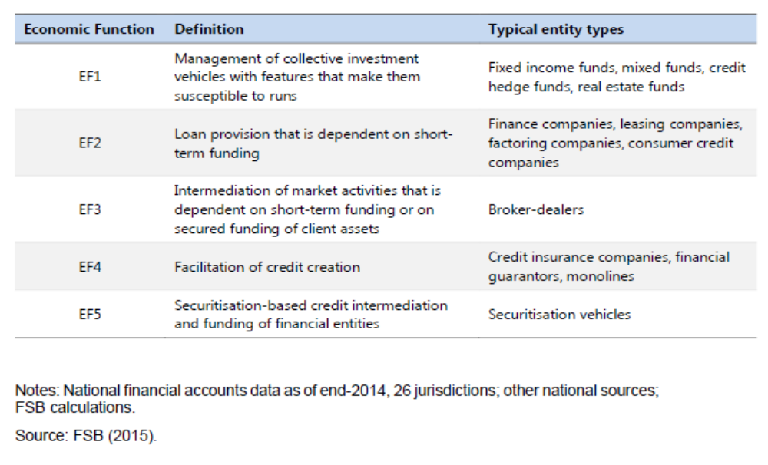
… (ii) financial intermediaries….
We now have a FSB regular data collection on shadow banks!
Shadow banking by economic function: size in % of total shadow banking

Slide 7
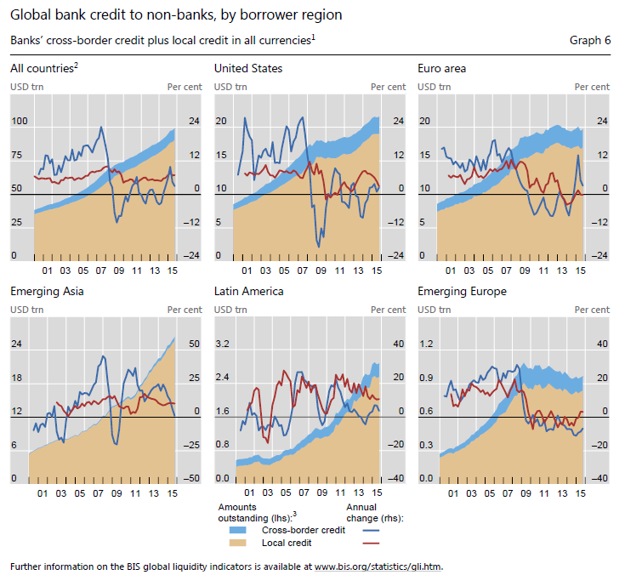
… cross-border & sector linkages…
We now have more consistent information on credit flows vis-a-vis counterparty countries and sectors!
See BIS “Global Liquidity Indicators”

Slide 8
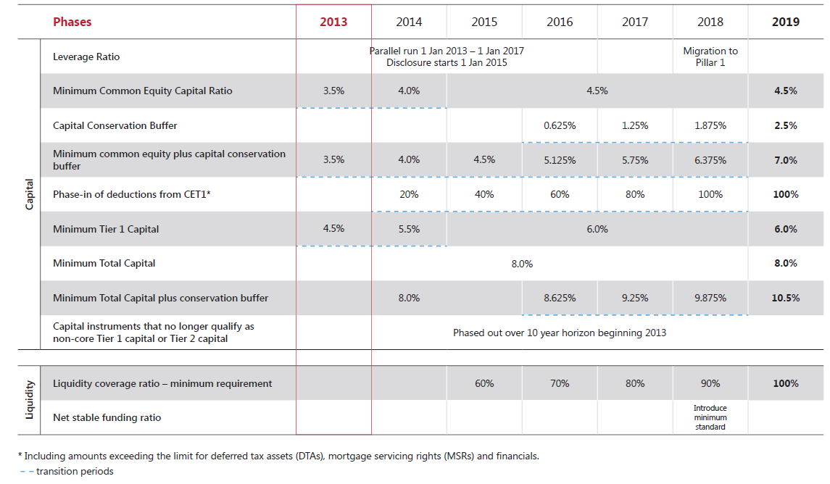
… and evidence-based financial regulation…
(Basel III phase-in arrangements)
Various regular Quantitative Impact Studies (QIS) to design regulation and monitor implementat-ion

Slide 9
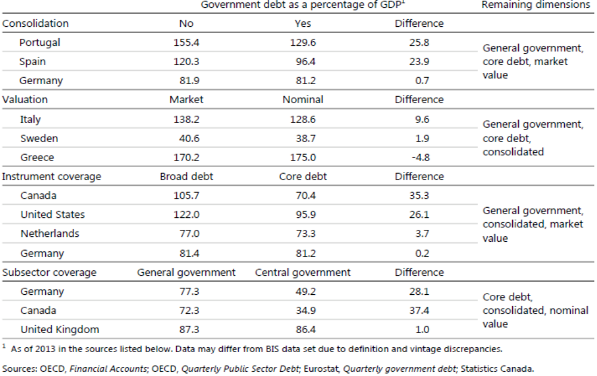
… yet there are still large Data Gaps!!!
Comparing public debt is still a key challenge.
Issues relate to consolidation, valuation, instrument & sectoral coverage
Source: Dembiermont, C, M Scatigna, R Szemere and B Tissot (2015): A new database on general government debt, BIS Quarterly Review, September, pp 69–87.

Slide 10
2. Post-crisis efforts: the 2nd DGI phase (DGI-II, 2016)…
“Implementing collection and dissemination of:
  comparable,
  timely,
  integrated,
  high quality,
  and standardized statistics
  for policy use”
“Help straddle the divide between micro and macro analysis”

Slide 11
… with a focus on three main levels of information…
Better macro statistics
Distribution information
Micro data
  As a tool for better macro statistics
  In itself: “pure”, macro-relevant micro information

Slide 12
… (i) the macro level…
Development of “integrated sectoral financial accounts”
Focus on financial positions and interconnections (eg FWTW tables)
More detailed subsectors
More information on instruments eg Foreign Currency exposures – including domestic positions
Link between the economy and the RoW: counterparty sectors and countries

Slide 13
… (ii) the distribution information level…
Focus on the distribution of indicators within a country
  Distributions relevant for policy purposes
  Increased importance in the post crisis era
  All countries’ aggregates are not the same!
DGI Recommendations
  “compile distributional information alongside aggregate figures…
  … & link national accounts data with distributional information”

Slide 14
… and (iii) the micro level
Collection of “pure”, macro-relevant micro information: eg SIFIs
►We need to see the forest as well as the trees within it (Borio, 2013)
Micro data to support macro compilation
  Mobilising “administrative” datasets
  Frameworks to combine micro- and macro-level data
Significant challenges
  Accounting
  Identification of institutions (Legal Entity Identifier - LEI)
  Standardisation of financial reports eg derivatives

Slide 15
3. But international comparisons require a conceptual paradigm shift
Increased role played by global companies / but international comparisons still rely on the residency-based SNA framework
Usual country statistics do not integrate the impact of the activities of national groups performed outside domestic boundaries
New data opportunities: nationality-based datasets can complement traditional residency-based statistics
►A few examples

Slide 16
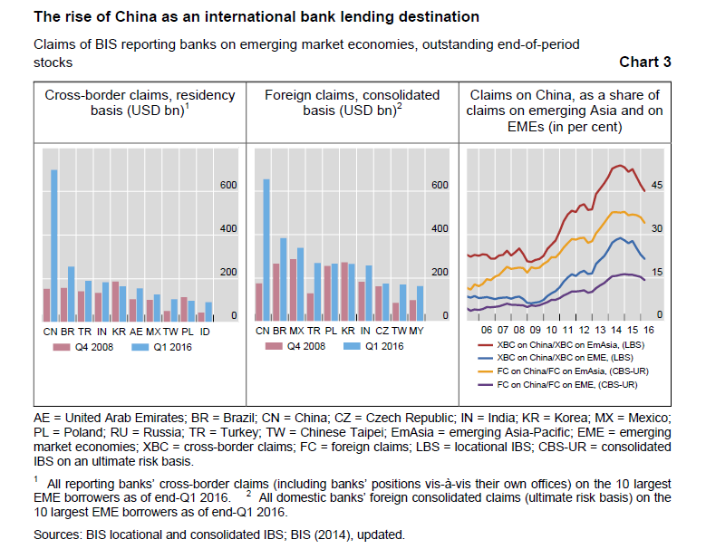
(i) Comparing international banking systems on a consolidated basis
  China first EME international bank lending destination
  Yet large inter-offices positions channelling credit to China
  Relative importance of Chinese borrowers is reduced on a consolidated basis

Slide 17
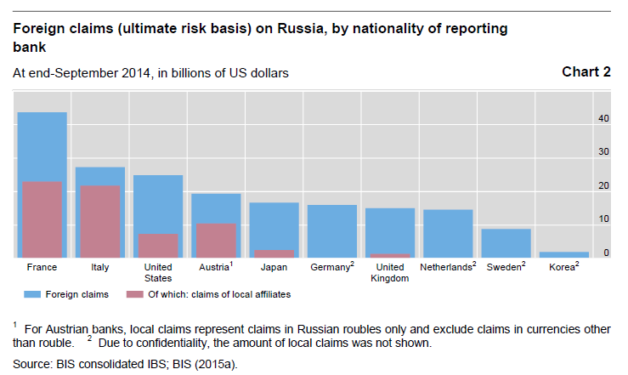
(ii) Assessing the foreign exposures of national banks
  Banks’ foreign claims on Russia in 2014 (blue)
  Importance of the claims booked by local affiliates (pink)
  Looking at cross-border claims is not enough

Slide 18
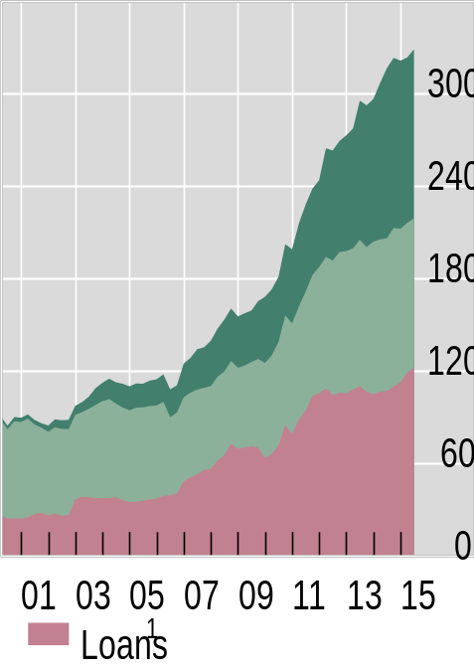
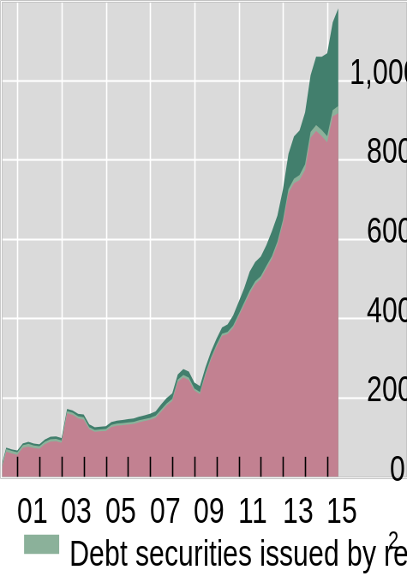
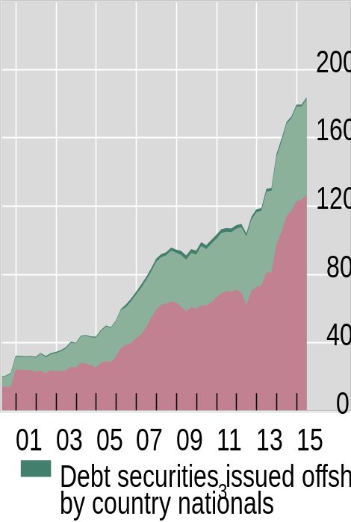
(iii) Measuring the reliance on international financing
  Debt issuance: the 2nd phase of global liquidity
  Issuance by (non-resident) affiliates can be large
In billions of US dollars
Brazil
China
Turkey
¹ US dollar-denominated loans to non-bank residents of the country listed in the panel titles. For China, locally extended US dollar loans are estimated from national data on total foreign currency loans, assuming 80% are dollar-denominated. ² Outstanding US dollar debt securities issued by non-bank residents of the country listed in the panel title. ³ Outstanding US dollar-denominated bonds issued offshore (ie outside the country listed in the panel title) by non-banks with the nationality listed in the panel title.
Sources: BIS locational banking statistics by residency; BIS International Debt Securities Statistics; national sources; BIS calculations.

Slide 19
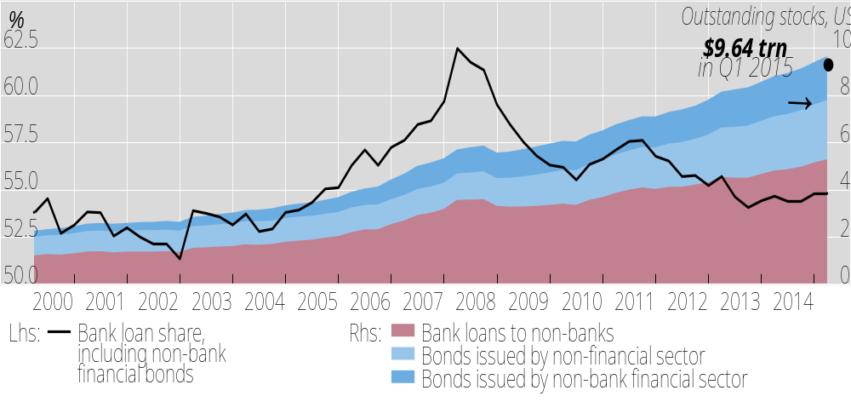
(iv) Looking at the impact of (domestic) monetary policies
$ credit to non-banks outside US represents $
10 trillion
Bank loans include cross-border and locally extended loans to non-banks outside the United States. For China, locally extended loans are derived from national data on total local lending in foreign currencies on the assumption that 80% are denominated in US dollars. For other non-BIS reporting countries, local US dollar loans to non-banks are proxied by all BIS reporting banks’ gross cross-border US dollar loans to banks in the country. Bonds issued by US national non-bank financial sector entities resident in the Cayman Islands have been excluded.
Sources: IMF, International Financial Statistics; Datastream; BIS international debt statistics and locational banking statistics by residence; BIS calculations.

Slide 20
Nationality-based statistics to enhance country comparisons…
Nationality-based consolidated data help to understand:
  who takes the underlying economic decisions?
  who supports the final risk and needs to hold buffers?
  in which country resides the ultimately responsible unit?
Key information for fiscal, monetary and prudential authorities – examples:
  Measuring the exposures of national (consolidated) banking systems, including foreign-resident offices
  Identifying claims on an immediate borrower basis but also on an ultimate risk basis (ie adjusting for credit risk mitigants)

Slide 21
… and support financial stability analysis
Facilitates the monitoring of the activities of global groups outside their resident markets, and hence the risks faced by national entities
Helps identifying spillover effects form national policies to other areas
Progress so far has mainly been on the financial sector
OECD ongoing work on Multinational Enterprises

Slide 22
Annex: International comparability and statistical post-crisis initiatives: five key dimensions
Area | Initiatives ⁽¹⁾ | Access to granular data | Information on distribution | Enhanced macro statistics | Evidence-based policy | Nationality-based information
Quality of statistics | II-1 |  |  | ✔
FSI indicators | II-2, 3 (I-2, 3) |  | ✔ |  | ✔
G-SIFIs | II-4 (I-8, 9) | ✔ |  |  | ✔ | ✔
Shadow banks | II-5 (I-4) | ✔ |  | ✔ | ✔ | ✔
Derivatives | II-6 (I-5) | ✔ |  | ✔ | ✔ | ✔
Securities | I-6, II-7 (I-7) | ✔ |  | ✔
Sectoral accounts | II-8 (I-15) |  |  | ✔
Distribution information | II-9 (I-16) |  | ✔ |  | ✔ | ✔
International statistics (eg IIP, IBS, CPIS, CDIS, GFS, PSDS, RPPI, CPPI) | II-10, 11, 12, 13, 15, 16, 17, 18 (I-10, 11, 12,17, 18, 19 |  |  | ✔
Cross-border exposures | II-14 (I-13, 14) | ✔ |  | ✔ |  | ✔
Granular identifier (eg LEI) | II-4, 5, 6, 14 | ✔ |  |  |  | ✔
Data sharing | II-19 | ✔ |  | ✔ |  | ✔
QIS exercises | Basel III, II-4, other regulatory work | ✔ |  |  | ✔ | ✔
(1): I- and II- relate to, respectively, the first and second phases of the Data Gaps Initiative (DGI) endorsed by the G-20.

