Slide 1

Session B7: promoting comparability in international statistics
Presentation #3:
Trade asymmetries, consistency between National Accounts and Balance of Payments; and international comparability
Conference of European Statistics Stakeholders
Budapest, 20-21 October 2016

Slide 2
Presentation
  Recent results on consistency in a nutshell
  Reasons for inconsistencies – state of findings (nontechnical)
  Bridging consistency and asymmetry aspects for trade in services
  Conclusions and outlook

Slide 3
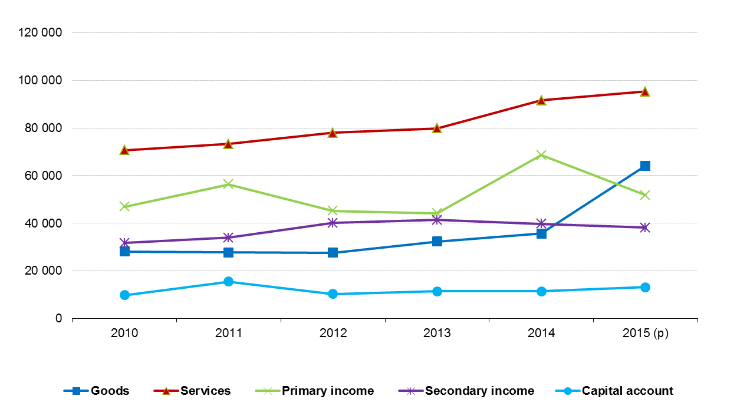
Extent of discrepancies in the nonfinancial accounts
  Absolute discrepancies, 2010-2015, sum of EU-28 MS
  (EUR million) - July 2016

Slide 4
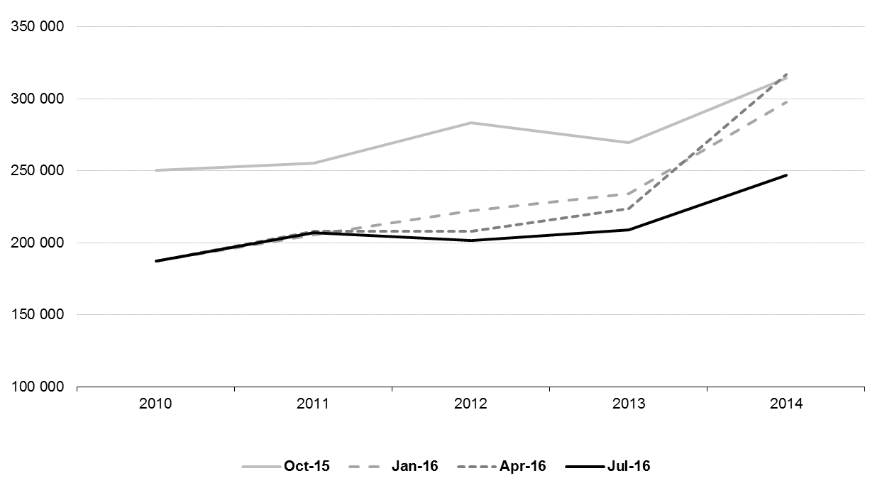
Impact of revisions
  Absolute discrepancies, sum of EU-28 MS, Oct.2015-July 2016 vintages (EUR million)

Slide 5
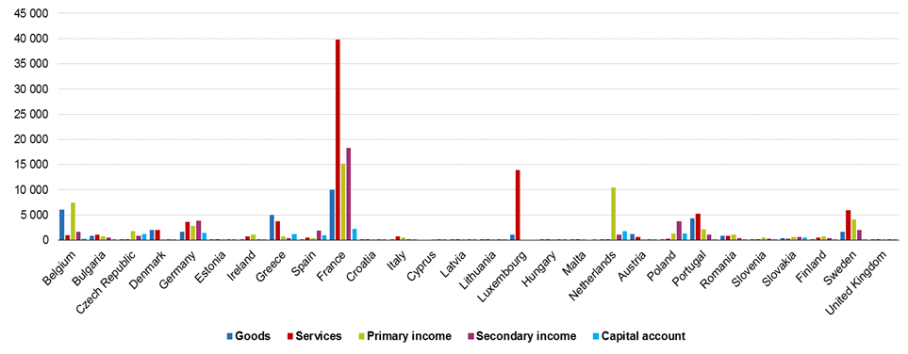
The geographical representation of inconsistencies (1)
  Absolute discrepancies, by EU-28 MS, mean 2010-2015 (EUR million) – July 2016

Slide 6
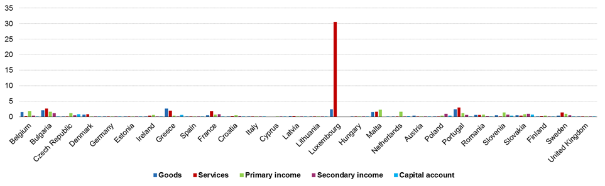
The geographical representation of inconsistencies (2)
  Relative discrepancies, by EU-28 MS, mean 2010-2015 (% of GDP) – July 2016

Slide 7
Reasons for inconsistencies – state of findings
  Autonomous organisational setting of national compilation processes
  Different access to (micro) data sources or source statistics
  Different estimation or extrapolation practices
  Rigidity of automated IT systems
  Different sector or geographical delineations
  Institutional progress in adopting statistical standards
  Systemic revision and vintage effects

Slide 8
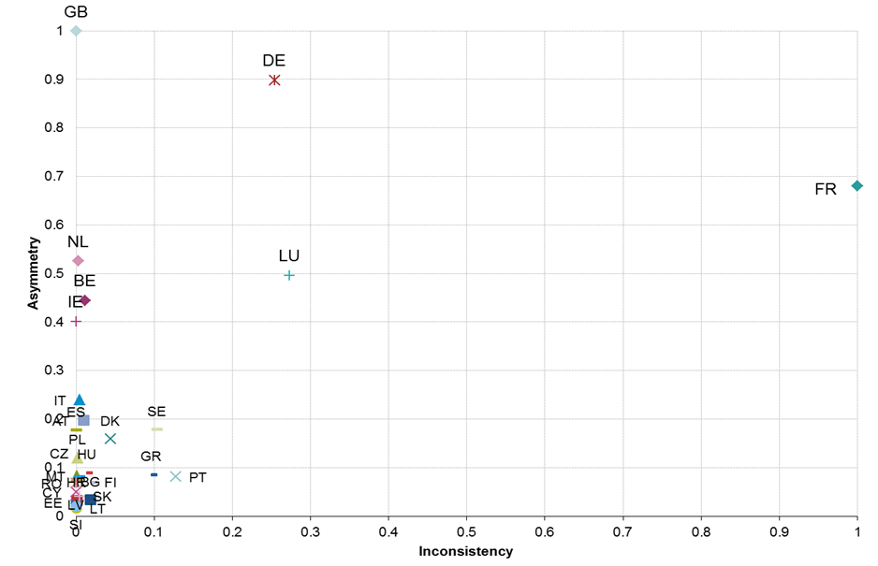
Bridging consistency and asymmetry aspects (1)
  Absolute discrepancies/asymmetries, trade in services, by MS, 2014 (normalised presentation)

Slide 9
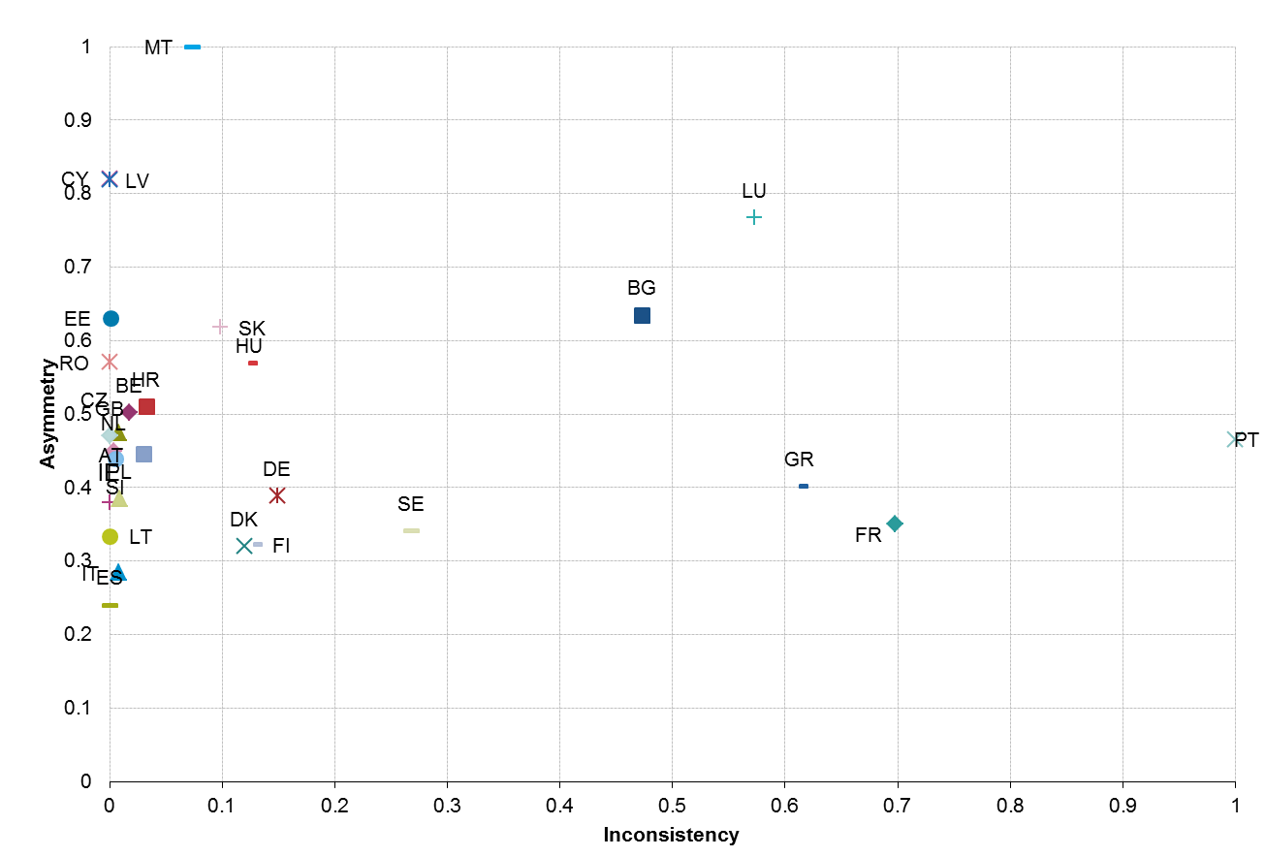
Bridging consistency and asymmetry aspects (2)
  Relative discrepancies/asymmetries, services, by MS, 2014 (normalised presentation)
  Percentage of total transactions in services

Slide 10
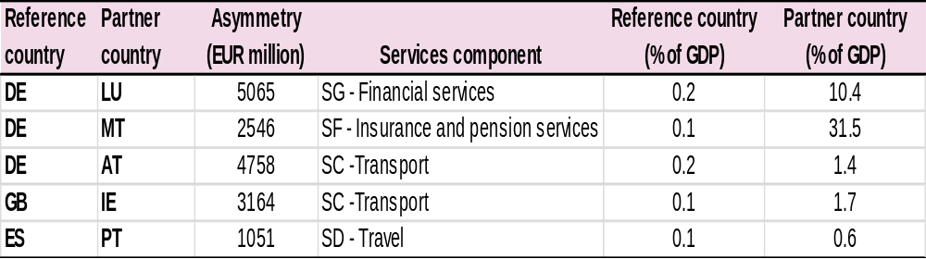
Impact of asymmetries
  Absolute asymmetries in selected countries and services components, 2014 (EUR million; % of GDP)
  Asymmetry = sum of absolute differences of credit and debit flows with their mirror transactions

Slide 11
Example: Financial services – asymmetries Germany and Luxembourg
DE < LU
Credit EUR 3 596 mn
LU > DE
Debit EUR 3 139 mn
DE > LU
Debit EUR 1 759 mn
LU < DE
Credit EUR 6 367 mn

Slide 12
Conclusions
  Comparability of both statistics in some MS very limited (especially services, primary income)
  Prominent intra-EU asymmetries for trade in international services
  Higher degree of coordination among European and worldwide counterparts
  Bilateral exercises not sufficient
  Global perspective/initiatives necessary to address issues

