Slide 1
"Migration flows: data and measurement"
Discussion
Giampaolo Lanzieri
EUROSTAT

Slide 2
Q&A for better migration measures
'What' do we measure?
  Challenging the concept of migration
'How' do we measure?
  New methods
'Where' do we measure?
  New data sources, better data exploitation
but also:
'When' do we measure?
'Who' does it actually?

Slide 3
Is the migration definition obsolete?
UN and EU definition of migration linked to the concept of (country of) usual residence
Higher mobility, lower transport costs, technologies, social media networking, new forms of families, freedom of movements, etc., are all challenging the concept of 'usual'
HOWEVER:
any change in the definition of migration implies a change in the definition of population

Slide 4
Statistical capture of migration
Usually considered 2 elements to identify a migration:
  The crossing of a border (space)
  The duration of stay abroad (time)
Often neglected:
  The timing of the statistical measurement
arrival
R1
R2
R3
time
2nd half year t
1st half year t+1
2nd half year t+1

Slide 5
Inclusion and reporting time
Reporting time 1 (R1):
  the person is included in the migration flow of the year t if the intention of stay is of at least one year
Reporting time 2 (R2):
  the person is included if the intention of stay is of at least one year, or considering an actual stay of 6 months + 1 day (most of the year)
Reporting time 3 (R3):
  the person is included if the actual stay is of at least one (continuous) year or, in default, based on the intention of stay measured at earlier time

Slide 6
'Actual' vs. 'intended' stay
The 'intended stay' should be a proxy of the 'actual stay' used when:
  The timing of the reporting does not allow to assess an actual stay of a year (R1 or R2 in the example before)
  The data source cannot capture the information on actual stay (e.g., survey of passengers at arrival)
The 'intended stay' avoids the would-be migrant to remain in a 'statistical limbo' for a year

Slide 7
The 'risk' of timeliness
Increasing need of timely information on 'would-be migrants'
Earlier reporting (towards 'real-time')
Larger use of 'intention of stay'
Higher risk of mismatch intended-actual stay

Slide 8
Confusing messages
'Media' language:
  arrival = asylum seeker = refugee = migrant = …
'Statistical' language:
  arrival ≠ asylum seeker ≠ refugee ≠ migrant ≠ …
The farther one is from technicalities, the fuzzier become the distinctions: would new/flexible definitions help the users to understand?

Slide 9
Further subtleness…
The 'usually resident population' (URP) is not the population concept used in all countries
What is a 'migration' in those cases?
  E.g.: for a population of national citizens (regardless of where they live), is the acquisition of citizenship a 'migration'?
  E.g.: in a 'permanent population', one may continue to belong to the population even if (s)he has left the country since long time; and one may belong to even without ever entering the country
Migration in non-URP could be disconnected from a physical border-crossing 'Migration' as change of population one belong to
Any adaptation needed in the models?

Slide 10
Efficacy of new data sources
Big Data:
  Assuming all issues related to bias / under-coverage / privacy / sustainability / etc. are solved, can they really have any effect on timeliness considering the definition of migration? (actual stay of 1 year)
Migration surveys:
  What are the pros and cons of a migration survey as compared to the (quicker) inclusion of variables linked to migration in already existing social surveys?

Slide 11
Statistical independence?
Migrants networks / strong & weak ties, family reunifications, 'chain migration', circular migration,…
Migration as a sequence of independent events?
Is the Poisson distribution the best candidate for modelling migration events?

Slide 12
Are statistical models 'objective'?
Example: Poisson / normal / gamma / log-normal / beta / mixed densities chosen in an application of a single method
Several other 'non-visible' methodological decisions taken, possibly in larger number in Bayesian applications
  Are Bayesian methods more 'difficult' in general?
Further on Bayesian methods:
  Are there evidences that informative priors elaborated from experts opinion are well performing?

Slide 13
Increasing complexity
The need of information on migrants goes well beyond the total counting.
Can statistical modelling remain 'manageable' when estimates must be produced consistently on a large number of individual characteristics? (additionally considering sampling variability)

Slide 14
Implementation issues in NSIs
High technical skills
Mobility/rotation of the personnel
Technical/scientific career path
Software / IT constraints
Learning/training opportunities

Slide 15
A way forward
Don't give up on harmonisation – that's primary!
Exploit better your data
Explore new data sources
Apply statistical models
Go Bayesian
Ensure sustainability

Slide 16
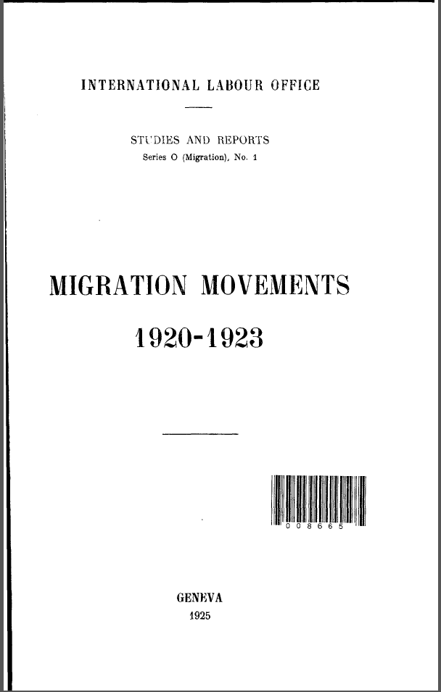
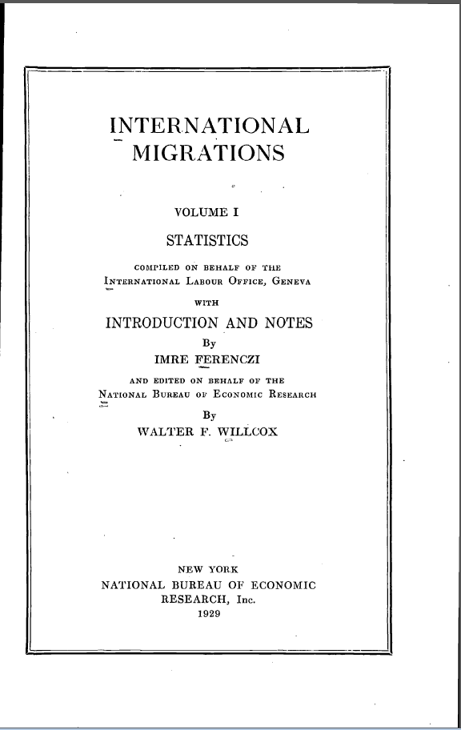
Thank you for the attention!
Dr. Imre Ferenczi
Former Chief of Migration Section
at ILO
Do you wish to discuss it further? You are welcome to contact me at: giampaolo.lanzieri@ec.europa.eu

