Slide 1
Perspectives for modelling in official migration statistics
ESRC Centre for Population Change
Jakub Bijak
University of Southampton
Conference of European Statistics Stakeholders
Budapest, 21 October 2016. Session B8 – Migration: Data and Management

Slide 2






Introduction
Importance of migration
High priority for the EU and UN (2016)
Demand for migration management
Prerequisite: more and better data
Fot: Irish Defence Forces
[CC BY 2.0] via Wikimedia Commons
Stake-
holders:
Notes:
Priority area around the world: European Agenda on Migration (2016), but also the UN New York Declaration Addressing Large Movements of Refugees and Migrants (September 2016)

Slide 3
Background
Regulation (EC) No 862/2007 on community statistics on migration
and international protection
  Art. 9
  “scientifically based and well documented statistical estimation methods may be used”
  to develop official statistics on migration and asylum
Notes:
We have the tools that enable us to do much more – and more creatively – with the data that we have at our disposal.

Slide 4
Problem
Provisions of Art. 9 underutilised
Available data do not achieve their full information potential
Should we look into:
  More data?
  New data?
  New methods?

Slide 5
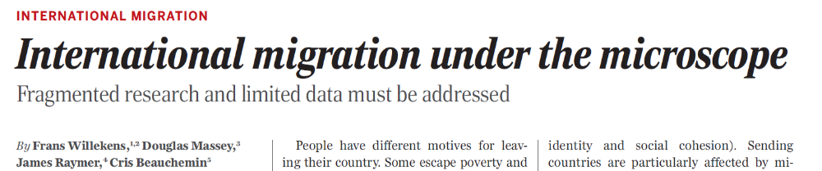

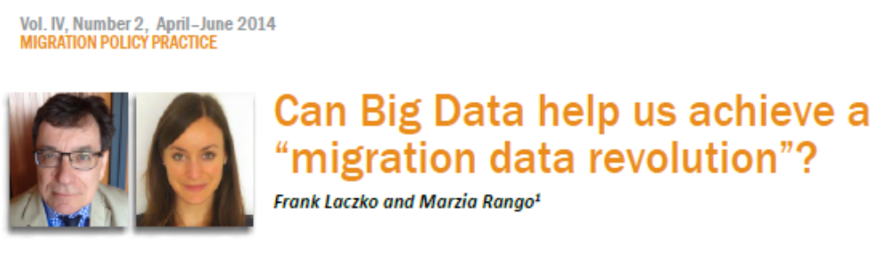

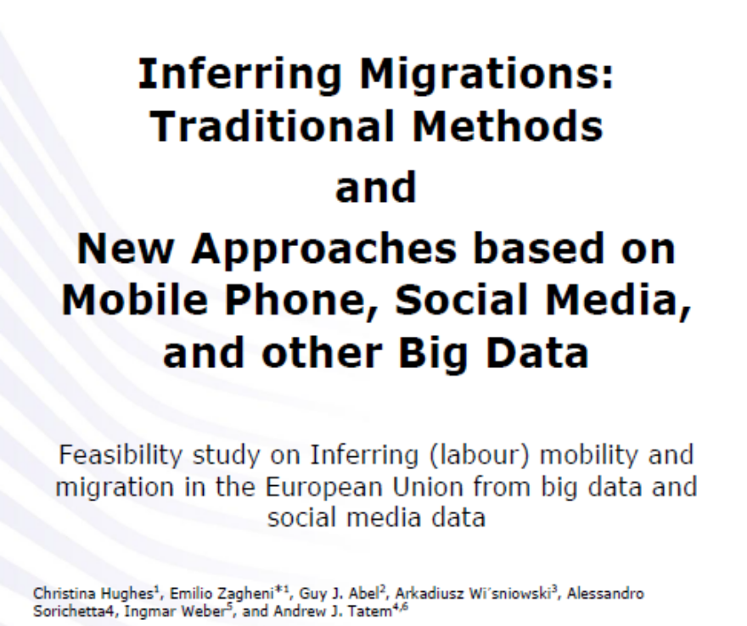
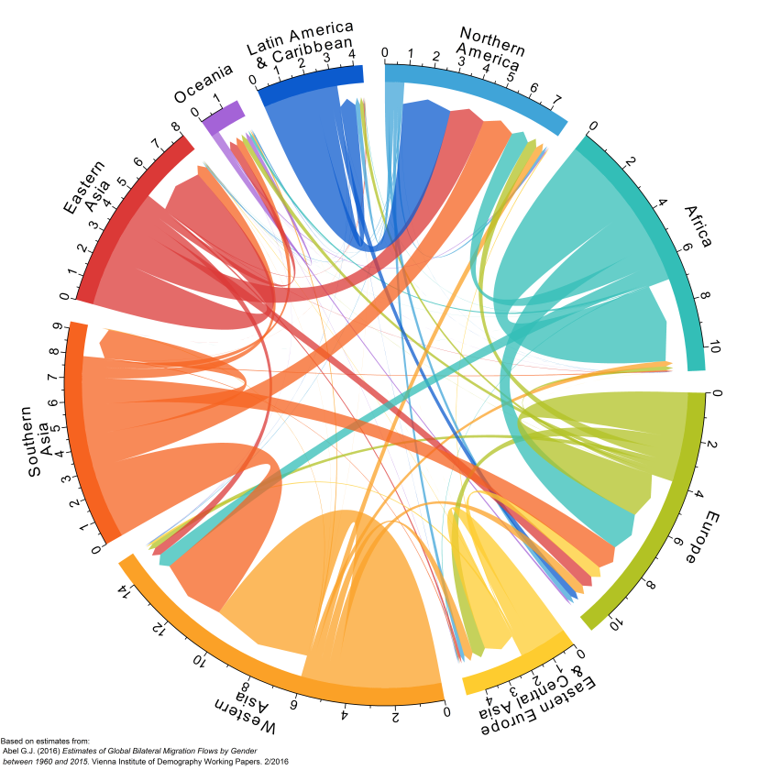
Guy Abel, via https://gjabel.wordpress.com
Notes:
Migration data limitations are still very high on the academic agenda. Big Data: there have been excellent examples of looking into the potential for the use of new data, new methods and approaches.

Slide 6
New concepts?
Traditional concepts rigid and not always fit for purpose
Towards purpose-driven concepts
and measures?
Time
(duration)
Type
(reason)
Space
(distance)
Notes:
But, does big data or new data not mean that the concepts we are used to (long-term migrants etc.) are out of date? Classification of migration/mobility flows along the three key dimensions will depend on the purpose of analysis. Note that type is no longer a dichotomous, or even categorical variable – the work on environmental migration or asylum-related flows suggests this is rather a continuum.

Slide 7
Flexibility
Mapping between different definitions
Challenge: Maintaining rigour and logical consistency
Migrants
3 months
migrations
Asylum seekers
6 months
Refugees
1 year
5 years
distance
Notes:
New methods need to be flexible to enable moving between different definitions – and Frans’s microsimulation approach, presented in the first talk, is an example of doing exactly that.

Slide 8
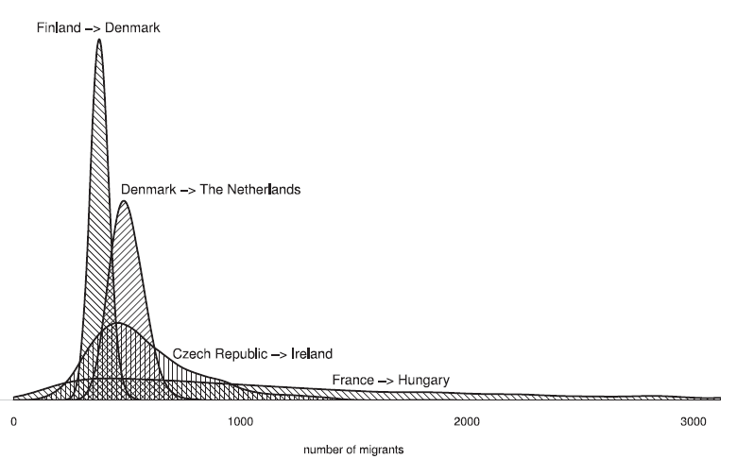
Integration of sources
Macro-level integration
Different countries or
data sources
Challenge: conceptual mapping
Examples
  IMEM project (Raymer et al. 2013)
  UK migration estimates (Disney 2015)
Raymer et al. (2013)
JASA 108, p811
Notes:
Different ways to integrate the existing data sources – either by fusing aggregates...

Slide 9
Integration of sources
Micro-level integration
Challenges: linkage quality,
privacy concerns
Examples
  Nordic population registers
  Post-enumeration surveys
A
C
B
Notes:
...or by individual-level linkage, multiple systems estimation, etc.

Slide 10

Ethical issues
Challenges surrounding data linkage:
  Anonymity and informed consent vs Big Data
  ‘Mission creep’: widening the data purpose
  Legal safeguards and data governance
http://www.ncrm.ac.uk/news/show.php?article=5444

Slide 11
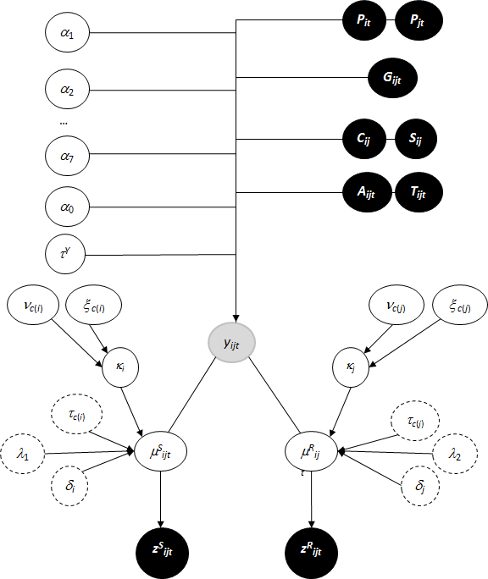
Statistical modelling
What are the “scientifically-based
and well-documented statistical estimation methods”?
  Hierarchical models?
    Bespoke solutions
    Data integration
    Flexible design
Raymer et al. (2013)
JASA 108, p804
Notes:
So, what methods can be used? One good choice are hierarchical models, which have some really desired properties.

Slide 12
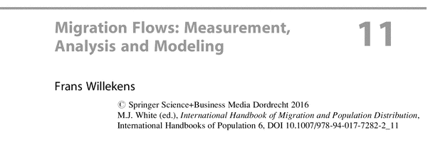

Statistical modelling
Some other options
  Microsimulations
  Recall the previous
  talk
  Micro-level matching and inference
    Multiple systems estimation
    Probabilistic matching techniques
    More exact than macro-level
Notes:
Other options – Frans has already mentioned microsimulation, but there are also methods based on individual-level linkages, such as multiple systems estimation. All are well established in the literature.

Slide 13
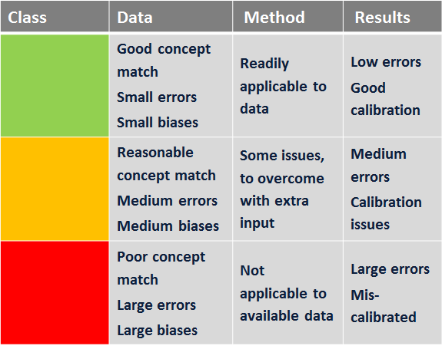
Communication
Creative visualisations
Summarising information
Adapted from: Disney et al. (2015) MAC report
Notes:
Given the complexity of the tasks, it is an imperative to find out ways to present the high-level findings in such a way that would be cognitively easy to process.

Slide 14
New challenges
Usefulness
Timeliness
Readiness
  Administrative registers: timely and ready
  Big data, social media: useful and timely
  Bespoke surveys: useful and ready
Pick two?
Notes:
Usefulness, timeliness and readiness (ready to use) actually map nicely onto quality, speed and price. It is highly unlikely that a source of data will have all three features at the same time. Many sources are not created with migration statistics in mind.

Slide 15
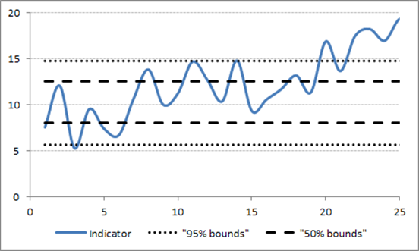
Uncertainty
Uncertainty is here to stay
New challenges require new tools
Example: early warning mechanisms
Notes:
Example – the asylum crisis and the need for much more timely, or even pro-active, estimates and warning signals in order to manage the situation and allocate resources. An example is offered by control theory.

Slide 16
Conclusions
Short-term solutions:
Using the already available data
more creatively – by modelling
Long-term agenda:
Coordination, harmonisation,
data exchange and linkage
Notes:
In the short term, modelling can help us overcome some of the challenges of migration data, but it will not solve all the problems. A longer-term impact requires co-ordination, harmonisation, data exchange and linkage. The EU is really well placed to deliver this, and it seems to be the right moment to push for such an agenda, but of course bearing in mind the caveats (privacy etc.)

Slide 17
Thank you!
Find out more and contact us:
Web: www.cpc.ac.uk
Email: cpc@southampton.ac.uk
Tel: +44 (0)2380 592 579
Twitter: @CPC_population
Facebook: CPCpopulation
Mendeley: CPC Population
Scoop.It: centre-for-population-change

