Slide 1
Looking across the border
Why cross-national comparability is
important for statistics and surveys
Ineke Stoop

Slide 2

How comparative is comparative research (1998)
  We tend to accept lower standards of rigour in cross-national surveys than in national surveys, leading to heroic conclusions about differences between nations on the basis of obviously faulty data.
  Arising perhaps from a commendable wish to respect different cultural norms, even some of the most conscientious cross-national studies make the mistake of permitting considerable variations by country in the type and quality of the methods they deploy.
  http://bit.ly/29QU8V5
  Roger Jowell
  Founder ESS
  10 golden rules

Slide 3
10 golden rules of comparative surveys
  No gee whiz
  Social scientists should undertake not to interpret survey data relating to a country about which they know little or nothing.
  No league tables
  Analysts of cross-national data should resist the temptation to compare too many countries at once.

Slide 4
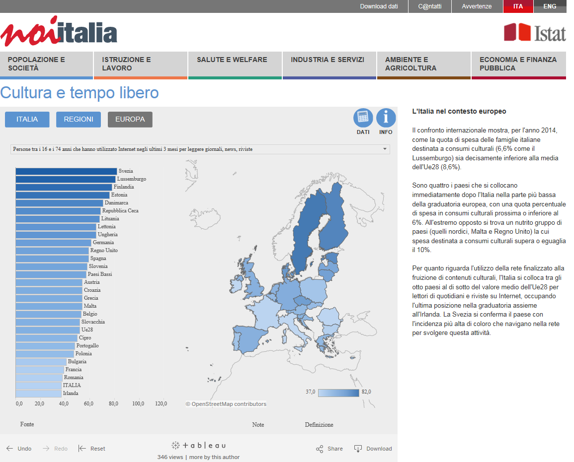

Slide 5
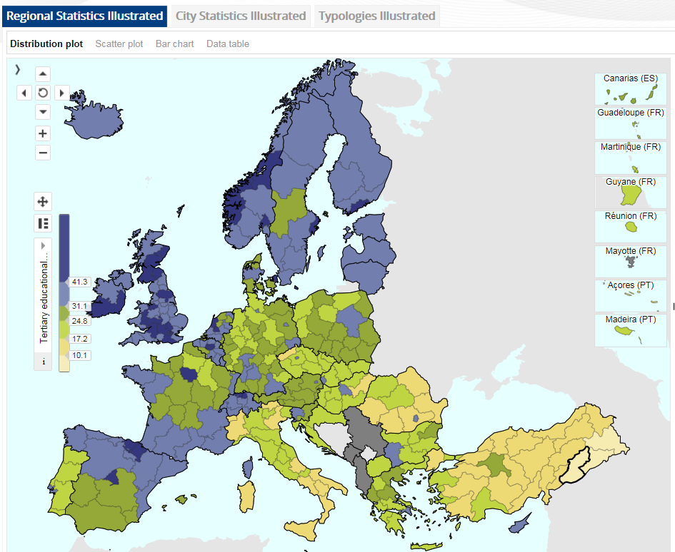
10 golden rules of comparative surveys (3)
  Context is crucial
  Cross-national surveys should pay as much attention to the choice and compilation of aggregate-level contextual variables as they do to individual-level dependent and independent variables.

Slide 6
10 golden rules of comparative surveys
  Know your limits
  Social scientists contemplating or engaged in cross-national studies should be as open about their limitations as they are enthusiastic about their explanatory powers.

Slide 7
Coverage errors LFS 2014 (selection http://bit.ly/29PIBFX)
BE | Households, all members of which are 77 years or older and collective households are excluded before draw.
CZ | Persons living in institutional households are not covered.
DE | Homeless people, other people without registered residence (e.g. people living in huts, caravans) out of frame
EL | Population living in collective households or in dwellings outside the borders of built areas is not covered.
IT | It is required that each non-responding household be replaced with a household having similar characteristics of the first one, in order to maintain as much as possible the sample representativeness and to minimize the impact of unit non-response. No more than 3 replaces are admitted.
LU | Households with no telephone will not be in the frame.
HU | Hard-to-access groups are characterized either by extremely bad traffic conditions to get to their place or by collective reluctance — usually within a small community — towards being interviewed. Though the effect of these factors cannot be estimated, it is supposed to be not significant.
NL
AT | This could mean an undercoverage of recent migrants.
SK | The LFS sample is based on a Population Census conducted once each ten years (last time in 2011). There is the lack of information on new statistical units during a rather long period.
SE | The over coverage consists of people born abroad who left Sweden without reporting this to the Swedish authorities. When these persons are included in the sample there are no information that they have moved out from Sweden. They cannot be reached for interview and will be classified as non-response.
UK | The LFS coverage omits communal establishments, excepting NHS housing and students in halls of residence. Members of the armed forces are only included if they live in private accommodation.

Slide 8
10 golden rules of comparative surveys
  Sound survey methodology
  Stringent and well-policed ground rules for comparable survey methods should become much more common in comparative studies than they are now.

Slide 9
10 golden rules of comparative surveys
  Be wary of spectacular country differences
  Analysts of cross-national data should undertake to suspend belief initially in any major inter-country differences they discover.

Slide 10

  Washington Post
  World Values Survey
  Inglehart and Wetzel reported weak statistical correlation with pro-democracy values “that only exists because of one single leverage case: Vietnam. Without Vietnam, there would be no relationship at all.”
  In favor of military rule
  2001: 99%
  2006: 33%
  2001: military role

Slide 11


10 golden rules of comparative surveys
  Be guided by aims and theory
  Emerging naturally from the six previous rules, cross-national surveys should ideally be confined to the smallest number of countries consistent with their aims, rather than celebrating as many nations as possible in their purview.
Statistics
Research

Slide 12
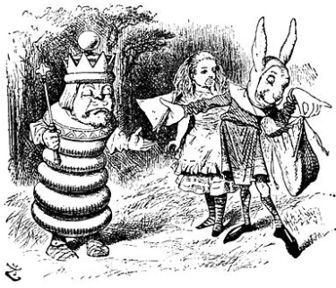
10 golden rules of comparative surveys
  Avoid single country perspective
  In order to transform cross-national surveys from parallel exercises into joint ones, collective development work, experimentation, scale construction and piloting should be undertaken in all participating nations.

Slide 13
CSDI guidelines on adaptation (Harkness) (1)
  A recent international project proposed fielding the question in multiple countries
  "Can you lift a two liter bottle of water or soda?"

Slide 14
CSDI guidelines on adaptation (Harkness) (2)
  Several locations (countries) noted that
  the normal size of bottle in their context was 1.5 liter bottles, not 2 liter bottles
  that they were unsure whether the bottle referred to was intended to be glass or plastic (which would affect the lifting task)
  that "soda" was not a salient generic concept in their locations
  that the formulation in English which indicates that the bottle is not empty
  ("bottle of water or soda") needed to become "a full bottle of water" or "a bottle full of water" in their translations. However, there was some concern that these much more explicit renderings of "bottle of water" might alter respondent perceptions of the lifting task.

Slide 15
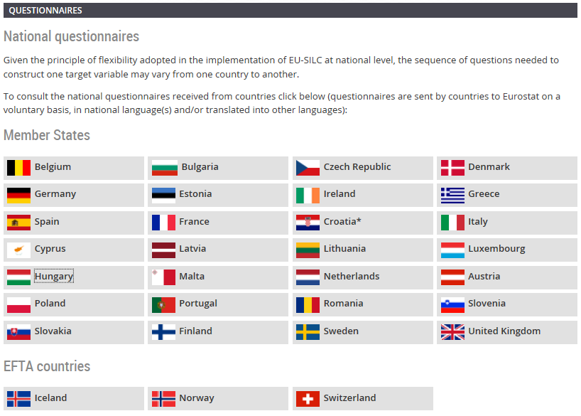
10 golden rules of comparative surveys
  Publish and read methodological background information
    Routinely provide for secondary analysts of the data (and primary analysts for that matter) detailed methodological reports about each participating nation’s procedures, methods and success rates, highlighting rather than suppressing variations.

Slide 16
Response outcomes European Social Survey, R5
Report on quality assessment of contact data files in Round 5: Final report 27 countries, Hideko Matsuo and Geert Loosveldt, Working paper Centre for Sociological Research (CeSO) Survey Methodology CeSO/SM/2013-3

Slide 17
Response outcomes EU SILC 2010
2010 COMPARATIVE EU INTERMEDIATE QUALITY REPORT Version 3 – October 2012

Slide 18
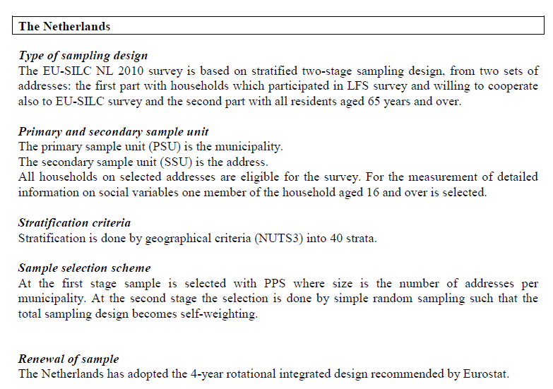

Slide 19

10 golden rules of comparative surveys
  Experiment, innovate and improve
  Routinely include methodological experiments in cross-national research

Slide 20
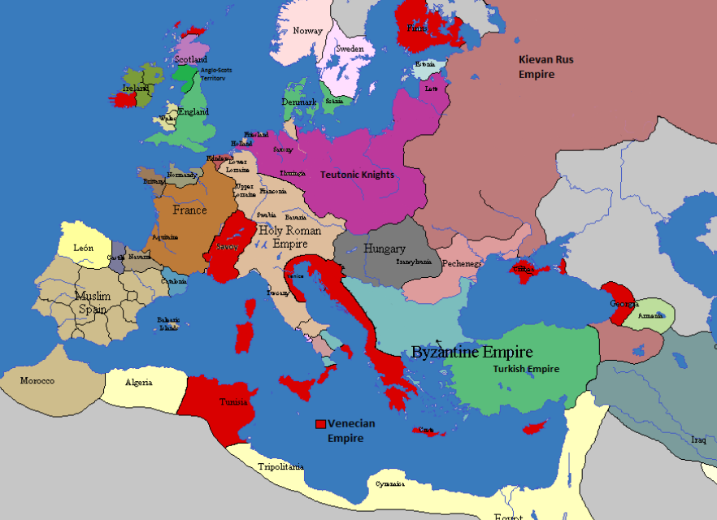
  Thank you for your attention
  i.stoop@scp.nl

