Slide 1
Extending the coverage to non-private citizens
Exclusion of the institutional population and the comparability of administrative data in Europe
Jan-Lucas Schanze (GESIS)
CESS, Budapest (HU), 10/21/16

Slide 2
Contents
  SERISS project on the institutional population
  The institutional population in Europe – an elusive population?
  The 2011 censuses and their comparability
  Conclusion & invitation for input

Slide 3


Source: www.seriss.eu

Slide 4



Including the institutional population into a sample survey of the general population
  Data inventory of European surveys including the institutional population
  Feasibility report on sampling and fieldwork in institutions

Slide 5
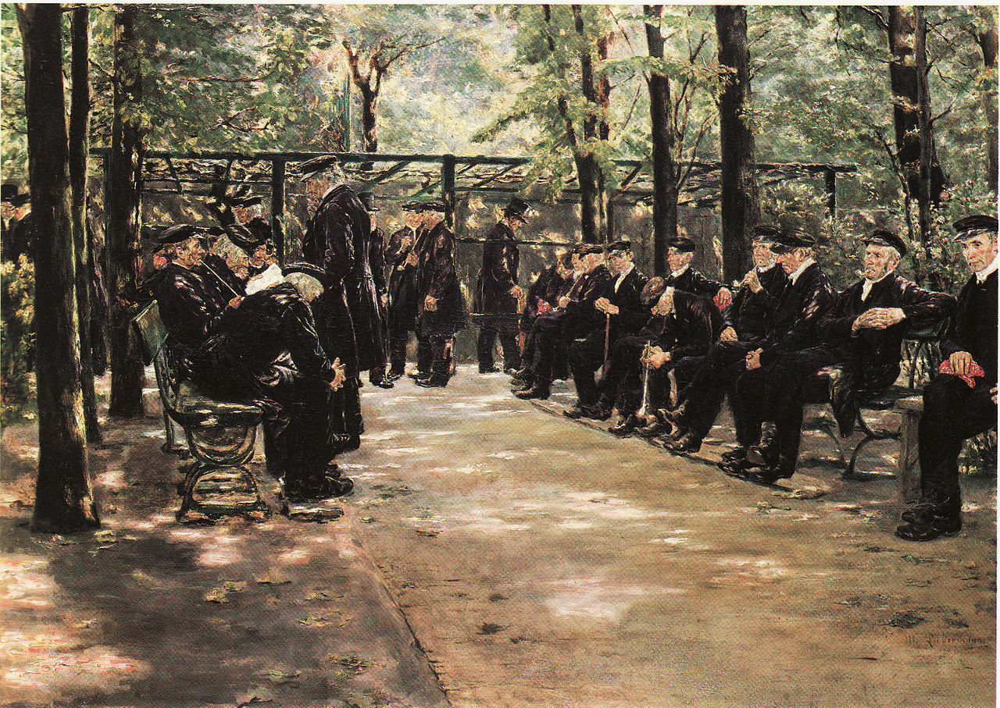
The institutional population in Europe
Max Liebermann
„Old Men‘s Home in Amsterdam“ (1880)

Slide 6
Definition
  Non-private = Hotels, camps, institutions (UN 2008)
  Institutions can be classified as:
  Educational institutions
  Health care institutions
  Institutions for retired and elderly persons
  Military institutions
  Religious institutions
  Other institutions (e.g. penal facility, refugee accommodation, homeless shelter)
Offering managed accommodation to a group of (mostly) unrelated inhabitants who cannot run their own household

Slide 7
An elusive population?
  Hard-to-sample
        A rare, but not a hidden population
  Hard-to-identify (sometimes)
        It can be a sensitive information if a household member lives in an institution
  Hard-to-contact
        Operators of institutions and relatives as gatekeepers
  Hard-to-interview
        Language barriers, functional and cognitive impairments (dementia)
Source: typology of Tourangeau 2014

Slide 8
Quantifying the non-private population
% of the entire population
EU-28: 7,506,967 (2011)
Source: European Statistical System, Census 2011

Slide 9
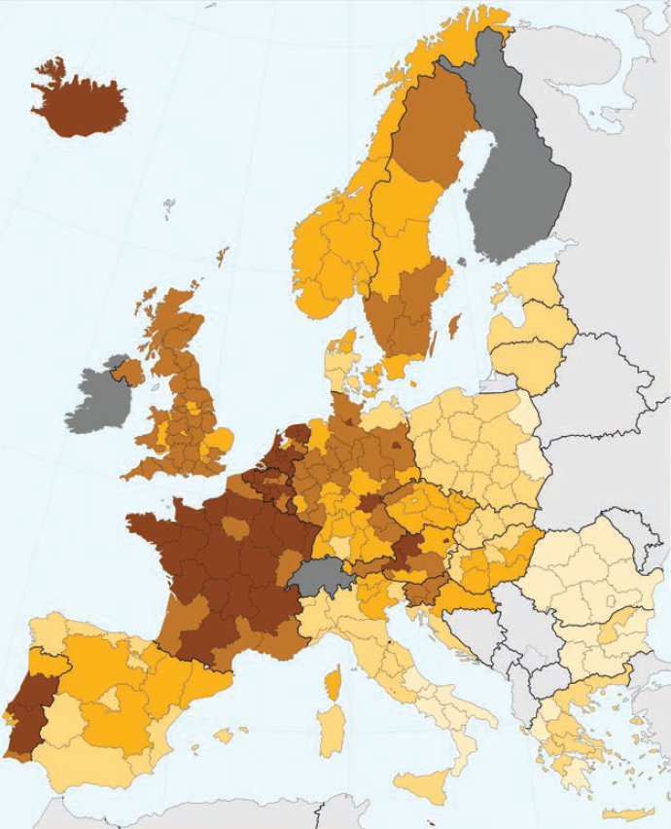
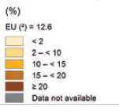
Share of population aged 85 years and over living in an institutional household
(%) at NUTS 2
< 2
2 - < 10
10 - < 15
15 - < 20
≥ 20
Data not available
Source: Eurostat 2015. „People in the EU“

Slide 10
The peril of exclusion
Quantitative size vs. distinctiveness
  Gender and age distribution
  Economic activity
  Medical condition
  Functional impairments
  Housing
  Ethnicity
  Marital status
  Social networks
Sources: ONS 2002; Laferrère et al. 2013; Luppa et al. 2010

Slide 11
The 2011 censuses in Europe
Different approaches of data collection
  1) Register-based
  2) Register + large-N survey
  3) traditional census
  Specific strategies for the institutional population employed
EU-level regulations
  Demanding data on the number of institutional residents at the NUTS 2 level
  No further supranational harmonization of the data collection in institutions

Slide 12
Comparability of census results
Definitions
  Place of usual residence (12-months rule) and housekeeping concept alike
    Clarifications for special cases (e.g. college students, military, homeless persons)
  Institutions defined slightly different within the countries
Methodology of data collection in institutions
  Follows country-specific requirements and legislations
    E.g. sensitive & non-sensitive institutions in Germany
+ Publication of data follows national legislations

Slide 13
Conclusion & invitation for input
  Institutional population heavily understudied (esp. with cross-national methods)
  Lack of comprehensive survey data increases the importance of administrative and census data
  Comparative analyses of the census data and the underlying methodology will be continued
  The SERISS project relies on (national) expertise
  Exchanges or cooperation with national statistical offices are highly appreciated

Slide 14
Contact
Jan-Lucas Schanze
GESIS – Leibniz Institute for the Social Sciences
Survey Design and Methodology (SDM)
P.O. Box 12 21 55
68072 Mannheim (GER)
phone: 0049 (0)621 1246-293
mail: jan-lucas.schanze@gesis.org

Slide 15
References
European Commission. 2008. "Regulation (EC) No 763/2008 of the European Parliament and the Council of 9 July 2008 on population and housing censuses" In: Official Journal of the European Union, L 218: pp.14-20.
European Commission. 2009. "Commission Regulation (EC) No 1201/2009 of 30 November 2009 implementing Regulation (EC) No 763/2008 of the European Parliament and of the Council on population and housing censuses as regards the technical specifications of the topics and of their breakdowns" In: Official Journal of the European Union, L 329: pp.29-68.
Eurostat. 2015. “People in the EU - Who are we and how do we live” European Union: Luxembourg.
Eurostat. 2016. "European Statistical System - Census Hub“ Online: https://ec.europa.eu/CensusHub2
Geiger, M./ Styhler, D. 2012. "Zensus 2011: Erhebungsteil Sonderbereiche" In: Bayern in Zahlen , 5: pp.280-285.
Groom, G. et al. 2009. “Communal Establishments Survey - Findings of the Pilot Stage: Summary Report”
Laferrère, A. et al. 2013. “Entry into institutional care: predictors and alternatives” In: Börsch-Supan, A. et al. (eds.) Active ageing and solidarity between generations in Europe: pp.253-264.
Lewinter, M. 2004. “Developments in home help for elderly people in Denmark - the changing concept of home and institutional care” In: International Journal of Social Welfare, Vol. 13: pp.89–96.
Luppa, M. et al. 2010. “Prediction of institutionalization in the elderly. A systematic review” In: Age and Ageing, Vol. 39: pp.31-38.

Slide 16
References (continued)
Martin, E. 2007. “Strength of Attachment: Survey Coverage of People with Tenuous Ties to Residences” In: Research Report Series No. 27. U.S. Census Bureau, Washington D.C., USA.
OECD. 2006. “Glossary of statistical terms: Institutional households –Eurostat” Online: https://stats.oecd.org/glossary/detail.asp?ID=1372.
ONS, Social Survey Division. 2002. “Survey of people living in communal establishements (pilot)” Technical report.
Poulain, M./ Herm, A. 2013. “Central Population Registers as a Source of Demographic Statistics in Europe” In: Population-E, Vol. 68 (2): pp.183-212.
Tourangeau, R. 2014 “Defining hard-to-survey populations” In: Tourangeau, R. et al. (eds.) Hard-to-Survey Populations: pp. 3-20.
United Nations, Economic Commission for Europe. 2006. "Conference of European Statisticians Recommendations for the 2010 Censuses of Population and Housing" ECE/CES/STAT/NONE/2006/4, New York and Geneva.
United Nations, Statistics Division. 2008. "Principles and Recommendations for Population and Housing Censuses – Revision 2" In: Statistical papers, Series M No. 67/Rev.2, New York, USA.
United Nations, Statistics Division. 2010. "Handbook on Population and Housing Census Editing - Revision 1“ In: Statistical papers, Series F No. 82/Rev.1, New York, USA.

