Slide 1
Models of harmonization: now and in the future
E. Baldacci¹, L. Japec², I. Stoop³
¹ Eurostat, Luxembourg, Luxembourg Emanuele.BALDACCI@ec.europa.eu
² Statistics Sweden, Stockholm, Sweden lilli.japec@scb.se
³ The Netherlands Institute for Social Research (SCP)/ESAC, Den Haag, The Netherlands; i.stoop@scp.nl

Slide 2
Background
Quality Dimensions (Eurostat): Relevance, Accuracy and Reliability, Timeliness and Punctuality, Coherence and Comparability, and Accessibility and Clarity
Code of Practice:
  “European Statistics are consistent internally, over time and comparable between regions and countries; it is possible to combine and make joint use of related data from different sources.”

Slide 3
Comparability through harmonization
Input harmonization - aims to standardize certain processes and methods in all countries. All countries are assumed to work in much the same way but for some other processes flexibility is necessary.
Output harmonization - specifies the target variables and their categories and then it is up to countries how to produce them.

Slide 4
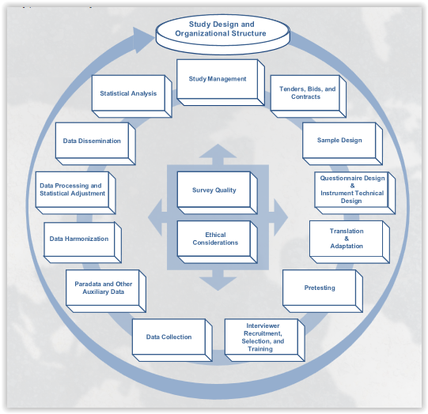
Culture, methods and resources affect comparability
3MC survey life cycle -
Mulitnational
Multiregional
Multicultural
Copyright: Survey Research Center. (2016). Guidelines for Best Practice in Cross-Cultural Surveys.

Slide 5
Translation methods
Word-for-word
Double translatation with adjudication
Backtranslation
Team translation

Slide 6
Adaptation – example
ISSP (International Social Survey Programme) 2008 module on religion
”For religious reasons do you have in your home a shrine, altar, or a religious object on display such as [COUNTRY-SPECIFIC LIST icon, retablos, mezuzah, menorah, or crucifix]?”
It would be hard to provide one list that would be valid in all countries.

Slide 7
Culture, methods and resources affect comparability
3MC survey life cycle -
Mulitnational
Multiregional
Multicultural
Copyright: Survey Research Center. (2016). Guidelines for Best Practice in Cross-Cultural Surveys.

Slide 8
Self-reported obesity rate, BMI≥30
Face to face
Telephone
18%
13%
Béland and St-Pierre (2008). Mode Effects in the Canadian Community Health Survey: A Comparison of CATI and CAPI

Slide 9
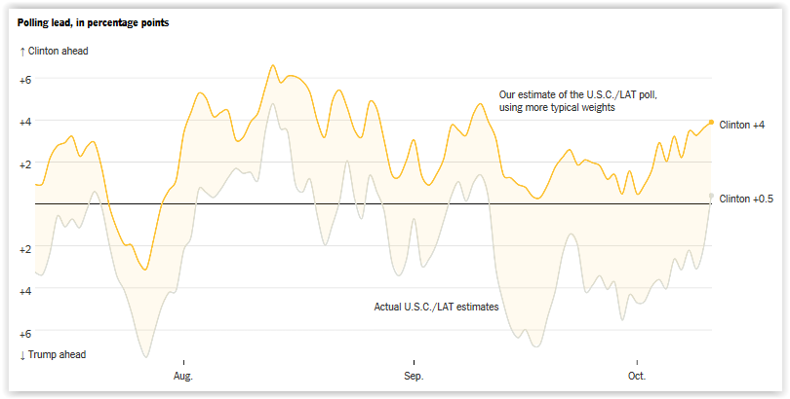
Weighting makes a difference
The University of Southern California/Los Angeles Times Poll
Source: New York Times, October 12, 2016. Nate Cohn.

Slide 10
Trends
Increased nonresponse rates
Increased costs for surveys
Mixed-mode surveys
Use of alternative data sources such as adminstrative data and big data
Mixing surveys and alternative data sources
What does this mean for comparability?

Slide 11
Some good and some bad news

Slide 12
Output harmonization is not enough to achieve comparability

Slide 13
The good news
Networks exist e.g. CSDI, comparative survey design and implementation network
We can learn from research that has been done already
The EU project on the use of adminstrative sources and Big Data - an opportuinity to include the comparability dimension
More research needed on how to achieve comparability and how to communicate this dimension to users

Slide 14
Concluding remarks
Comparability hard to achieve even when we design for comparability
National interest versus international comparability
Get more involved in research groups such as CSDI

