Slide 1



Sequential Aggregation of Heterogeneous Experts for PM10 Forecasting
Jean-Michel Poggi
Univ. Paris-Sud Orsay & Univ. Paris Descartes
Joint work with
B. Auder (Université d’Orsay) M.Bobbia (Air Normand) B. Portier (INSA Rouen)
Conference of European Statistics Stakeholders
Budapest, 20–21 October 2016

Slide 2




Pollution context
  European regulation particulate matter PM₁₀ daily average cannot exceeds 50 µg/m³ more than 35 days per year
  Many forecasts each day for the day after of the daily average concentration of PM10 (and other pollutants) are available coming from 2 families
  1. statistical models constructed using different methods and different set of predictors
  2. deterministic models of physicochemical prediction modeling pollution, weather and atmosphere

Slide 3
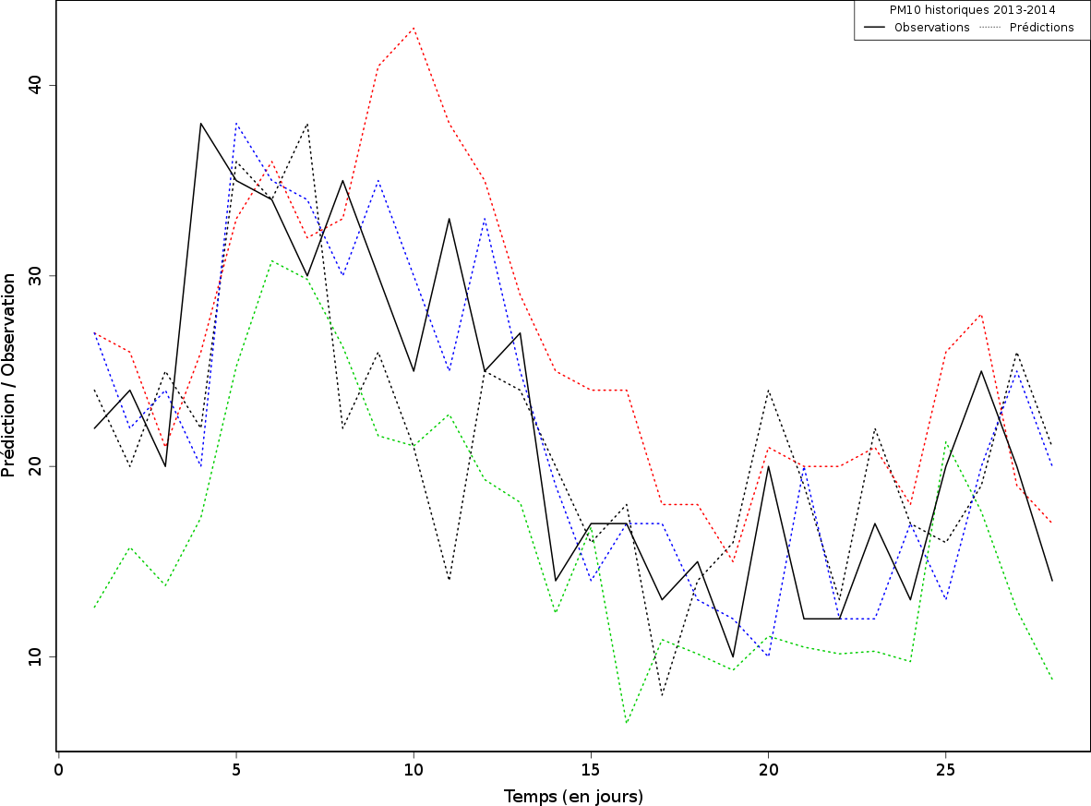
Motivation
  Problem: how to exploit the large variety of models and the fact that for each given instant, the forecasts often disagree
Aim: perform sequential prediction by combining forecasts to have a single better ensemble prediction in the context of particulate matter PM10
It is a very general framework but PM10 is the more crucial pollutant in Normandy

Slide 4
Statistical context
About the theory of prediction of individual sequences:
- survey paper by Clemen (1989)
- book of Cesa-Bianchi, Lugosi (2006)
- paper by Stoltz (2010) in French
These studies focus on the rules of aggregation of a set of experts and examine how to weight and combine these experts
Empirical studies:
- climate Monteleoni et al. (2011)
- air quality Mallet (2010), Mallet et al. (2009)
- quantile prediction number of daily calls Biau et al. (2011)
- the prediction of electricity consumption Devaine et al. (2013)
  These papers combine "homogeneous" methods: only deterministic methods or only statistical ones. In this last case, there are to be compared with Aggregation methods

Slide 5
Contributions
1- Adaptation to the effective context of pollution engineer forecaster
2- Main originality: combining
- experts coming from statistical models
and
  - experts defined by deterministic models of physicochemical prediction modeling pollution, weather and atmosphere
Sequential prediction
- allows mixing several models built on very different assumptions in a unified approach
- does not require any prior knowledge about the internal way to use for each expert to generate predictions
It is therefore especially relevant for our application

Slide 6
Sequential prediction framework
The complete time series from instant 1 to T:
y₁,…, y_{t},…, y_{T} ∈ [0, B]
Problem : forecasting y_{t}, given the past values of instant t : y₁,…, y_{t-1}
and using K given experts (K finite) known only through:
- their instantaneous predictions of y_{t} denoted by
x_{t} = (x_{1,t},…,x_{K,t}) ∈ [0, B]^{K}
- the history of their predictions
x₁^{t} = x₁,…,x_{t}
Idea : to optimally combine the predictions
ŷ_{t} = p_{t}.x_{t} = Σ_{k} p_{k,t} x _{k,t}
by choosing the weights p_{t} = (p_{1,t},…,p_{K,t}) at each step
with respect to the instantaneous losses : L_{t}(x) = (y_{t} − x)²
and the individuals losses of the experts L_{t}(x_{k,t}) = (y_{t} − x_{k,t})²

Slide 7
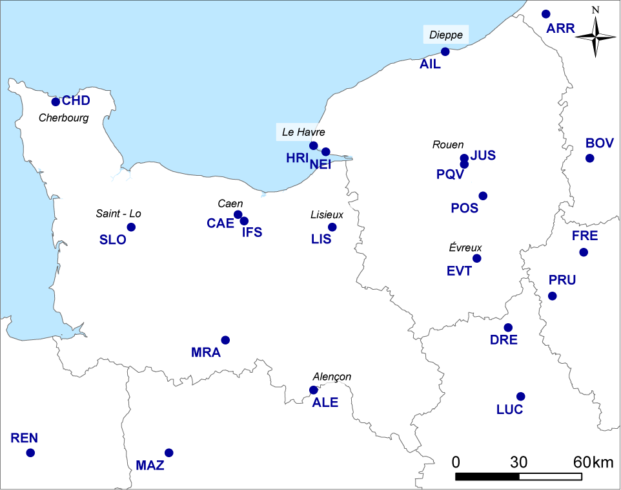
PM10 monitoring stations
Three background urban stations:
Air Normand network
(Haute-Normandie)
HRI (Le Havre)
PQV (Rouen)
Air COM network
(Basse-Normandie)
LIS (Lisieux)

Slide 8
PM10 Data - Experts
Study period from April 3, 2013 to March 18, 2014 (351 days)
Measures of the daily average concentration of PM10 (including the volatile fraction)
Forecasts of the day for the day after coming from 10 different prediction models
http://www2.prevair.org/
http://www.esmeralda-web.fr/
Poggi, Portier (2011)
4 statistical models (from Air Normand): a mixture of regression models, two linear models (one fitted on slightly polluted days and the other one, on polluted days), a non-linear additive GAM model
2 statistical models (from INERIS and AIRPARIF): GLM models
3 numerical models: Esmeralda and two PREV'AIR models at different spatial resolutions
+ the persistence model

Slide 9
Sequential aggregation methods
See Cesa-Bianchi, Lugosi (2006), Stoltz (2010)
Two families of methods:
First, the methods adaptively updating the weights at each step
EWA (Exponential Weighted Average)
p_{k,t} = c . exp( -η Σ_{s=1,t-1} L_{s}(x_{k,s}) )
Second, the methods optimizing at each step a global criterion on the history of measurements and expert predictions (with or without convexity constraints)
RR (Ridge regression type criterion):
p_{.,t} = arg min { Σ_{s=h,t-1} (y_{s} − u.x_{s})² + λ ||u – p₀||₂² ; u∈R^{K} }
Lasso criterion:
p_{.,t} = arg min { Σ_{s=h,t-1} (y_{s} − u.x_{s})² + λ ||u – p₀||₁ ; u ∈ R^{K} }

Slide 10
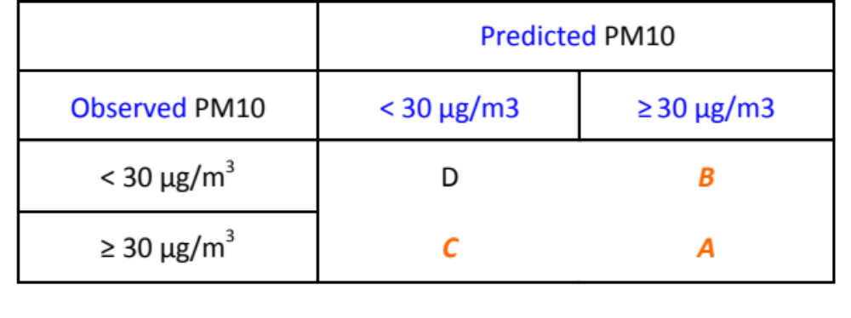
Evaluating performance
Alarms
Threat score TS = A / (A+B+C)
Errors
RMSE, the Root Mean Square Error
EV, the explained variance: 1 – residual variance / observed variance

Slide 11
Comparative performance: HRI
Unbiased scatterplot for RR
Best Expert
RR is dominant for alarms (see the Threat Score TS)
EWA (Exponential Weighted Average) is the best for errors, see the RMSE
Oracles: best convex RMSE 7.32 - TS 0.49
best expert RMSE 7.49 - TS 0.48

Slide 12
References
Auder, Bobbia, Poggi, Portier, Atmospheric Pollution Research, 2016
[1] Biau, Patra, IEEE Transactions on Information Theory, 2011
[2] Cesa-Bianchi, Lugosi, Cambridge University Press, 2006
[3] Chaloulakou, Saisana, Spyrellis, The Science of the Total Environment, 2003
[4] Clemen, International Journal of Forecasting, 1989
[5] Devaine, Gaillard, Goude, Stoltz, Machine Learning , 2013
[6] Dietterich, Springer, 2000
[7] Freund, Schapire, Journal of Computer and System Sciences, 1997
[8] Gaillard, Stoltz, van Erven, ArXiv, 2014
[9] Gaillard, Goude, Lecture Notes in Statistics, Springer, 2015
[10] Mallet, Stoltz, Mauricette, Journal of Geophysical Research, 2009
[11] Mallet, Journal of Geophysical Research, 2010
[12] Monteleoni, Schmidt, Saroha, Asplund, Stat. Analysis & Data Mining, 2011
[13] Poggi, Portier, Atmospheric Environment, 2011
[14] Stoltz, Journal de la Société Française de Statistique, 2010

