Slide 1

Non Parametric Bootstrap in Factor Analysis - White Blood Cell Count and the Metabolic Syndrome
John Öhrvik
Göran Nilsson
Uppsala University, Center for Clinical Research
John.Ohrvik@ki.se
Notes:
₁

Slide 2
Background
Cardiovascular disease (CVD) is a major cause of morbidity and mortality in the developed world. As risk factors have been identified, more than one risk factor has been observed in many individuals.
Clustering of risk factors has been extensively studied; special interest has been focused on the clustering of the risk factors in the Metabolic Syndrome (MetS).
High white blood cell (WBC) count and MetS are related. Both conditions predict dismal survival.

Slide 3
Objective
Search for a smaller set of underlying variables – factors – behind the components of the MetS
and WBC count
Study the prognostic impact of these factors on 10-year mortality in an elderly population
Components of MetS
Systolic and Diastolic Blood Pressure (BP)
Fasting Glucose (FG)
High Density Lipoprotein Cholesterol (HDL-c)
Triglycerides (TG)
Waist circumference
White Blood Cell (WBC)
Count

Slide 4
Outline of Presentation
Introduction to Bootstrap
Principal Component and Factor Analysis
Factor Analysis of the Components in the Metabolic Syndrome and White Blood Cell Count
Prognostic impact on 10-year mortality of the derived Factors

Slide 5
Bootstrap Basic Idea
The distribution of the values found in a sample of size n from the population
is the best estimate of the population distribution
in absence of any other knowledge.

Slide 6
Bootstrap – Re-sampling with replacement
Original sample of n=6 observations
Possible new samples:
A
B
C
D
E
F
A
A
A
D
C
C
B
A
C
E
Re-sample with replacement
D
C
B
C
D
F
E
F
What’s the probability that an observation is in a particular sample? = 1-(1-1/n)⁻¹ ≈ .632

Slide 7
Bootstrap Sampling
Population Distribution Function F  parameters θ
∧
Observed Random Sample x  estimates θ = t(x)
∧
Empirical Distribution Function F
∧
Bootstrap Sample x*  estimates = t(x*)
θ*
Notes:
–Real world versus Bootstrap world.
-bootstrap Cis estimated on the basis of s(x*)
-For a population mean: very simple

Slide 8
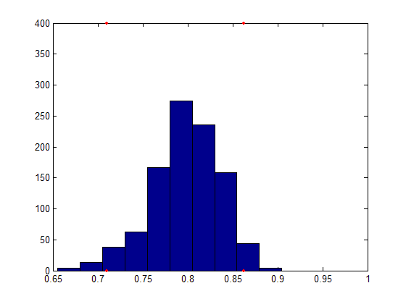

How to Estimate Confidence Intervals
from the Distribution of θ* ?
∧
Quantile based methods
  Quantile method
  Efron’s percentile method
  BC_{α} method (Bias Corrected and Accelerated, corrects for potential Bias and skewness of the Bootstrap distribution)
  …

Slide 9
Factor Analysis the Idea
To ascertain whether the interrelation between a set of directly measurable variables are
explicable in terms of a smaller number of underlying unobservable variables
representing unique domains termed factors.

Slide 10
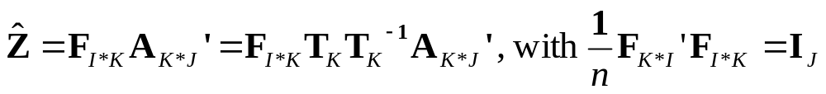
Principal Component Analysis
X (I×J): observed data of I subjects on J variables
Z (I×J): standardized scores of X
F (I×K): Principal component matrix
A (J×K): Principal loadings
K: Number of selected principal components
T (K×K): Factor rotation matrix

Slide 11
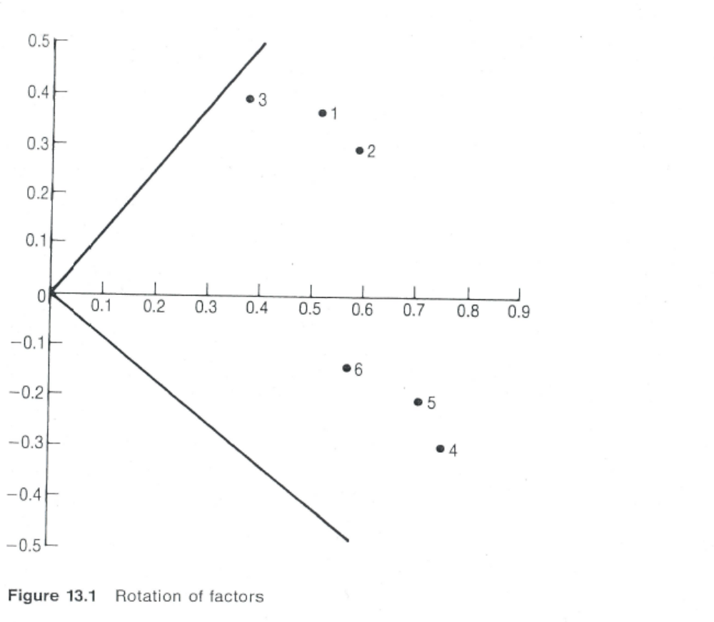
Varimax Orthogonal Rotation
From Everitt & Dunn (1991) Applied Multivariate Data Analysis

Slide 12
What is t(x) Exactly?
Loadings:
1. Principal loadings (A_{J*K})
2. Rotated loadings (A_{J*K}T_{K})
    a. Procrustes rotation towards external
    structure
    b. use one fixed criterion (e.g., Varimax)

Slide 13
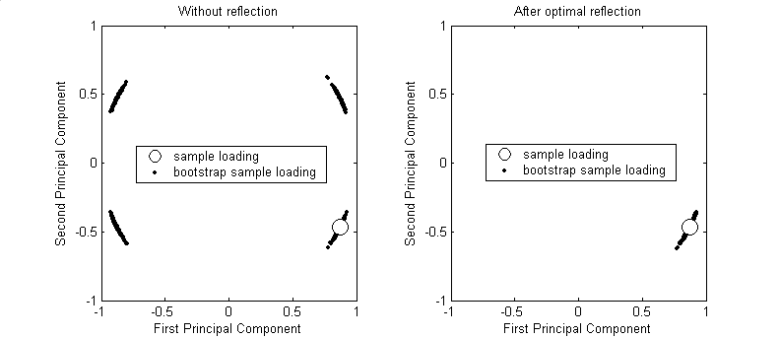
  Principal Loadings
  Sign of Principal loadings is arbitrary:
  reflect columns of the principal loadings to the same direction
  as the loadings of the original sample
Notes:
Depends on interpretation chosen!

Slide 14
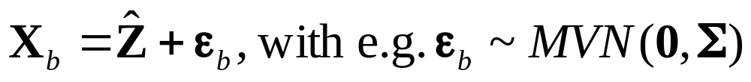
How to Define the Empirical Distribution?
  Non parametric:
  X_{b}: row wise resampling from X
  Semi parametric:
  Parametric:
  elements of X_{b} from particular distribution

Slide 15
Study Population
In 1997 there were 1100 inhabitants of the city of Västerås who were 75 years old (born 1922)
Of these 618 individuals were randomly selected and invited to participate in a cardiovascular health survey
The invitation was accepted by 433 subjects (223 women and 210 men)
Main reasons for not participating were: diseases under treatment (54), unavailable (29), locomotive impairment (28), and language difficulties or logistical problems (26)

Slide 16
Clinical Data Baseline,
Median (Interquartile range) or Number (%)
Variable | Men (n=196) | Women (n=200) | p-value
Fasting glucose (mmol/L)¹ | 5.82 (5.40-6.49) | 5.93 (5.48-6.49) | 0.36
HDL-cholesterol (mmol/L) ² | 1.36 (1.17-1.54) | 1.62 (1.34-1.96) | -
Triglycerides (mmol/L) ³ | 1.51 (1.11-1.92) | 1.43 (1.11-2.07) | 0.94
Waist (cm) | 94 (89-100) | 88 (80-97) | -
Diastolic BP (mmHg) | 83 (80-90) | 85 (80-90) | 0.84
Systolic BP (mmHg) | 160 (150-180) | 165 (150-190) | 0.007
WBC count (10⁹/L) | 6.3 (5.4-7.2) | 5.7 (4.8-6.8) | <0.001
Present MetS acc to NCEP III | 48(24) | 75(38) | 0.007
High BP (≥ 140/90) | 118 (60) | 128 (64) | 0.47
Newly detected diabetes (≥ 7.0) | 20 (10) | 21 (11) | 1.00
Current smoker | 24 (12) | 14 (7.0) | 0.089
¹ 1 mmol/L = 18 mg/dL; ² 1 mmol/L = 39 mg/dL; ³ 1 mmol/L = 89 mg/dL

Slide 17
Medical History Baseline,
Number (%)
Variable | Men (n=196) | Women (n=200) | p-value
Cardiovascular disease | 49(25) | 30(15) | 0.017
Previous myocardial infarction | 30 (15) | 9 (4.5) | <0.001
Angina pectoris | 32 (16) | 20 (10) | 0.075
Stroke/TIA | 3 (1.5) | 7 (3.5) | 0.34
Heart failure | 14(7.1) | 12(6.0) | 0.84
Known hypertension | 52 (27) | 58 (29) | 0.65
Known diabetes | 15 (7.7) | 14 (7.0) | 0.85

Slide 18
Pearson Correlations of the MetS Components and the WBC Counts for Men (m) and Women(w)
 | (HDL-c)⁻¹ | log(TG) | Waist | Diastolic BP | Systolic BP | log(WBC)
log(Fasting Glucose) | m 0.14* w 0.37*** | m 0.28** w 0.33*** | m 0.11 w 0.30*** | m 0.006 w -0.038 | m -0.029 w -0.003 | m 0.10 w 0.30***
HDL-cholesterol⁻¹ |  | m 0.54*** w 0.59*** | m 0.23*** w 0.39*** | m -0.053 w 0.023 | m -0.052 w -0.037 | m 0.009 w 0.24**
log(Triglycerides) |  |  | m 0.33*** w 0.30** | m 0.004 w 0.06 | m -0.066 w 0.05 | m 0.12 w 0.16*
Waist |  |  |  | m 0.17* w 0.19* | m 0.066 w 0.007 | m 0.032 w 0.24**
Diastolic BP |  |  |  |  | m 0.55*** w 0.59*** | m -0.029 w 0.011
Systolic BP |  |  |  |  |  | m 0.15* w 0.009
* Significant at the 5% level.
** Significant at the 1% level.
*** Significant at the 0.1% level.

Slide 19
Results of the Factor Analysis
The Factor Analysis revealed 3 factors in men and 2 in women applying Bootstrap:
Factor 1: Fasting Glucose, HDL-c, Triglycerides, and Waist in men and in addition WBC count in women
Factor 2: Diastolic and Systolic Blood Pressure.
Factor 3 men: Fasting Glucose and WBC count.
These factors explained in average (Efron’s 95% CI):
Men Women
All 65.9% (62.6-69.6%) 56.8% (53.1-60.6%)
1st factor 28.0% (25.0-31.6%) 33.9% (30.4-37.4%)
2nd factor 22.7% (20.3-24.7%) 23.0% (20.9-24.8%)
3rd factor 15.2% (13.7-17.0%)
of the total variation.

Slide 20
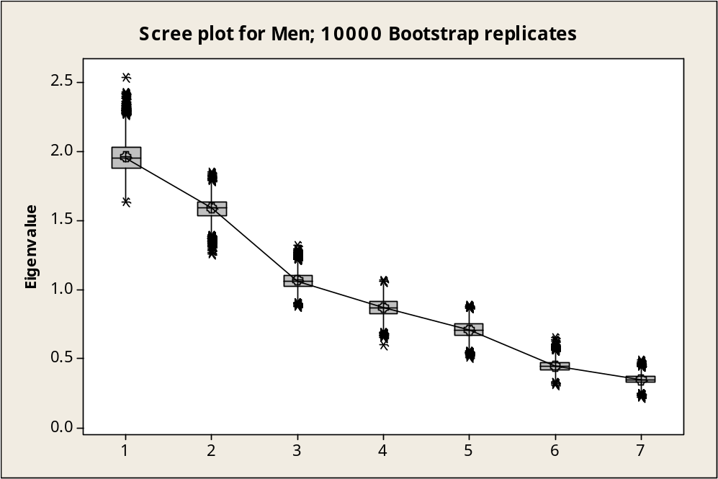
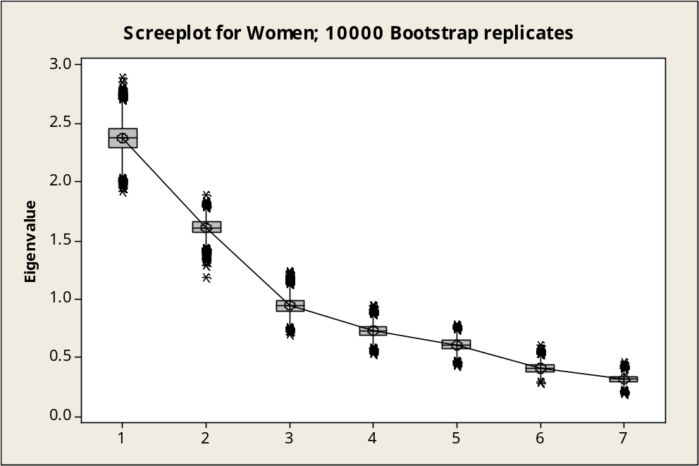
Screeplot for Men and Women Based
on 10,000 Bootstrap Replicates (Boxplots)

Slide 21
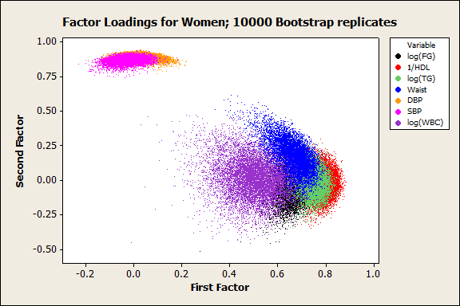
Factor Loadings for Women in Varimax
Rotated Space; 10000 Bootstrap Replicates

Slide 22
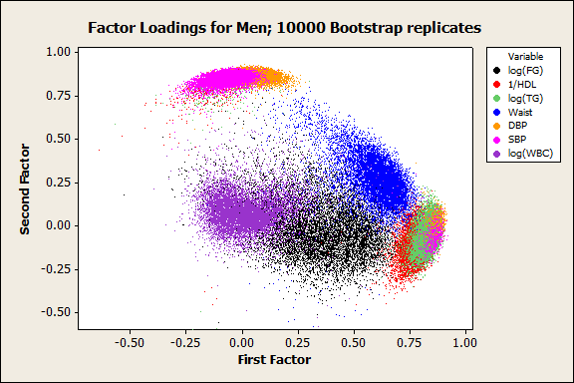
Factor Loadings for Men in Varimax
Rotated Space; 10000 Bootstrap Replicates

Slide 23
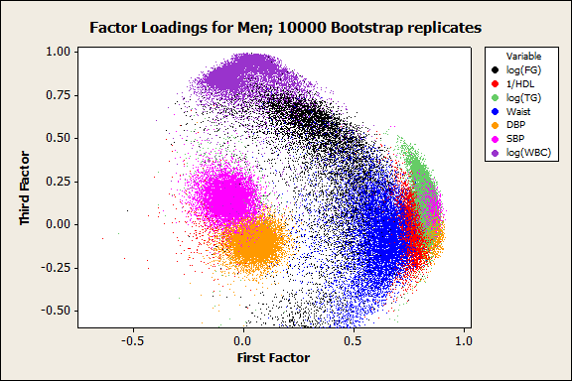
Factor Loadings for Men in Varimax
Rotated Space; 10000 Bootstrap Replicates

Slide 24
Factor Loadings with 95% Confidence Intervals
 | Median loadings (95% CI Efron’s percentile interval)†
Individual comp | 1st Factor |  | 2nd Factor |  | 3rd Factor
 | Men | Women | Men | Women | Men
log(Fasting Glucose) | 0.35(0.04-0.60) | 0.67(0.57-0.74) | -0.03(-0.23-0.26) | -0.06(-0.24-0.12) | 0.44(-0.59-0.74)
(HDL-cholest)⁻¹ | 0.78(0.56-0.84) | 0.80(0.73-0.85) | -0.10(-0.23-0.15) | -0.03(-0.19-0.14) | -0.01(-0.20-0.17)
log(Triglycerides) | 0.83(0.66-0.87) | 0.75(0.65-0.81) | -0.05(-0.17-0.20) | 0.00(-0.18-0.19) | 0.15(-0.05-0.36)
Waist | 0.61(0.36-0.72) | 0.67(0.53-0.76) | 0.26(0.09, 0.50) | 0.16(-0.05, 0.40) | -0.08(-0.45-0.27)
Diastolic BP | 0.06(-0.05-0.25) | 0.03(-0.06-0.13) | 0.87(0.70-0.90) | 0.89(0.85-0.92) | -0.10(-0.22-0.02)
Systolic BP | -0.07(-0.17-0.12) | -0.02(-0.12-0.07) | 0.85(0.59-0.89) | 0.87(0.82-0.91) | 0.15(0.03-028)
log(WBC) | 0.00(-0.14-0.22) | 0.50(0.29-0.64) | 0.07(-0.06-0.25) | 0.00(-0.25-0.29) | 0.87(0.66-0.97)
†Loadings of the individual components included in the respective factor in
red (cut-off = 0.30)

Slide 25
Follow Up
During a median follow-up of 10.6 years (range 0.2-10.9), 145 individuals (37%) died (90 men 46% and 55 women 28%)
The sex difference in mortality was highly significant (p<0.001); for men 5.4 deaths/100 person-year at risk and for women 2.8 deaths/100 person-year at risk
The main causes of death were cardiovascular (40 men; 27 women) and malignancy (27 men; 11 women)
Ten year mortality among the185 invited individuals (89 men; 96 women) who did not participate in the study was considerably higher; 66 (74%) among men and 44 (46%) among women

Slide 26
Cox Proportional Hazard Regression
Prospective associations of the factors with all cause mortality were assessed by Cox proportional hazard regression
A best subset approach, using the Bayesian information criterion defined as BIC = -2log[L(θ│x] + klog(n_{e}) , where k = the number of estimated parameters n_{e} = the number of events was used to find an ‘optimal’ set of significant confounders.
The predictive ability of the models was assessed by the time dependent area under the ROC curve (AUC_{t})

Slide 27
Hazard Ratios and 95% CIs for All Cause Mortality per 1 unit Increase
Model | BIC | p-value | Hazard Ratio (95%CI)
Metabolic factor men |  | 0.007 | 1.22 (1.06-1.41)
Metabolic factor women |  | 0.010 | 1.25 (1.06-1.48)
Blood pressure factor men |  | 0.20 | 1.12 (0.94-1.33)
Blood pressure factor women |  | 0.25 | 0.88 (0.71-1.09)
Inflammatory factor men |  | 0.009 | 1.29 (1.07-1.57)
Metabolic factor adjusted for sex | 1547.9 | <0.001 | 1.23 (1.11-1.38)
Blood pressure factor adjusted for sex Interaction sex*BP factor (m=0, w=1) | 1563.3 | 0.18 0.085 | 1.13 (0.95-1.34) 0.79 (0.60-1.03)

Slide 28
Adjusted Hazard Ratios and 95% CIs for All Cause Mortality per 1 Unit Increase
Model | BIC | AUC_{t=10 yrs} | p-value | Hazard ratio (95%CI)
Metabolic factor† | 1520.7 | 0.698 | 0.010 | 1.16 (1.04-1.29)
HDL-c^{-1 †} | 1518.5 | 0.700 | 0.003 | 4.25 (1.65-10.95)
log(WBC)† | 1520.5 | 0.690 | 0.010 | 2.70 (1.27-5.71)
HDL-c⁻¹, log(WBC)† | 1518.3 | 0.710 | 0.002‡
log(FG), HDL-c⁻¹, log(TG), Waist† | 1529.5 | 0.707 | 0.014‡
log(FG), HDL-c⁻¹, log(TG), Waist, log(WBC)† | 1530.1 | 0.713 | 0.008‡
Blood pressure factor (m=0, w=1) Interaction sex*BP factor† | 1529.2 | 0.676 | 0.32 0.086 | 1.10 (0.91-1.32) 0.78 (0.59-1.04)
Inflammatory factor men†† | - | 0.678 | 0.055 | 1.20 (1.00-1.44)
Adjusting variables | 1522.2 | 0.583 | <0.001‡‡
†Adjusted for sex, known hypertension, previous myocardial infarction and current smoking.
††Adjusted for known hypertension, previous myocardial infarction and current smoking..
‡p-value for the difference in Wald Χ² between the full model and the model with adjusting variables only .
‡‡ p-value for the difference in Wald Χ² between the model with adjusting variables and the null model.

Slide 29
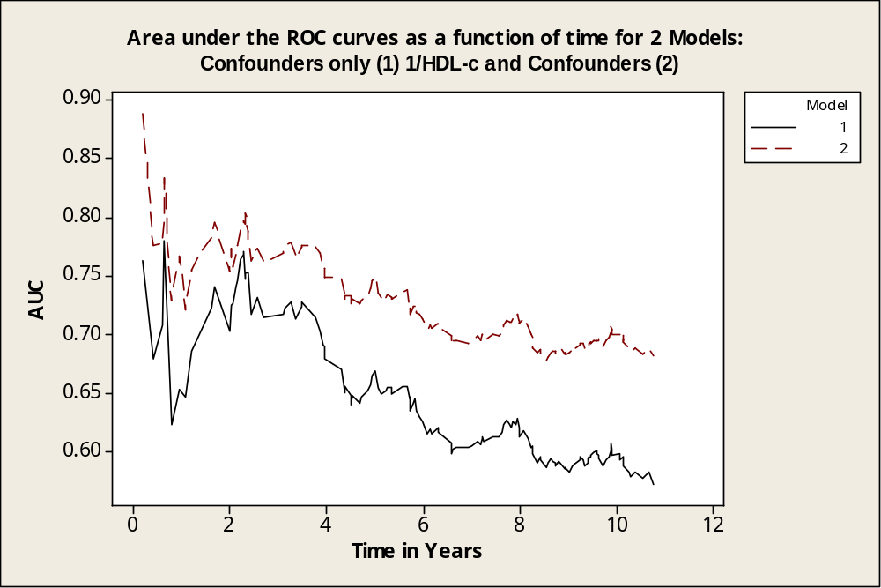
Time Dependent Area under the ROC Curves
for Confounders and HDL-c⁻¹ and Confounders

Slide 30
Conclusions
The factor analysis identified 3 factors in men and 2 in women
In women the factors were clearly separated while in men fasting glucose was part of both the 1st and the 3rd factor.
Using bootstrap in factor analysis together with optimally reflected varimax rotated loadings proved to be a useful method to assess the stability of the loadings.
The close relation between the individual components in women manifests itself in shorter confidence intervals for the factor loadings.

