Slide 1
GDP growth estimates for Europe at 30 days
– is that feasible?
Conference of European Statistics Stakeholders
Session C3: Timely estimates of economic indicators
Budapest, 20–21 October 2016
EC - Eurostat, Arto Kokkinen & Hans Wouters

Slide 2
Content
1. Background
2. Development work
3. Quality acceptance criteria
4. a) Results, EU t+30 estimates
4. b) Results, EA t+30 estimates
5. Communication
6. From 29 April 2016:
- t+30 (and t+0) releases for Europe

Slide 3
1. Background
GDP t+30 Task Force, May 2013 – end 2015:
Purpose:
  Assess the feasibility of producing GDP flash estimates at t+30 days for the EA and EU
  Sharing country experiences and best practices with national GDP t+30 estimations
  → Guidance for non-experienced Member States
  Compile test estimates for the EA and EU 2012Q1-2015Q4
  (real time 2014Q1-2015Q4)

Slide 4
2. Development work
  A. Country t+30 estimates
  Up to countries to decide whether to publish or not
  A possibility to provide confidential estimate to Eurostat
  How to estimate missing data (e.g. 3rd month of STS data)
  B. Methodology for Eurostat
  A sample to population estimator of MSs growth rates
  – How to aggregate MSs QoQ chain-linked volume growth rates?
  Quality acceptance criteria
  The project decided to develop a priori quality criteria
  → For assessment of test results
  → Decision to go 'live' or not

Slide 5
3. Quality acceptance criteria
Unbiased GDP t+30 estimate
  Average revision between -0.05 and +0.05 ppt
  Max 67% revision in the same direction
Limited revisions, average absolute revision
  Max 0.10 ppt at t+45
  Max 0.13 ppt at t+65
Sufficient country coverage
  > 70% GDP for 2015 test quarters
Availability of communication plan in case going 'live'

Slide 6
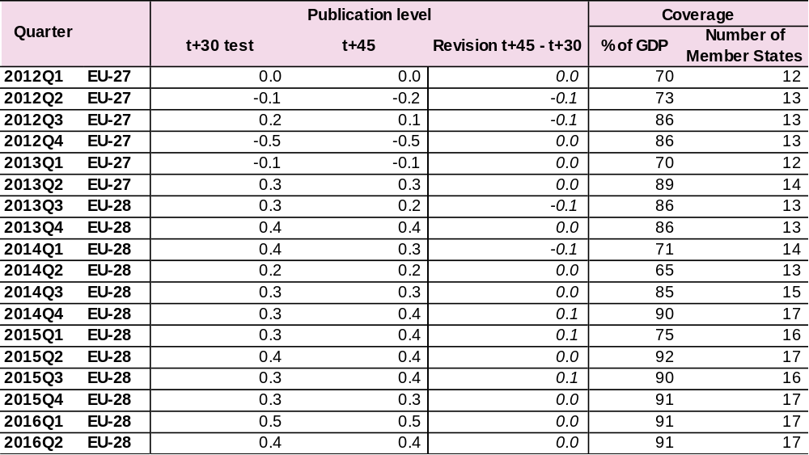
4. a) Results, EU t+30 estimates (1)

Slide 7
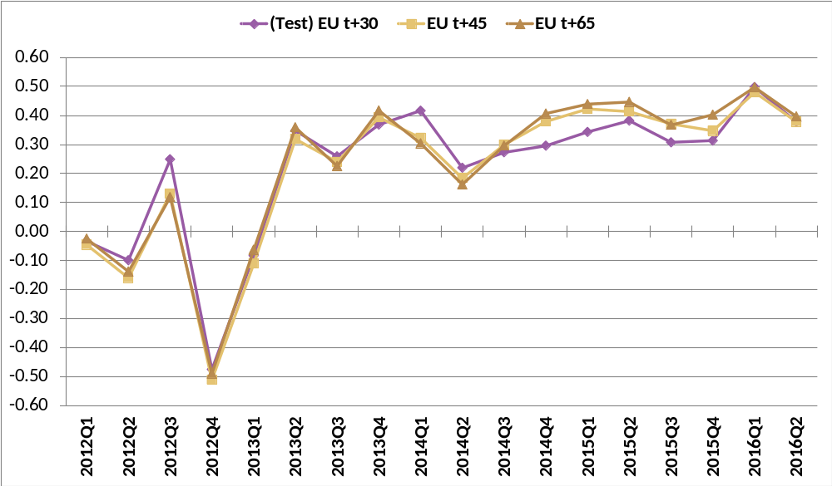
4.a) Results, EU t+30 estimates (2)

Slide 8
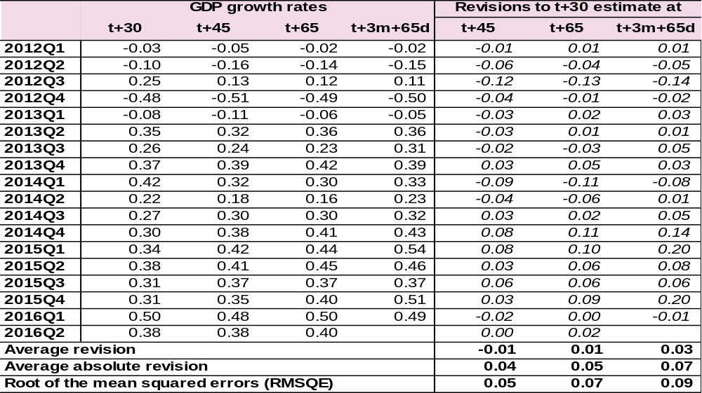
4.a) Results, EU t+30 estimates (3)

Slide 9
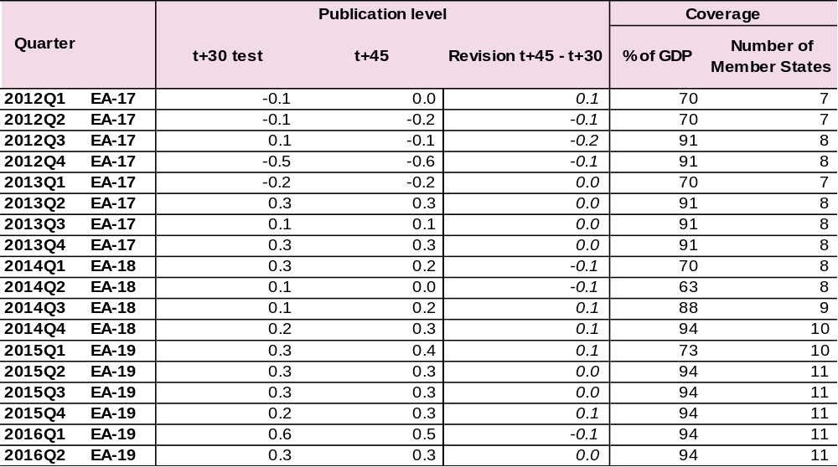
4. b) Results, EA t+30 estimates (1)

Slide 10
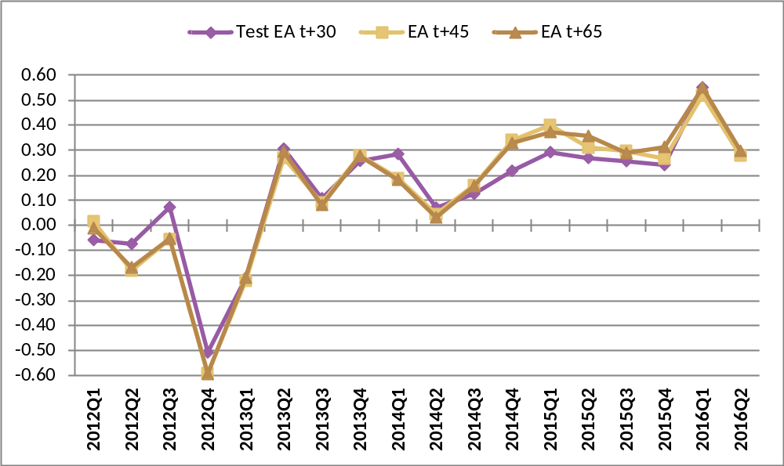
4.b) Results, EA t+30 estimates (2)

Slide 11
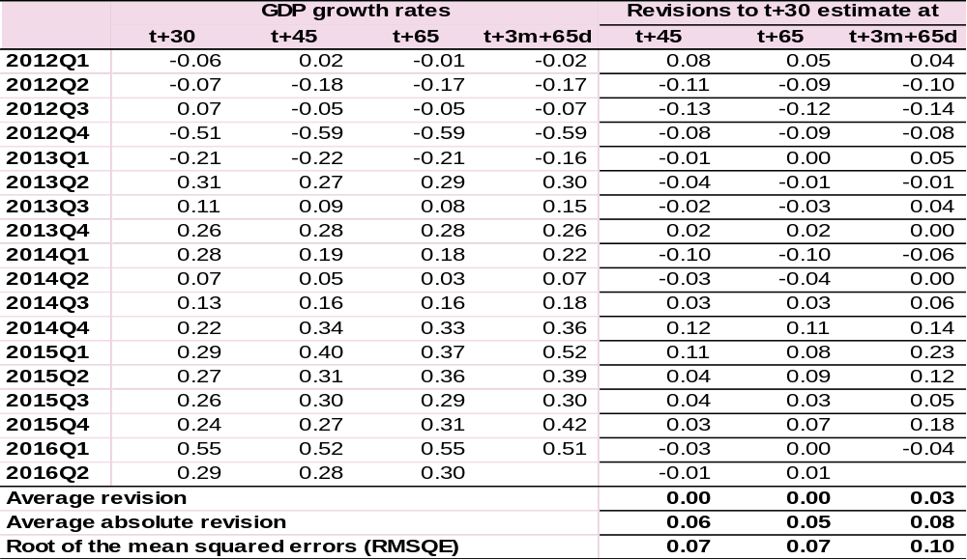
4.b) Results, EA t+30 estimates (3)

Slide 12
4. Results of the t+30 estimates (4)
Conclusions
Successfully passing all a priori quality criteria
Better than market forecasts at t+30 (tested for real-time quarters 2014Q1 onwards)
But: revisions t+30 → t+45 a bit larger than revisions t+45 → t+60
Eurostat (and ESS) decided to start publishing GDP t+30 from 2016Q1 onwards

Slide 13
5. Communication
Full information including background information available for all users at/after first release April '16
  Methodogical working papers on (Estat NA website):
    Methods and techniques for national GDP t+30 estimations
    Eurostat estimation procedure
  Article in Eurona journal, 1/2016
  Presentations in meetings and conferences
    ESCB Working Group GES, February 2016
    e.g. IARIW in August 2016, Ciret pre-conference Sept 2016,
    CESS 2016 …

Slide 14


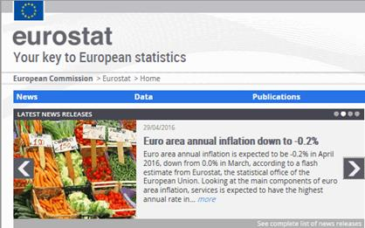
6. T+30 (and t+0) releases for Europe, 29/4/2016 →

