Slide 1
Discussion: Timely estimates of economic indicators
– Session C3 –
Stanimira Kosekova
European Central Bank
DG-Statistics
Conference of European Statistics Stakeholders
Budapest, 20–21 October 2016

Slide 2
Initial thoughts
The session
ECB-UNRESTRICTED
DRAFT
Highly relevant
Timely estimates are certainly needed
Need to be supported with reliable coverage and quality
The value added of statistical outputs
Communication/metadata is essential
User-producer dialogue

Slide 3
Three presentations
The session
ECB-UNRESTRICTED
DRAFT
GDP growth estimates for Europe at 30 days – is that feasible? (Eurostat)
Towards a comprehensive monthly volume indicator for trade and services in Europe (Eurostat)
How does early statistical output become late statistical input? (DG ECFIN)

Slide 4
GDP flash estimates
First presentation
ECB-UNRESTRICTED
DRAFT
Long standing users request
Joint efforts and commitment / ESS product
Advanced timeliness from t+45 to t+30 days
Successfully met all predefined quality criteria
In regular publication since April 2016
….. what comes next?

Slide 5
Euro area estimates for the GDP
First presentation
ECB-UNRESTRICTED
DRAFT
Revisions to GDP flash estimate (t+30)
Revisions to GDP flash estimate (full time series)
Period: 2003Q1 - 2016Q2
Current estimate refers to 2016Q2 data; GDP at t+45 days as First estimate until 2011Q4, after that GDP at t+30 days
Notes:
ECB Economic Bulletin, issue 4/2016, Box 4 provides some details on the GDP flash estimate at t+30 days

Slide 6
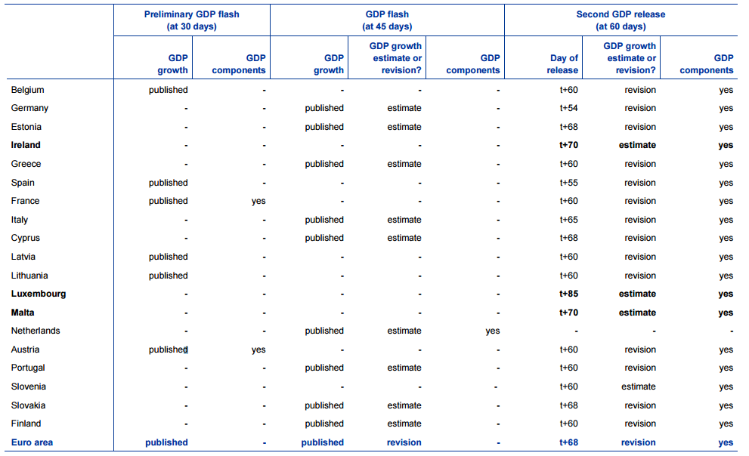
GDP publications and revisions
First presentation
ECB-UNRESTRICTED
DRAFT
GDP and components released under the quarterly national accounts framework
Source: ECB compilation based on the websites of the national statistical institutes and Eurostat.
Notes:
ECB Economic Bulletin, issue 4/2016, Box 4
Notes: GDP flash releases refer to Q1 2016 data. Second GDP releases refer to Q4 2015 data. Beyond the releases listed in the table, some euro area countries (e.g. Belgium and France), as well as some non-euro area countries (e.g. the United Kingdom) publish third GDP releases about three months after the end of the reference quarter. They include revisions to the previous estimates for GDP and the main aggregates. Eurostat discontinued the third euro area GDP database update in September 2014, when ESA 2010 entered into force. In addition, quarterly sectoral accounts (early release published at about 110 days and final release two weeks later) might provide revisions to the second euro area GDP release; however these are currently not aligned with the quarterly national accounts for the euro area.

Slide 7
GDP flash estimates
First presentation
ECB-UNRESTRICTED
DRAFT
Specific questions:
  The estimation methodology for the euro area/EU aggregates – aggregation of levels vs growth rates? What are the differences? What about the data properties in the long run?
  What is the data coverage for the euro area/EU in terms of input data (so called “hard” data) rather than the country coverage?
  Future development plans: t+30 national GDP estimates, GDP components?

Slide 8
Monthly volumes for trade and services
Second presentation
ECB-UNRESTRICTED
DRAFT
Growing importance of trade and non-financial business services
Short-term business statistics relevant for the business cycle
Input to GDP flash estimate at t+30
Need for comparable monthly volume indicator for services -> monthly ISP implementation in the short run

Slide 9
Monthly volumes for trade and services
Second presentation
ECB-UNRESTRICTED
DRAFT
Dedicated Task Force (2013-2015):
  New SPPIs
  Monthly turnover collection/estimation
  Trade deflators
First results -> promising! / quarterly & monthly results
Enhancing national production systems
FRIBS and publication in 2023 (EU and national monthly services turnover and ISPs)

Slide 10
Monthly volumes for trade and services
Second presentation
ECB-UNRESTRICTED
DRAFT
Specific questions:
  What criteria were used to assess the quality of the monthly service turnover?
  Is the threshold of 60% sufficient for the EU aggregates?
  When releasing the euro area/EU aggregates do you plan to publish national data as well?

Slide 11
The early statistical output
Third presentation
ECB-UNRESTRICTED
DRAFT
Complete overview of a statistical production process -> users are also producers!
Quality and timing are key -> the earlier the better* (trade-off between timeliness and other quality aspects)
Better outputs -> only if we have better inputs and better processes
Adaptation might be needed -> User-producer dialogue
Policy makers might not compromise regarding the timing of outputs

Slide 12
The early statistical output
Third presentation
ECB-UNRESTRICTED
DRAFT
The solution to make early output also ‘early’ input:
  Improved statistical production systems (making use of big data?)
  Coordination at all levels (across and within)
  Harmonisation of revision policies (across and within)
  Communication/dialogue and (political) commitment
But also keep in mind:
  Need to have reliable coverage and quality
  The value added of statistical outputs

Slide 13
The early statistical output
Third presentation
ECB-UNRESTRICTED
DRAFT
Specific questions:
  How users can help producers to meet user requirements?
  How producers can help users? Shall we wait for the next legal act in official statistics?
  Current tight timelines, rapidly changing economies, insufficient resources – is there a room to manoeuvre?

Slide 14
Conclusion and general questions
ECB-UNRESTRICTED
DRAFT
Timely estimates of economic indicators are highly relevant
Quality is necessary -> value added of official statistics
Communication -> user-producer dialogue
Key input for economic analysis, monitoring, projections
General question:
  Do we miss out something?

Slide 15
ECB-UNRESTRICTED
DRAFT
Thank you for your attention!

