Slide 1
Towards a comprehensive monthly volume indicator for trade and services in Europe
Thomas Jaegers and Håkan Linden
Eurostat

Slide 2
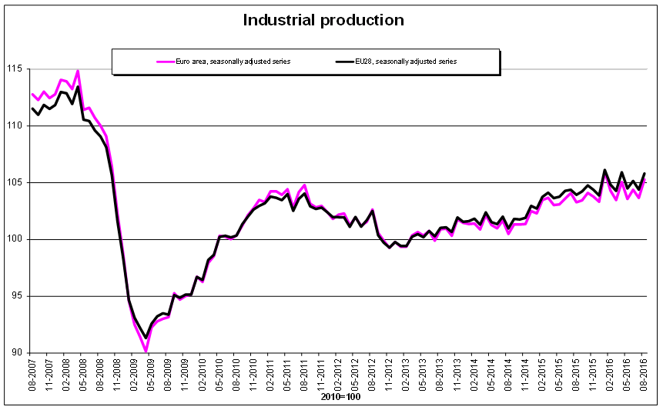
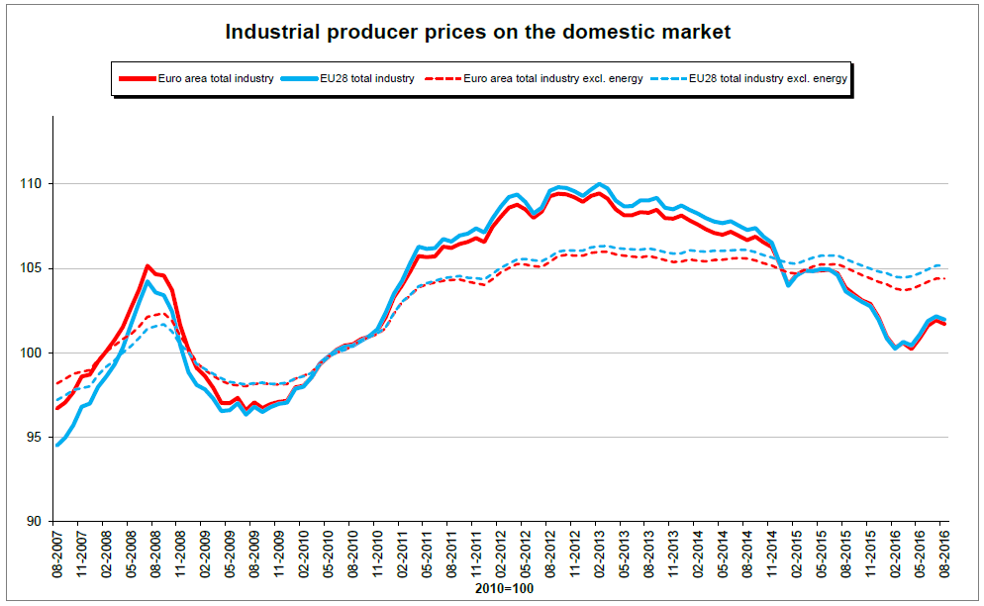
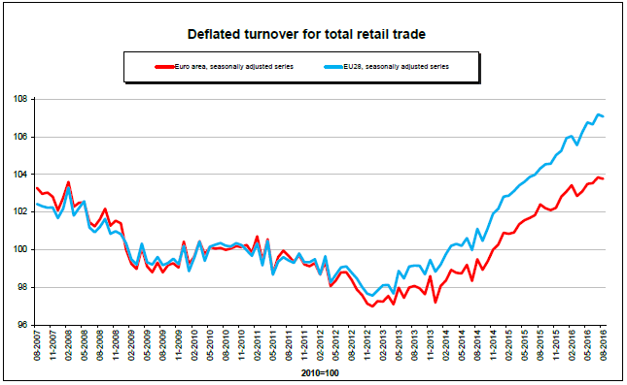
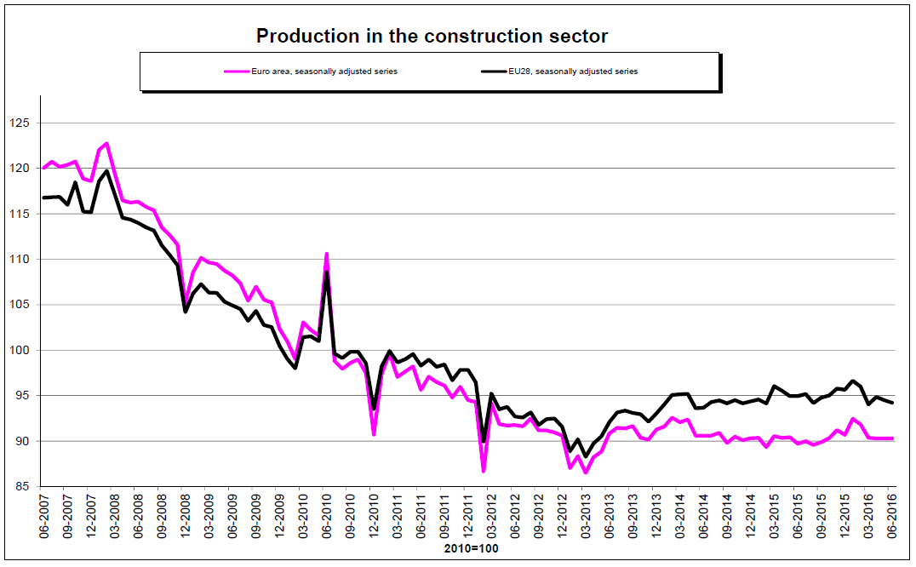
STS monthly news releases

Slide 3
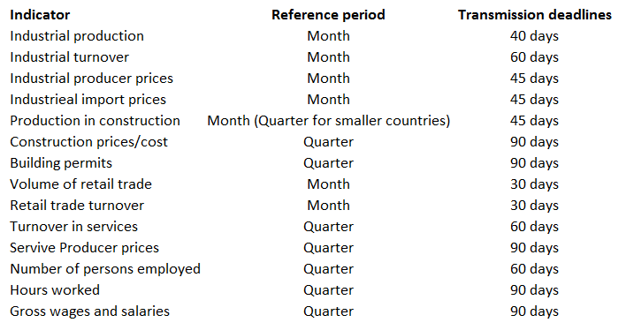
STS indicators and transmission deadlines

Slide 4
STS users and uses
Users | Uses
European Central Bank Commission services National governments and central banks Economic analysts and journalists Companies and Financial markets | Fastest economic indicators available Short-term economic analysis ("business cycle analysis"), policy formulation and monitoring Econometric models Input for quarterly national accounts / early estimates of quarterly GDP

Slide 5
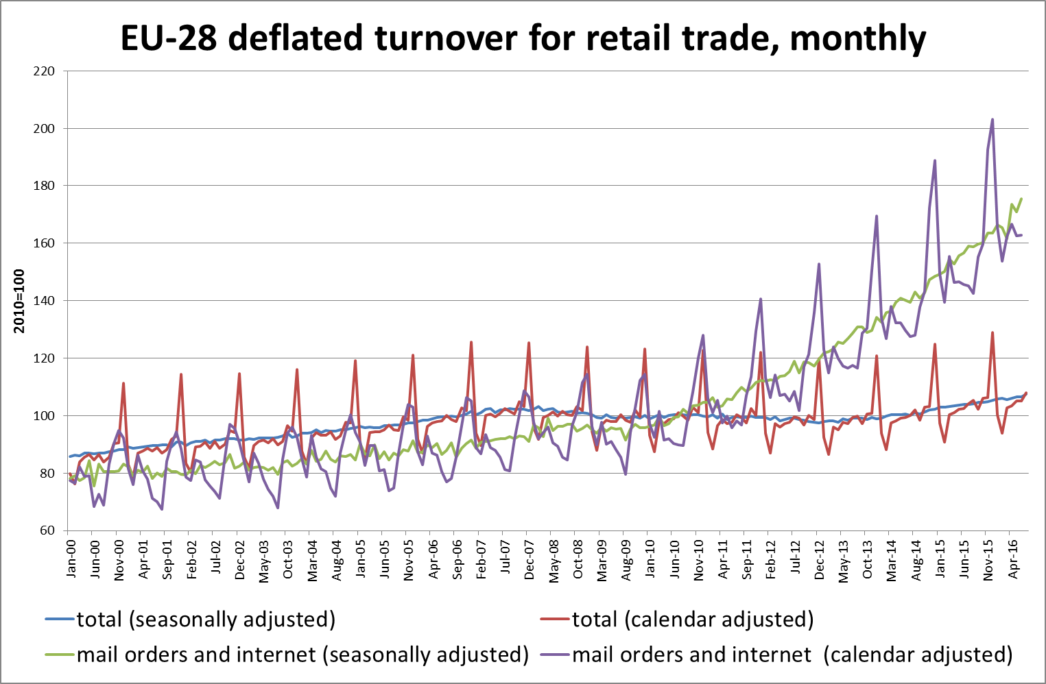
STS monthly indicators

Slide 6
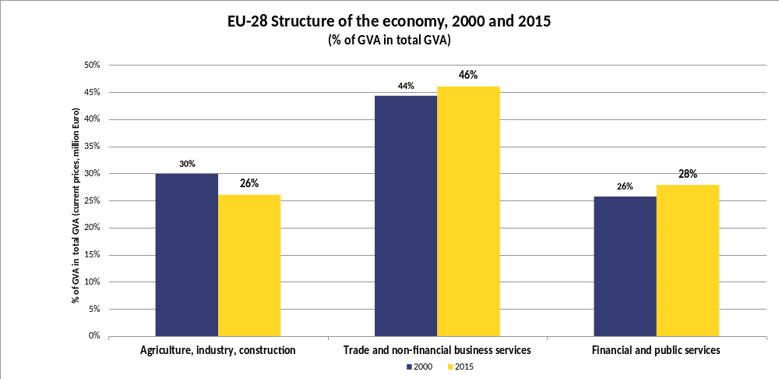
Increasing importance of services

Slide 7
Trade and services short term indicators
Monthly deflated retail trade turnover (NACE Rev. 2 G47);
Quarterly turnover indices (NACE Rev. 2 Sections H to N excl. K);
Quarterly producer price indices (NACE Rev. 2 Sections H to N excl. K);
Service producer prices B2B.

Slide 8
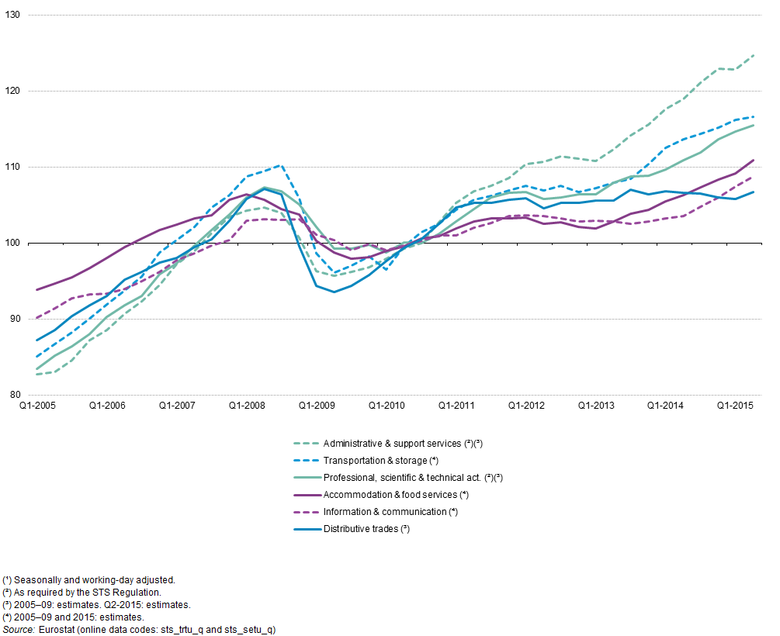
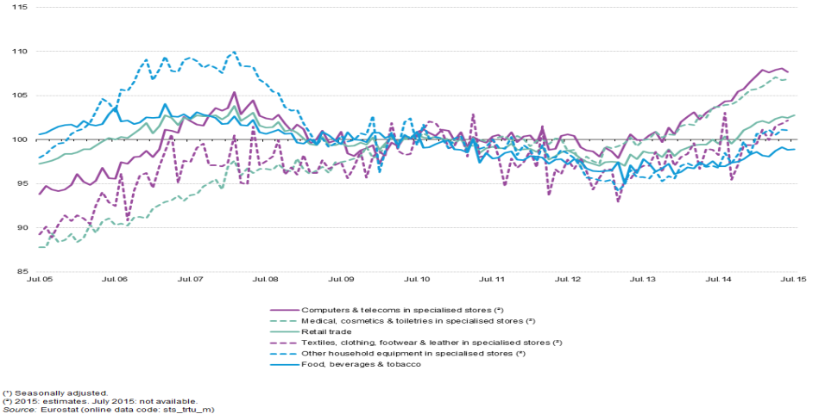
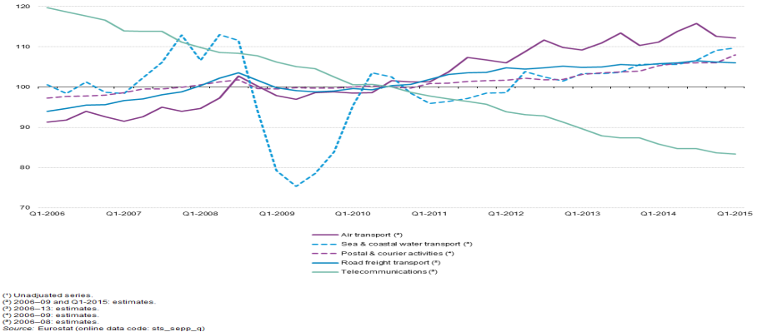
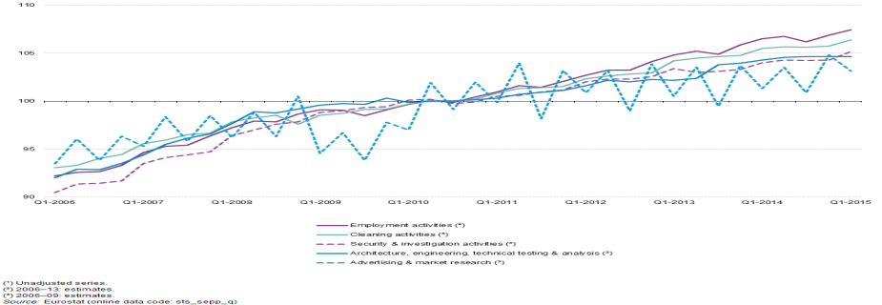
Trade and services short term indicators
Index of turnover, selected service activities, EU-28, 2005–15
Volume of sales index, selected retail trade activities, EU-28, 2005–15
Producer price indices, transport and communications services,
EU-28, 2006–15
Producer price indices, selected business services, EU-28, 2006–15

Slide 9
The EU Framework Regulation Integrating Business Statistics (FRIBS)
  New monthly Index of Services Production (ISP) covering NACE H-N (excl. K) at 2-digit level;
  Additional service industries covered (L68, N77, N81.1, and N81.2);
  Services turnover indicators with monthly frequency (now quarterly);
  Additional Service Producer Prices (SPPIs) where needed for deflation;
  Service producer prices from B2B to B2All prices.

Slide 10
Preparation - Grants
2013 – 2015 Extensive grant scheme for the methodological development of:
  - New SPPIs
  - Monthly turnover collection/estimation
  - Trade deflators.
2016+ grants for setting up regular and maintained national production processes of ISPs.

Slide 11
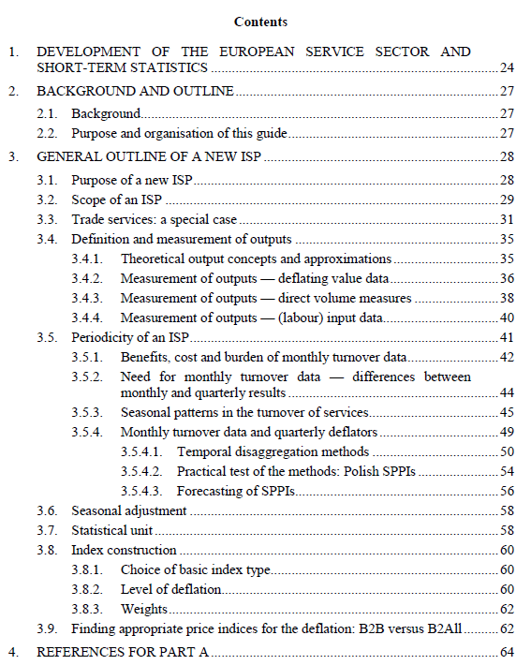
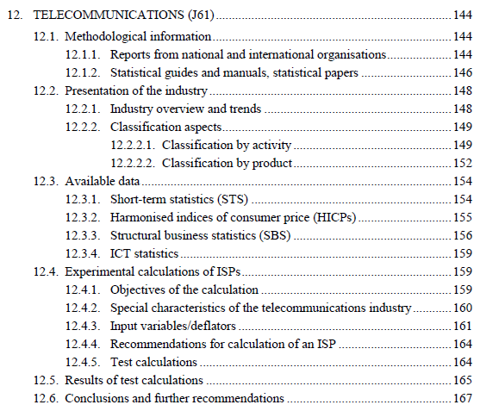
Preparation – ISP Guide (2016)
A practical guide on how to develop an ISP
Results partially based on OECD Compilation manual for an index of service production
Additional analysis (e.g. need for monthly frequency, temporal disaggregation of deflators, …)
21 service industries covered in special chapters

Slide 12
Preparation – monthly service turnover
12 countries (CZ, DK, ES, FR, LU, PT, RO, SI, SK, FI; SE, UK) plus DE for hotels and restaurants (I55, I56) already send monthly turnover data for service industries;
For some industries (at NACE 2- digit level) it is already possible to produces EU aggregates for monthly service turnover (60% estimation threshold);
In general, the volatility of the national data is impacting the data quality more than the mere coverage (comparisons of monthly and quarterly data; and size of revisions etc.)
To start publishing a monthly service turnover aggregate for EU-28.

Slide 13
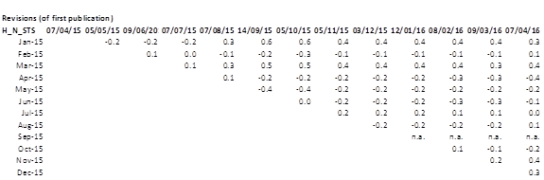
Revision triangle for total services (STS), EU-28

Slide 14
Comparison full quarterly coverage and monthly estimates

Slide 15
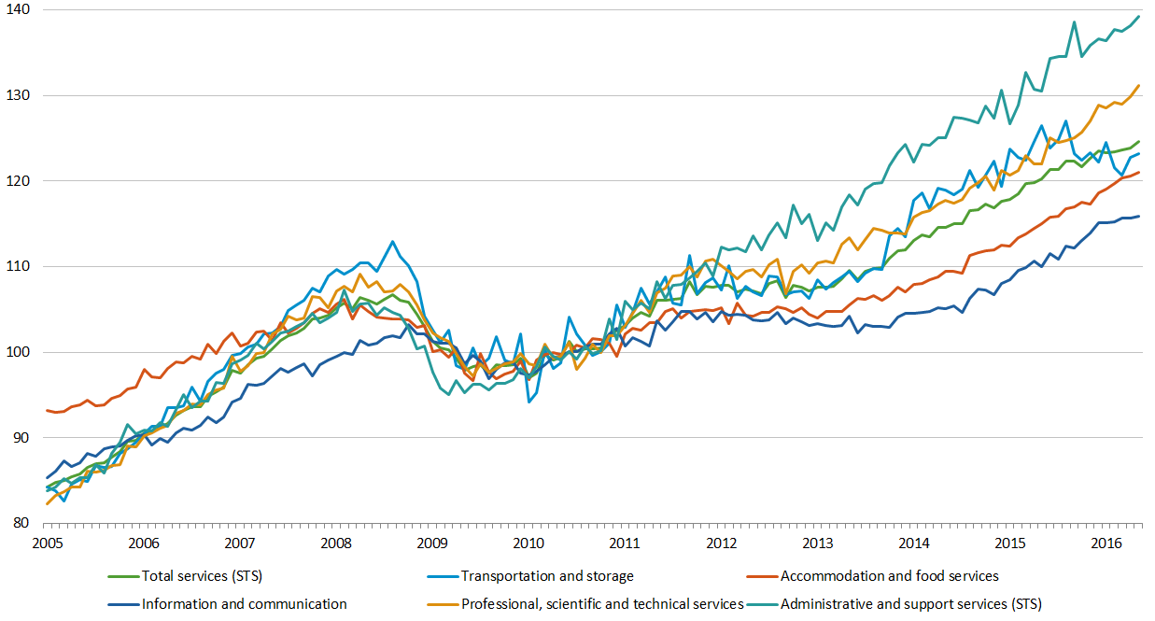
Turnover in selected service industries, EU-28, monthly data, seasonally adjusted, (2010=100)

Slide 16
EU-28, Volume, turnover and producer prices for telecommunication

Slide 17
ISP implementation in the short run
Monthly ISP = monthly turnover deflated by monthly SPPI;
Monthly turnover data and quarterly deflators;
Measurement of outputs;
Temporal disaggregation methods of SPPIs;
Forecasting methods for SPPIs;
Seasonal adjustment;
Statistical unit;
Index construction.

Slide 18
EU-28 Quarterly ISP (experimental)
Transport and industrial production
Notes:
In the transport industries, especially in land transport, the crisis is very visible. The graphs are similar to industrial production: less produced less to transport

Slide 19
EU-28 Quarterly ISPs (experimental) Communication
Notes:
Structural changes in communication as a result of new technologies

Slide 20
EU-28 Quarterly ISPs (experimental)
"Business services"
Notes:
Classical business services like cleaning are relatively stable over time, employment activities however clearly show the crisis

Slide 21
EU-28 Monthly ISPs - experimental calculations

Slide 22
Conclusions
Eurostat has started to publish monthly service turnover EU-28 aggregates;
Eurostat is working on the compilation of monthly Indices of Services Production (ISP) for some EU aggregates;
The ongoing work to support the national production and exchange of new indices of services production will allow successive release of more EU services data;
With the upgraded FRIBS services requirement, it will be possible to publish all EU and national monthly services turnover and ISPs in 2023;
We intend to release the total volume index of business production from 2023 onwards.

