Slide 1
The Item Count Technique (ICT)– past and present
Philosophische Fakultät Institut für Soziologie Lehrstuhl für Methoden der empirischen Sozialforschung
Hagen von Hermanni
Technische Universität Dresden (TUD)
Conference of European Statistics Stakeholders
Budapest 2016

Slide 2
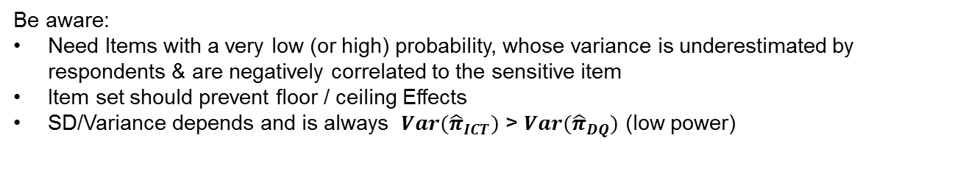
Item Count Technique (ICT)
Group SL1 (Short List) | Group LL1 (Long List)
Did you ever keep a book of household accounts? Does you household contain more TV‘s than members? Do you own a mobile phone? | Did you ever keep a book of household accounts? Does you household contain more TV‘s than members? Do you own a mobile phone? Have you engaged in any undeclared work for a private person this year [2010]?
How many of these questions apply to you (were answered with ‘yes’)?
ICT Estimator | Variance of ICT Estimator
$${\hat{π}}_{ICT}={\overline{x}}_{LL}− {\overline{x}}_{SL}$$ | $$Var({\hat{π}}_{ICT})={Var(\overline{x}}_{LL})+ {Var(\overline{x}}_{SL})$$
Be aware:
Need Items with a very low (or high) probability, whose variance is underestimated by respondents & are negatively correlated to the sensitive item
Item set should prevent floor / ceiling Effects
SD/Variance depends and is always $Var({\hat{π}}_{ICT})$ > $Var({\hat{π}}_{DQ})$ (low power)

Slide 3
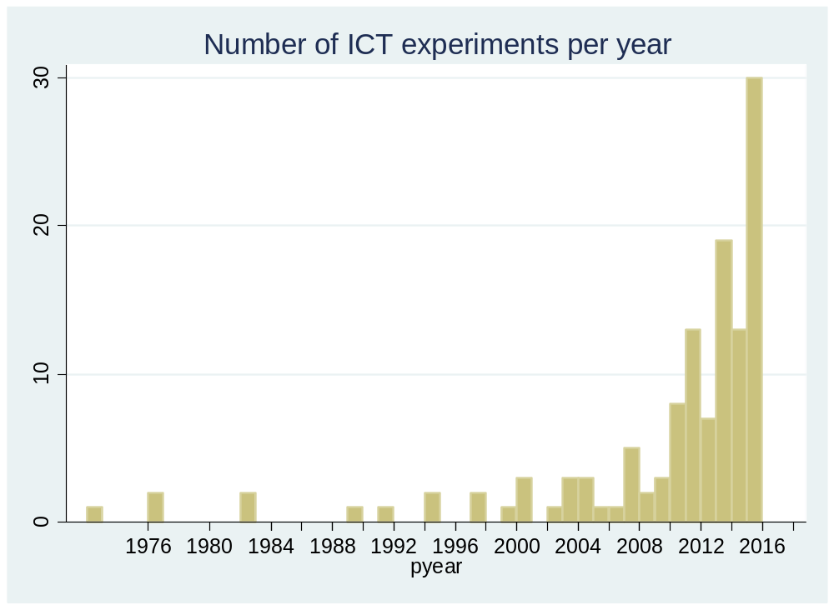
ICT Review (preliminary results)
Searched:
Web of Science (WOS)
Google Scholar
Conference Proceedings
Found:
366 papers & presentations
91 papers applying ICT
69 controlling with a direct question
Results (preliminary):
Different statistical tests (not all applicable)
Minority reported SD/SE of ICT estimator
Random effects meta-analysis of 60 experiments shows an overall effect size of 4.1 %

Slide 4
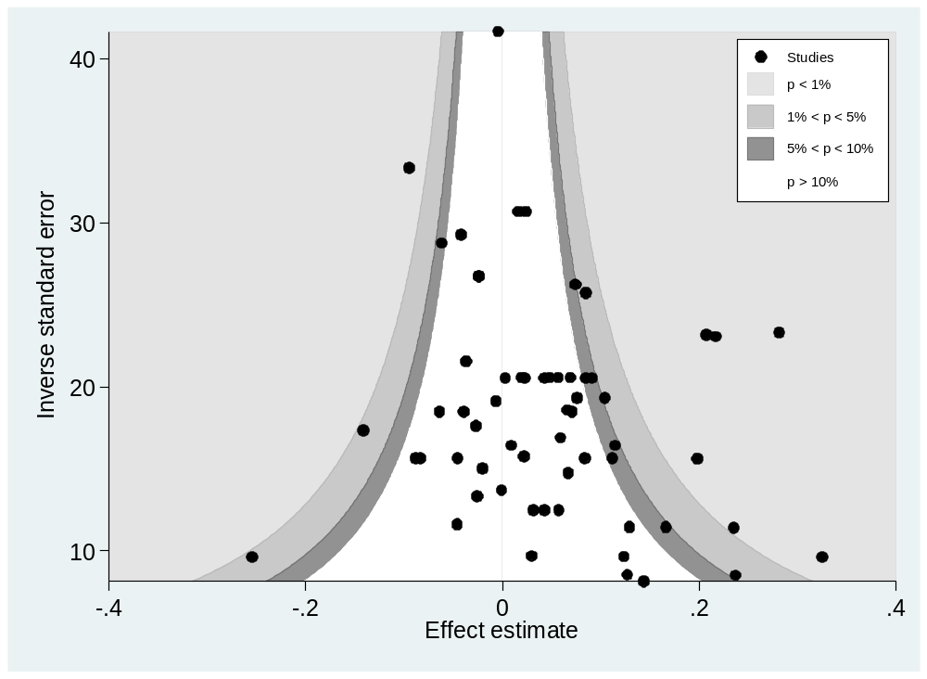
ICT Review (preliminary results)

Slide 5
Summary: ICT Review (preliminary results)
no sign of publication bias (Egger‘s test; p=0.068)
High heterogeneity between studies / within groups suggests review instead of meta-analysis
so far no „true score“ validation of the ICT (relying exclusively on the „more-is-better“ (undesirable) / „less-is-better“ (desirable) assumption
Outlook:
  Further coding (incl. reverse calculation via reported t- & z-values)
  Recalculation of results using different test statistics (e.g. t-test instead of binominal)
  Sensitivity rating of items (assuming that ICT works ‘only’ for high-sensitive items)

Slide 6
Item Sum Technique (IST)
Goal: Finding a Question technique which …
  … does not require a randomization device
  … imposes only little cognitive burden on respondents
  … is applicable in CATI and self-administered settings
  … enables the collection of continuous (sensitive) items
Group LL (Long List) | Group SL (Short List)
C1: How many hours did you watch TV last week? S1: How many hours do you usually spend in undeclared work per week? | C1: How many hours did you watch TV last week?
How many of these questions apply to you (were answered with ‘yes’)?
Group LL (Long List) | Group SL (Short List)
C2: How high are your monthly costs for your apartment or your house? S2: On average, how much do you earn per month from undeclared work? | C2: How high are your monthly costs for your apartment respectively or your house?
How many of these questions apply to you (were answered with ‘yes’)?
(Trappmann et al. 2014)

Slide 7
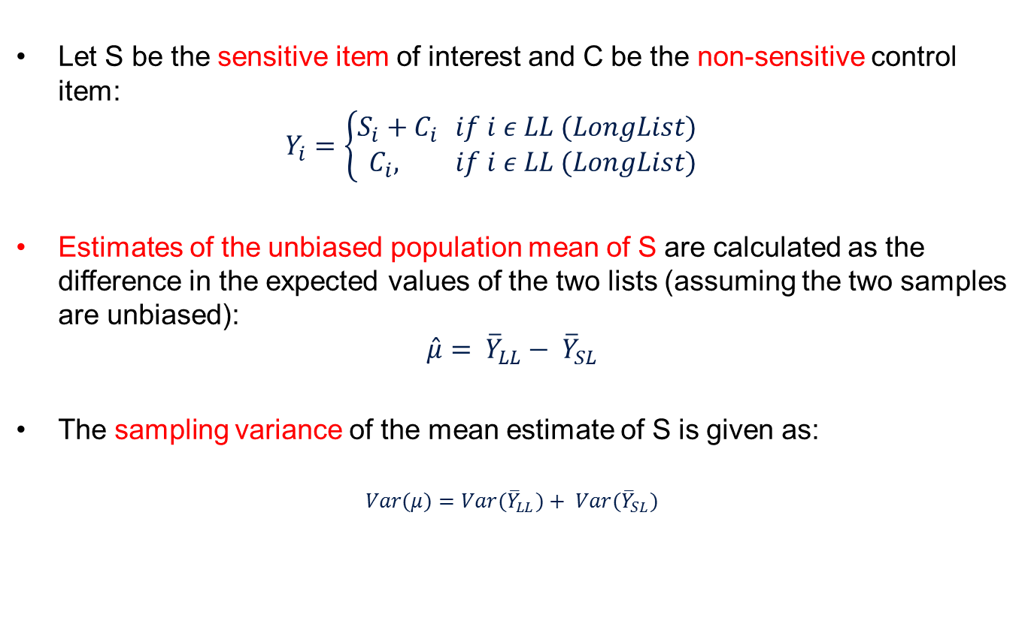
IST Estimator
Let S be the sensitive item of interest and C be the non-sensitive control item:
$$Y_{i}=\left\{\begin{aligned}S_{i}+C_{i } &if i ε LL (LongList) \\ C_{i}, &if i ε LL (LongList)\end{aligned}\right.$$
Estimates of the unbiased population mean of S are calculated as the difference in the expected values of the two lists (assuming the two samples are unbiased):
$$\hat{μ}= {\overline{Y}}_{LL}− {\overline{Y}}_{SL}$$
The sampling variance of the mean estimate of S is given as:
$$Var(μ)={Var(\overline{Y}}_{LL})+ {Var(\overline{Y}}_{SL})$$

Slide 8
IST application – Trappmann et al. 2014
Mode | CATI Study
Randomization | Split-ballot Experiment Sample (n = 3,211)
Structure of Undeclared Work (Hours & Earnings) | Direct Questioning (n = 1,145) |  | Item Sum Technique (n = 2,066)
 |  |  | Short List* | Long List*
2 random samples from federal employment agency registers (RR1: 17.5 %):
register sample of employees (18-70) and
register sample of basic income support recipients (18-64)
* 128 opted to swap from SL to DQ
* 146 opted to swap from LL to DQ

Slide 9
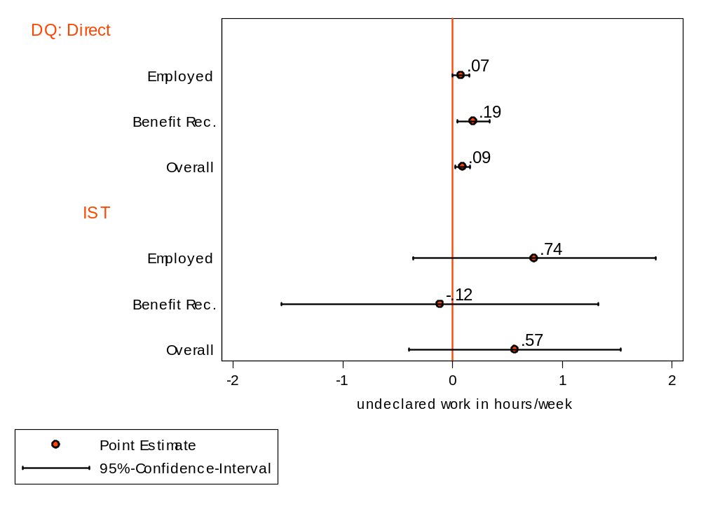
IST application – Trappmann et al. 2014

Slide 10
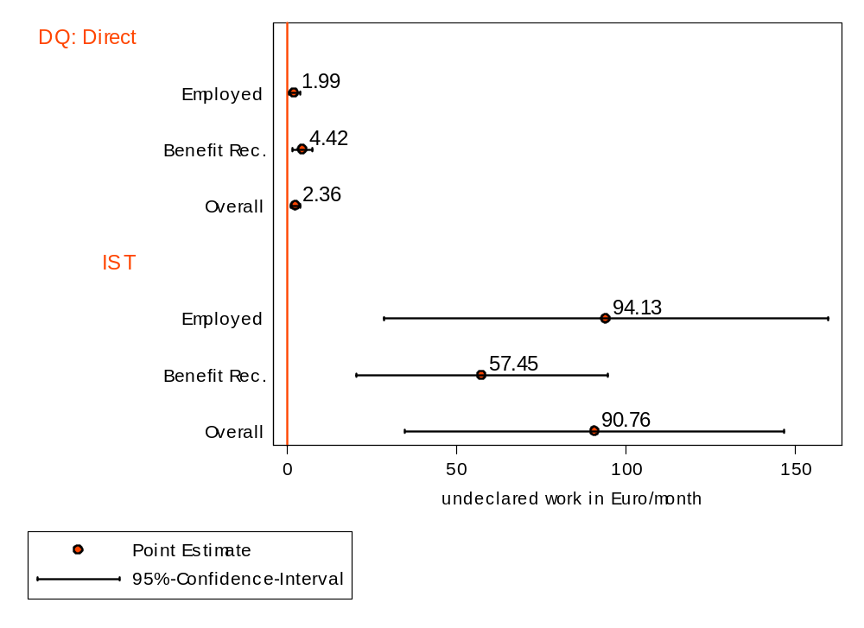
IST application – Trappmann et al. 2014

Slide 11
Summary IST
Summary:
Generalizing from the item count technique IST presents a new privacy preserving technique for metric sensitive items
IST can be fruitful in yielding higher estimates:
  No significantly higher reports of ‘hours’ of undeclared work
  Significantly higher estimates of ‘earnings’ compared to direct questioning
  Point and regression estimators available (isreg, Jann 2011)
Limitations & outlook:
  low statistical power, i.e. large standard errors of point estimates and regression coefficients: Trade-off with privacy preservation
  Success depends largely on adequacy of innocuous items (see Hussain et al. 2016 for an ‘improved estimator’)
  Underlying assumption of IST valid? (e.g. testing with two innocuous items)

Slide 12
Thank You!
By interest in the …
… ICT review contact: hagen.von_hermanni@tu-dresden.de
… IST study contact: mark.trappmann@iab.de
Trappmann, M., Krumpal, I., Kirchner, A. and B. Jann (2014). Item Sum: A New Technique for Asking Quantitative Sensitive Questions. In: Journal of Survey Statistics and Methodology 2(1), 58- 77.
Hussain, Zawar, Naila Shabbir, and Javid Shabbir (in press). "An Alternative Item Sum Technique for Improved Estimators of Population Mean in Sensitive Surveys.“ In: Hacettepe Journal of Mathematics and Statistics
Jann, B. (2011): “isreg: Stata module to estimate a regression for item sum data” Unpublished.

Slide 13
Former systematic reviews
    Meta- Analysis of the ICT by Tourangeau & Yan (2007):
      Overall effect not significant (n=7)
      “undergraduate samples tended to yield positive results […] general population survey received clearly negative results.” (ebd: 873)
      “no evidence of publication bias” (ebd)
    Holbrook & Krosnick (2010) reviewed:
      „only two studies […] found no difference” (ebd: 45)
      “Combining across all past studies, the ICT yielded significantly higher prevalence estimates of undesirable behaviors and attitudes than did direct self-report measures in 63 percent of forty-eight comparisons, much more than would be expected by chance alone.” (ebd)
    Wolter & Laier (2014):
      “Overall, we can conclude that the usefulness of ICT in eliciting more valid estimates than DQ with respect to self-reported delinquency has not yet been evaluated and ascertained sufficiently.“ (158)

Slide 14
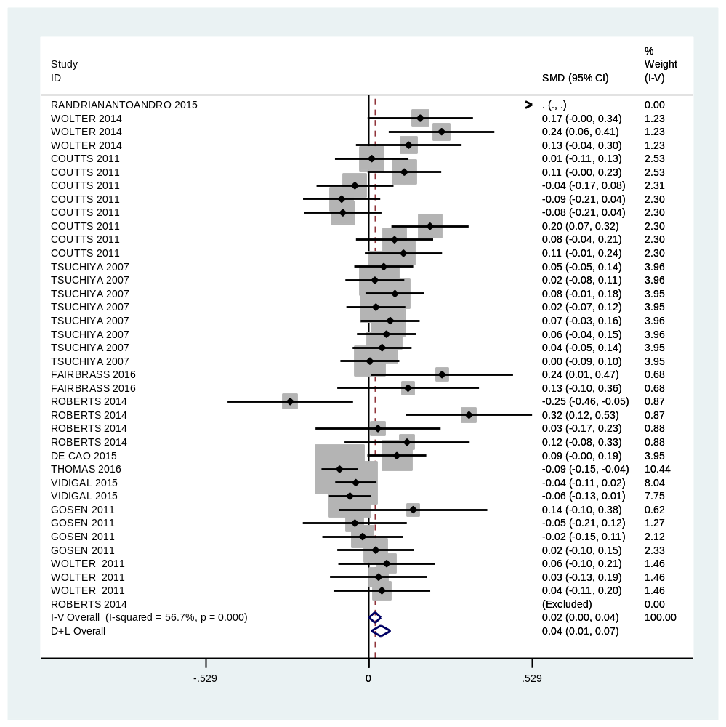

Slide 15
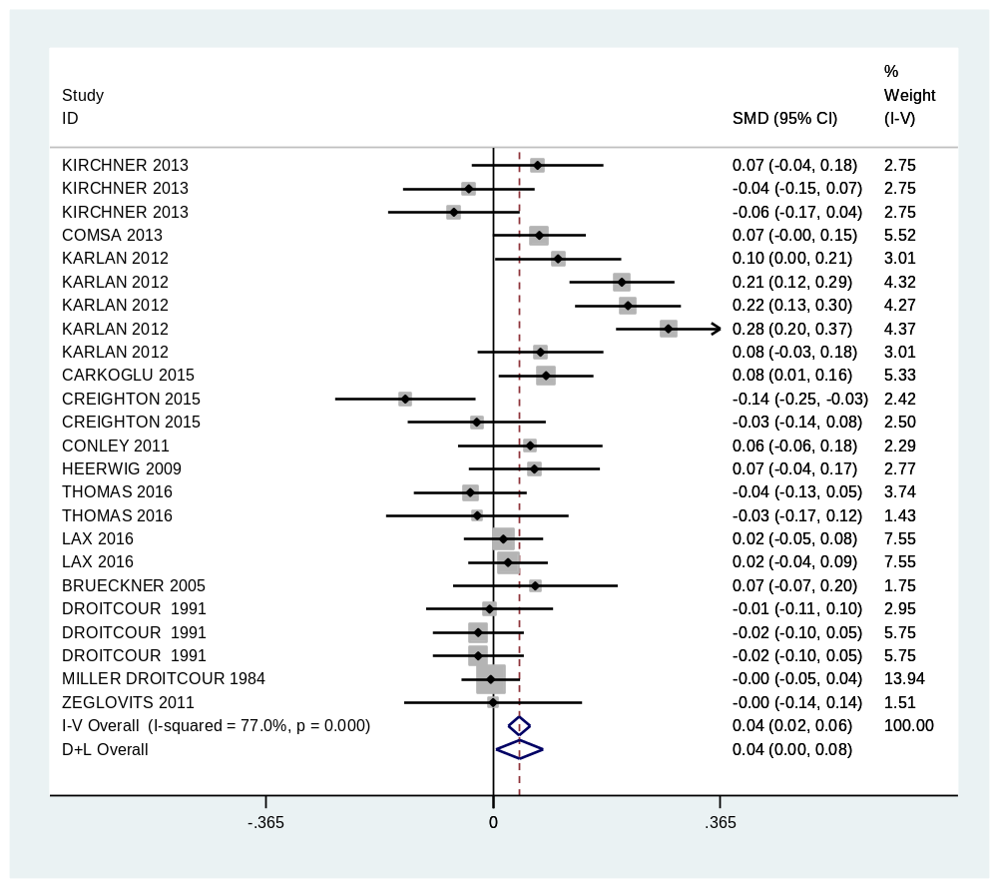

Slide 16
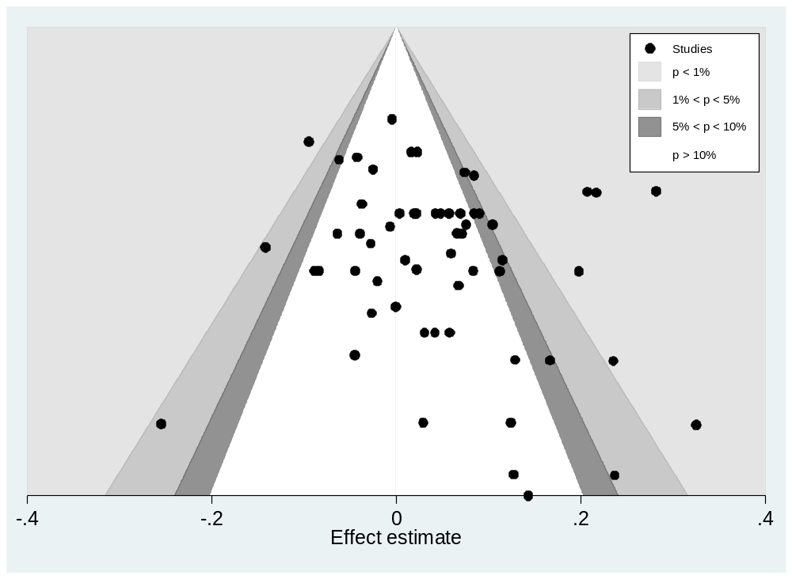

Slide 17
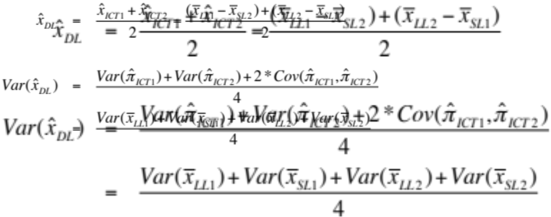
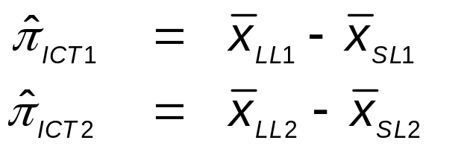
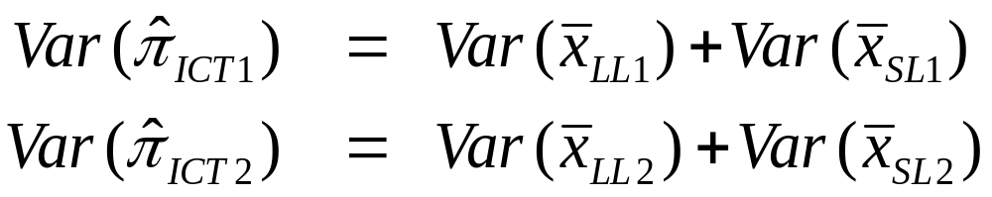
Double-list Design (Droitcour et al. 1991)

Slide 19
Item Sum: Mean Estimates
(isnreg: Jann 2013)
 | Hours of undeclared work (per week)
 | Employees | Benefit recipients
Direct questioning (DQ) | 0.07 (0.03) | 0.14 (0.06)
Assigned to DQ | 0.07 (0.04) | 0.19 (0.08)
Opted for DQ | 0.05 (0.05) | 0.00 (-)
Item sum technique (IST) | 0.85 (0.70) | -0.17 (1.06)
24 of 29
Notes:
Thank you for pointing us to Knaeuper’s work, which is extremely relevant to how we implemented the IST. Indeed, the question was filtered in the direct questioning condition and not filtered in the IST condition and you are absolutely right to point out that this might be an alternative explanation for the differences in favor of the IST that we find. We have good evidence, however, that this alternative explanation does not make our findings invalid. Knaeuper finds that for questions about witnessing or being the victim of a crime the mean frequency is approximately doubled when the question on frequency is not preceded by a filter question whether any instance occurred at all. The main explanation she gives for this is a “meaning shift” in situations where the construct is not clearly defined. Here respondents infer from the question format whether this is something most people are likely to have experienced (unfiltered frequency question) or not (filter question first) and adjust their interpretation. In our study the question was directly preceded by a definition of undeclared work (compare last sentence in section 3). This is exactly what Knaeuper suggests in order to avoid unwanted shifts. Furthermore, in order to render the significant effect of the IST for our second item insignificant the impact of filtering would have to be much larger than that found in Knaeuper’s work. While in Knaeuper’s article the average frequency is approximately doubled by abandoning the filter question, we would need a factor of more than 10 to leave the IST effect in table 3 insignificant.

Slide 20
Item Sum: Mean Estimates
(isnreg: Jann 2013)
 | Hours of undeclared work (per week)
 | Employees | Benefit recipients
Direct questioning (DQ) | 0.07 (0.03) | 0.14 (0.06)
Assigned to DQ | 0.07 (0.04) | 0.19 (0.08)
Opted for DQ | 0.05 (0.05) | 0.00 (-)
Item sum technique (IST) | 0.85 (0.70) | -0.17 (1.06)
24 of 29
Notes:
Thank you for pointing us to Knaeuper’s work, which is extremely relevant to how we implemented the IST. Indeed, the question was filtered in the direct questioning condition and not filtered in the IST condition and you are absolutely right to point out that this might be an alternative explanation for the differences in favor of the IST that we find. We have good evidence, however, that this alternative explanation does not make our findings invalid. Knaeuper finds that for questions about witnessing or being the victim of a crime the mean frequency is approximately doubled when the question on frequency is not preceded by a filter question whether any instance occurred at all. The main explanation she gives for this is a “meaning shift” in situations where the construct is not clearly defined. Here respondents infer from the question format whether this is something most people are likely to have experienced (unfiltered frequency question) or not (filter question first) and adjust their interpretation. In our study the question was directly preceded by a definition of undeclared work (compare last sentence in section 3). This is exactly what Knaeuper suggests in order to avoid unwanted shifts. Furthermore, in order to render the significant effect of the IST for our second item insignificant the impact of filtering would have to be much larger than that found in Knaeuper’s work. While in Knaeuper’s article the average frequency is approximately doubled by abandoning the filter question, we would need a factor of more than 10 to leave the IST effect in table 3 insignificant.

Slide 21
Item Sum: Mean Estimates
(isnreg: Jann 2013)
 | Hours of undeclared work (per week) |  | Earnings from undeclared work (per month)
 | Employees | Benefit recipients | Employees | Benefit recipients
Direct questioning (DQ) | 0.07 (0.03) | 0.14 (0.06) | 1.8 (0.7) | 3.4 (1.2)
Assigned to DQ | 0.07 (0.04) | 0.19 (0.08) | 1.9 (0.8) | 4.4 (1.5)
Opted for DQ | 0.05 (0.05) | 0.00 (-) | 1.1 (1.1) | 0.0 (-)
Item sum technique (IST) | 0.85 (0.70) | -0.17 (1.06) | 113.8 (40.1) | 83.4 (27.4)
24 of 29
Notes:
Thank you for pointing us to Knaeuper’s work, which is extremely relevant to how we implemented the IST. Indeed, the question was filtered in the direct questioning condition and not filtered in the IST condition and you are absolutely right to point out that this might be an alternative explanation for the differences in favor of the IST that we find. We have good evidence, however, that this alternative explanation does not make our findings invalid. Knaeuper finds that for questions about witnessing or being the victim of a crime the mean frequency is approximately doubled when the question on frequency is not preceded by a filter question whether any instance occurred at all. The main explanation she gives for this is a “meaning shift” in situations where the construct is not clearly defined. Here respondents infer from the question format whether this is something most people are likely to have experienced (unfiltered frequency question) or not (filter question first) and adjust their interpretation. In our study the question was directly preceded by a definition of undeclared work (compare last sentence in section 3). This is exactly what Knaeuper suggests in order to avoid unwanted shifts. Furthermore, in order to render the significant effect of the IST for our second item insignificant the impact of filtering would have to be much larger than that found in Knaeuper’s work. While in Knaeuper’s article the average frequency is approximately doubled by abandoning the filter question, we would need a factor of more than 10 to leave the IST effect in table 3 insignificant.

Slide 23
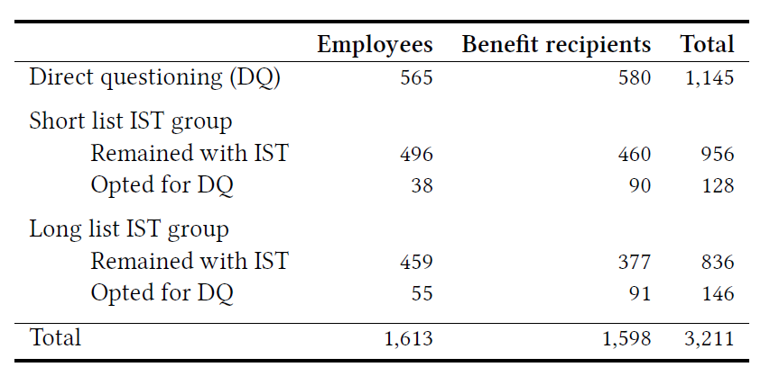
IST: Regression Output
Back to: Future Research

Slide 24
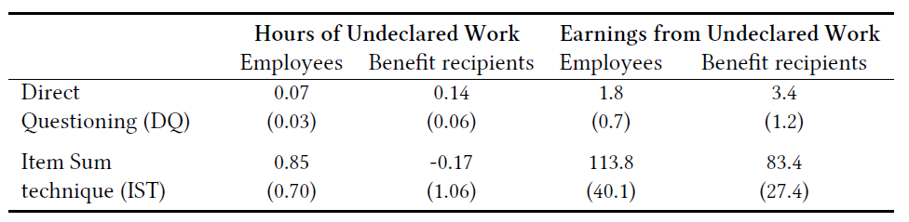
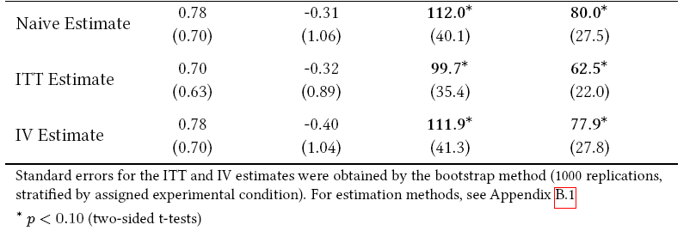
IST: Naïve, ITT, IV
IST: Regression Output
Back to: Future Research

Slide 25
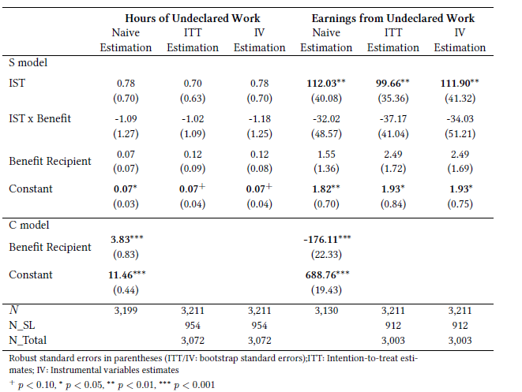
IST: Regression Output
Notes:
Instrumental variable methods allow consistent estimation when the explanatory variables (covariates) are correlated with the error terms of a regression relationship. Such correlation may occur when the dependent variable causes at least one of the covariates ("reverse" causation), when there are relevant explanatory variables which are omitted from the model, or when the covariates are subject to measurement error. In this situation, ordinary linear regression generally produces biased and inconsistent estimates.^{[2]} However, if an instrument is available, consistent estimates may still be obtained. An instrument is a variable that does not itself belong in the explanatory equation and is correlated with the endogenous explanatory variables, conditional on the other covariates. In linear models, there are two main requirements for using an IV:
The instrument must be correlated with the endogenous explanatory variables, conditional on the other covariates.
The instrument cannot be correlated with the error term in the explanatory equation, that is, the instrument cannot suffer from the same problem as the original predicting variable.
Informally, in attempting to estimate the causal effect of some variable x on another y, an instrument is a third variable z which affects y only through its effect on x. For example, suppose a researcher wishes to estimate the causal effect of smoking on general health.^{[6]}Correlation between health and smoking does not imply that smoking causes poor health because other variables may affect both health and smoking, or because health may affect smoking in addition to smoking causing health problems. It is at best difficult and expensive to conduct controlled experiments on smoking status in the general population. The researcher may proceed to attempt to estimate the causal effect of smoking on health from observational data by using the tax rate on tobacco products as an instrument for smoking in a causal analysis. If tobacco taxes affect health only because they affect smoking (holding other variables in the model fixed), correlation between tobacco taxes and health is evidence that smoking causes changes in health. An estimate of the effect of smoking on health can be made by also making use of the correlation between taxes and smoking patterns.
Because demonstrating that the third variable 'z' is causally related to 'y' exclusively via 'x' is an experimental impossibility, and because the same limitations that prevent an experiment to determine if there is a causal relationship between 'x' and 'y' will normally also prevent experiments determining if there is a causal relationship between 'z' and 'y' (assumed to be mediated through 'x'), correlational data is the only type of evidence that analysis by instrumental variable can provide, and causal inference is not licensed. The use of an instrumental variable simply produces additional evidence of a statistical relationship (in this case between 'z' and 'y'), without providing evidence of what type of relationship it is, and without providing evidence for the type of relationship between 'x' and 'y'.

Slide 26
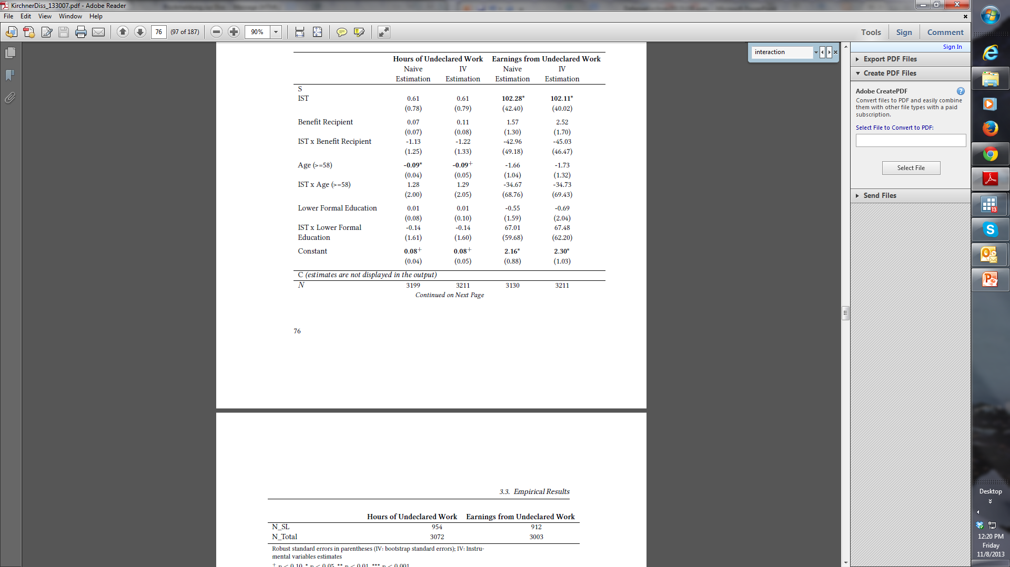
IST: Interaction Effects

Slide 28
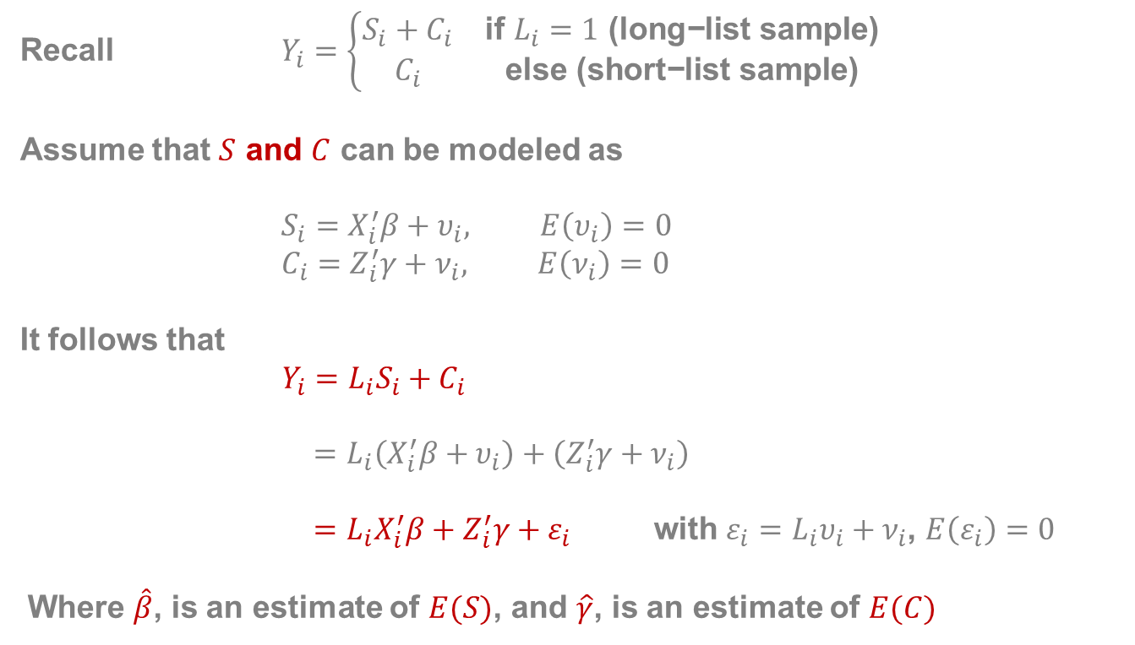
Estimators: IST
Recall $Y_{i}=\left\{\begin{matrix}S_{i}+C_{i} & \text{if} L_{i}=1\text{ (}\text{long}\text{−}\text{list} \text{sample}\text{)} \\ C_{i} & \text{else}\text{ (}\text{short}\text{−}\text{list} \text{sample}\text{)}\end{matrix}\right.$
Assume that $S$ and $C$ can be modeled as
$$S_{i}=X_{i}^{′}β+υ_{i}, E\left(υ_{i}\right)=0$$
$$C_{i}=Z_{i}^{′}γ+ν_{i}, E\left(ν_{i}\right)=0$$
It follows that
$Y_{i}=L_{i}S_{i}+C_{i}$
$$=L_{i}\left(X_{i}^{′}β+υ_{i}\right)+\left(Z_{i}^{′}γ+ν_{i}\right)$$
$=L_{i}X_{i}^{′}β+Z_{i}^{′}γ+ε_{i}$ with $ε_{i}=L_{i}υ_{i}+ν_{i}$, $E\left(ε_{i}\right)=0$
Where $\hat{β}$, is an estimate of $E(S)$, and $\hat{γ}$, is an estimate of $E(C)$

Slide 29
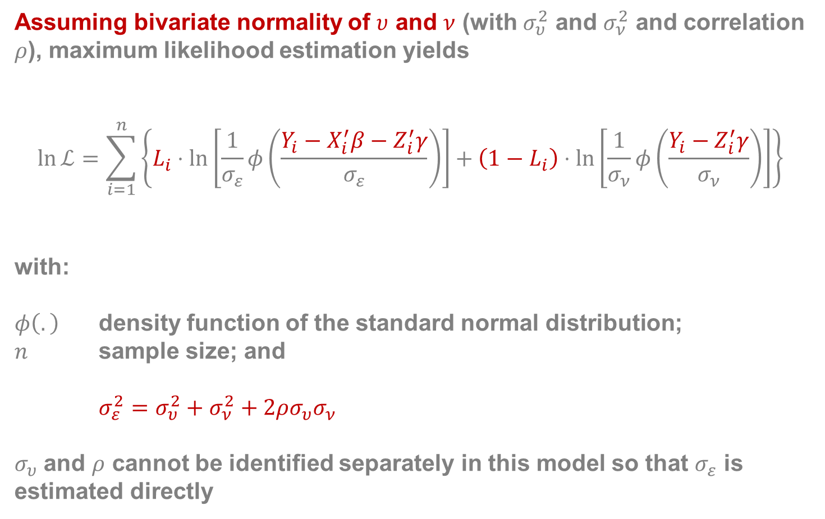
Estimators: IST cont.
Assuming bivariate normality of $υ$ and $ν$ (with $σ_{υ}^{2}$ and $σ_{ν}^{2}$ and correlation $ρ$), maximum likelihood estimation yields
$$\ln{ℒ}=\sum_{i=1}^{n}{\left\{L_{i}⋅\ln\left[\frac{1}{σ_{ε}}φ\left(\frac{Y_{i}−X_{i}^{′}β−Z_{i}^{′}γ}{σ_{ε}}\right)\right]+\left(1−L_{i}\right)⋅\ln\left[\frac{1}{σ_{ν}}φ\left(\frac{Y_{i}−Z_{i}^{′}γ}{σ_{ν}}\right)\right]\right\}}$$
with:
$φ\left(.\right)$ density function of the standard normal distribution;
$n$ sample size; and
    $$σ_{ε}^{2}=σ_{υ}^{2}+σ_{ν}^{2}+2ρσ_{υ}σ_{ν}$$
$σ_{υ}$ and $ρ$ cannot be identified separately in this model so that $σ_{ε}$ is estimated directly
Notes:
Although the coefficients are identified, the error variance of S, , and rho is not. This is because no information is available that could be used to disentangle and , which are both subsumed in ( ). However, as long as we are not specifically interested in this should not be a problem (note that the sampling variance of can still be estimated without difficulty even though the error variance of S is unidentified)

Slide 30
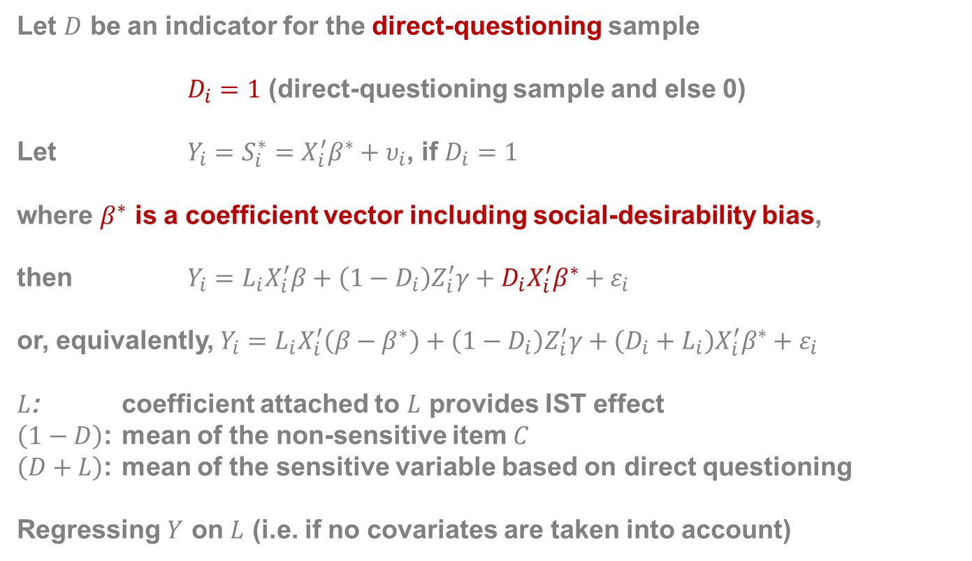
Estimators: IST cont.
Let $D$ be an indicator for the direct-questioning sample
$D_{i}=1$ (direct-questioning sample and else 0)
Let $Y_{i}=S_{i}^{∗}=X_{i}^{′}β^{∗}+υ_{i}$, if $D_{i}=1$
where $β^{∗}$ is a coefficient vector including social-desirability bias,
then $Y_{i}=L_{i}X_{i}^{′}β+{\left(1−D_{i}\right)Z}_{i}^{′}γ+D_{i}X_{i}^{′}β^{∗}+ε_{i}$
or, equivalently, $Y_{i}=L_{i}X_{i}^{′}\left(β−β^{∗}\right)+{\left(1−D_{i}\right)Z}_{i}^{′}γ+\left(D_{i}+L_{i}\right)X_{i}^{′}β^{∗}+ε_{i}$
$L$: coefficient attached to $L$ provides IST effect
$\left(1−D\right)$: mean of the non-sensitive item $C$
$\left(D+L\right)$: mean of the sensitive variable based on direct questioning
Regressing $Y$ on $L$ (i.e. if no covariates are taken into account)

Slide 31
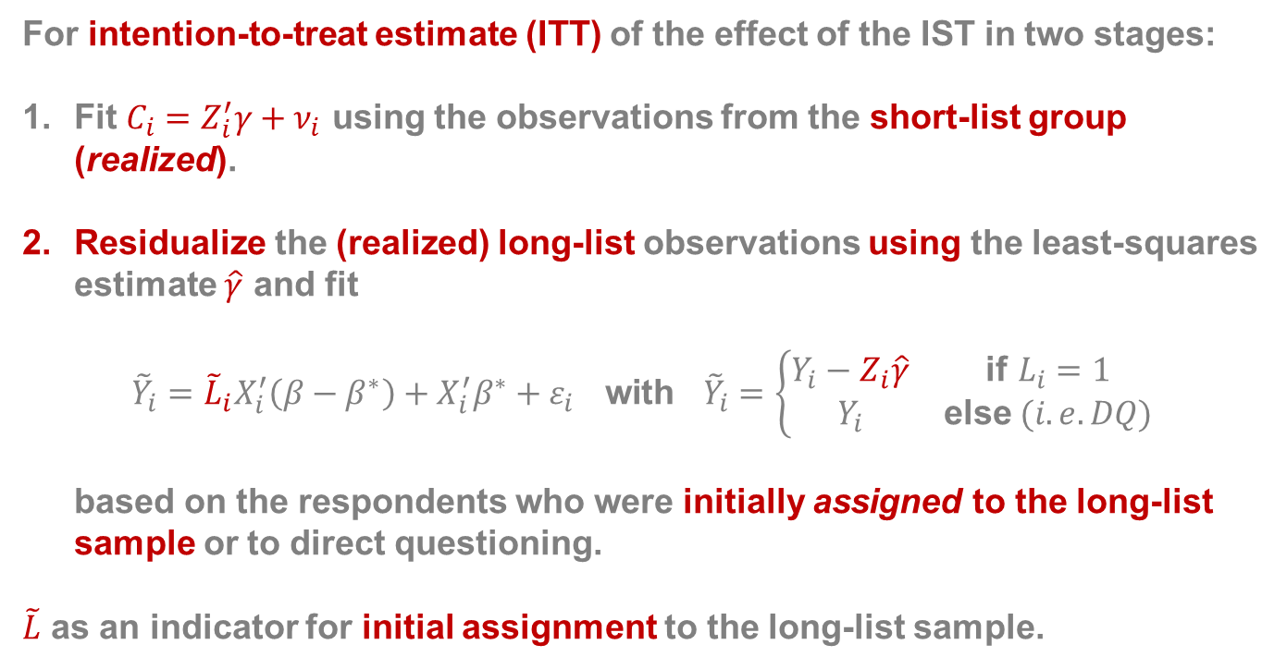
Estimators: IST cont.
For intention-to-treat estimate (ITT) of the effect of the IST in two stages:
Fit $C_{i}=Z_{i}^{′}γ+ν_{i}$ using the observations from the short-list group (realized).
Residualize the (realized) long-list observations using the least-squares estimate $\hat{γ}$ and fit
$${\tilde{Y}}_{i}={\tilde{L}}_{i}X_{i}^{′}\left(β−β^{∗}\right)+X_{i}^{′}β^{∗}+ε_{i} \text{with} {\tilde{Y}}_{i}=\left\{\begin{matrix}Y_{i}−Z_{i}\hat{γ} & \text{if} L_{i}=1 \\ Y_{i} & \text{else} (i.e. DQ)\end{matrix}\right.$$
based on the respondents who were initially assigned to the long-list sample or to direct questioning.
$\tilde{L}$ as an indicator for initial assignment to the long-list sample.
Notes:
Instead of measuring the effect of actually receiving the treatment, the effect of being assigned to the treatment is estimated. The ITT is a conservative estimate for the causal treatment effect. That is, because only a fraction of the assigned treatment group is actually treated, the ITT is a weighted average of the true treatment effect and zero. However, other than the naive approach, the ITT protects from possible overestimation of the treatment effect
The least-squares estimate of $\left(β−β^{∗}\right)$ is a consistent estimate of the intention-to-treat effect of the IST, but note that standard errors are biased because the additional uncertainty introduced by the variance of $\hat{γ}$ is not taken into account. We therefore apply the non-parametric bootstrap procedure across the two steps to compute the standard errors (Davison and Hinkley 1997).
The ITT is a conservative estimate of the causal treatment effect. We can improve on the ITT by fitting

Slide 32
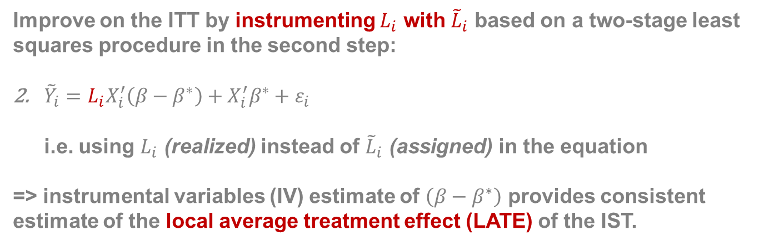
Estimators: IST cont.
Improve on the ITT by instrumenting $L_{i}$ with ${\tilde{L}}_{i}$ based on a two-stage least squares procedure in the second step:
${\tilde{Y}}_{i}=L_{i}X_{i}^{′}\left(β−β^{∗}\right)+X_{i}^{′}β^{∗}+ε_{i}$
i.e. using $L_{i}$ (realized) instead of ${\tilde{L}}_{i}$ (assigned) in the equation
=> instrumental variables (IV) estimate of $\left(β−β^{∗}\right)$ provides consistent estimate of the local average treatment effect (LATE) of the IST.
Notes:
Estimation follows the two-step procedure outlined above, where in a first step gamma is estimated using the shortlist group and, using this estimate, the observations from the longlist group are residualized. In the second step,
A necessary assumption for the ITT estimate to be consistent is that the respondents opting out of the short-list sample (who are completely discarded in our ITT estimation procedure) are not systematically different from the respondents opting out of the long-list group. This assumption appears plausible in our case because respondents did not know to which of the two IST groups they were assigned to when deciding to opt for direct questioning (we also tested the assumption by comparing the outcomes for the two subgroups; no significant differences were found).

