Slide 1


Big data-based inflation calculation for Hungary – a Research Concept
Pal Danyi, PhD
Associate Professor
danyi@mvt.bme.hu
Dept. of Management and Corporate Economics
Faculty of Economic and Social Sciences
Budapest University of Technology and Economics (BME)
Hungary
Conf. of European Statistics Stakeholders, 2016
Budapest, October 20, 2016
Notes:
I will talk about methodology options of inflation calculations. I’d like to emphasize that this is a research concept and experimentation, and not an official inflation calculation.

Slide 2
Model of Traditional Inflation (CPI) Calculation in Hungary
Represen-tative items | Avg Price | Wt. %
Pork, short loin, kg | 890 | 1.8
Eggs, 10 | 320 | 0.4
Roll, piece | 45 | 0.6
Beer | 195 | 2.8
Coal 100kg | …
Printer inkj.
Shower gel
Roses
Taxi, km
.
.
.
.
.
.
Product groups | Index % | Wt. %
Meat | 96.8 | 5.8
Dairy prod | 103.2 | 3.6
Clothing | 96 | 6.2
Durable goods | 92.3 | 5.9
Energy | …
Services
.
.
.
.
.
.
.
.
.
.
.
.
.
.
.
.
.
.
.
.
.
.
.
.
.
.
.
CPI
.
.
.
.
.
.
.
.
.
.
.
.
.
.
.
.
CPI for 140 Prod Groups
1000
representative
items
80K price quotes / month
Notes:
How does the CPI calculation look like?

Slide 3
Challenges of Traditional Inflation Calculation
Same calculation methods for 60 years
Commercial processes changed: e-commerce
Meaning of “representative” changed: 100x more products; sales figures (popularity) of product models are not timely analyzed
Price data collection is inefficient
Data source from internet is very limited
Weighting is based on 2-year old data
Notes:
Representative: 50 yrs ago 2 types of bread: white and half-brown, now 50 types.
Price data are not representative: One type of TV or smart phone is picked but there are thousands of different types: sales volumes are not known
Sales figures: (Which model should be a representative)
Price data collection: (too much manual work)

Slide 4
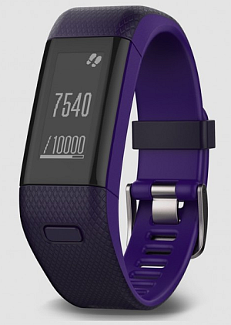


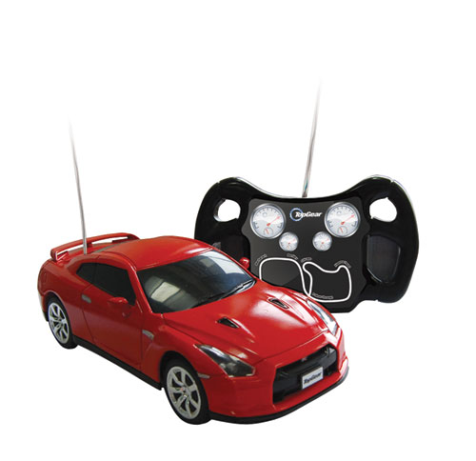
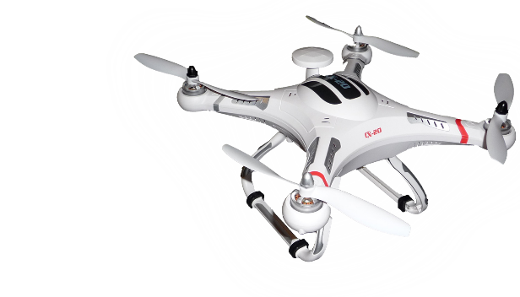


Set of representatives cannot follow product popularity
Popular products always change: new models, new versions

Slide 5
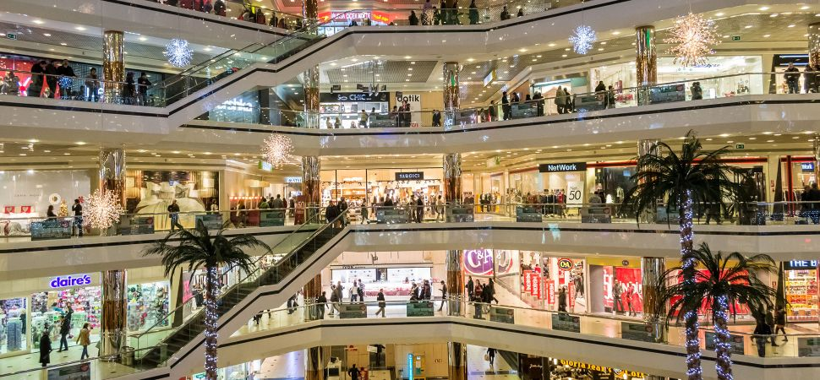
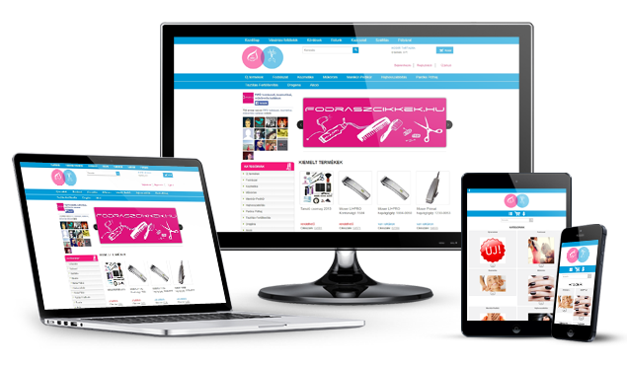
Offline prices ≠ Online prices
Offline (traditional) offer | Online (e-commerce) offer
No shipping | Cust. shipping is part of product cost
Geographically different prices (wholesale shipping, real estate) | Geographically same pricing (slightly different cust. shipping cost)
Few discount options | Many discount options
Difficult analysis of campaigns: slow feedback | Easy analysis of campaigns: fast feedback
Limited variety of product models | Infinite variety of product models
Notes:
Risk cannot be monetized

Slide 6
Latest pricing techniques
Customers hunt for best deals (price comparison) go for the cheapest or best price/performance
Dynamic pricing (e.g., airplane tickets)
Personal pricing/discounts are emerging
Zillions of online marketing campaigns: coupons, mobile discounts, additional presents

Slide 7
Forget List or Purchase Price – Pricing practice of Retailers
Product Discount (by manufacturer, wholesaler or retailer)
Coupons (by manufacturer or retailer)
Loyalty card discount (points)
Volume discount (Cust. Groups)
Personal discounts
Currently not considered
Ideally:
Check out price instead of “purchase” price

Slide 8
Solution 1: Instead of Representatives
Billion Prices Project (BPP) by MIT – good hints
Should not pick representative items but analyze millions of products, millions of prices
Price changes of million products are statistically proper inflation meter (for certain product categories)

Slide 9
Solution 2: Price collection
Web scraping: download data from web sites (prices of stores)
80K / month -> 1000K /day or week
Daily or weekly calculations are not necessary but they can increase reliability of inflation data
This may demand big data processing, but in reality: SMALL DATA
Large number of data is statistically resistant to typical online price problems (out of stock, typos, outdated offers, imprecise descriptions.)

Slide 10

Price comparison sites
Street (actual) prices (vs List price)
Arukereso: 2275 stores, 8.4M products, 2000+ product categories
Idealo (Germany): 58K stores, 218 M offers, 1900 product categories
Drawback: price comparison statistics do not consider actual volume of purchase

Slide 11
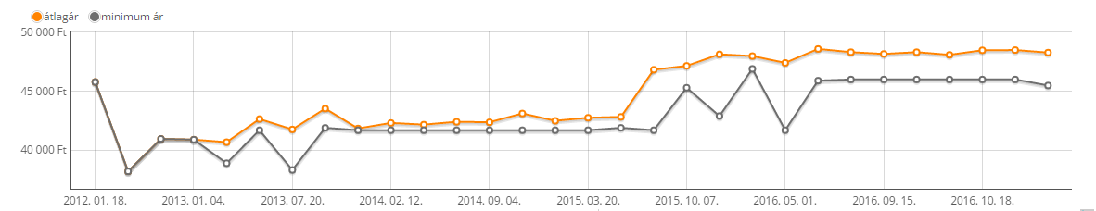

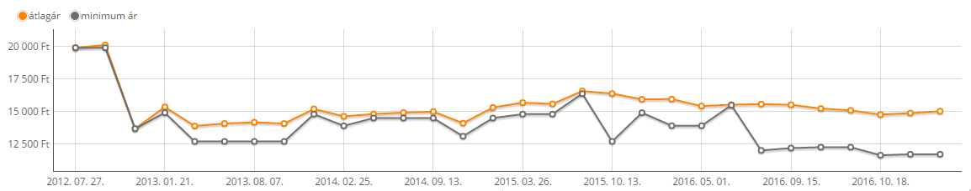

Price history on Price comparison sites

Slide 12
Recommended solution for price collection
Weigh prices according to popularity
One selected product: 50-100 price quotes
Clicks
Clicks
E.g., Sony TV sets 48-50”, 21 models
500
1600
Cheapest
$
Models by $
Cheapest

Slide 13
Recommended changes for weighting (Customer basket)
Currently: based on Household Diaries or Nationwide statistical surveys
No sensitivity analysis, no reference: online price comparison or retail store statistics do not help.
During crisis people spend differently (Changing patterns of 2009 customer habits only reflected in 2011 inflation figures)
Online Personal Finance Software and Apps collect useful data
Notes:
Sensitivity analysis: no test what happens if we have half or double numbers of representatives
No reference: no ideal distribution, no theoretical statistical model

Slide 14
Conclusion
For certain product categories: check all prices for all products instead of representatives
Develop a Personal finance software/app and experiment with weights
Big data techniques are not needed, Small data approach is enough
Unsolved mystery: Measuring check out price instead of list/street price
Cooperation with price comparison sites
Web scraping of webshops
Cooperation with Personal Finance app providers
?
Cooperation with webshops and offline stores

Slide 15



Thank you for your kind attention!
Pal DANYI
Dept. of Management and Corporate Economics
Faculty of Economic and Social Sciences
Budapest University of Technology and Economics
danyi@mvt.bme.hu
https://www.linkedin.com/in/paldanyi
Notes:
Az elektronikus kereskedelem más logikával, implicit módon módosítja a termék tényleges, vevő általi bekerülési értékét (garancia, szállítás, támogatás díjainak beépítése, termékkapcsolások, stb.)
A szolgáltatások köre oly mértékben kibővült (tanfolyamok, utazások, pénzügyi szolgáltatások, biztosítások, stb.), amelyeket szintén érdemes figyelembe venni.
Igényként jelentkezik, hogy változatosabban lehessen lakossági szegmensekre vonatkozóan inflációt számítani.
A fogyasztói árak mellett más árfajták változásának folyamatos (akár napi, heti) követésére is igény jelentkezhet (pl. termelői, import, export, stb.)

