Slide 1
Capturing depositors’ expectations with Google Data
Falko Fecht, Stefan Thum & Patrick Weber
DISCLAIMER
The views expressed in this presentation do not necessarily reflect the views of the Deutsche Bundesbank.

Slide 2
1. Motivation
Strategic complementarities and financial crises
Research Goal: Can Google searches be used as a predictor for a deposit run on banks?
Many financial institutions exposed to self-fulfilling liquidity crises
  Financial institutions performing liquidity transformation are exposed to runs by depositors
  Worries that others excessively withdraw induce investors to withdraw
  Some empirical evidence…
    Mutual funds: Chen, Goldstein, & Jiang (JFE 2010)
    Open end real estate funds: Fecht & Wedow (JFI 2014)

Slide 3
2. Contribution
Capturing depositor‘s expectations
How to measure investors’ expectations?
  Google searches might serve as a proxy for investors' worries
  Searches serve as an early warning indicator for liquidity crises
Exploit particularities of German banking system
  Savings Banks de facto government-guaranteed
  Suitable reference group: Cooperative Banks
Natural experiment: Blanket guarantee for German banks’ liabilities
  Public announcement on 5 October 2008 by Chancellor Merkel
  All retail deposits are safe: deposit insurance scheme
  Intention was to avoid possible bank run

Slide 4
3. Data
Google data are obtained via Google Trends
We obtain Google Trends Data via www.google.com/trends
  Relevant data:
  Relative search interest in search terms related to deposit insurance in Germany at the local level
  Breakdowns:
    Web searches by federal state

Slide 5
3. Data
Augment the Google data set with central bank data sources
We augment the Google Trends Data with…
1. Bundesbank Balance Sheet Items statistics
  Outstanding Euro amounts of overnight deposits at a monthly frequency at bank level (census approach)
2. Bundesbank MFI Interest Rate statistic
  Interest rates on outstanding amounts of overnight deposits at a monthly frequency at bank level for roughly 230 German banks (sample approach)

Slide 6
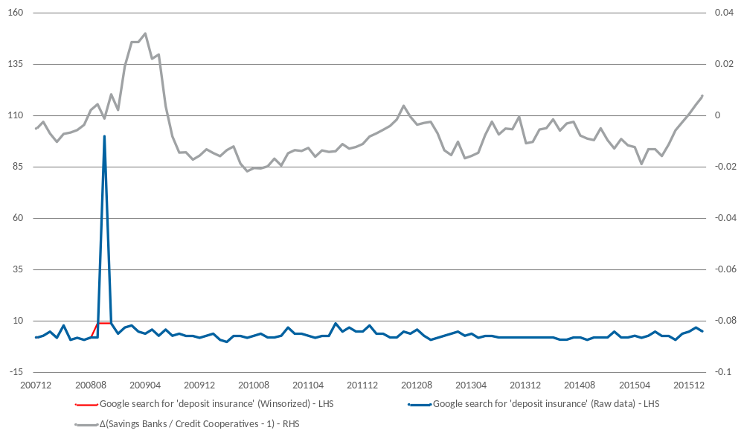
4. Descriptive Statistics
Google search interest versus deposit shifts
Google searches have a high correlation to ‚deposit shifts‘

Slide 7
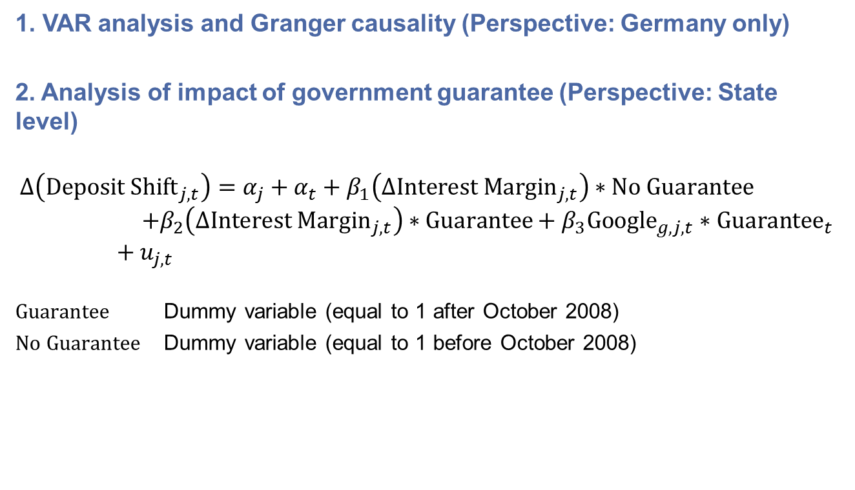
5. Methodology
Inter-temporal Analysis
1. VAR analysis and Granger causality (Perspective: Germany only)
2. Analysis of impact of government guarantee (Perspective: State level)
$$∆\left({\text{Deposit} \text{Shift}}_{j,t}\right)=α_{j}+α_{t}+β_{1}\left(∆{\text{Interest} \text{Margin}}_{j,t}\right)∗\text{No} \text{Guarantee}=+β_{2}\left(∆{\text{Interest} \text{Margin}}_{j,t}\right)∗\text{Guarantee}+β_{3}{\text{Google}}_{g,j,t}∗{\text{Guarantee}}_{t} +u_{j,t}$$
$\text{Guarantee}$ Dummy variable (equal to 1 after October 2008)
$\text{No} \text{Guarantee}$ Dummy variable (equal to 1 before October 2008)

Slide 8
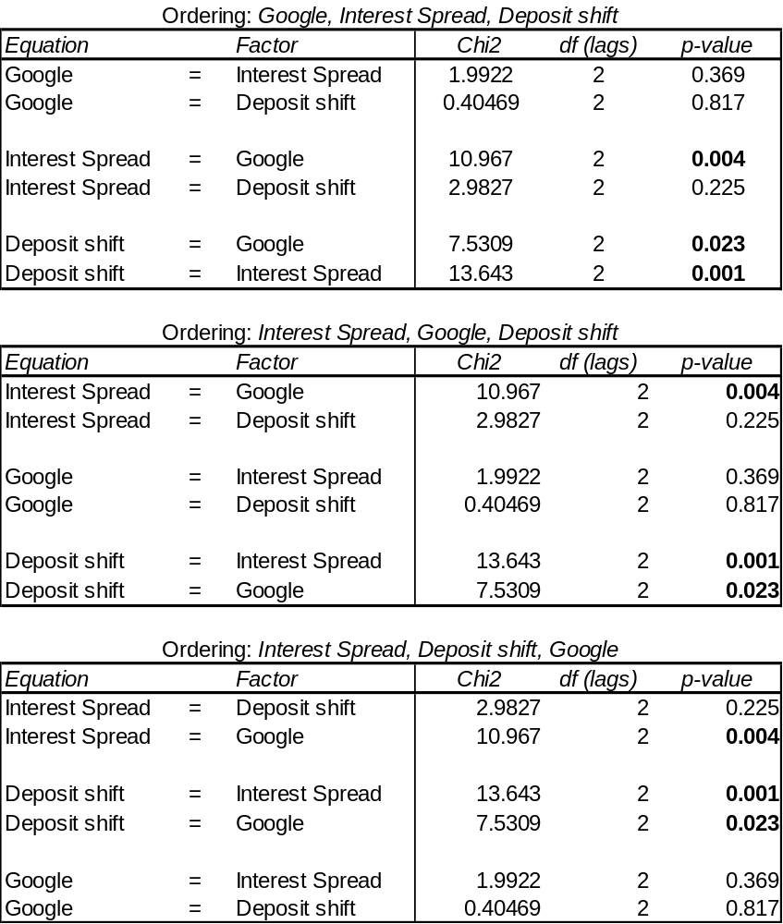
6. Results
Granger causality results (Perspective: Germany)
Google searches Granger cause the Interest Spread and Deposit Shifts
The results holds independent of the ordering
Alternative Google searches also Granger cause the Interest Spread and, for most of the time, Deposit Shifts

Slide 9
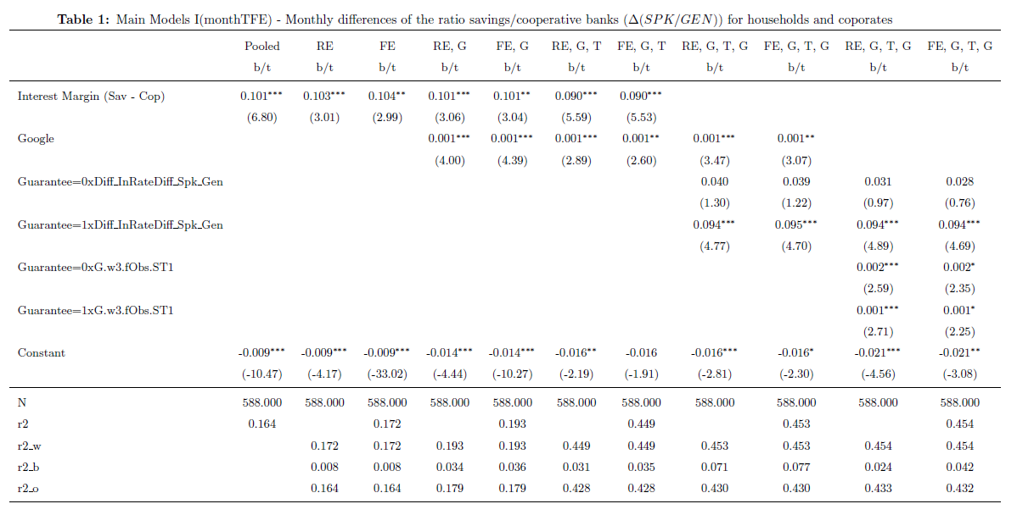
6. Results
Main regression result (Perspective: State level)

Slide 10
7. Conclusions
Google searches are a valuable measure for depositors’ expectations
Google searches can indeed be used as a measure for the concern of depositors
  Indication of run-type phenomena in local deposit markets
Blanket guarantee during the crisis led to a level playing field between private and public banks
  Deposit flows became more sensitive to interest rate spreads
  Fiercer competition in the deposit market
  Potentially more excessive risk-taking

