Slide 1
A Revision Analysis Plugin for Jdemetra+
CESS Budapest,20 Oct 2016
Dario Buono, Riccardo Gatto, Bogomil Kovachev, Gian Luigi Mazzi, Rosa Ruggeri Cannata

Slide 2
Revisions
Timeliness vs accuracy
Accuracy vs reliability
Types of revisions:
  Routine – periodic
    Within the year
    Annual benchmark
    …
  Occasional – irregular
    Changes in estimation procedure
    Conceptual changes (new classification etc.)
  Mixed

Slide 3
Why revision analysis
Check for:
the presence of bias
serial correlation
unit roots
heteroskedasticity
…
Apply for:
improvement of the revision process
Harmonization of revision policy
…

Slide 4
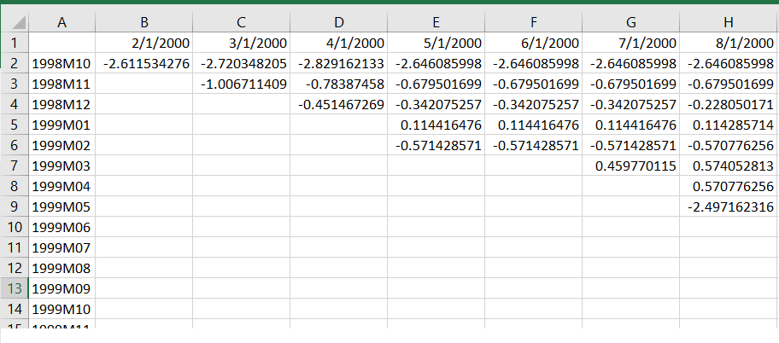
RA plugin – input
Releases
Reference
periods

Slide 5
Types of revision analysis
Horizontal – successive vintages of the same phenomenon
Diagonal – 1st release vs 2nd release, 2nd vs 3rd etc.
Vertical – all backward revisions at a particular date

Slide 6
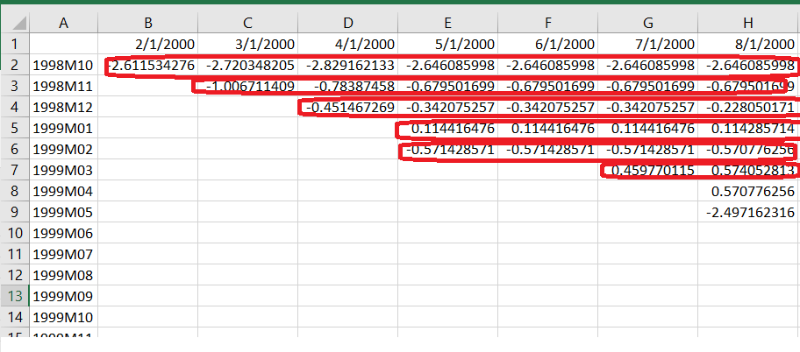
Horizontal revision

Slide 7
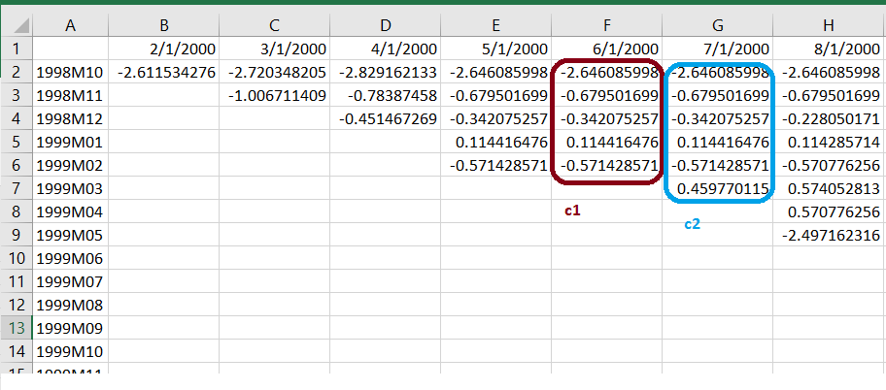
Vertical revision
r = c2 – c1

Slide 8
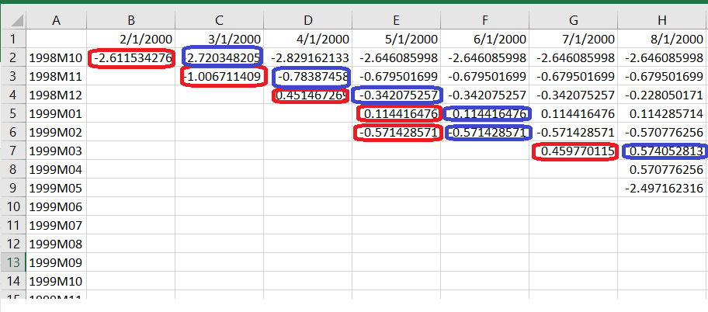
Diagonal revision
c1 – first release vector
c2 – second release vector

Slide 9
Descriptive analysis
Mean, median, ..
Ratio of upward revisions
Correlation of earlier/later estimate with revision
Skewness
Kurtosis
..

Slide 10
Parametric analysis – regression based
Theil inequality coefficient
Regressing the later vintage on the earlier vintage:
  Slope and drift
Regressing the revision on the earlier vintage
Regressing the revision on the previous revision
  Check orthogonality
  Heteroscedasticity of residuals
  Normality

Slide 11
Parametric analysis – VAR based
Unit root tests
  Dickey-Fuller
  Philips-Perron
Autocorrelation tests
  Breusch-Godgrey
  Ljung-Box
Cointegration test
Vector Error Correction Model

Slide 12
News vs Noise
Correlation between revision and earlier estimate (test if revisions are „noise‟)
Correlation between revision and later estimate (test if revisions are „news‟)

Slide 13
RA plugin status
Originally developed for Jdemetra 1.2
A port for version 2.* is available at https://github.com/bogosmith/jdemetraplus-revtool

