Slide 1
The expandable seasonal adjustment framework of JDemetra+
Jean.palate@nbb.be
CESS 2016
Budapest

Slide 2
0. Outline
Overview of the main SA methods
Design
SA framework: common features
Extensions
Next challenges

Slide 3

1. SA methods
$$Y=T+S+I$$
Non parametric
Parametric
Stochastic
Deterministic
LO(W)ESS
Moving averages
ARIMA
models
Structural models
Local regressions
STL
X11
Canonical decomposition
SEATS
BV4
X12-ARIMA
UCARIMA
models
Kalman smoother
WK filters
Ladiray D. and Quenneville B. [1999], Comprendre la methode X11

Slide 4
1. SA methods
$$Y=T+S+I$$
Non parametric
Parametric
Stochastic
Deterministic
JD+J
LO(W)ESS
Moving averages
ARIMA
models
Structural models
Local regressions
STL
X11
Canonical decomposition
SEATS
BV4
X12-ARIMA
UCARIMA
models
Kalman smoother
WK filters

Slide 5
2. OO-Design of JD+
Conceptual approach
Time series
SA decomposition
Linear filters
Arima models
…
Generic algorithms
Kalman filters
WK filters
RegARIMA estimation
…
Common tools
Presentation tools
Diagnostics
…
Implementation of specific SA/modelling algorithms
X11, X12
Tramo-Seats
…

Slide 6
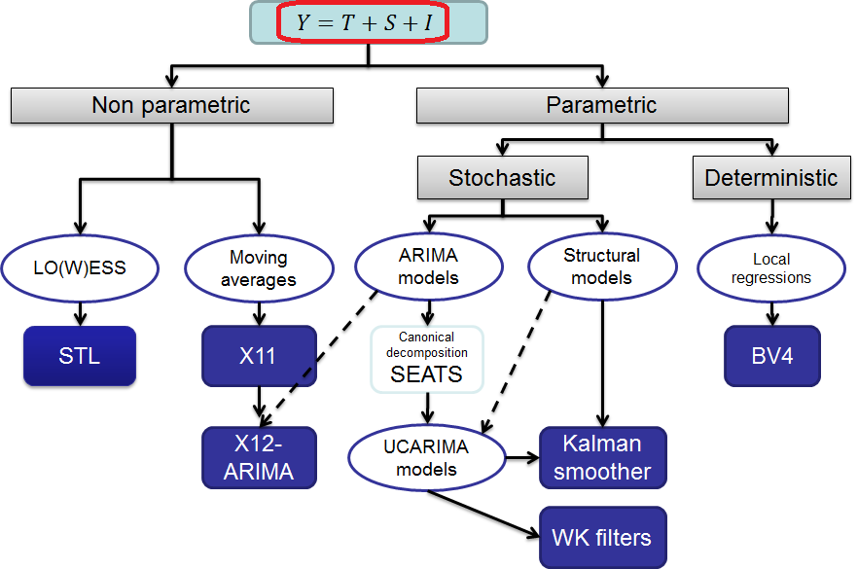
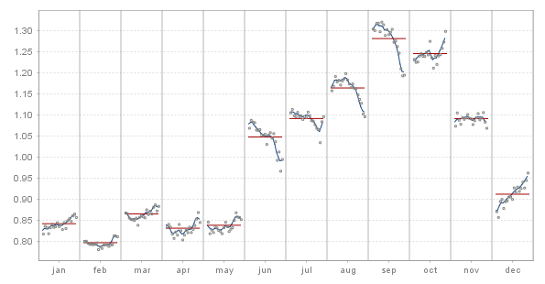
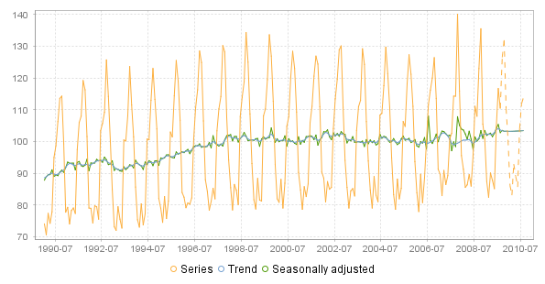
3.1 Common presentation tools
S-I ratios
Main series

Slide 7
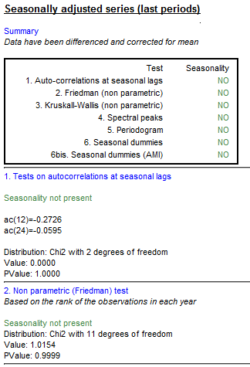
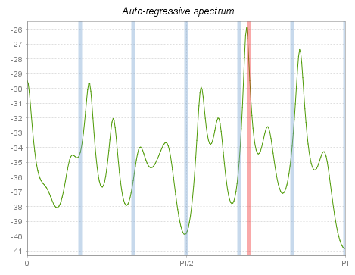
3.2 Common (non parametric) diagnostics
Seasonality tests
Spectral analysis
Sliding spans,
Revisions history
…

Slide 8
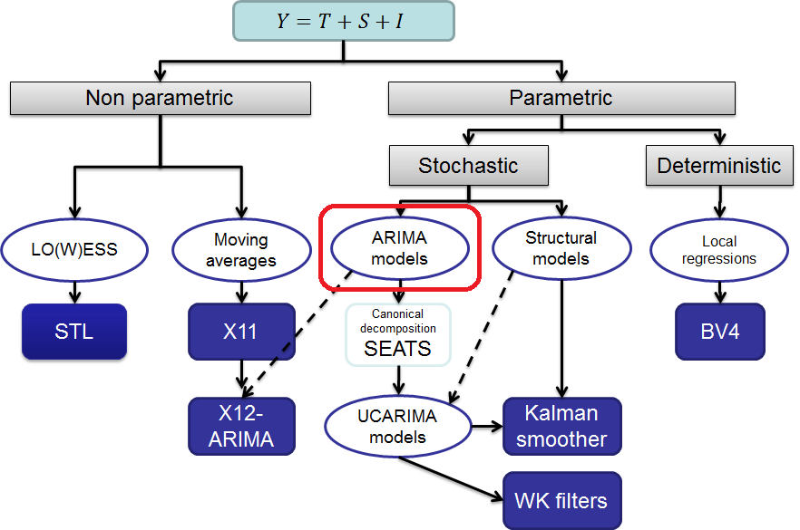
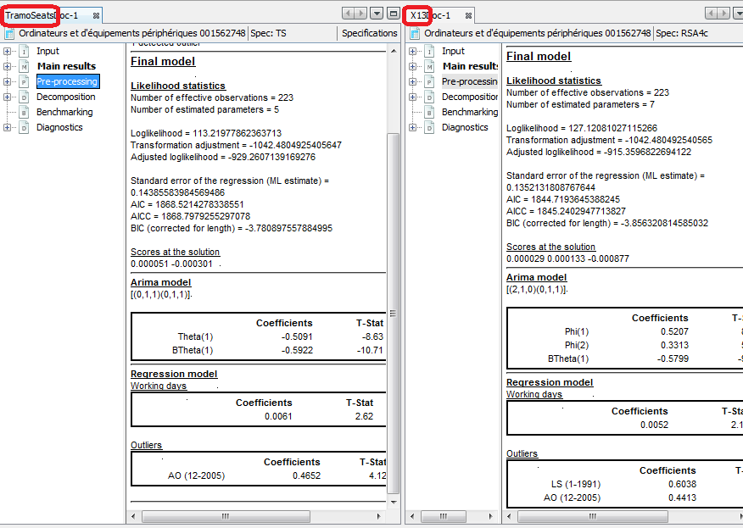
3.3 Common regression model
RegArima (Tramo, X12-ARIMA)

Slide 9
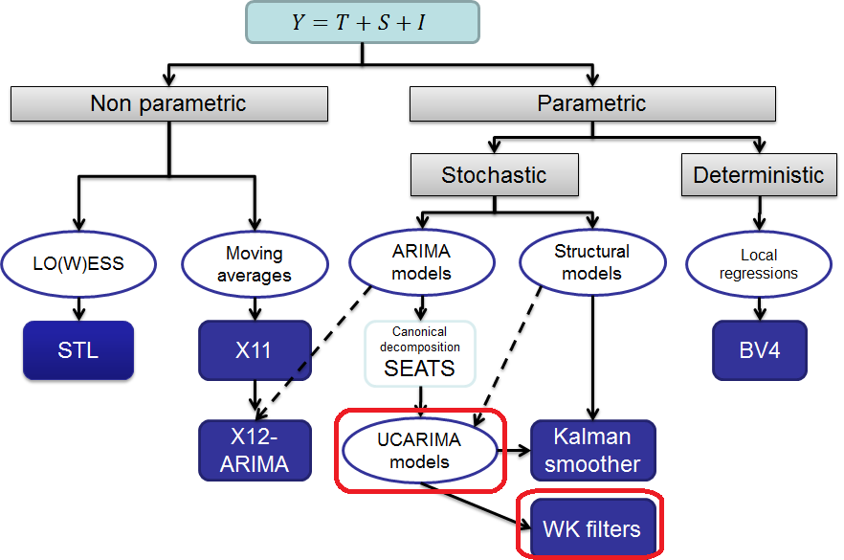
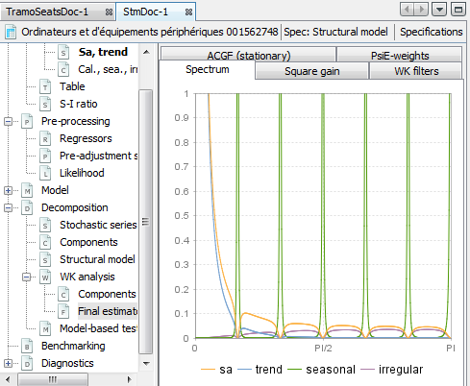
3.4 Common estimation methods
WK analysis (SEATS)
UCARIMA components
WK filters (Burman)
Kalman smoother
…

Slide 10
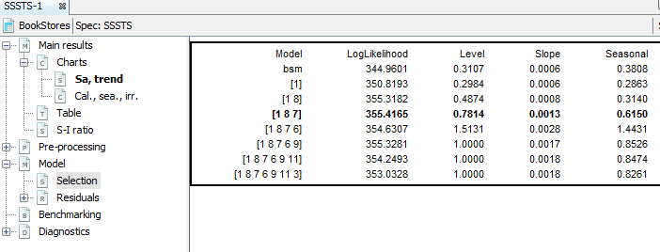
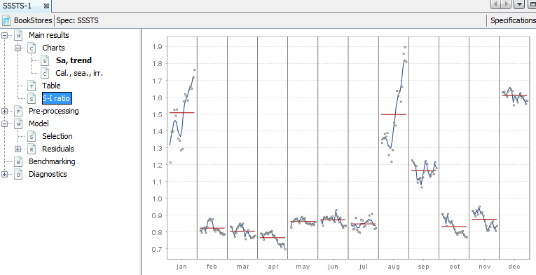
4.1 Extensions.
Model-based example
Time variant structural models (seasonal specific structural time series)

Slide 11
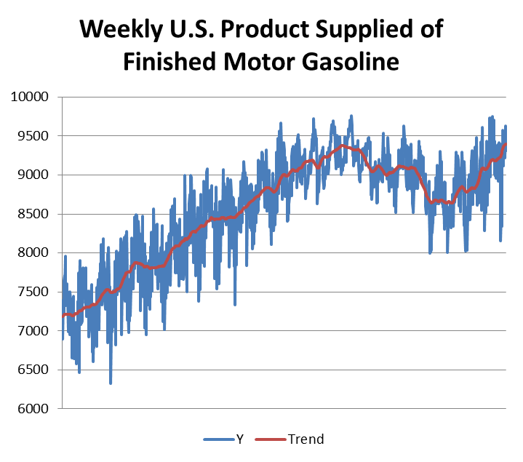
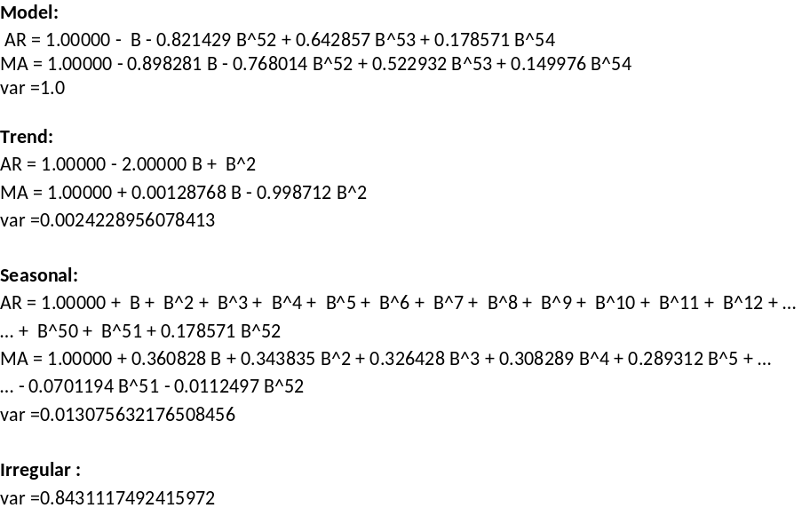
4.2 Extensions.
Canonical decomposition of high-frequency models

Slide 12
5. Next challenges (JD+ 3.0…)
Quality report
Common automatic REGARIMA modelling (Tramo-Seats, X12/X13)
Handling of high-frequency series
New extension points
  Blocks of automatic REGARIMA modelling
    Outliers detection, calendar effects…
  Filters in X11
  …

