Slide 1
Adding new sources of data
The example of the .STAT plugin
philippe.charles@nbb.be

Slide 2
Sources of data
Graphical
user interface
I/O
Spreadsheet
Text / Xml
JDBC
Statistical
algorithms
Your own

Slide 3
.STAT overview
Central repository of statistics
and related metadata
Source of data for data sharing
and dissemination purposes
Accessible through an SDMX web service

Slide 4
.STAT plugin
Retrieves time series from .STAT
Not limited to .STAT
  SDMX RESTful API (ECB, Eurostat, OECD, …)
Allows reordering of dimensions

Slide 5
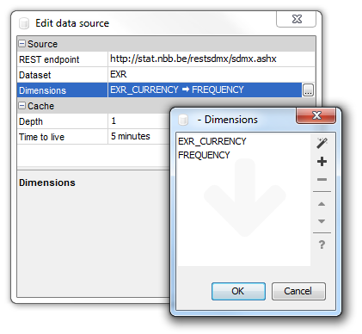
Example: configuring data source

Slide 6
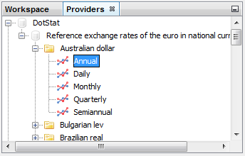
Example: browsing data

Slide 7
Example: browsing data
Dimension #1
EXR_CURRENCY
Dimension #2
FREQUENCY

Slide 8
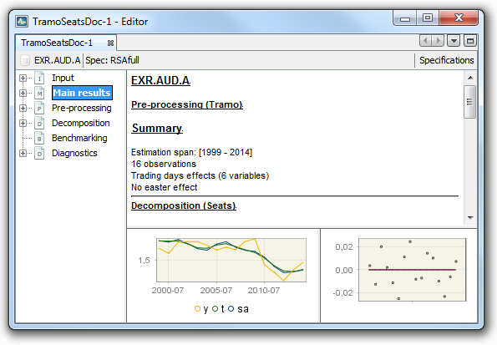
Example: analyzing data

Slide 9
Final remarks
Example of time series provider
One of many JD+ extension points
Available at:
github.com/nbbrd/jdemetra-dotstat

