Slide 1
Migration to JDemetra+
Susanne Stollenmayer, Nina Gonschorreck

Slide 2
Agenda
Motivation
Details

Slide 3
Agenda
Motivation
Details

Slide 4
Eurostat and ECB recommendation
“The Seasonal Adjustment Steering Group decided at its meeting in December 2014 that JDemetra+ will be recommended, as of 2 February 2015, as software for conducting seasonal adjustment of official statistics within ESS and ESCB.”

Slide 5
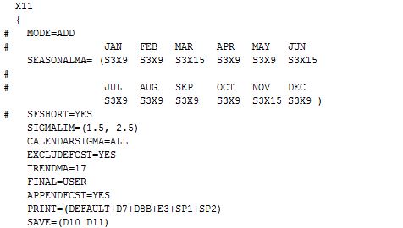
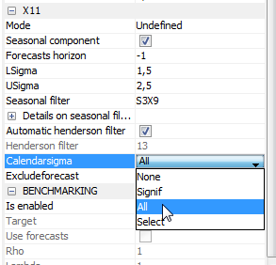
Manual migration
X-12-ARIMA
JDemetra+ (GUI)

Slide 6
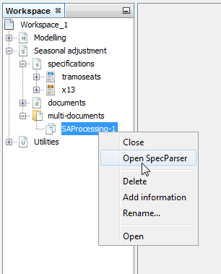
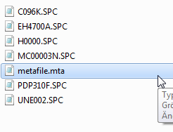
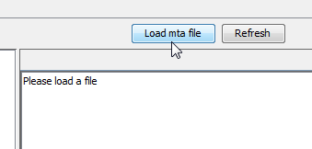
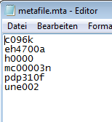
Automated migration (1/3)
1
2
3

Slide 7
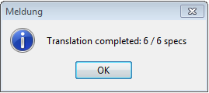
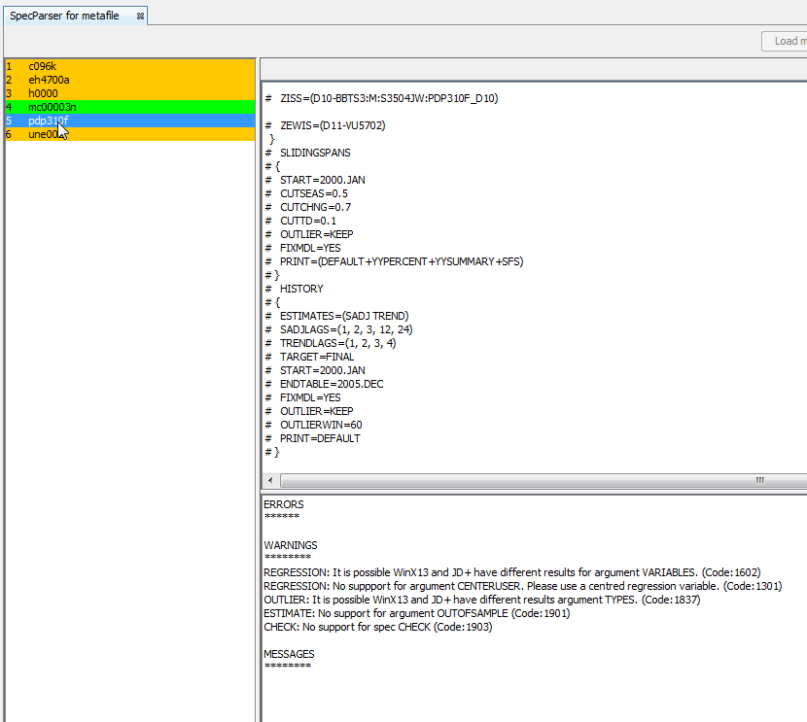
Automated migration (2/3)
4
5

Slide 8
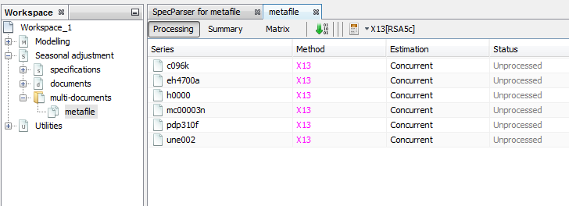
Automated migration (3/3)
6

Slide 9
Agenda
Motivation
Details

Slide 10
Translation Report
Warnings
Specification part or argument not supported
Results in original software can be differently
Errors
No data for time series
No seasonal adjustment possible
Messages
- Value is wrong for an argument
Empty
No messages, warnings or errors

Slide 11


Specification Parts
Specification | Support | Specification | Support
ARIMA |  | AUTOMDL
CHECK |  | COMPOSITE | /
ESTIMATE | / | FORCE | /
FORECAST |  | HISTORY | /
METADATA |  | IDENTIFY
OUTLIER |  | PICKMDL
REGRESSION |  | SEATS
SERIES |  | SLIDINGSPANS
SPECTRUM |  | TRANSFORM
X11 |  | X11REGRESSION
Explanation
translatable
untranslatable
Always in JD+
Plugin

Slide 12
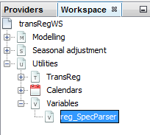
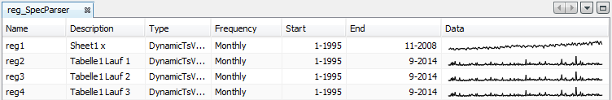
User defined regression variables
Where do you find the regressors in the JD+?
Here are the regressors in the spc file:
REGRESSION {
file = ‘myRegressors.dat’
user = (reg1 reg2 reg3 reg4)
usertype = (td user ls seasonal)
# final = user
}

Slide 13
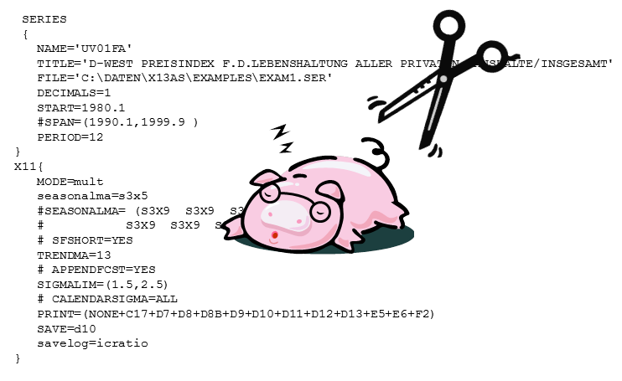
Thank you
Spec - abbreviation for ‘specification’
(sounds like the German word for bacon)
Parser - technical term for cut, separate and analyse input
Contact
Deutsche Bundesbank
Central Office
Statistics Department
Wilhelm-Epstein-Strasse 14
60431 Frankfurt am Main, Germany
E-mail: jdemetra@bundesbank.de
Available at: https://github.com/bbkrd/SpecParser

Slide 14
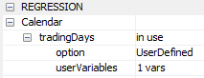

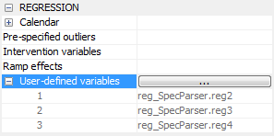



Appendix
Component type allocation of regression variables
Spc-file | JD+ Spec | Component | Table
usertype = td |  | - | A6
usertype = user #final = user |  |  | A8i
usertype = user final = user |  |  | A9ser
usertype = seasonal |  |  | A8s
usertype = ls |  |  | A8t

