Slide 1
KIX: A plug-in for aggregating chain-linked indices
Susanne Stollenmayer, Thomas Witthohn

Slide 2
Agenda
Motivation
Details

Slide 3
Agenda
Motivation
Details

Slide 4
Chain-linked indices (1/2)
Prime concepts
Annual overlap
Quarterly overlap
December overlap
Over-the-year
Idea
Apply changing weighting structure to component indices for aggregation
Examples
GDP
HICP
Index of labour costs

Slide 5
Chain-linked indices (2/2)
Problem
non-trivial aggregation in case of indirect seasonal adjustment

Slide 6
Agenda
Motivation
Details

Slide 7
Functions
Aggregation of chain-linked indices with annual overlap or one-month overlap method
Chaining and unchaining of single time series
Lagged growth rate contribution

Slide 8
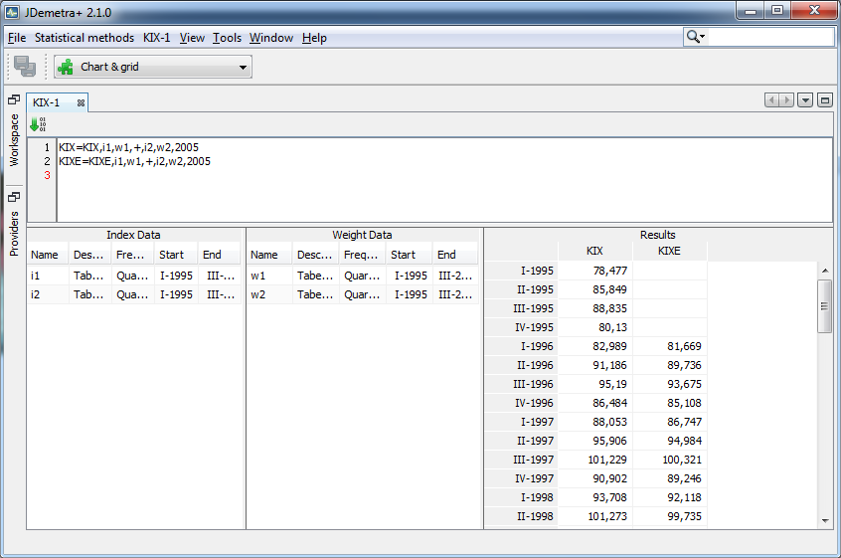
User Interface
Formula input
Index data input
Weight data input
Results

Slide 9
Possible extension
Adding over-the-year method
Weighted aggregation of time series
Upgrade to universal time series calculator in JDemetra+

Slide 10
Thank you
Contact
Deutsche Bundesbank
Central Office
Statistics Department
Wilhelm-Epstein-Strasse 14
60431 Frankfurt am Main, Germany
E-mail: jdemetra@bundesbank.de
Available at: https://github.com/bbkrd/KIX
chain-linked index = KettenIndeX

