Slide 1
Evaluation of small area estimates for hypercubes in the German census
Thomas Zimmermann
Destatis – Division of Mathematical-Statistical Methods & Research Data Centre
CESS 2016, Budapest

Slide 2
Background
Question: Should we apply small area estimation methods in the next German Census?
Ongoing evaluation using Census data from 2011
Consider target variables, which are not included in the population register, e.g.:
  Highest level of school education
  Employment status (ILO definition)
  Migrant status
Today’s talk: Focus on the hypercube constructed as cross-classification of the migrant status with age-classes and sex

Slide 3
Hypercubes and small area estimation
Estimates for the hypercube are desired on the county-level (NUTS3)
This yields 20600 hypercube cells (412 counties, 5 categories of the migrant status, 5 age-classes and two sexes) →Unplanned domains
Sample sizes frequently too small to produce reliable direct estimates for hypercubes at the county-level
(G)SPREE approaches are not directly applicable due to lack of register information

Slide 4
Synthetic estimation approach
Step 1: Obtain design-based direct estimates of the cell structure at an aggregated level
Step 2: Adjust aggregated cell structure to reliably estimated margins at the county-level using a log-linear model
Variance estimation using the rescaling bootstrap to reflect both sources of uncertainty
Inspect synthetic estimates for potential biases

Slide 5
Available diagnostics (Brown et al., 2001)
Bias diagnostics: Scatterplot of direct vs. synthetic estimates; Their ratio as a function of the sample size ✓
Goodness-of-fit diagnostic ✗
  Assumes validity of CLT in small areas
Coverage diagnostic ✗
  Assumes independence between design-based and synthetic estimates
  Valid for normally distributed estimates
Calibration diagnostic (✓)

Slide 6
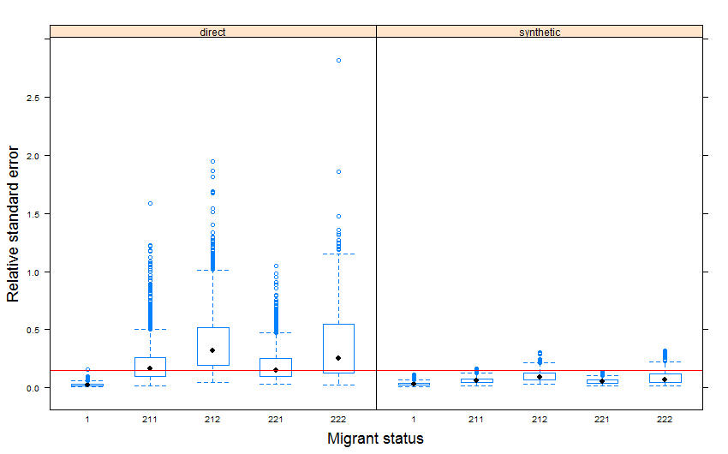
Precision of the estimates

Slide 7
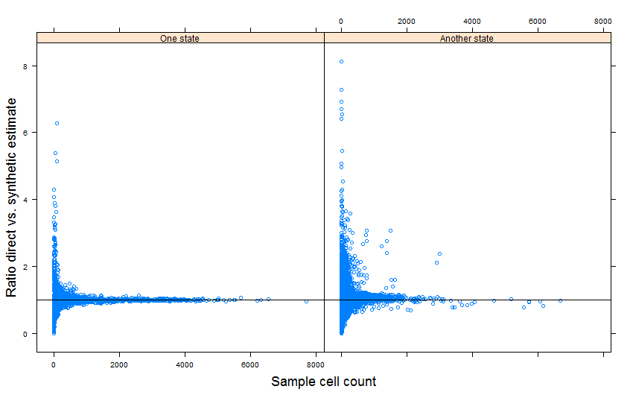
Plausibility of synthetic estimates

Slide 8
Main findings
Direct estimator suffers from small sample cell counts in many hypercube cells
Synthetic estimator achieves reduction in relative standard error
Benchmarking to margins of the migrant status on the county-level may give rise to a bias-variance trade-off
In some states, benchmarking the migrant status on the state-level is the better choice

Slide 9
Outlook and possible extensions
Initial cell estimates could be obtained for groups defined by similar characteristics rather than administrative boundaries
Apply further tools to check implicit assumptions based on sample data
Consider a composite estimator
Weights for a one-number Census

